Slide 1
QuantSight
FYP progress update
Syed
6 October 2026
Changes since 28 September 2026
1
Notes:
Presenter: Syed. This update compares the 28 September 2026 supervisor presentation, Git commit 23df560, with project work through commit 168fcc9 on 5 October. Prepared on 6 October 2026. New work concerns explanation, evaluation and system reliability. It does not establish a new profitable model.

Slide 2
Progress since the previous presentation
Area | 28 September presentation | Latest progress
Explainable AI | Indicator summaries and attention | Exact XGBoost TreeSHAP
Model evaluation | News pilot and prepared folds | Finance study and confidence audit
Backtesting | Overall returns and costs | Yearly and monthly comparisons
System support | Deployment and local backup | Chat repair, faster loading, PDF guide
The latest work adds evidence and reliability. A model gain remains unproven.
2
Notes:
Sources: previous deck at docs/presentations/QuantSight_Supervisor_Progress_2026-09-28.pptx, recovered read-only from Git; docs/CHATBOT_AND_XAI.md; docs/research/FINANCE_DEVELOPMENT_STUDY.md; docs/BACKTEST_PERIOD_CONSISTENCY.md; docs/LOADING_AND_RELIABILITY.md; docs/ILLUSTRATED_PROJECT_GUIDE.md. The previous deck already presented original cost-aware backtesting, cloud architecture and the news sentiment pilot. Same-date chatbot and native XAI commits occurred after the presentation commit.

Slide 3
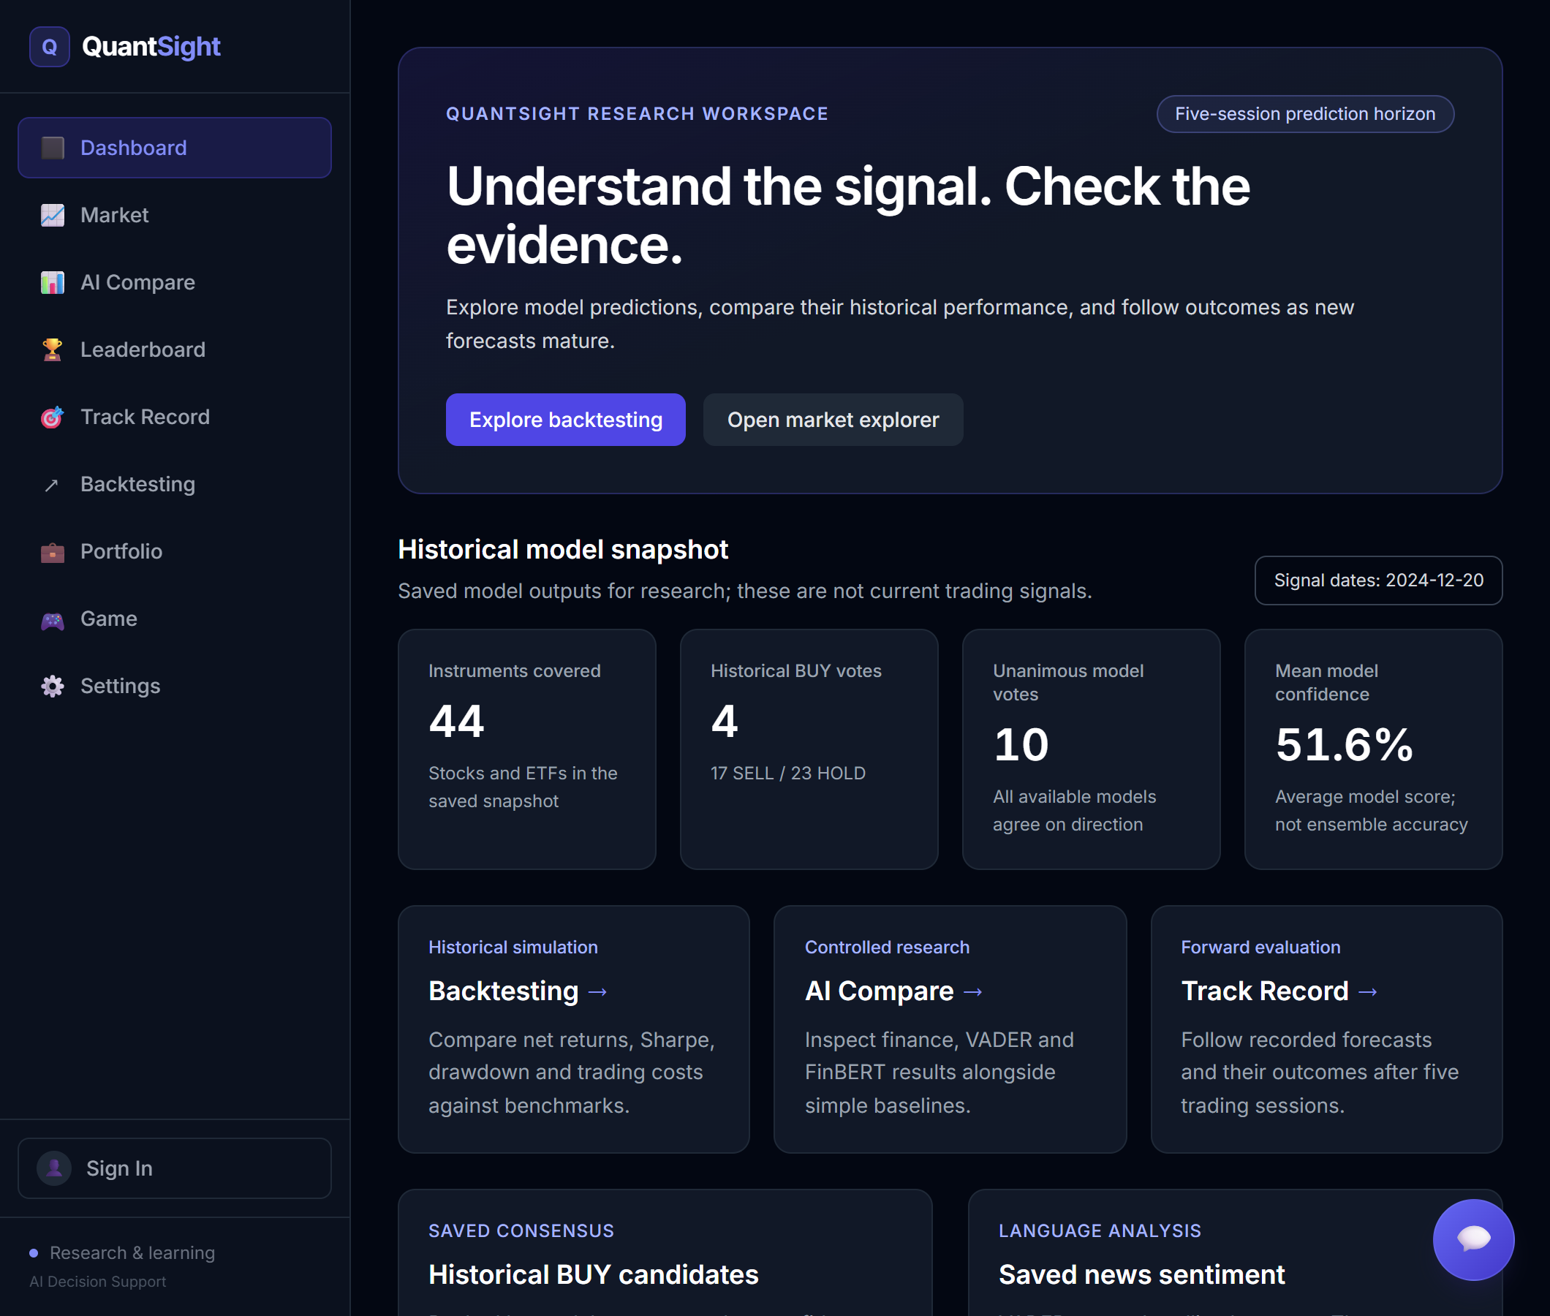
Current project scope
Five-session price-direction forecasts for 44 US instruments
Historical model comparison and simulation after costs
Stock explanations, news views and a project chatbot
Portfolio tools, learning quiz and account features
Saved historical results and fresh live forecasts have separate dates.
3
Notes:
Sources: PROJECT_CHEAT_SHEET.md; docs/ILLUSTRATED_PROJECT_GUIDE.md. QuantSight predicts whether the closing price will rise after five trading sessions. The historical universe has 44 instruments. Historical model families are XGBoost, logistic regression, random forest, LSTM with attention, GRU and a separate Transformer encoder. Two input variants create 12 entries plus the four-model probability ensemble. Current live inference remains finance XGBoost with calibration. Saved historical signals end on 20 December 2024.

Slide 4
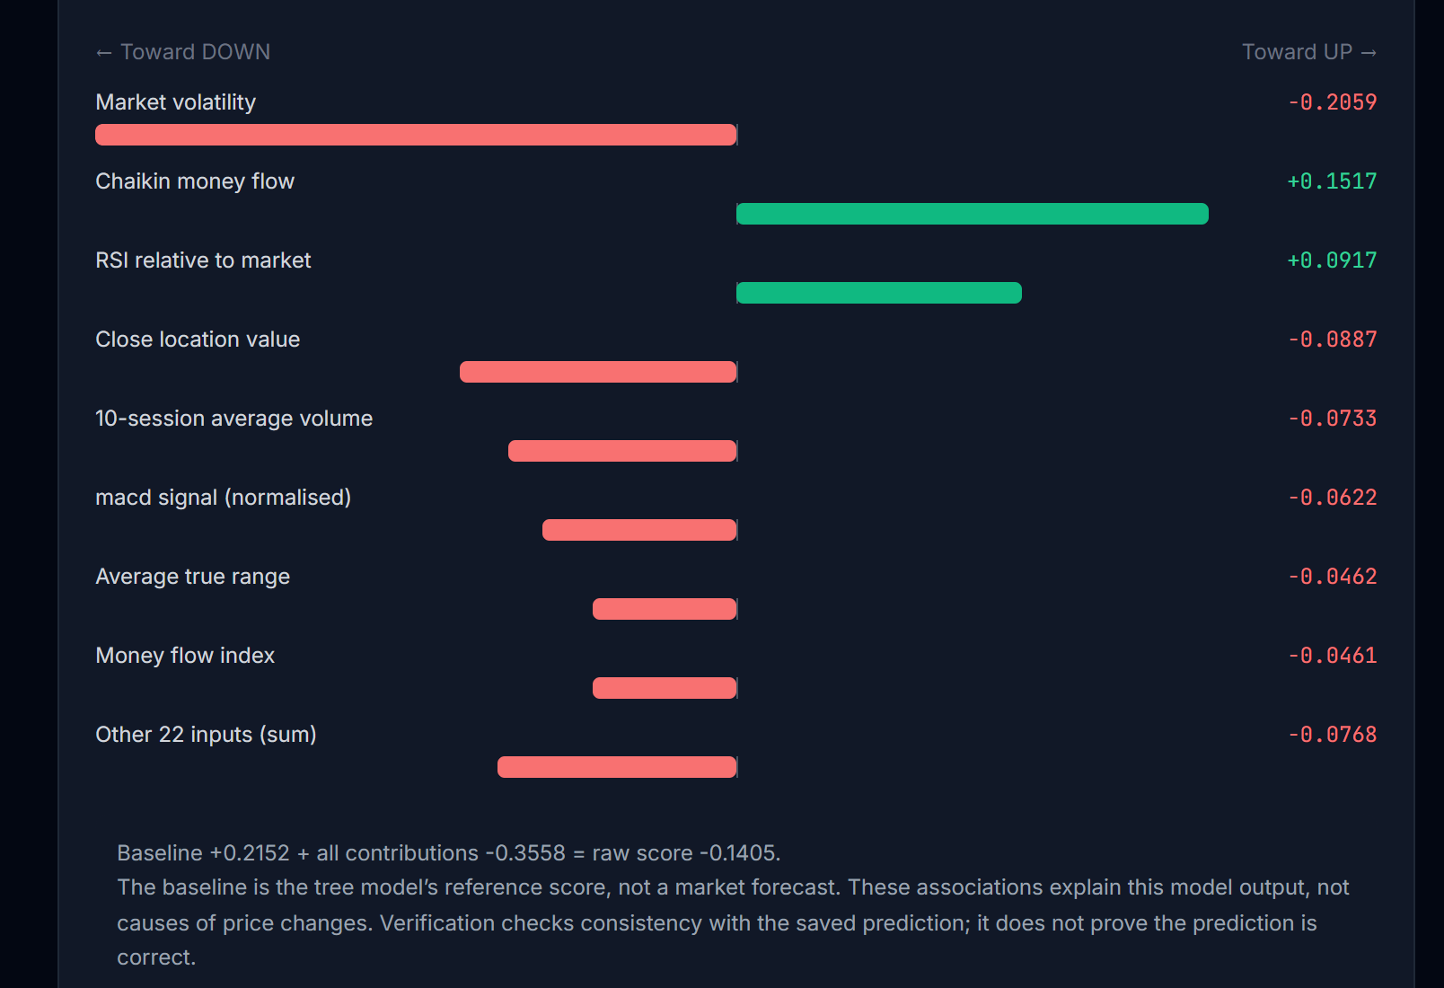
Exact XGBoost explanations
Shows which inputs move the raw model score
Verifies all 88 saved XGBoost explanations
Includes input values and model/source hashes
Scope: saved historical XGBoost predictions
4
Notes:
Sources: docs/CHATBOT_AND_XAI.md and docs/XAI_SERVING_PERFORMANCE.md; release a9a5389 and 381183d. Native exact TreeSHAP uses pred_contribs=True and approx_contribs=False. The baseline plus all contributions reconstructs raw UP log-odds. Positive contributions push the raw UP score higher. They are associations, not causal effects or probability-point changes. All 88 latest historical predictions across 44 tickers and two XGBoost variants reproduce saved outputs. Maximum raw reconstruction error is 6.28e-7. The screenshot shows the saved AAPL historical explanation from 20 December 2024, captured locally on 5 October 2026. The endpoint does not explain changing live inputs, LSTM or consensus.

Slide 5
Model probability and direction
AAPL Finance | Saved value | Meaning
Raw P(UP) | 46.49% | Determines the saved direction
Calibrated P(UP) | 55.19% | Separate probability estimate
Saved direction | SELL | Raw P(UP) is below 50%
Probability, observed accuracy and trading return measure different things
5
Notes:
Source: docs/CHATBOT_AND_XAI.md, per-prediction attribution section. AAPL Finance saved date 20 December 2024. Raw P(UP) about 46.49%; sigmoid calibrated P(UP) 55.19%; legacy label SELL. Saved legacy direction follows raw probability at the 50% threshold. Calibration does not retrospectively change that CSV label. TreeSHAP explains raw log-odds only. P(UP) describes an output probability and cannot be reported as measured prediction accuracy.

Slide 6
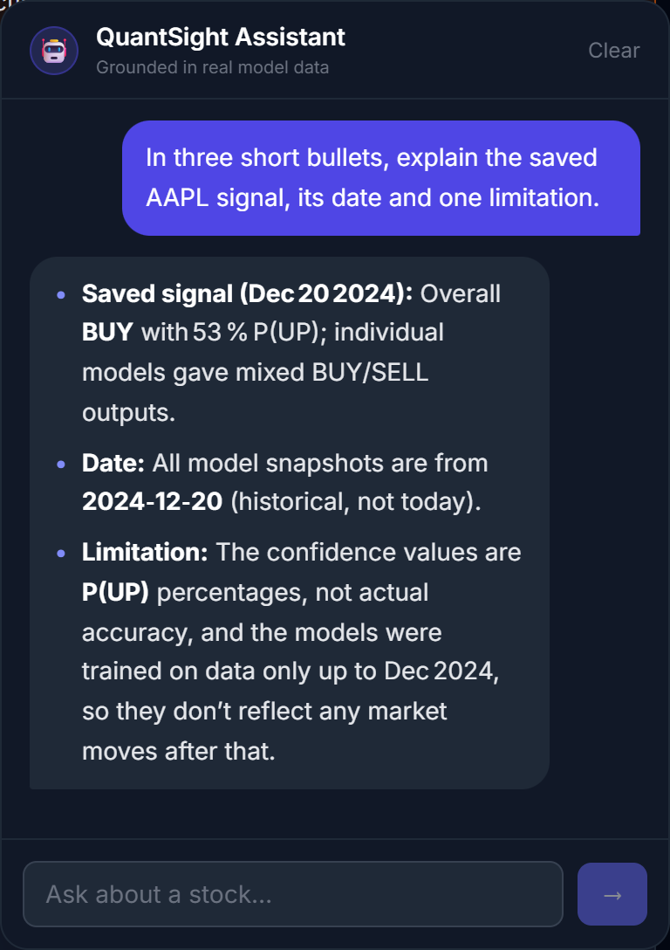
Chatbot repair
Replaced the retired provider model
Retrieves dated QuantSight evidence
Added Stop, retry and readable failure messages
Generated answers still need factual checks
6
Notes:
Source: docs/CHATBOT_AND_XAI.md; releases 92e3598 and a2a38a1. A retired Groq model caused model_not_found failures. Current configured default in backend code is openai/gpt-oss-120b. GROQ_MODEL can override it. The assistant can request dated project tools for historical signals and indicators. Browser supports Stop and retry; safe provider failures return non-success statuses. Real local and hosted replies were verified on 28 September. The shown local reply was captured on 5 October. Functional success does not establish factual accuracy for every response. No new key or Supabase migration was required for this change.

Slide 7
Controlled finance-model study
Compared three fixed model families with simple baselines
Used 13 finance inputs and three chronological validation years
Evaluated 32,472 ticker-days with purged boundaries
Kept raw and calibrated probabilities separate
The 2025 candidate final-test period remains unopened.
7
Notes:
Source: docs/research/FINANCE_DEVELOPMENT_STUDY.md; backend/data/research_reports/development_models.json; registration commit 2ce3ac6 before fitting and publication 1308f35. Three fixed families: logistic regression, histogram gradient boosting and XGBoost. Raw and separately sigmoid-calibrated candidates, plus three simple baselines. Thirteen fixed ratio/return inputs from the frozen price snapshot. Validation years 2022, 2023 and 2024, with preceding fit/calibration periods and purged label boundaries. Purging removes earlier rows whose five-session outcomes reach into the next data period. There are 32,472 validation ticker-days, nine predictor fits and nine calibrator fits. The study selection criterion weights yearly Brier scores equally. These development years were previously examined. The candidate 2025 holdout stays unopened pending prior-use confirmation.

Slide 8
The finance study did not beat the baseline
Output | Accuracy | Brier loss
Training-prior baseline | 52.38% | 0.250877
Logistic regression, raw | 52.53% | 0.251299
Histogram boosting, raw | 52.50% | 0.252198
XGBoost, raw | 52.54% | 0.251999
Lower Brier is better. The baseline wins the selection rule.
No tested candidate replaced the live model.
8
Notes:
Source: docs/research/FINANCE_DEVELOPMENT_STUDY.md and development_models.json. Equal-year mean results for validation 2022-2024: training-prior baseline accuracy 52.38%, Brier 0.250877; raw logistic 52.53%, 0.251299; raw histogram boosting 52.50%, 0.252198; raw XGBoost 52.54%, 0.251999. Brier is the average squared difference between P(UP) and the actual zero-or-one outcome. Lower Brier is better. Calibration worsens average Brier for all three families. Baseline wins the registered selection rule among all nine outputs. Raw logistic baseline-relative improvement -0.000422 has exploratory paired date-block 95% interval [-0.001329,0.000489], including zero. No candidate replaced live inference. Values differ slightly from pooled metrics on the next slide because this comparison weights each year equally.

Slide 9
Confidence and prediction coverage
Minimum confidence | Coverage | Accuracy | Same-row baseline
50% | 100.00% | 52.53% | 52.38%
60% | 12.91% | 51.51% | 51.49%
70% | 0.10% | 62.50% | 62.50%
At 60%, accuracy falls while most predictions disappear.
The 70% score uses only 32 rows and equals its baseline.
9
Notes:
Source: docs/research/CONFIDENCE_COVERAGE_AUDIT.md and backend/data/research_reports/development_confidence.json. Fixed diagnostic audit, no new fits. Raw development XGBoost pooled across 2022-2024: 50% threshold retains 32,472 rows, 100% coverage, model accuracy 52.53%, matching baseline 52.38%; 60% retains 4,193 rows, 12.91% coverage, model accuracy 51.51%, same-row baseline 51.49%; 70% retains only 32 rows on 24 dates, 0.10% coverage, both model and matching baseline 62.50%. Every 70% retained prediction is UP and model Brier is worse. Confidence means max(P(UP),1-P(UP)). Pooled row weighting differs from equal-year study means. No cutoff was selected for live use. Overlapping labels and cross-instrument dependence prevent independent-trial interpretations.

Slide 10
Backtest consistency across observed years
22 Feb to 29 Dec 2023 and 2 Jan to 20 Dec 2024
9 of 23 months beat SPY
2024 trails SPY by 0.60 percentage points
Partial years, after costs. Reused history makes these exploratory results.
10
Notes:
Source: docs/BACKTEST_PERIOD_CONSISTENCY.md; backend/data/backtests/period_returns.json. Saved run 20260926T102301904516Z, 462 sessions, 15bps per-side combined commission/slippage. Ensemble 2023 window 22 February-29 December returns 29.40%, SPY 20.60%; 2024 window 2 January-20 December returns 25.18%, SPY 25.78%. Period returns geometrically compound the existing continuous net daily series. No year-boundary portfolio reset or annualization. Ensemble beats SPY in 9 of 23 observed months, 14 months positive, best May 2023 +12.23%, worst April 2024 -8.93%. Both windows are partial years. History was reused during development, so results remain exploratory.

Slide 11
Faster loading and safer recovery
Initial JavaScript (kB)
57.2% fewer initial JavaScript bytes
Prepares exact XAI before web requests
Cancels stale requests and supports retry
Build-size evidence. Actual Render response times can still vary.
11
Notes:
Sources: docs/LOADING_AND_RELIABILITY.md; docs/BACKEND_RELIABILITY.md; docs/XAI_SERVING_PERFORMANCE.md; docs/SERVING_SNAPSHOTS.md. Same-configuration production build reduced initial JS bytes from 1,063,230 to 455,013 (57.2%), gzip from 293,513 to 135,341 (53.9%). Lazy route splitting defers unnecessary page modules; total application JS is not reduced by the same amount. Generation guards and cancellation prevent stale request results replacing new data. Exact prepared XAI has local fresh-process sample 3.884s before/0.124s after for finance; those are diagnostic observations, not controlled production guarantees. Backend separates serving and training dependencies and validates readiness. Compact latest sentiment preserves source-bound results. Cloud scheduling and external providers still influence latency.

Slide 12
Verification and deployment
Last verified release: 144 backend and 7 frontend tests
GitHub stores code and runs automated release checks
Vercel hosts React, Render serves FastAPI
Supabase stores accounts and forward predictions
6 October hosted reads timed out. Keep the local demo backup ready.
12
Notes:
Sources: docs/research/CONFIDENCE_COVERAGE_AUDIT.md verification 4 October 2026; project deployment configuration and HOW_TO_RUN.md. Last documented release checks: 144 backend tests, seven frontend tests, production build, clean serving smoke, native XAI recomputation, all confidence audit combinations. These counts describe the verified application release on 4 October, not newly rerun tests for this presentation. Later 5 October commits contain documentation. Render API health and tracker read attempts on 6 October timed out at 45 seconds each; current hosted availability therefore remains unverified. Render, Vercel and Supabase do not remove external provider dependency. Supabase migrations require explicit execution and do not automatically run merely from a GitHub push.

Slide 13
Forward prediction tracking status
44 logged forecasts
Last verified snapshot: 5 October 2026
That snapshot had 44 pending and zero resolved forecasts
The target session has passed, but current status is unconfirmed
Fresh results need a successful read and outcome reconciliation
No verified live accuracy result is claimed in this update.
13
Notes:
Sources: backend/data/research/documentation_20261005/captures.json and track-record screenshot; verified local /live-track-record response on 5 October 2026 documented in project guide. Last verified snapshot contains 44 forecasts, all pending, zero resolved; source session 28 September and fifth-session target 5 October. That target has now passed, but the 6 October hosted request timed out, so the current resolution state is unconfirmed. Do not present old pending counts as current or infer success from maturity alone. New mature records must be retrieved and reconciled before reporting live accuracy or Brier. No admin forecast logging or database writes were performed for slide preparation.

Slide 14
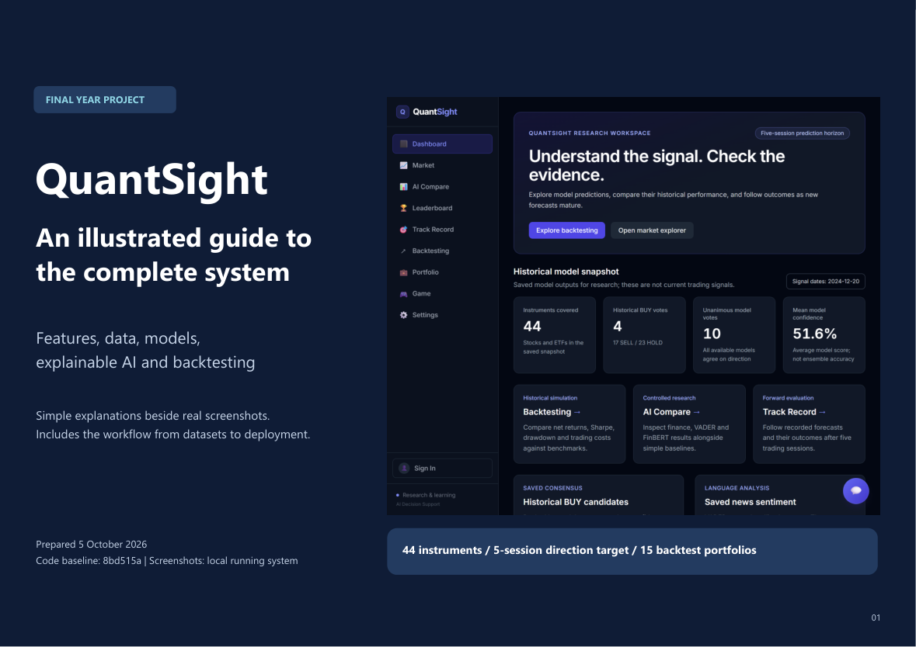
Illustrated project documentation
72-page guide with dashboard feature screenshots
Simple explanations of data and calculation methods
Dataset-to-deployment workflow trees
Metric definitions and local demonstration steps
14
Notes:
Sources: output/pdf/QuantSight_Project_Guide_2026-10-05.pdf; docs/ILLUSTRATED_PROJECT_GUIDE.md; releases 14c1fa4 and 168fcc9. The final 72-page PDF contains 60 feature screenshot pages, system workflow trees, data preparation, model scope, metric definitions, deployment and local demo instructions. Screenshot evidence includes Dashboard, Market, Stock Detail and native XAI, AI Compare and research diagnostics, Backtesting and downloads, forward tracker, Portfolio, quiz/player leaderboard, authentication/settings and real chat. Historical dates and research limitations are explicit. This deliverable improves documentation, not forecasting accuracy.

Slide 15
Remaining research and user evaluation
Confirm an unused final evaluation period
Register the next feature experiment before fitting
Evaluate a fixed trading strategy after realistic costs
Collect forward outcomes and test user understanding
Prediction gains, live profitability and user benefit still need evidence.
15
Notes:
Sources: docs/IMPROVEMENT_ROADMAP.md; docs/research/FINANCE_DEVELOPMENT_STUDY.md; docs/research/CONFIDENCE_COVERAGE_AUDIT.md; docs/CHATBOT_AND_XAI.md. These are next milestones rather than completed or approved experiments. Confirm whether 2025 guided any model choice inside or outside this workspace before calling it untouched. Freeze a separately documented prediction and cost-aware strategy procedure before scoring an eligible final period. Historical survivors, adjusted-price provenance and incomplete historical news remain limitations. Forward results need multiple dates and sufficient genuine outcomes. Human evaluation should measure task completion, ease of explanation and chatbot factual correctness.

Slide 16
Demonstration and supervisor discussion
Demo: native XAI and the repaired chatbot
Show finance-study evidence and backtest consistency
Agree on final evaluation and user-testing criteria
Live website
https://quantsight.vercel.app
Local backup
http://127.0.0.1:3000
16
Notes:
Demo sequence: Stock Detail native XAI, real chatbot, AI Compare finance study and confidence audit, Backtesting year/month breakdown, illustrated documentation. Allow time for cloud wakeup and use the local app if needed. Live URL https://quantsight.vercel.app. Local frontend http://127.0.0.1:3000 with backend as configured in frontend/.env. Services were not running at the initial 6 October read; launch via HOW_TO_RUN.md before the meeting. Local external Yahoo/Groq/Supabase features still need internet. Suggested discussion: agree on final evaluation eligibility, the contribution of rigorous negative findings, and measurable user-testing criteria.

