Slide 1
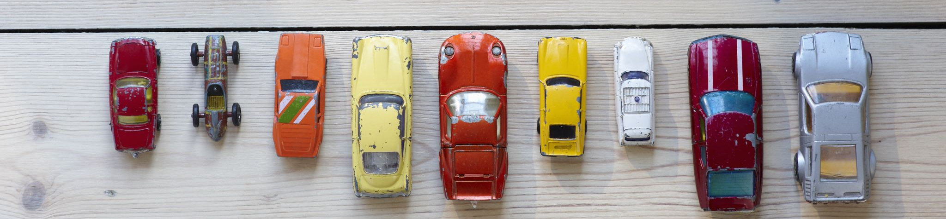
Chicago Traffic Crashes
Sunday A., Farman S., John F., Sameen S.

Slide 2
Project https://data.cityofchicago.org/widgets/85ca-t3if?mobile_redirect=true
Project Purpose
The project involves analyzing crash data from the Chicago Police Department's electronic reporting system to identify patterns and factors contributing to road accidents in the city. The dataset covers reportable crashes on city streets and includes information such as street conditions, weather, and speed limits. The goal is to provide insights to improve road safety in Chicago.
Project Scope
This project involves analyzing crash reports from the Chicago PD to identify patterns and factors contributing to traffic incidents in the area. The model we created used 2020 data which, after cleaning, contained 20,000+ rows of data. After cleaning the data the rows, columns dropped from (~70,000, 49) to (~20,000,24)

Slide 3
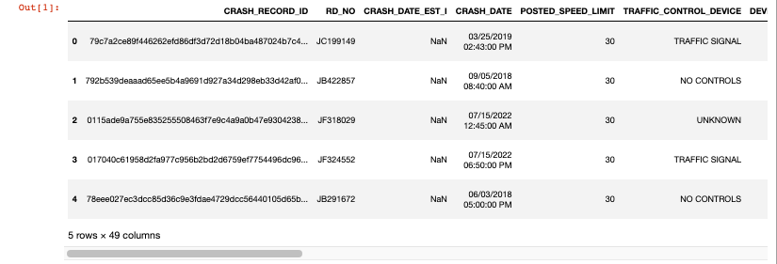
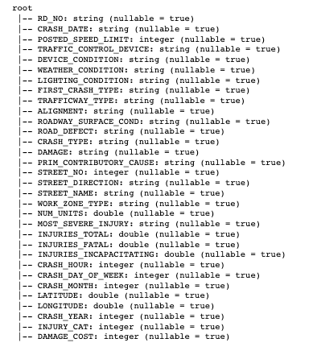
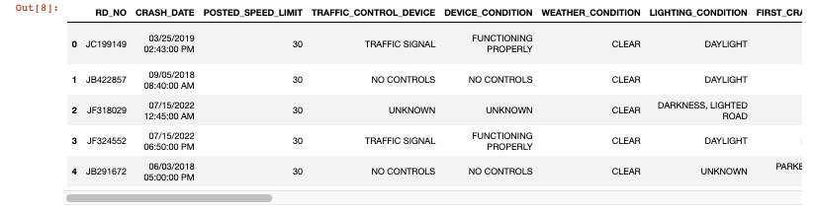
Extract, Transform, Load
SCHEMA
Dropped Unnecessary columns
Replaced NaN values with 0 & NA
Converted CRASH_DATE column to datetime datatype
Redefined Injury and Damage columns

Slide 4
ETL Cont.
Dependencies
SQL
Pyspark
Pandas
Matplotlib
Numpy
Keras
Tensorflow
Sklearn
Tableau

Slide 5
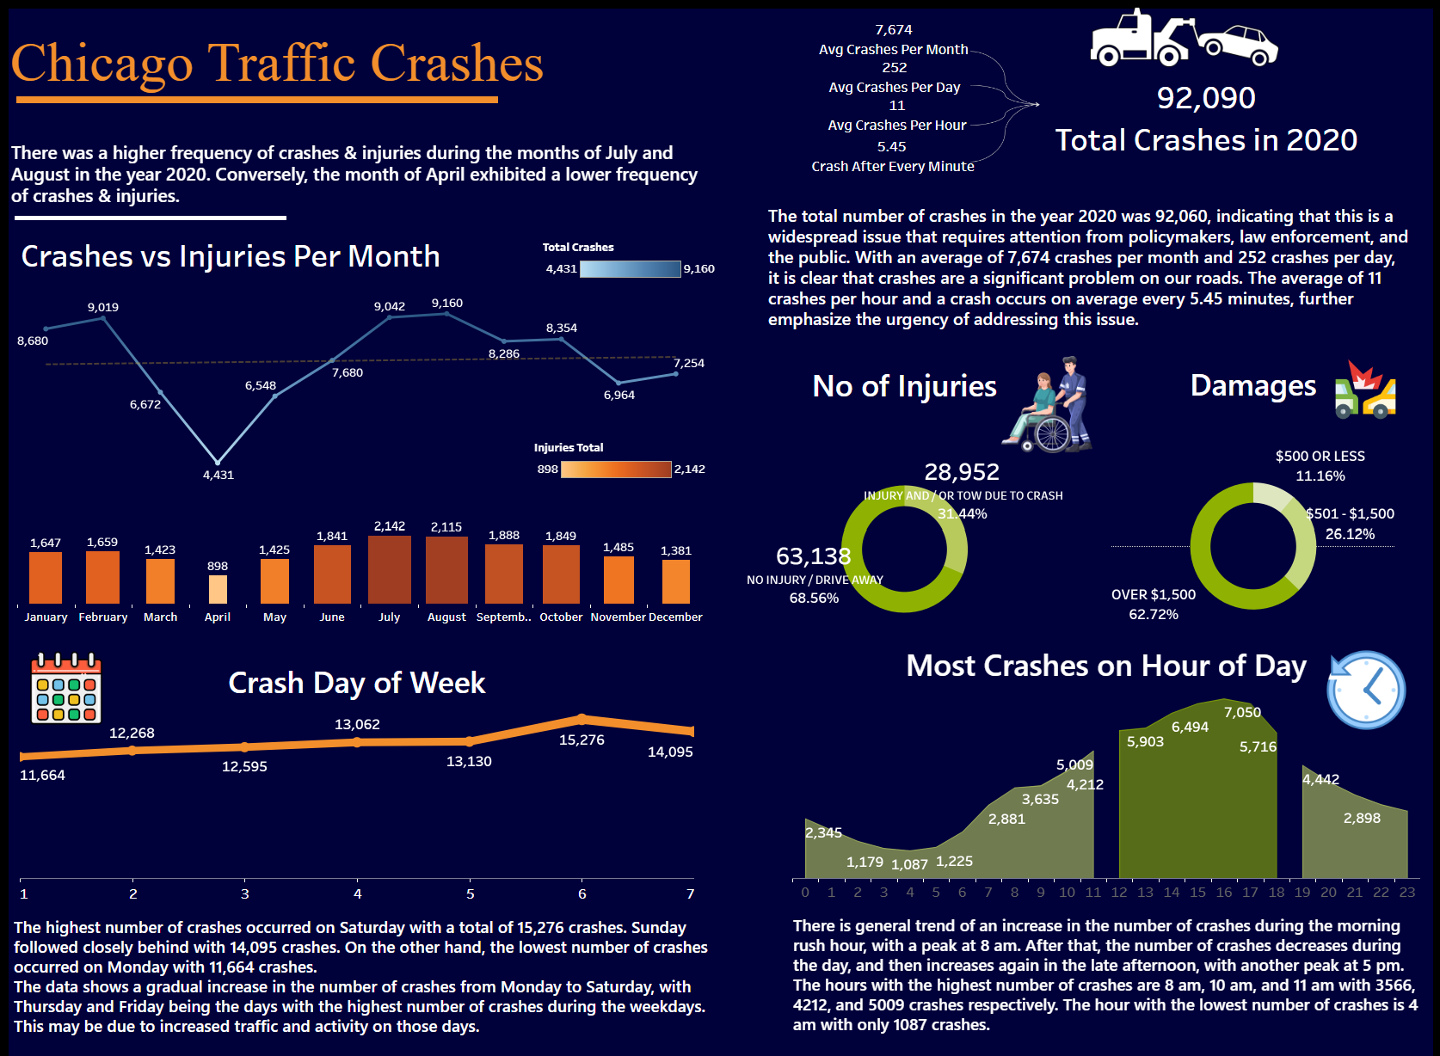

Slide 6
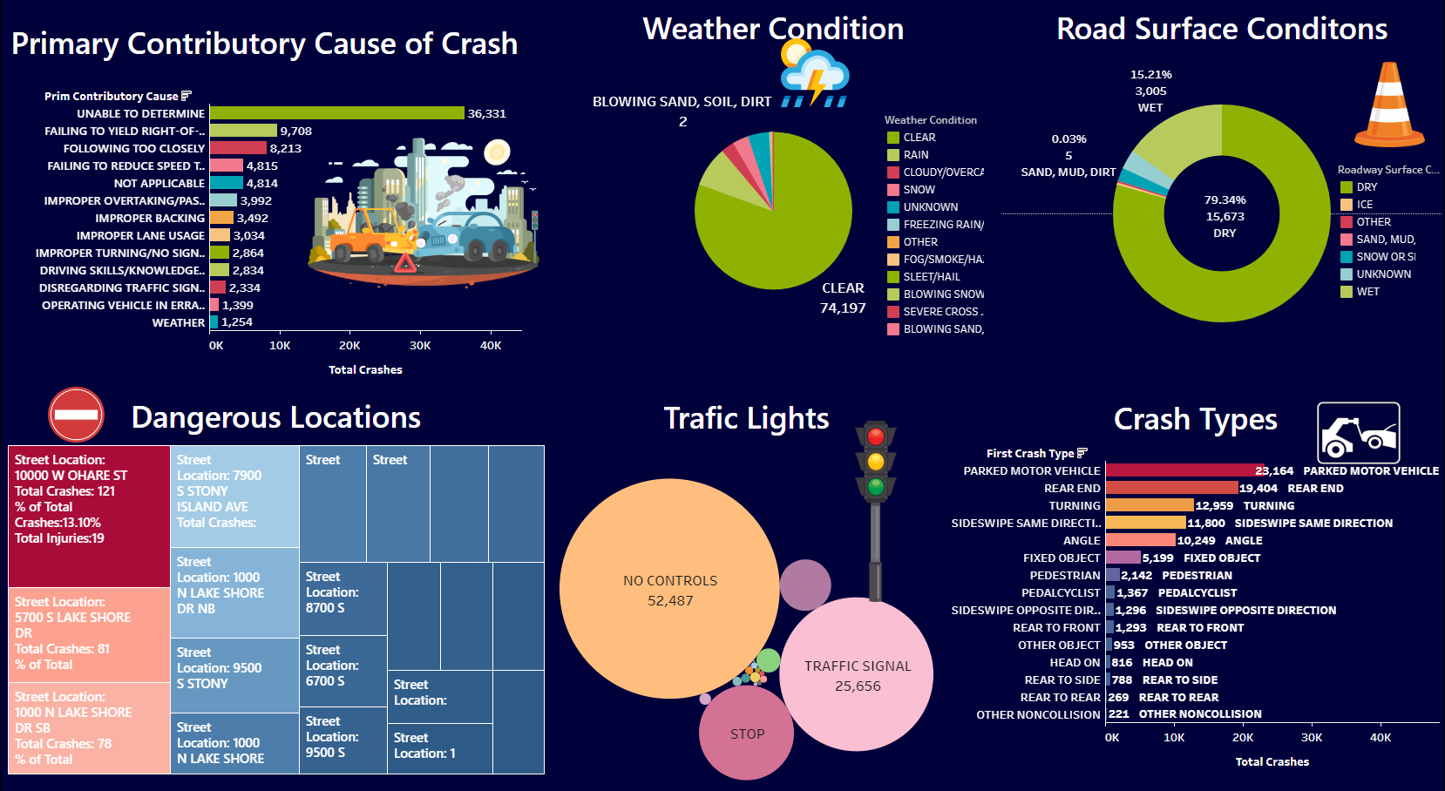

Slide 7

https://public.tableau.com/app/profile/farman5186/viz/ChicagoTraficCrashesAnalysis/Dashboard1?publish=yes

Slide 8
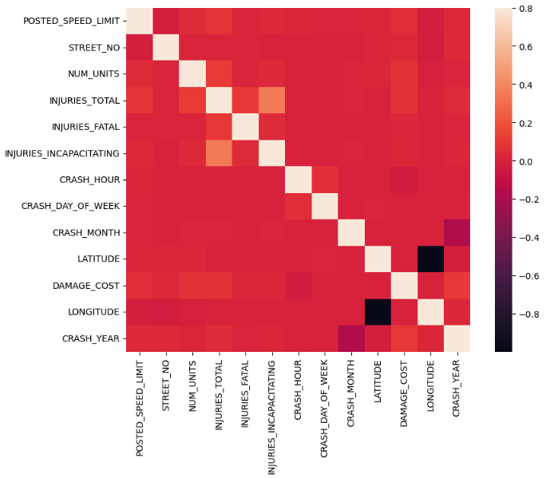
CORRELATION HEATMAP
This heatmap outlines the variables varying levels of correlation between each other
The most important variables according to this heatmap are
Injuries Total
Injuries Incapacitating

Slide 9
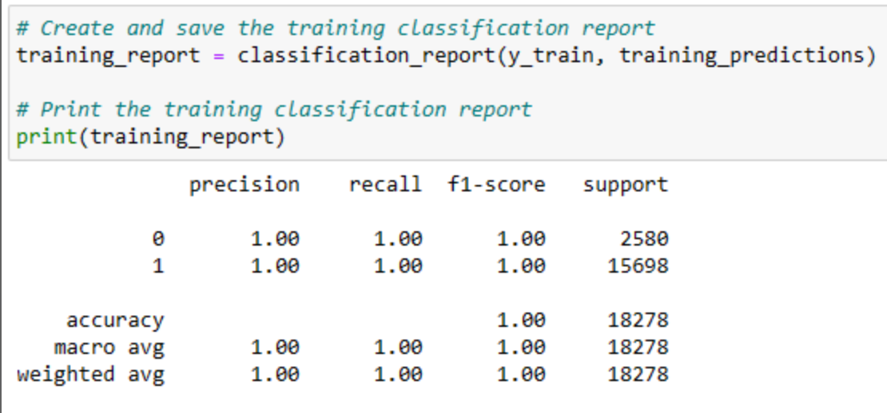
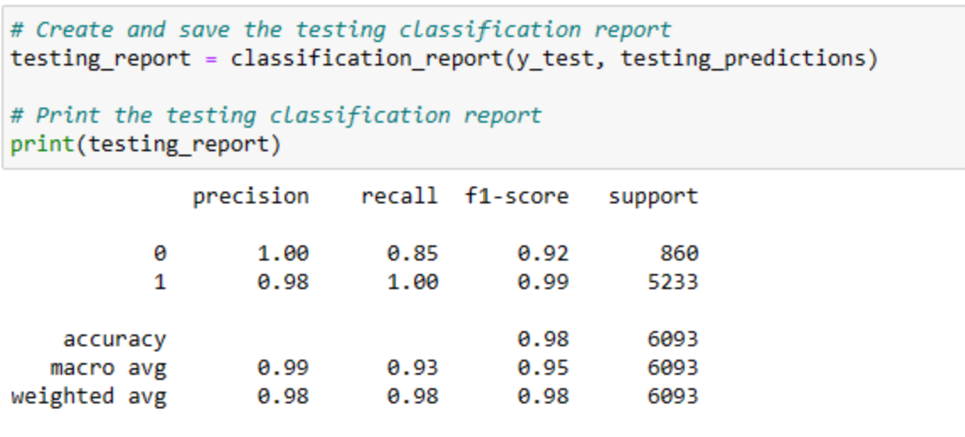
Machine learning– logistic Regression Model
Training Report:
Target variable: INJURIES_TOTAL
- Prediction of the high-risk streets vs the low-risk area.
Aims to predict the highest risk area.
Accuracy of model: 98%
High Bias, appears to be underfitting the data which provides good results but difficult to be confident in
Testing Report:

Slide 10
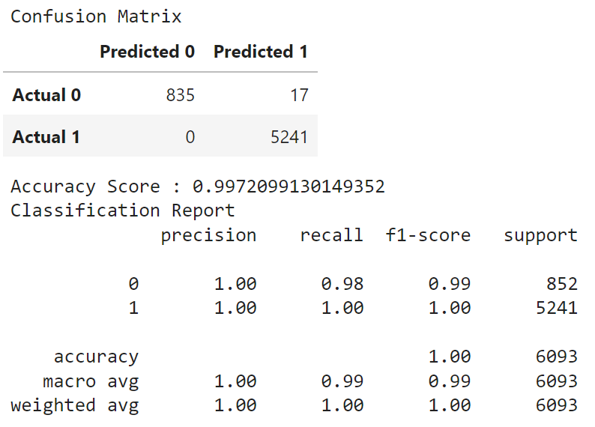
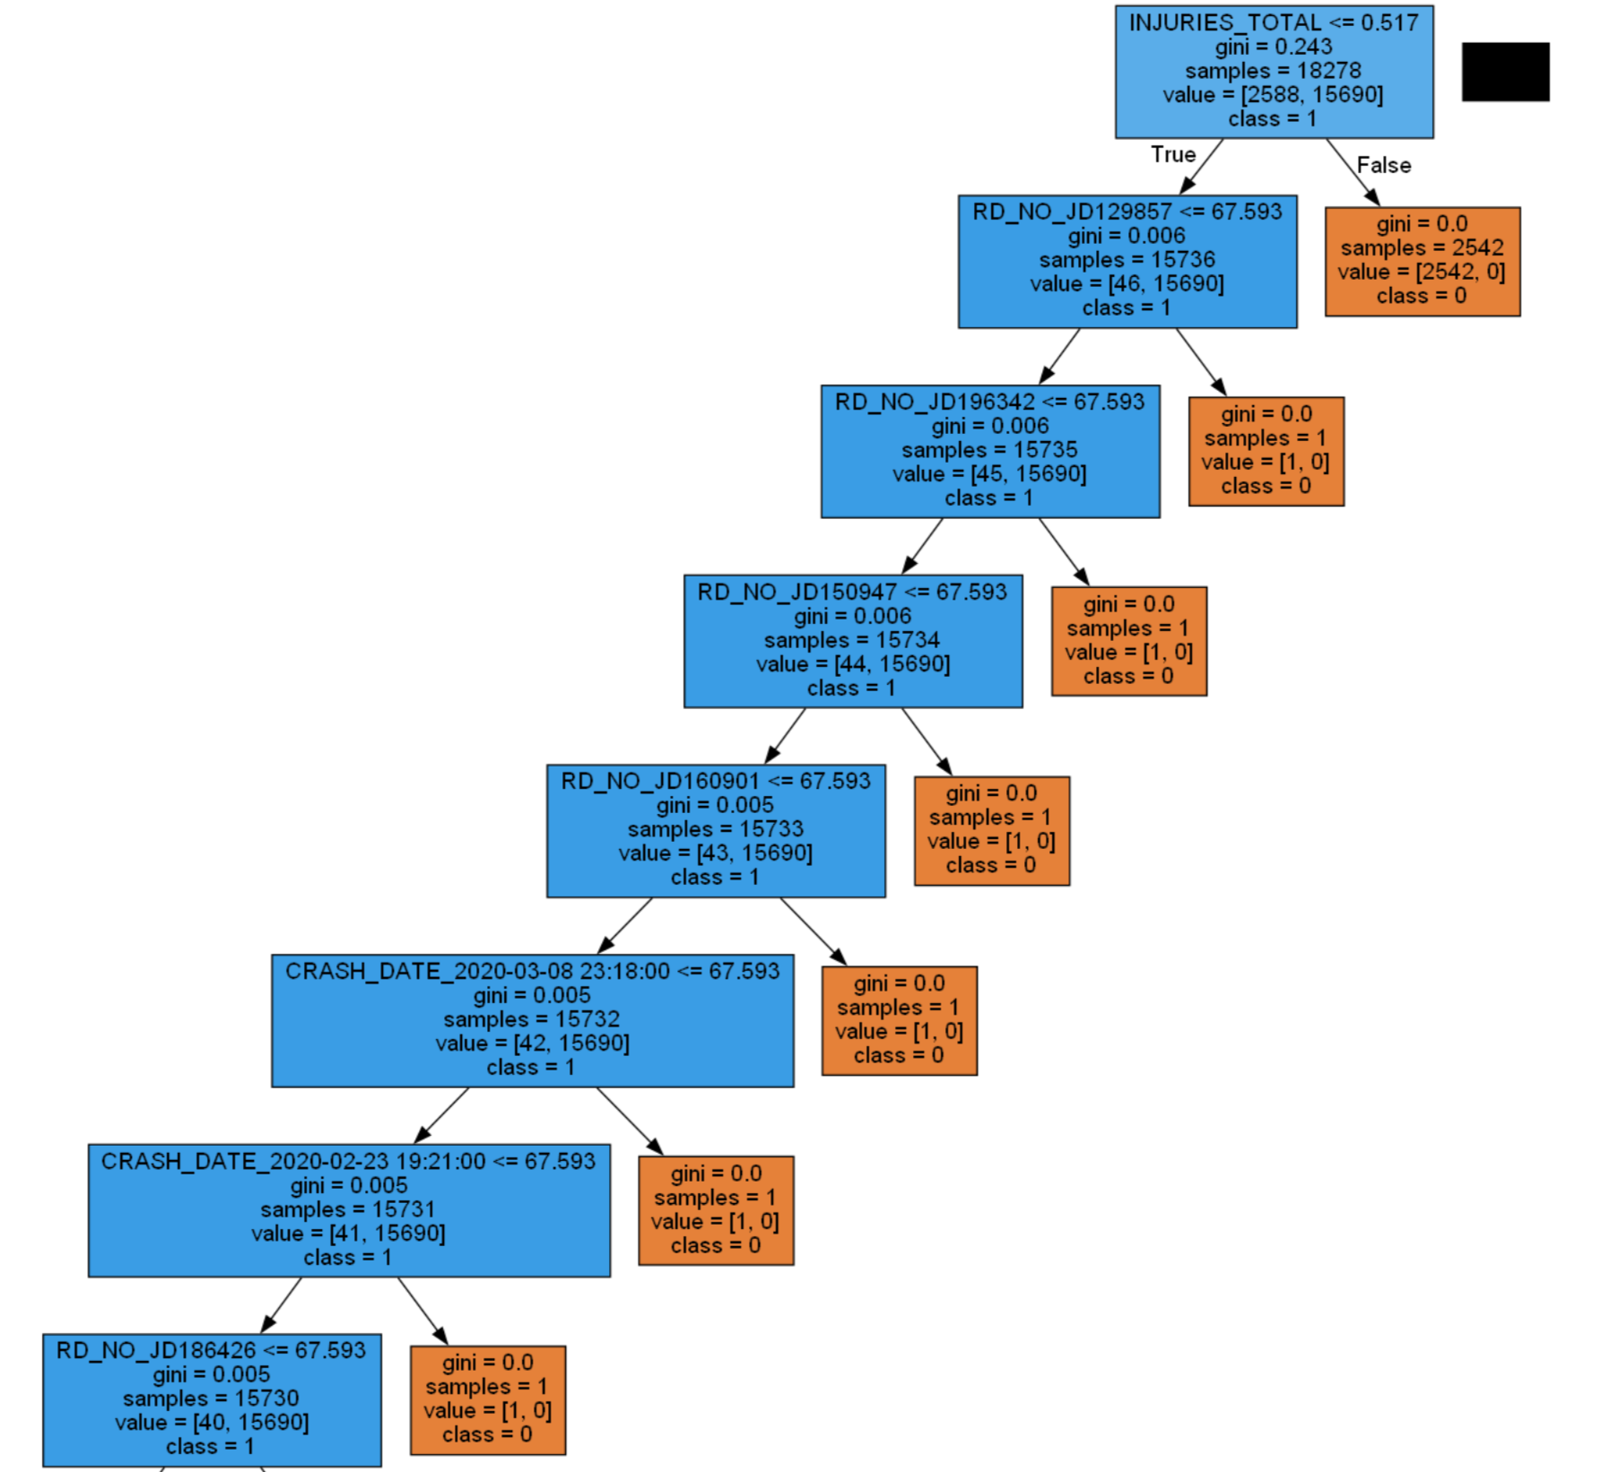
Machine learning - Decision tree model
Target variable: INJURIES_TOTAL
Add details

Slide 11
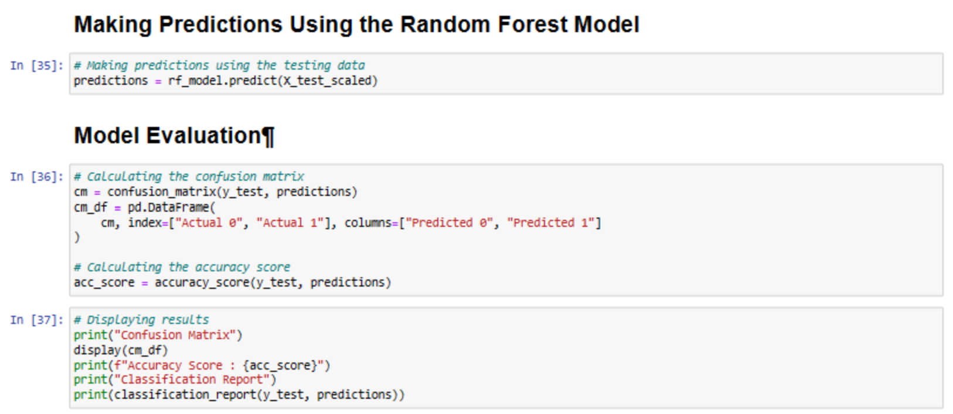
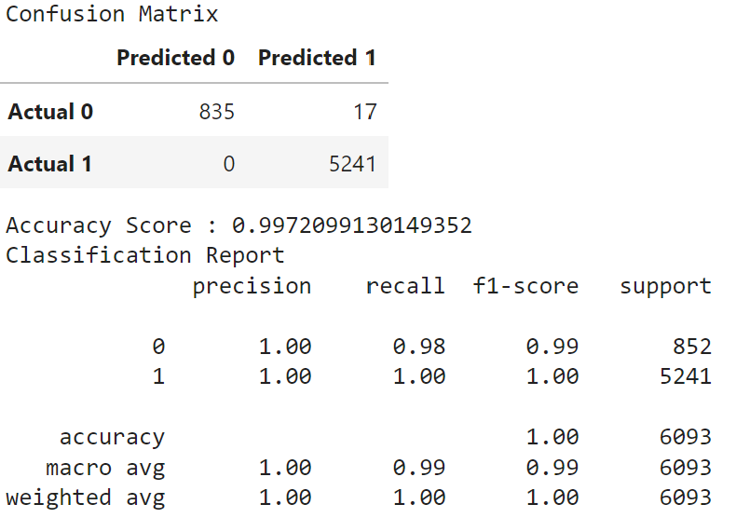
Machine learning – random forest model
Target variable: INJURIES_TOTAL
Accuracy: 99.7%

Slide 12
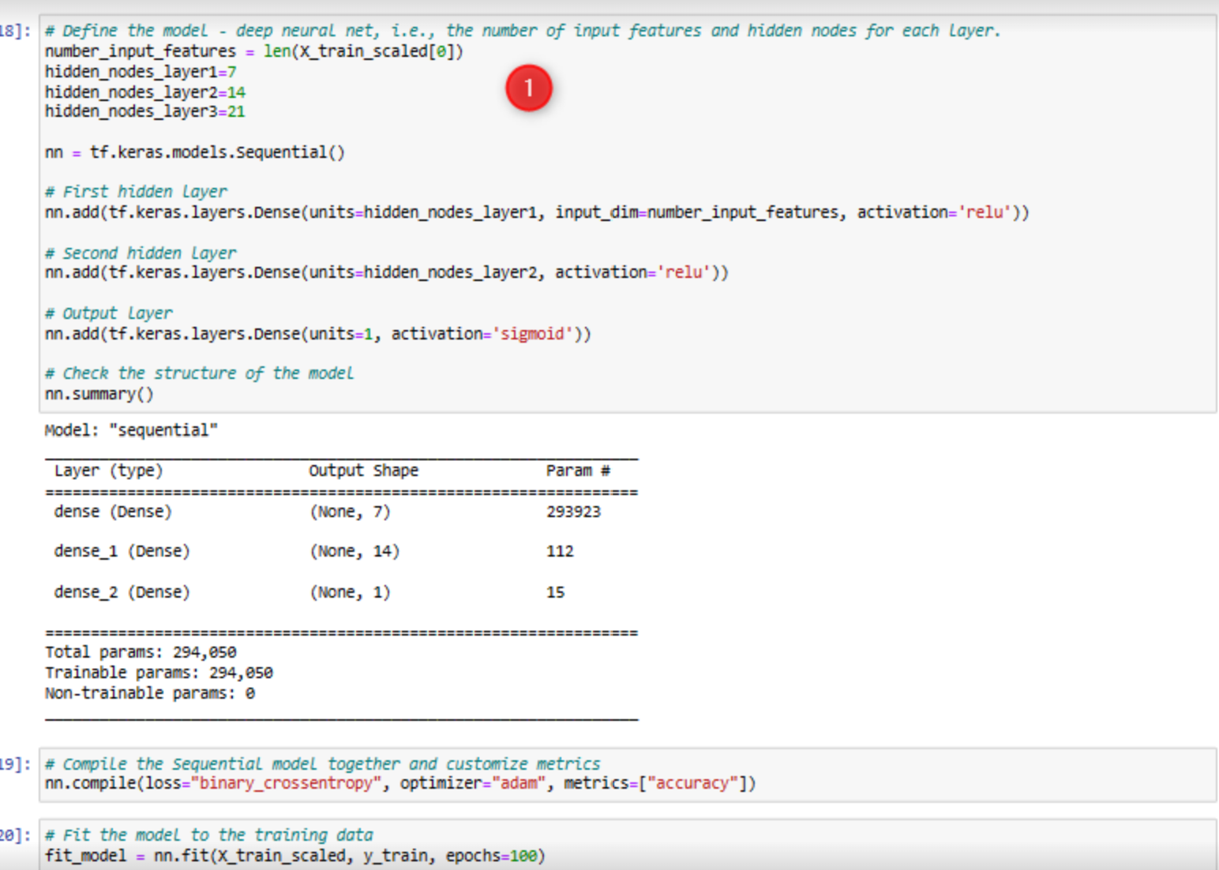
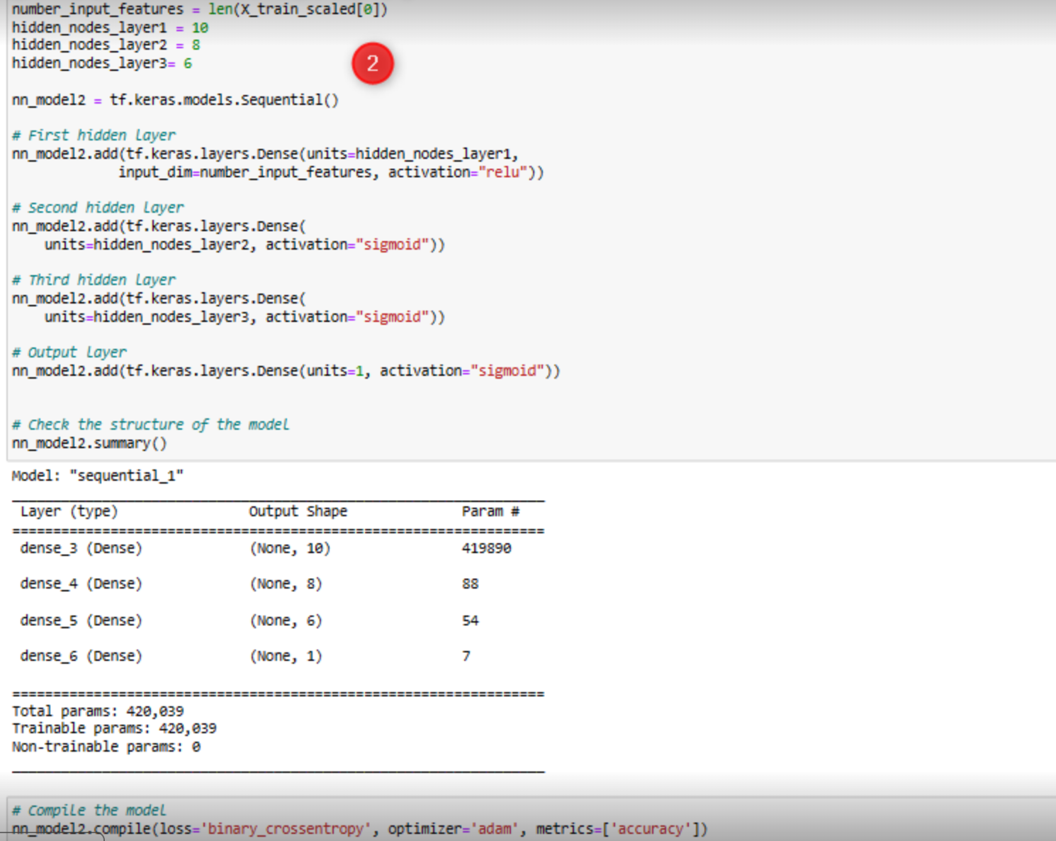
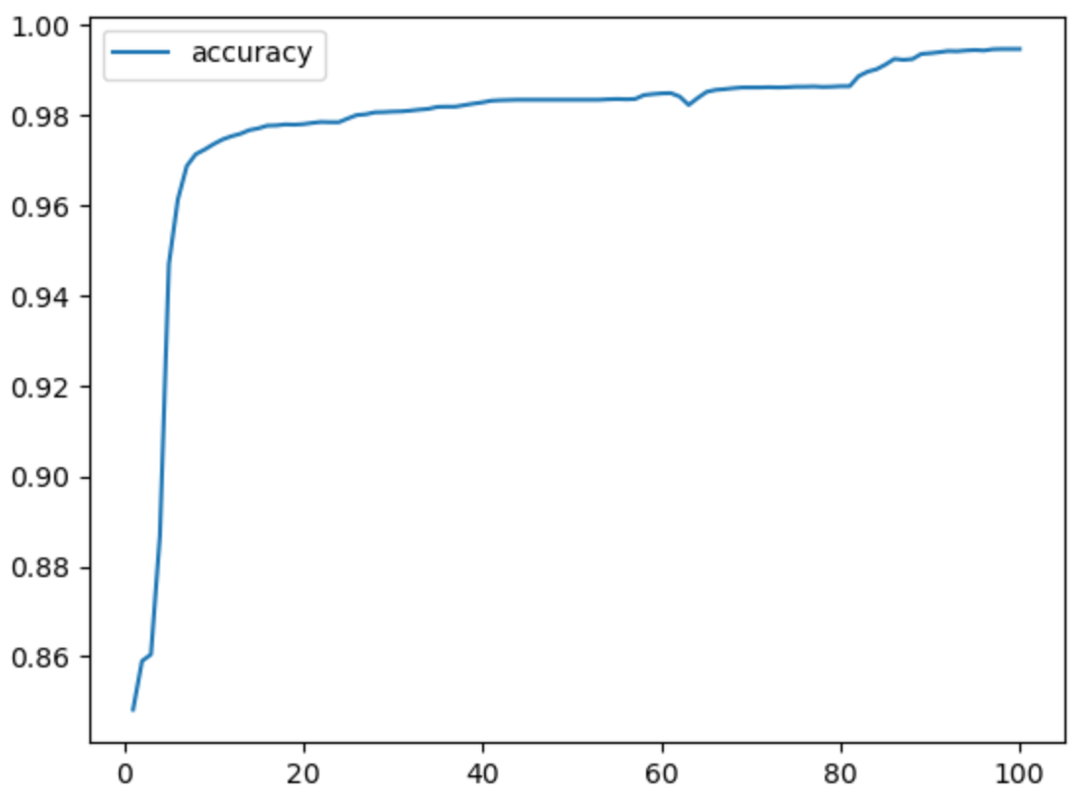
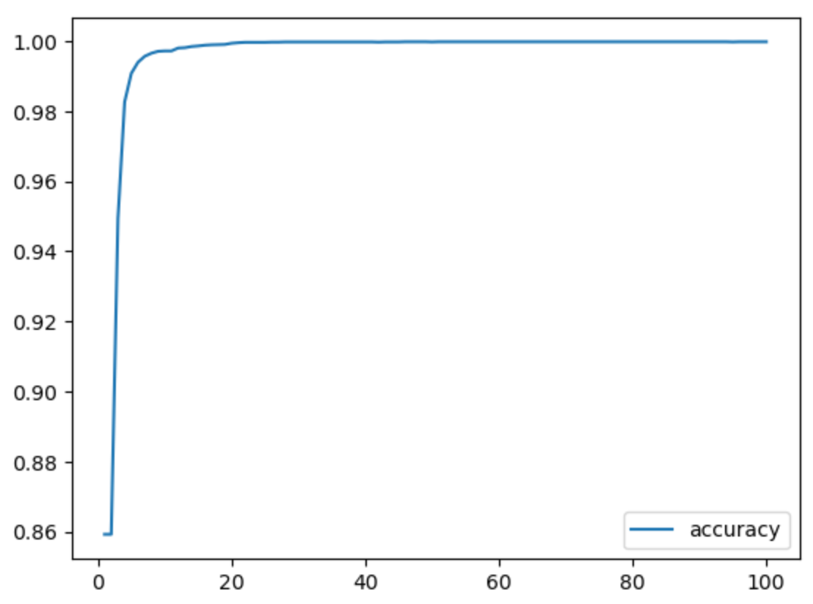
Machine learning– DEEP LEARNING model and optimization
Trial 1 Trial 2
Target variable: INJURIES_TOTAL
Trial 1
Total parameters: 294,050
Model Accuracy: 87.8%
191/191 - 1s - loss: 4.3641 –
accuracy: 0.8776 - 733ms/epoch - 4ms/step
Loss: 4.364131450653076, Accuracy: 0.8775644302368164
191/191 - 1s - loss: 0.8260 –
accuracy: 0.9073 - 675ms/epoch - 4ms/step
Loss: 0.8259850740432739, Accuracy: 0.907270610332489
Optimized (Trial 2)
Total parameters: 420,039
Model Accuracy: 90.7%

Slide 13

Limitations
No premium data so it was difficult to specify the true cost of damages caused in each incident.
<500
500-1500
1500+
How to correct..
With additional premium (cost, not data quality) datasets it will be a much more robust model that can more accurately predict damages which will ultimately be more helpful to the insurance company.
As always with more time and funding, the model will continue to perform better

Slide 14
Conclusion
Deep Learning Model is the best model to use to predict the high-risk areas of Chicago’s streets to apply to an insurance company’s model to help gauge the right pricing for a user of their services.

