Slide 1
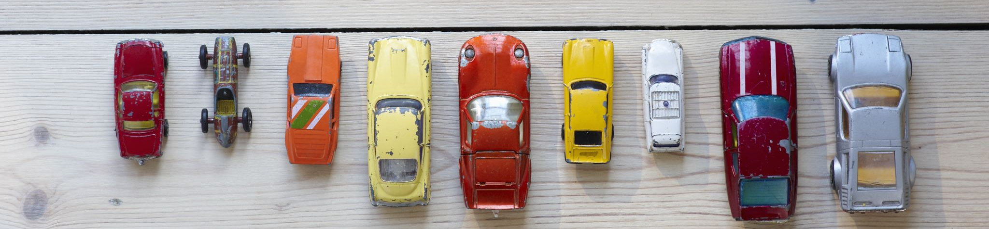
Chicago Traffic Crashes
Sunday A., Farman S., John F., Sameen S.

Slide 2
Project Description
Project Purpose
The project involves analyzing crash data in the City of Chicago, which is collected from the electronic crash reporting system (E-Crash) at the Chicago Police Department (CPD). The dataset includes information about each traffic crash that occurs on city streets under the jurisdiction of CPD. The records are added to the dataset when a crash report is finalized or amended in E-Crash. The data covers some police districts in 2015, but citywide data is not available until September 2017. The data includes information such as street condition, weather condition, and posted speed limits, recorded by the reporting officer based on the best available information at the time.
The project aims to analyze the data to identify patterns, trends, and factors contributing to crashes in Chicago, with the goal of providing insights to improve road safety in the city. It is important to note that the dataset only includes reportable crashes, which are those with a property damage value of $1,500 or more or involving bodily injury to any person(s) and that happen on a public roadway and that involve at least one moving vehicle, except bike dooring.
Project Scope
The project involves analyzing electronic crash reports from the Chicago Police Department to identify patterns and factors contributing to traffic crashes in Chicago. The dataset covers some police districts in 2015, but citywide data is available from September 2017. The goal is to provide insights to improve road safety in the city, but the dataset only includes reportable crashes that involve property damage of $1,500 or more, bodily injury, and at least one moving vehicle (except bike dooring).

Slide 3
Data Exploration and Cleaning

Slide 4
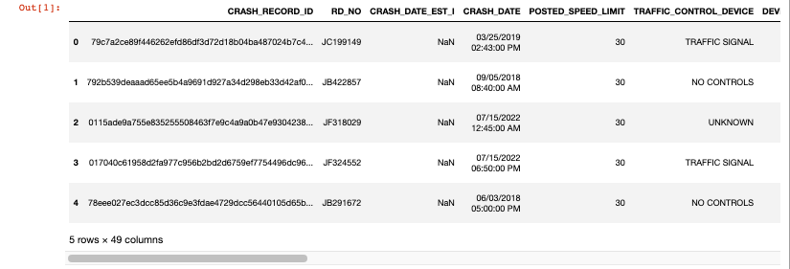
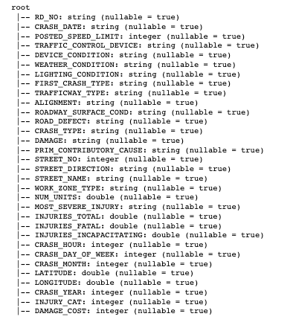
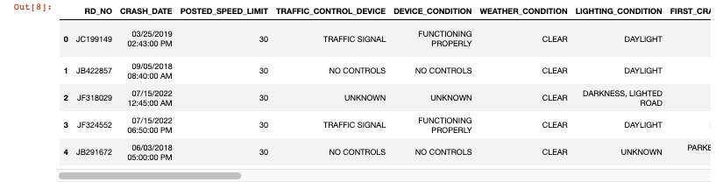
Extract, Transform, Load
SCHEMA
Dropped Unnecessary columns
Replaced NaN values with 0 & NA
Converted CRASH_DATE column to datetime datatype
Redefined Injury and Damage columns

Slide 5
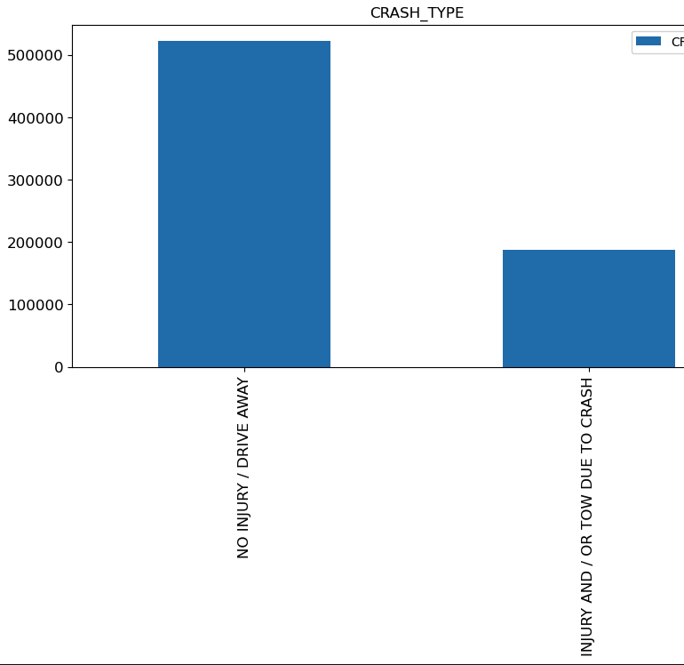
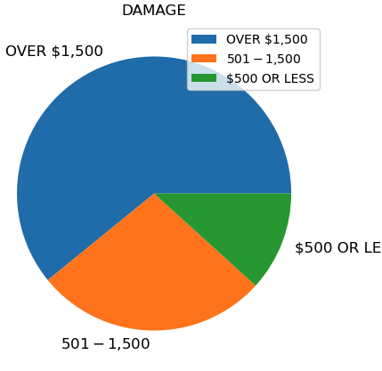
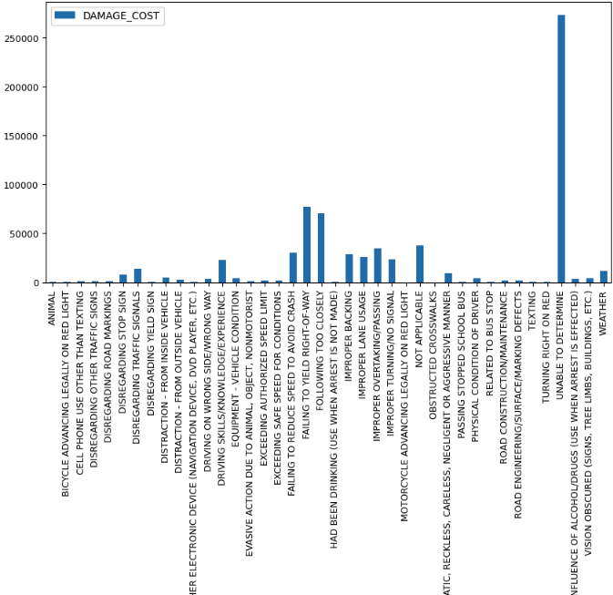
Deep Dive

Slide 6
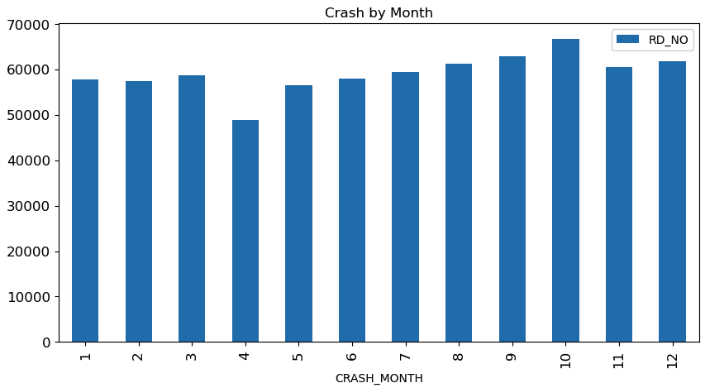
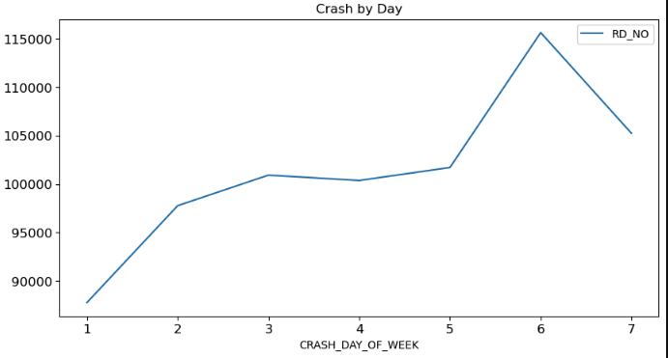
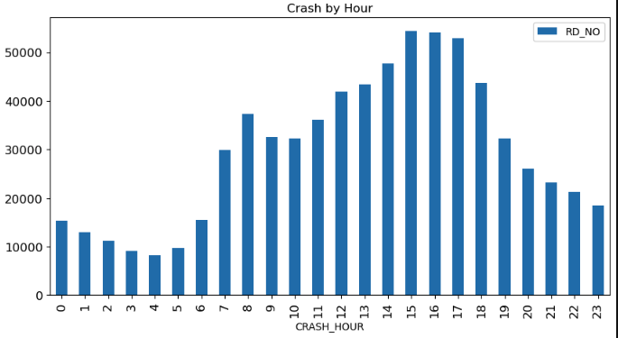
Deep Dive into Data Set

Slide 7
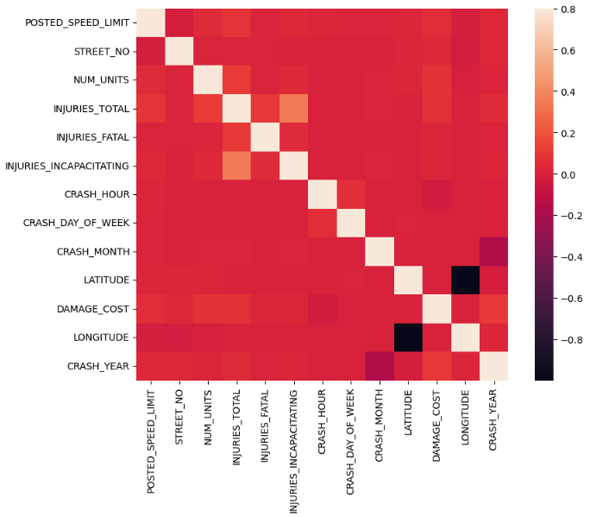

Slide 8
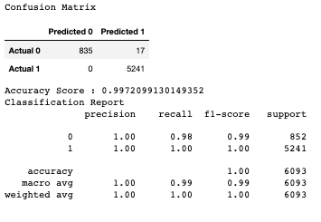
Machine learning– Regression Model
Target variable: INJURIES_TOTAL
Add details

Slide 9

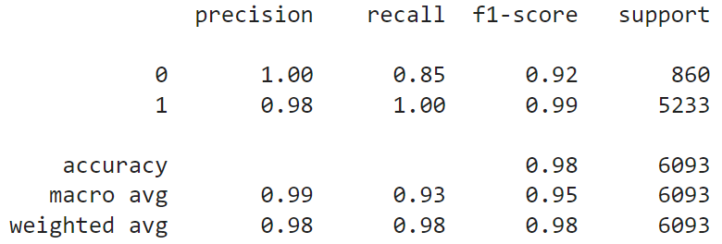
Machine learning– logistic Regression Model
Target variable: INJURIES_TOTAL
Test Matrix
Add details
Testing Report

Slide 10
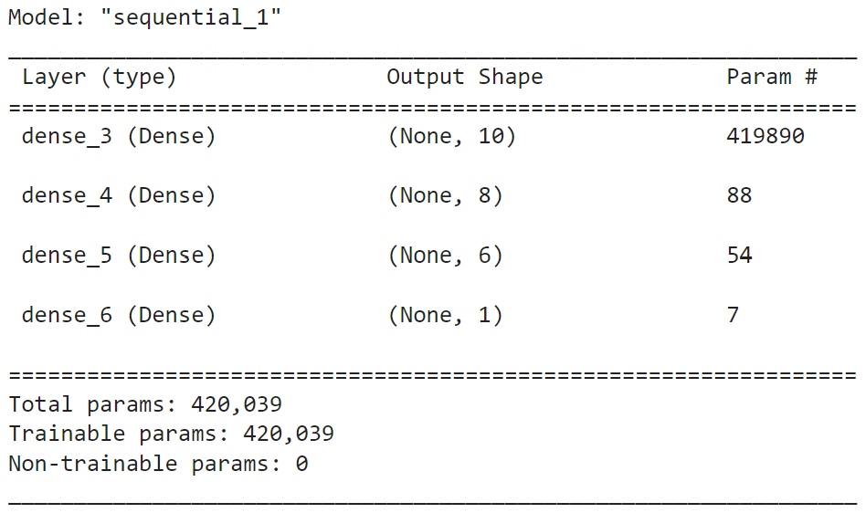
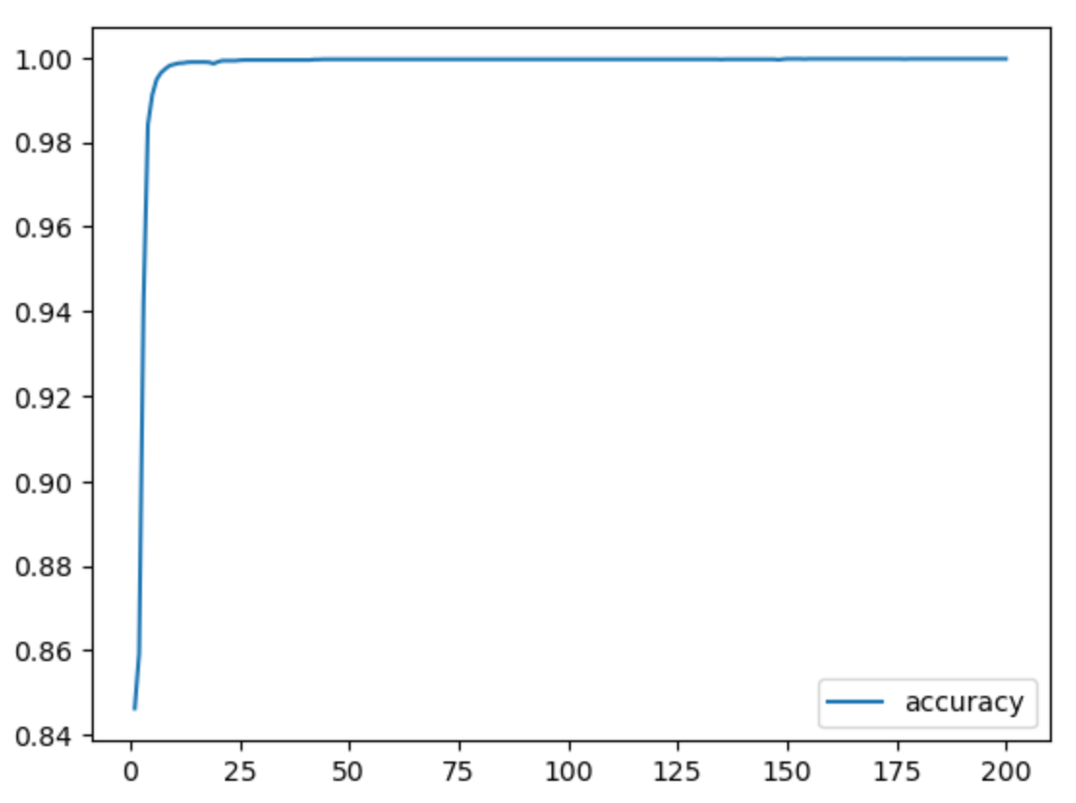
Machine learning– DEEP LEARNING model and optimization
Target variable: INJURIES_TOTAL
Total parameters: 420,039
Model Accuracy: 85.9%
191/191 - 1s - loss: 1.5178 - accuracy: 0.8595 - 703ms/epoch - 4ms/step
Loss: 1.5177603960037231, Accuracy: 0.8595108985900879

Slide 11
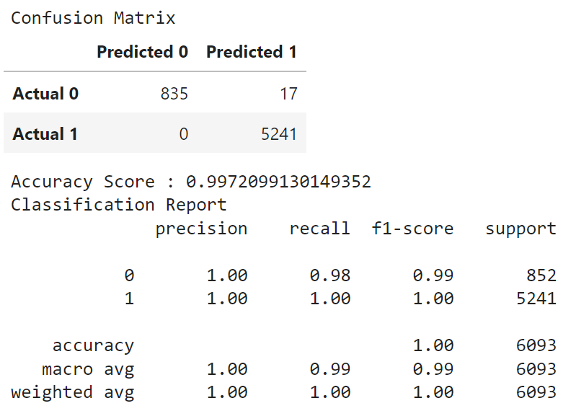
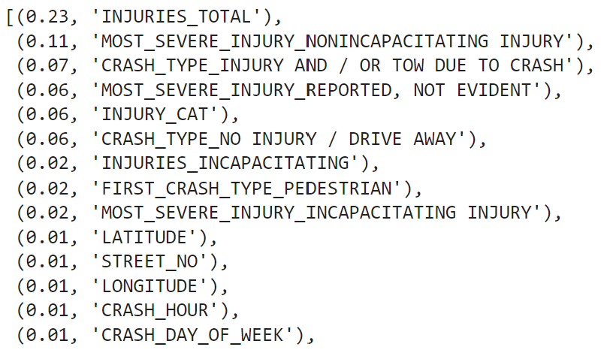
Machine learning – random forest model
Target variable: INJURIES_TOTAL
Add details
Feature Importance

Slide 12
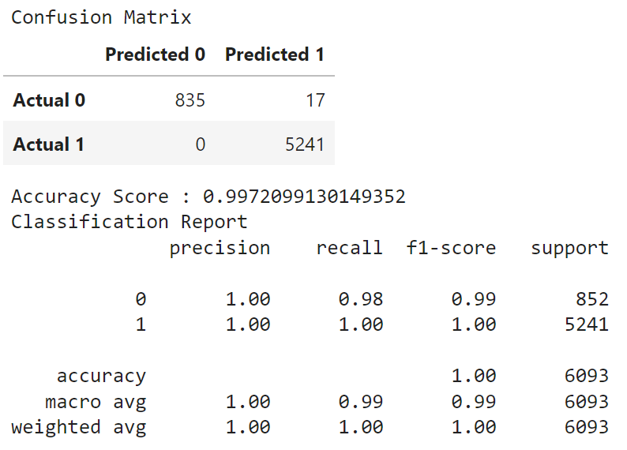
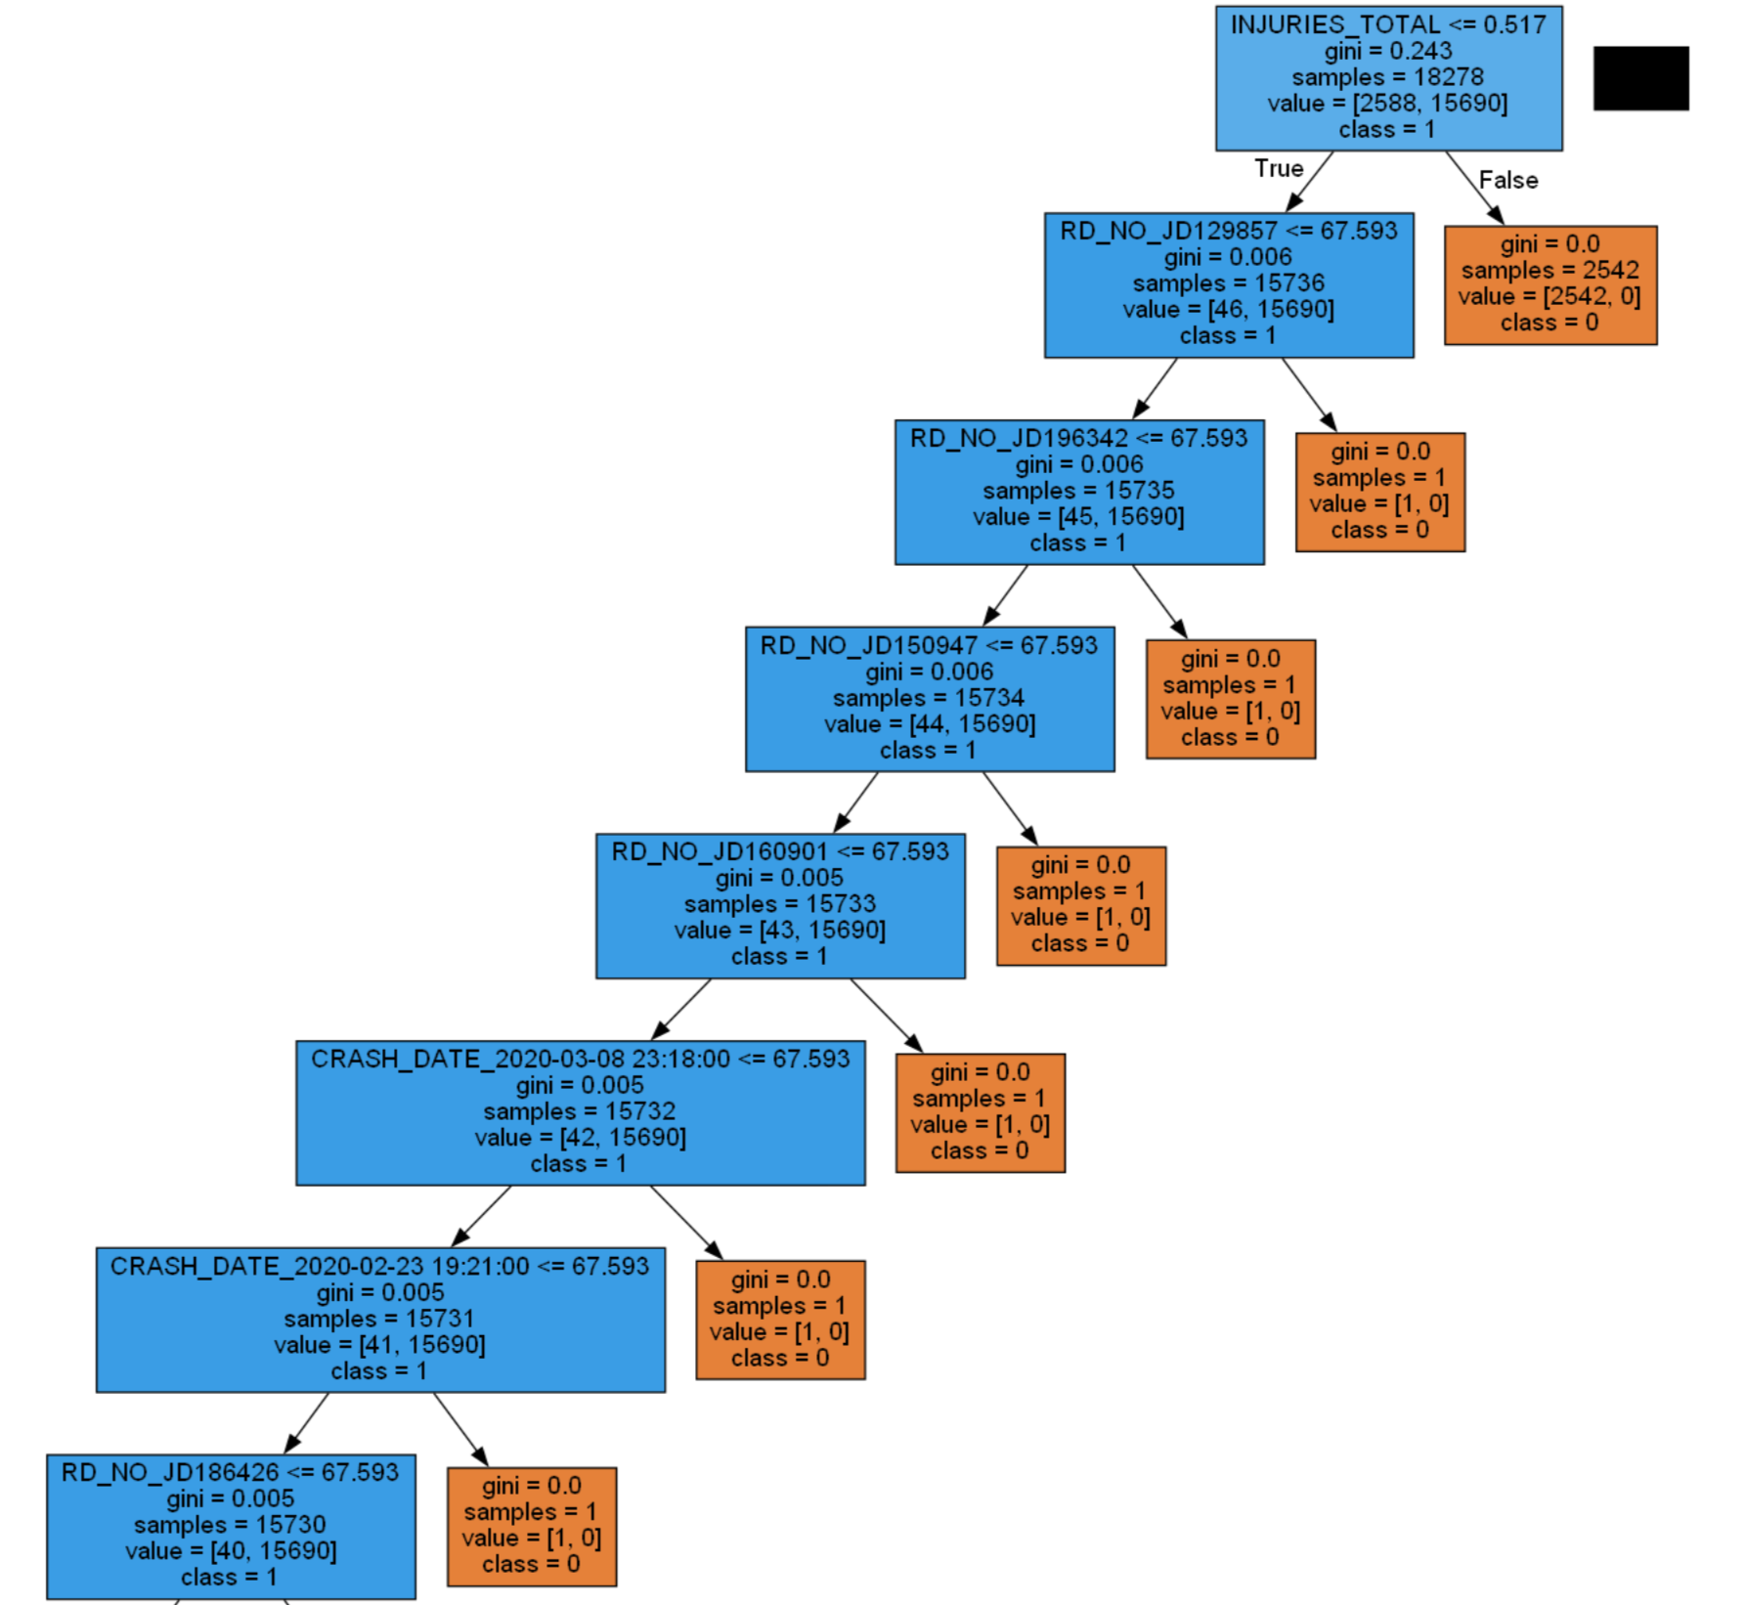
Machine learning - Decision tree model
Target variable: INJURIES_TOTAL
Add details

Slide 13
Conclusion

