Slide 1
LangChain Teacher ASSISTANT
A NLP based project submitted to Dr. Shoaib Farooq
1

Slide 2
TABLE OF CONTENTS
01
03
02
04
Introduction
Usage
The Features
Contribution & Conclusion
2

Slide 3
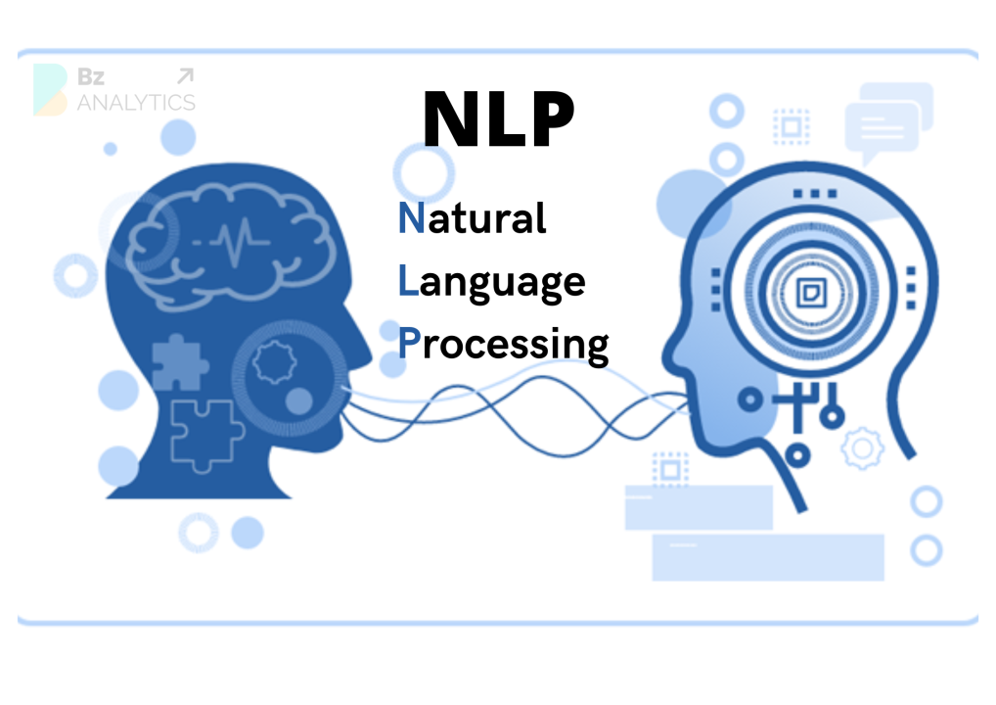
Overview
LangChain Teacher Assistant is a tool that combines document embedding, vector search, and a question-answering chain to provide users with accurate answers based on uploaded documents. This project integrates Streamlit for a user-friendly interface.
3

Slide 4
01
Introduction
4

Slide 5
ABOUT THIS PROJECT
LangChain Teacher Assistant is designed to assist users in extracting meaningful information from uploaded documents. Whether it's querying specific details from a LangChain Teacher or finding relevant content, the tool streamlines the process through document embedding and advanced question-answering capabilities.
5

Slide 6
02
The Features
6

Slide 7
PROJECT FEATURES
Question-Answering Chain
Document Embedding
Vector Search
Streamlit Integration
Provides appropriate answering w.r.t inserted pdf.
Utilizes PyPDFLoader, text splitting, and Hugging Face Embeddings for efficient document representation.
Implements Chroma from LangChain to perform similarity searches among embedded documents.
Leverages Streamlit, allowing document upload and Q&A in a single interface.
7

Slide 8
03
Usage
8

Slide 9
APP USAGE
STEP 1
STEP 2
STEP 3
Upload a PDF document using the provided interface.
Ask your questions in the input field.
Tap "Get Answer" to get based responses as per the uploaded pdf.

Slide 10
03
Contribution & Conclusion
10

Slide 11
THANKS!
Do you have any questions?

