Slide 1
AL-HAFEEZ Technology Center
SOLO Project Presentation

Slide 2
Problem Statements
Complex storage of records.
To reduce copyright paper cost.
To decrease time taken to enter a record.
Manual Records can be easily stolen or misplaced which is a big vulnerability.
Very Slow Management of Date Differences and Order Calculations.

Slide 3
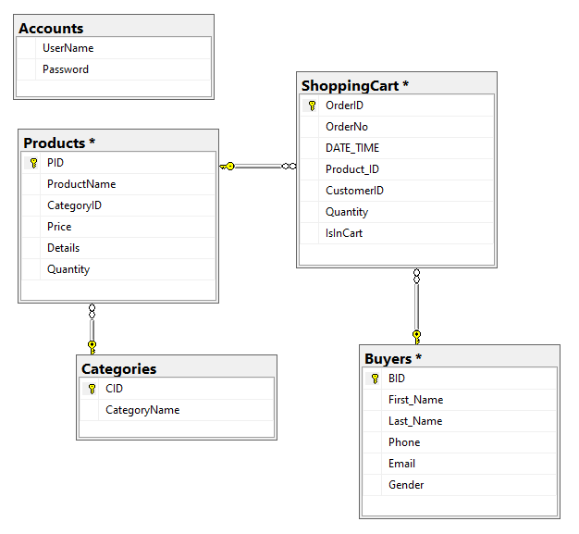
DB - Diagram

Slide 4
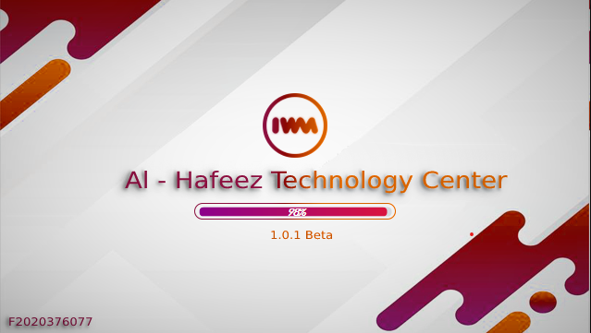
Starting With
Splash Screen

Slide 5
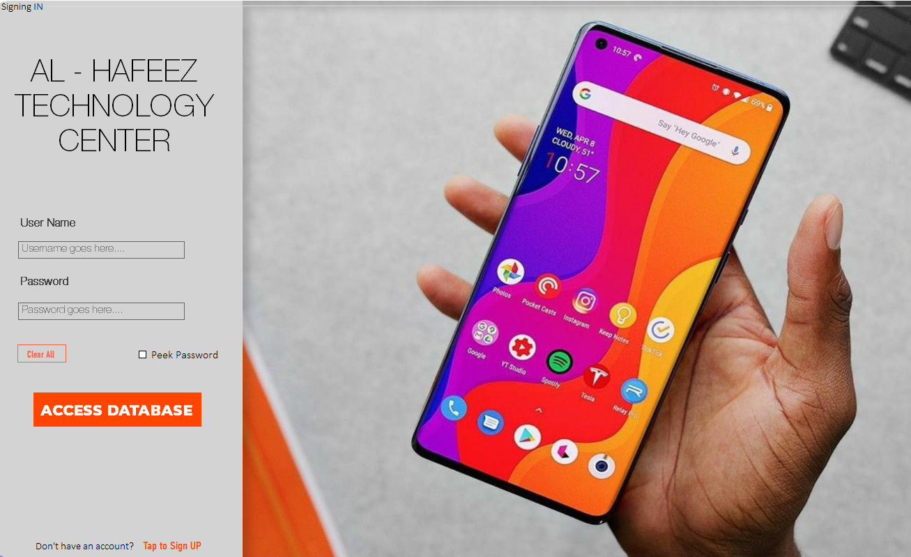
Login & SignUP
F2020376077

Slide 6
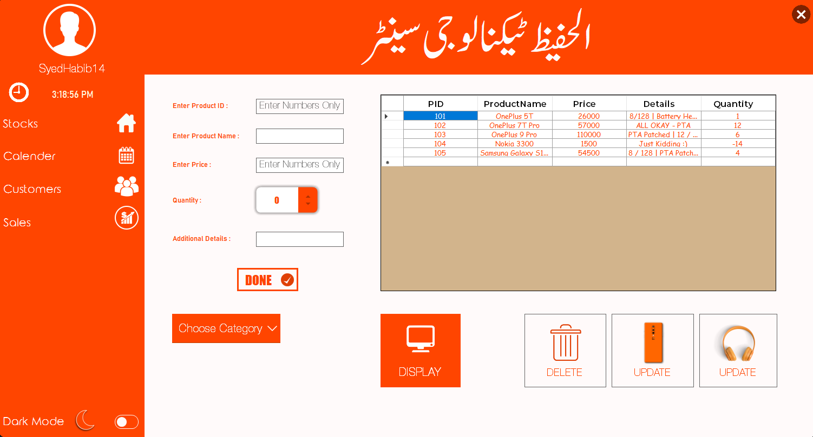
Adding Stocks ^_^

Slide 7
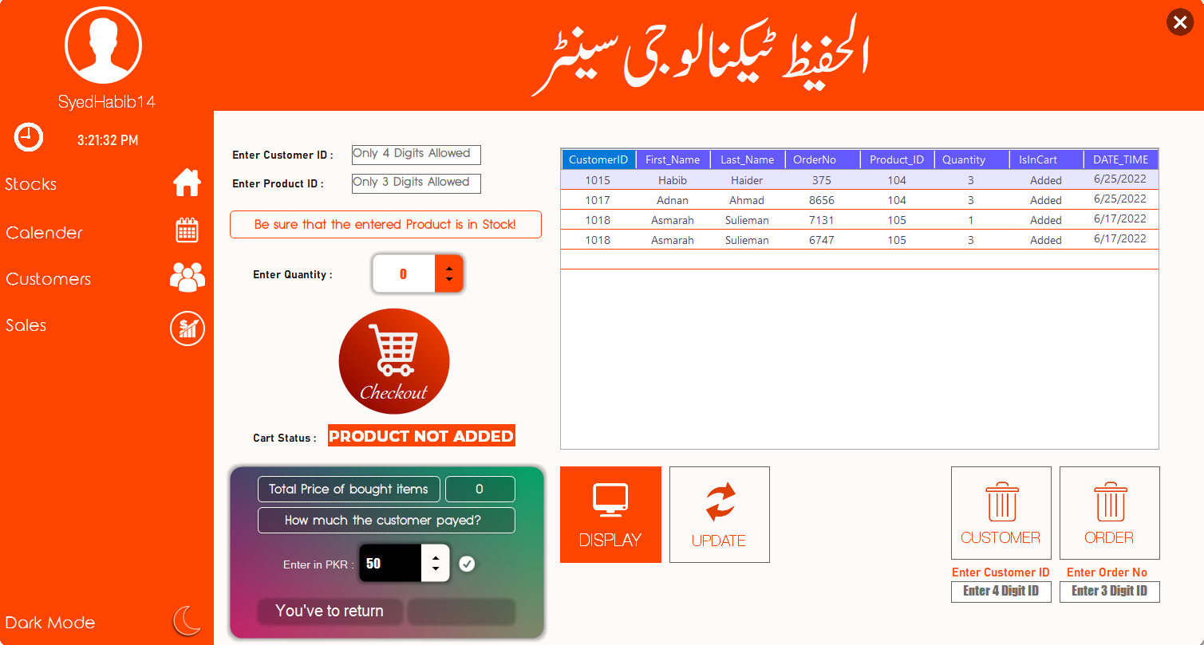
SALES DEPARTMENT

Slide 8
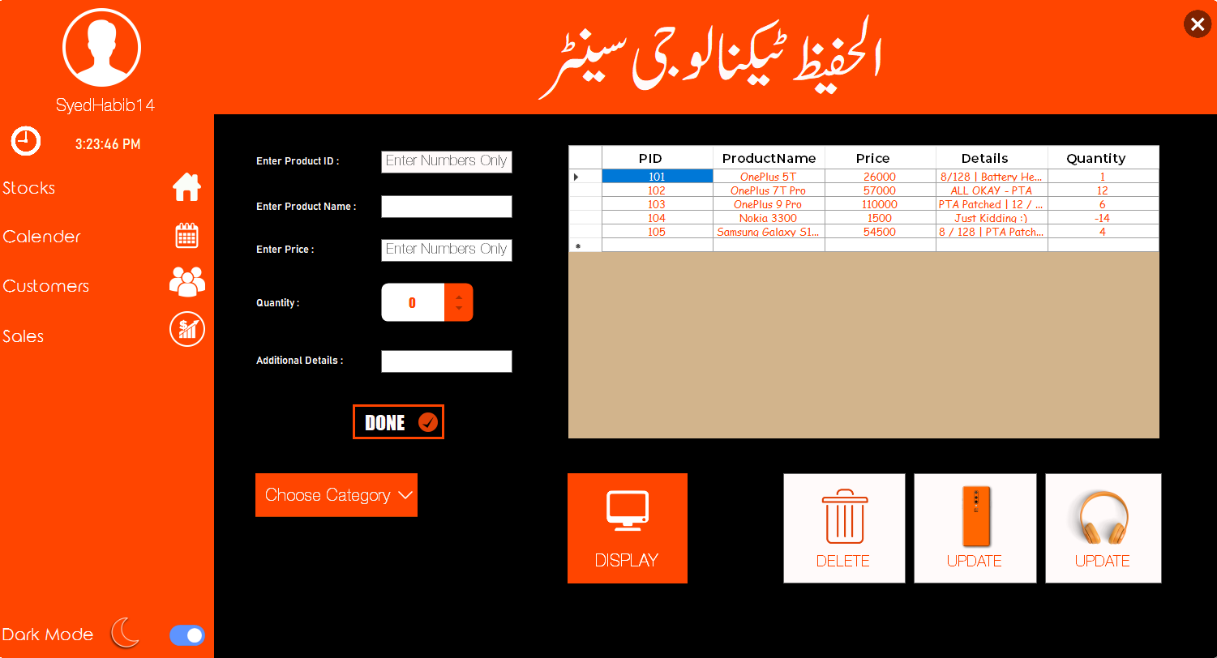
DARK MODE 2.0

Slide 9
بہت بہت شکریہ عزیز
کوئی سوال؟

