Slide 1
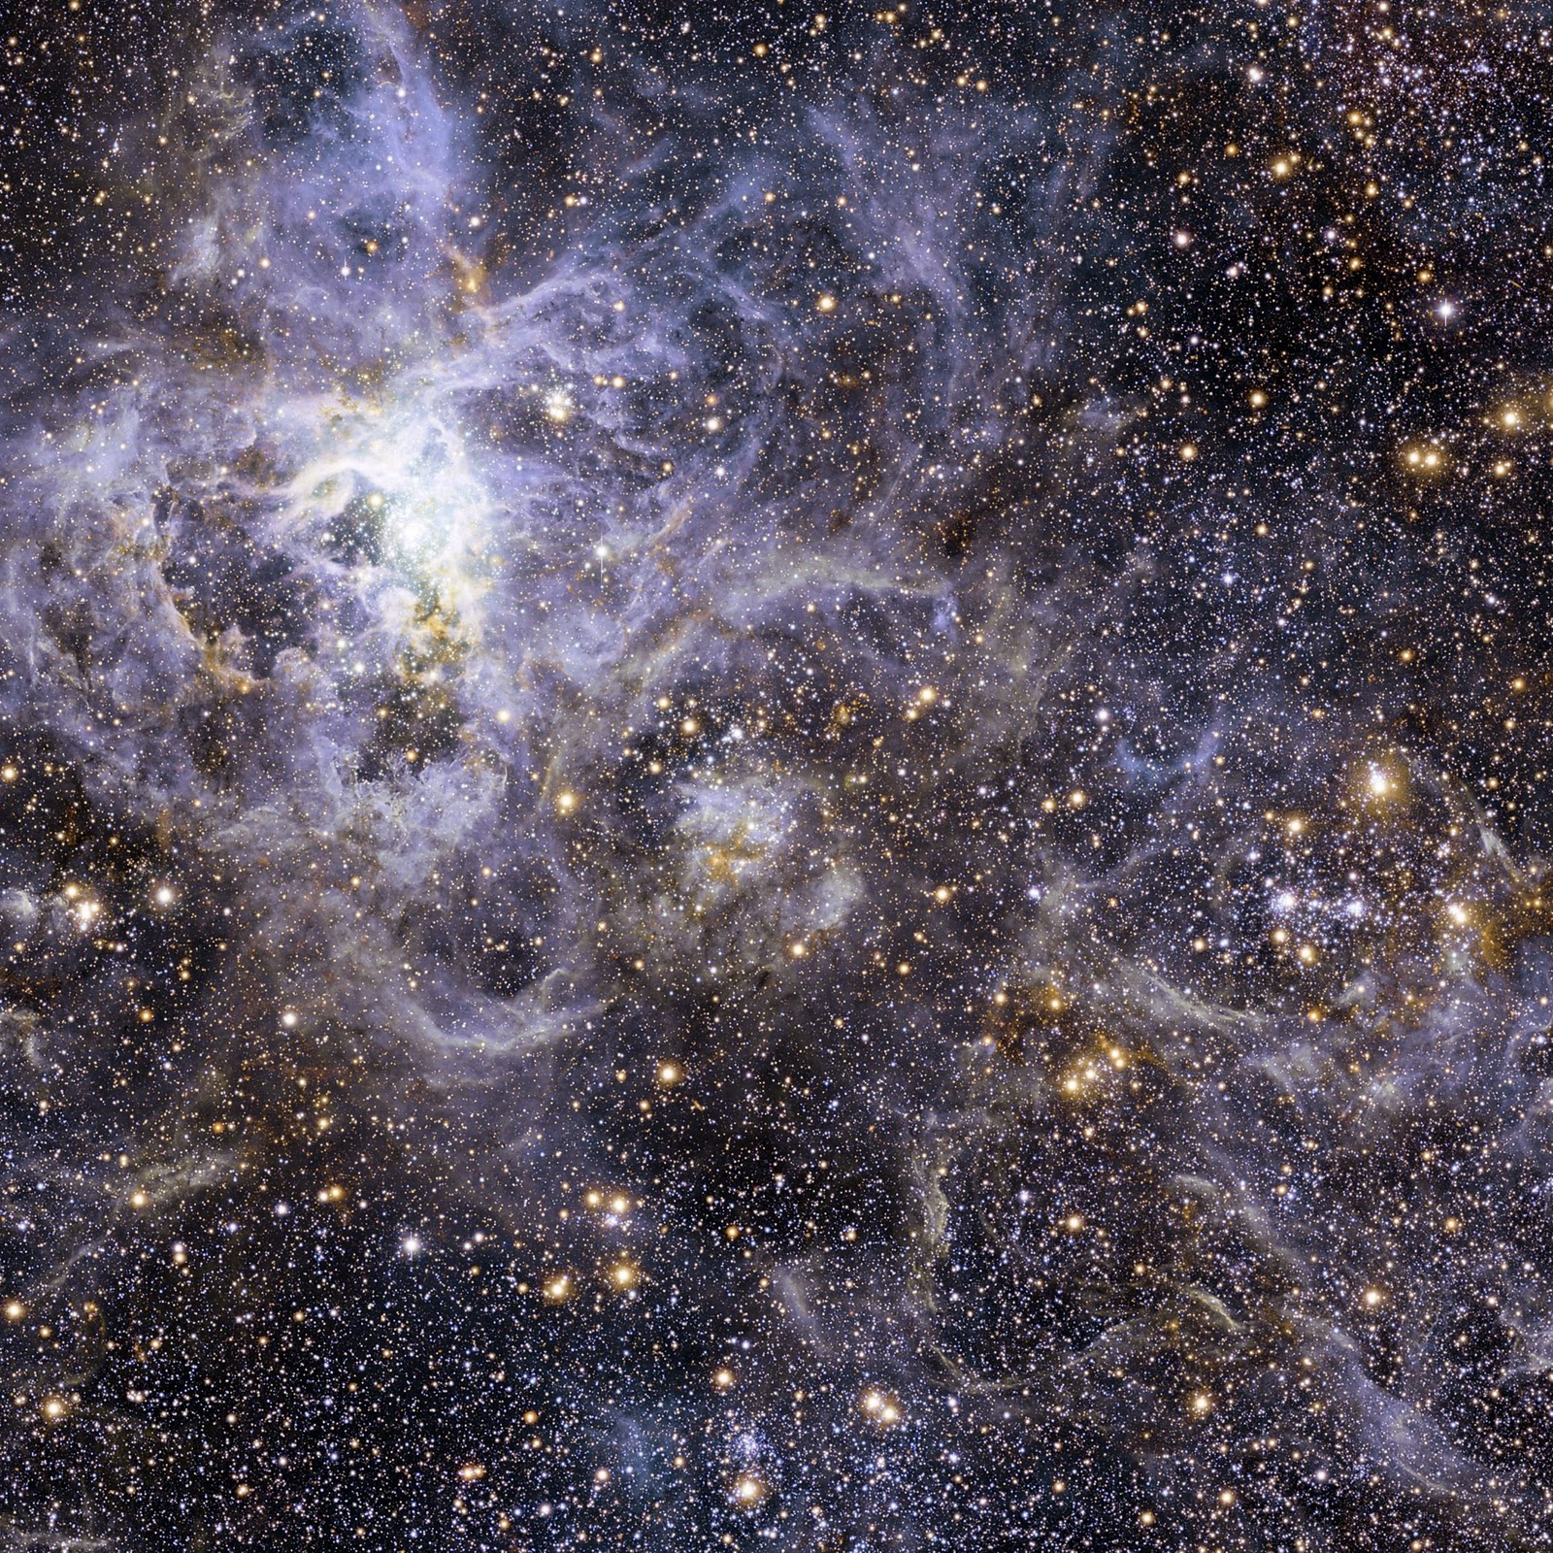
Methodology & Experiments
By Syed S. Huda
This Photo by Unknown author is licensed under CC BY-NC-ND.

Slide 2
DATA Source
The Data was used from HRSA Website
These reports are made public every year and by law all the FQHCs all over the U.S has to submit the data in order to receive funding from Congress.
Follow the link below
Data_Description
This Photo by Unknown author is licensed under CC BY-NC-ND.

Slide 3
MAINE : county level HEALTH data REPORT
This Photo by Unknown author is licensed under CC BY-NC-ND.

Slide 4
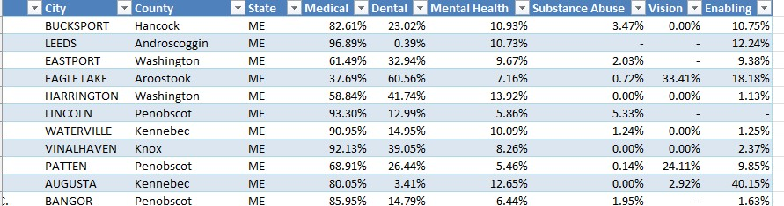
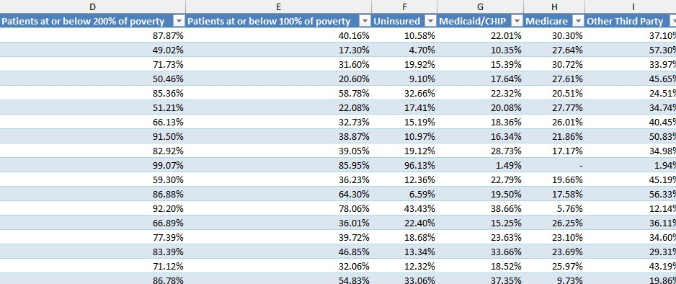
This Photo by Unknown author is licensed under CC BY-NC-ND.

Slide 5
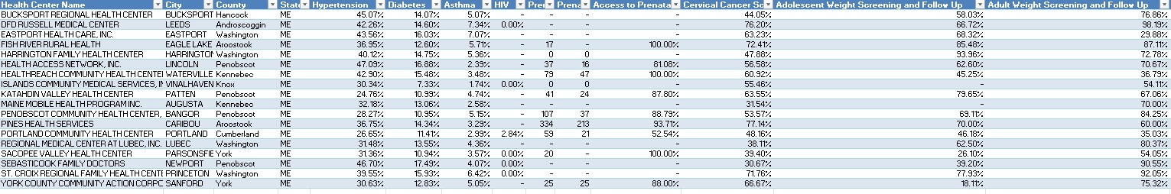
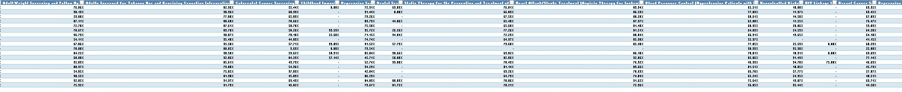
This Photo by Unknown author is licensed under CC BY-NC-ND.

Slide 6
FACILITIES: Federal qualified health centers (fqhc)
This Photo by Unknown author is licensed under CC BY-NC-ND.

Slide 7
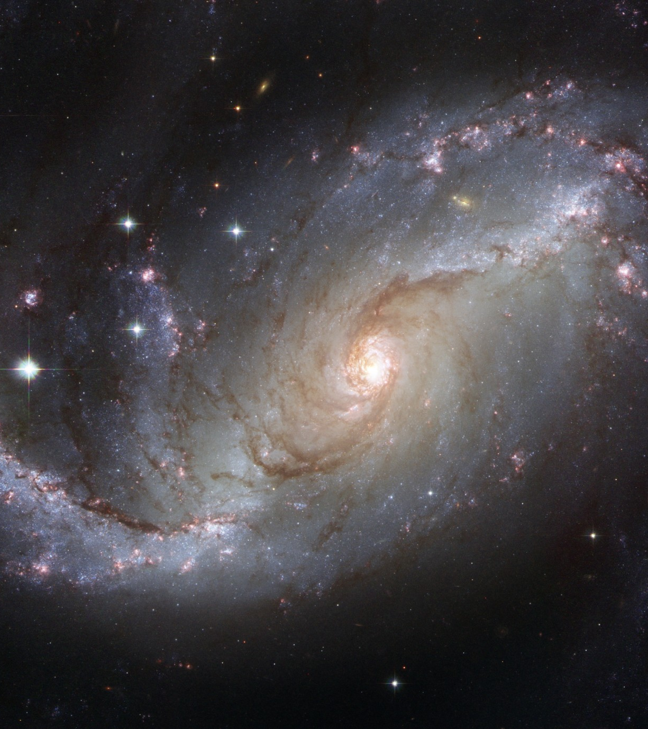
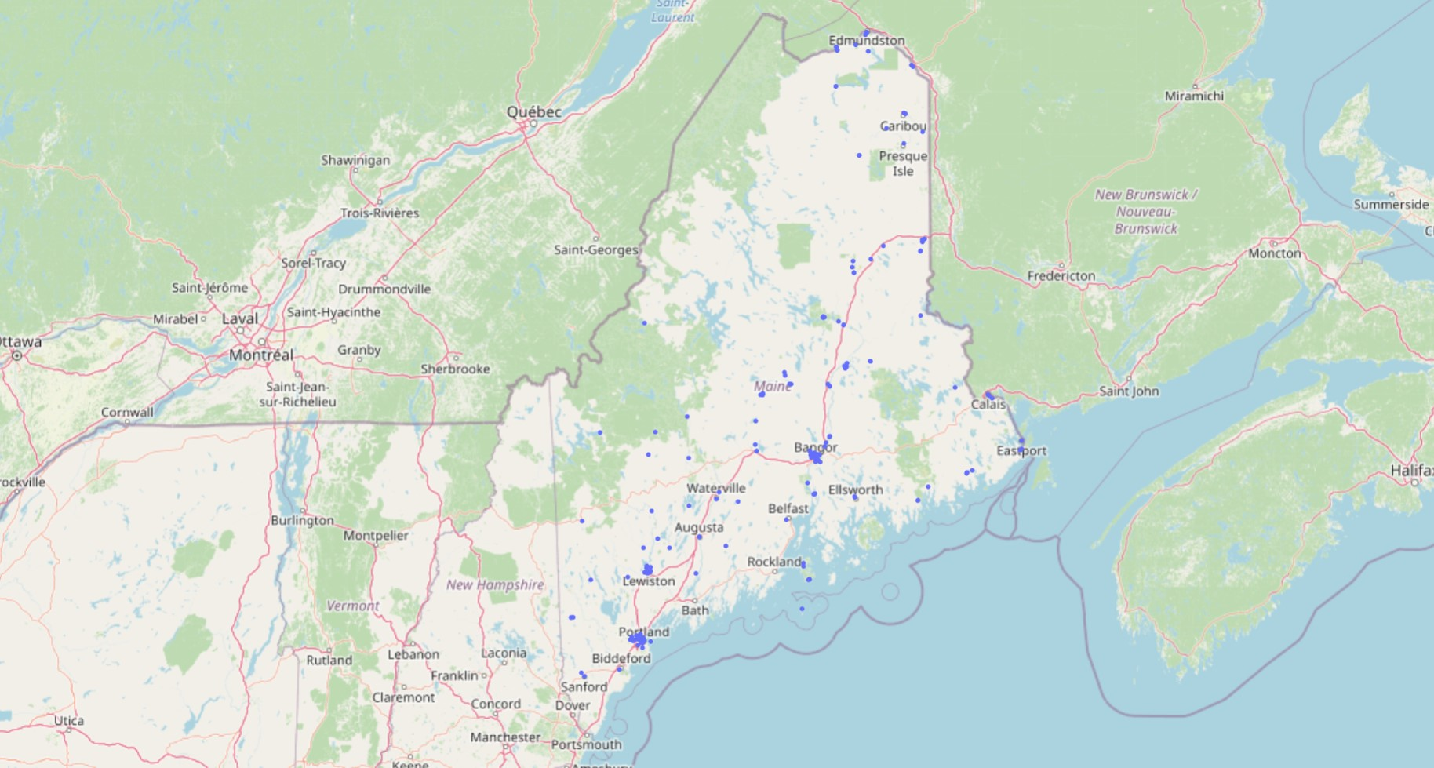
Facilities - Maine

Slide 8
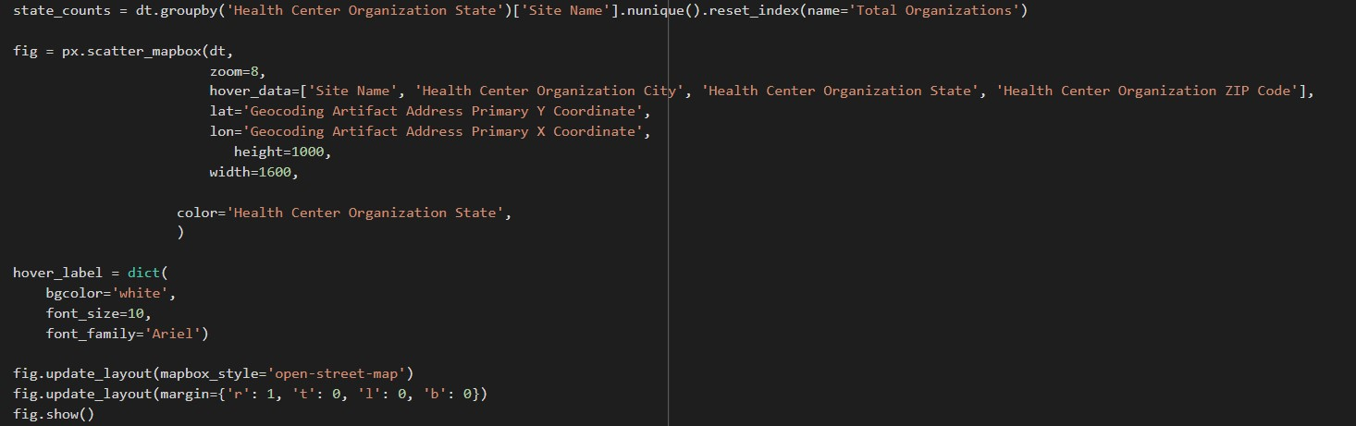
Facilities: Interactive map

Slide 9
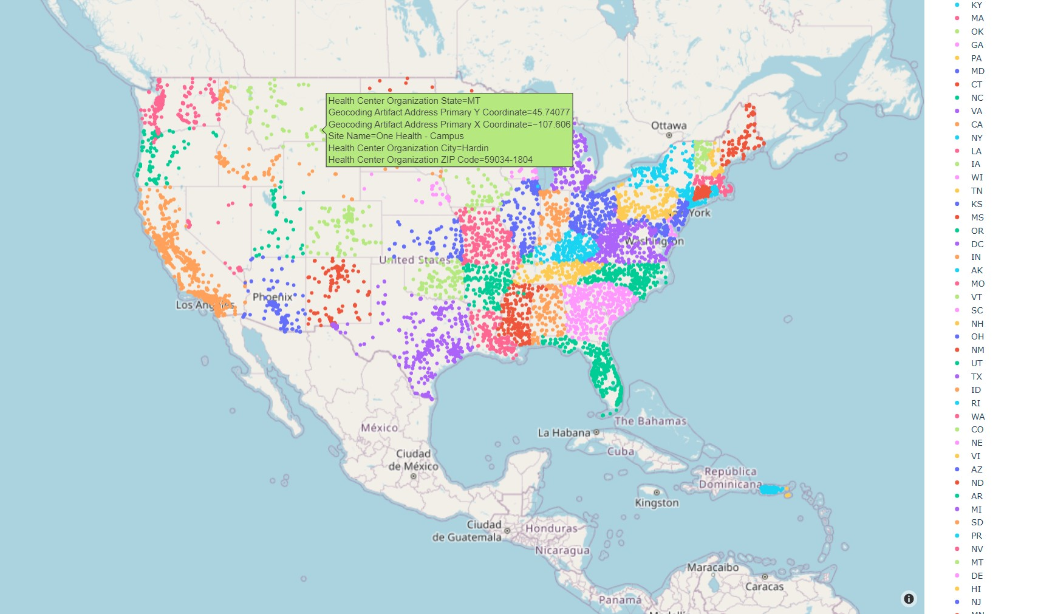
Facilities: Interactive map

Slide 10
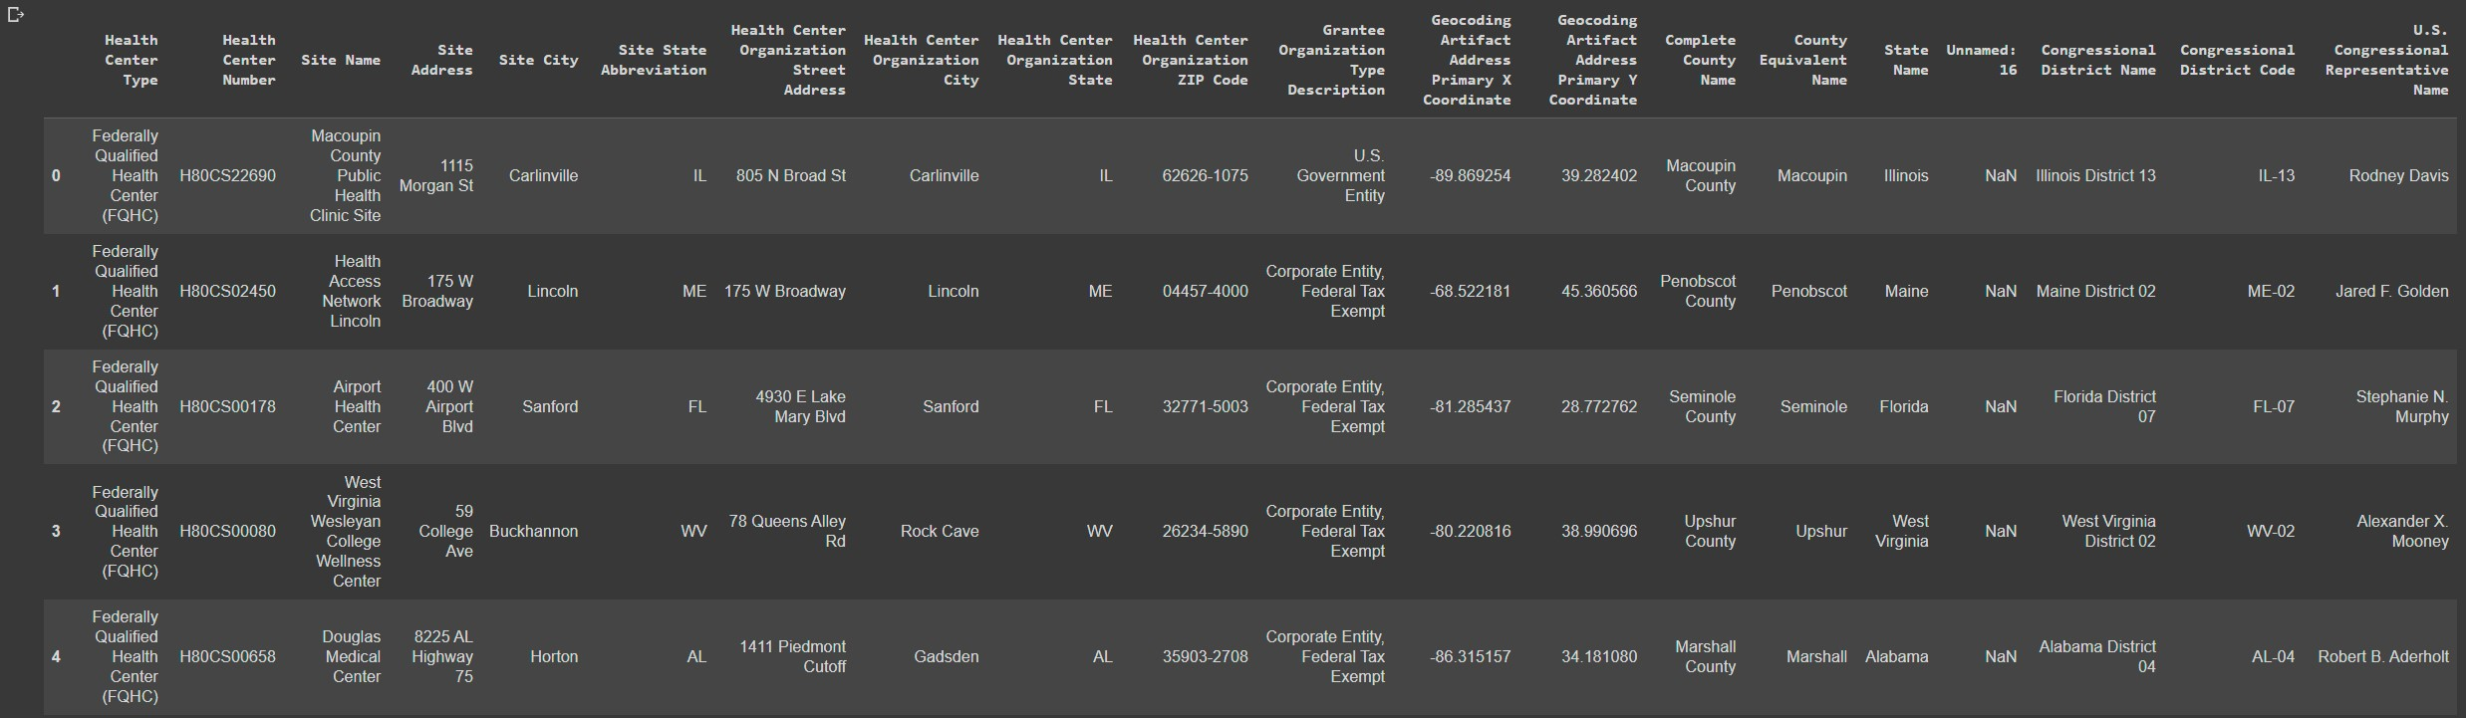
Facilities

Slide 11
Technique
Machine learning algorithms were used to identify patterns and relationships in data. Use multiple Python libraries for machine learning, including panda, scikit-learn and TensorFlow. These libraries provide a wide range of machine learning models, including linear regression, decision trees, and neural network
Normalization
Regression Models
Parameter Tuning

Slide 12
ECONOMIC INDICATORS
https://www.maine.gov/labor/cwri/county-https://www.maine.gov/labor/cwri/county-economic-profiles/countyProfiles.html
This Photo by Unknown author is licensed under CC BY-NC-ND.

Slide 13
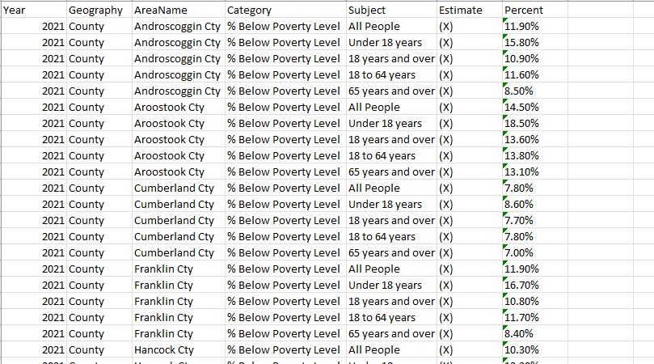
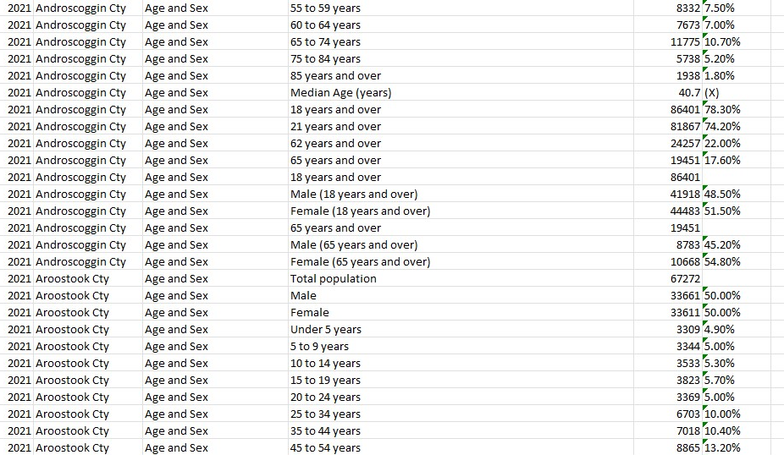
ECONOMIC INDICATORS
Population Demographics
Poverty levels- Food Insecurity

Slide 14
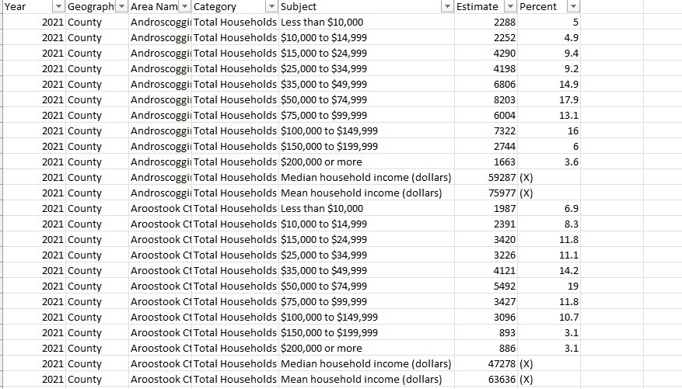
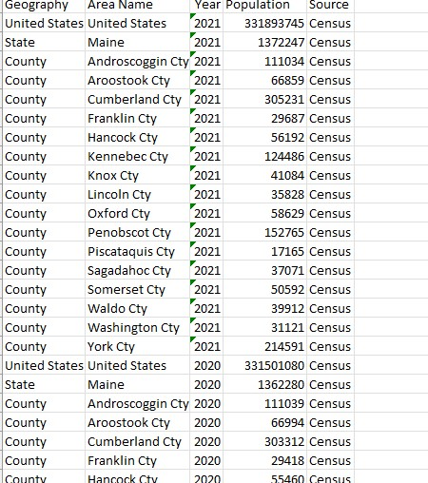
ECONOMIC INDICATORS
Mean Household Income
County total Population

Slide 15
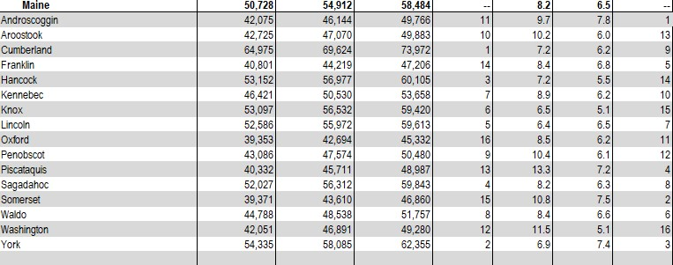
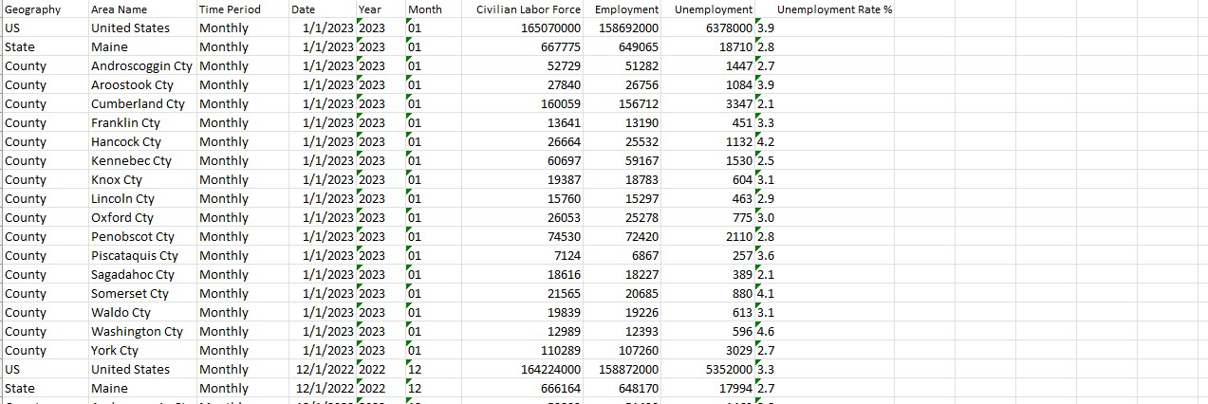
ECONOMIC INDICATORS
GDP per capita
Employment/ Unemployment

Slide 16
Techniques
Perform regression, including stats-models and scikit-learn. These libraries will allow to fit different types of regression models (e.g., linear, logistic, polynomial) and evaluate the goodness of fit.
Use Hypertension health outcome as the dependent variable and the socioeconomic variable as the independent variable. The results will include an odds ratio, which indicates the strength of the association between the socioeconomic variable and the health outcome.
I also used Matplotlib and Seaborn. Scatter plots, line plots, and heatmaps .visualizations for exploring relationships between variables.

Slide 17
Techniques
•To incorporate multiple sources of data, I performed feature selection and determined unbiased variables based on specific requirements.
•The Input variables were normalize using Min-Max Scaling. This method turns variables to 0 & 1 range.
•A value is normalized as follows:
y = (x – min) / (max – min)
• Regression model results prior to normalization were overfitting and created a bias in result. To solve the issue of scaling, Min-Max Normalization method was implemented using Scikit-Learn.
•Result Prior & after feature selection
•P-Value
•Multiple research paper including from Kansas Journal of Medicine have either used Poisson and Logistic regression models in interpretation of relationship.

