Slide 1

Literature Review Can Socio-economic Factors impact Health Outcomes in US? What are the impact of these factors on Healthcare Performance & delivery in different counties in Maine?
by Syed S. Huda
M.S Data Science
CS 668

Slide 2

Article 1 Bann, D., Fluharty, M., Hardy, R. et al. Socioeconomic inequalities in blood pressure: co-ordinated analysis of 147,775 participants from repeated birth cohort and cross-sectional datasets, 1989 to 2016. BMC Med 18, 338 (2020). https://doi.org/10.1186/s12916-020-01800-w
Regional economic development, household income, gender and hypertension: evidence from half a million Chinese
Goal: Nearly half the population (47%) of U.S population suffer from Hypertension. It can be influenced by multiple factors including social, economic and individual factors. The following study try to determine relationship between income, gender and regional economic development
Dataset: Data from the China Kadoorie Biobank (CKB), a population-based study on half a million Chinese adults from 10 geographically distinct regions
Methodology: A logistic regression-based method was used in calculating the prevalence of hypertension in different household income, regional economic development, and gender groups, adjusting for demographic, social-economic factors
Results: The prevalence of hypertension was the lowest in the medium GDP per capita areas in both male (and females as compared to that in the low GDP per capita regions and high GDP per capita areas (male: 39.74, 95% CI: 39.33–40.16%; female: 35.19, 95% CI: 34.74–35.65%). There was an inverse relationship between hypertension and household income in the low and high GDP areas and an U-shaped association in the medium GDP per capita areas
Article Link: https://rdcu.be/c61cF
This Photo by Unknown author is licensed under CC BY-NC-ND.

Slide 3
Article 5 Uray T, Mayr FB, Fitzgibbon J, Rittenberger JC, Callaway CW, Drabek T, Fabio A, Angus DC, Kochanek PM, Dezfulian C. Socioeconomic factors associated with outcome after cardiac arrest in patients under the age of 65. Resuscitation. 2015 Aug;93:14-9. doi: 10.1016/j.resuscitation.2015.04.032. Epub 2015 May 21. PMID: 26003812; PMCID: PMC4856150.
SOCIOECONOMIC FACTORS ASSOCIATED WITH OUTCOME AFTER CARDIAC ARREST IN PATIENTS UNDER THE AGE OF 65
Goal: Pittsburgh had the highest crude rate of cardiac arrest deaths in patients 18 to 64 years of age, particularly in neighborhoods with lower socioeconomic status (SES). We hypothesized that lower SES, associated poor health behaviors (e.g., illicit drug use) and pre-existing comorbid conditions (grouped as socioeconomic factors [SE factors]) could affect the type and severity of cardiac arrest, thus outcomes.
Dataset: All IHCA and OHCA patients were identified from preexisting cardiac arrest quality improvement databases at the respective hospitals, which contained arrest characteristics, injury severity, post-resuscitation care data and outcomes data. Missing clinical, demographic and SES data were obtained by cross-linking the cardiac arrest database with individual electronic medical records.
Methodology: Patients aged 18 to 64 years treated for in-hospital (IHCA) and out-of hospital arrest (OHCA) at two Pittsburgh hospitals between January 2010 and July 2012. Data abstracted on baseline demographics and arrest characteristics like place of residence, insurance and employment status. Favorable cerebral performance category [CPC] (1 or 2) was primary outcome.
Results: SE factors strongly influence type and severity of OHCA but not IHCA resulting in an association with outcomes. Among 415 subjects who met inclusion criteria, unfavorable CPC were more common in patients who were unemployed, had a history of drug abuse or hypertension.
Article Link: https://www.ncbi.nlm.nih.gov/pmc/articles/PMC4856150/
This Photo by Unknown author is licensed under CC BY-NC-ND.

Slide 4
Article 2 Redmond, Michelle & Bimali, Milan & Ablah, Elizabeth & Mayes, Paigton & Dugan, Katelyn. (2022). A Geo-Stratified Analysis of Associations Between Socio-Economic Factors and Diabetes Risk. Kansas Journal of Medicine. 15. 175-183. 10.17161/kjm.vol15.15799.
A Geo-Stratified Analysis of Associations Between Socio-Economic Factors and Diabetes Risk
Goal: This study examined and compared the association between diabetes risk and previously established socio-economic factors across four geo-graphic regions (South, Midwest, West, and Northwest).
Dataset: The data is from 2014 Behavioral Risk Factor Surveillance System (BRFSS) compromised by four geographic regions of the U.S. The risk estimates of diabetes associated with previously established socio-economic factors, as well as diabetes prevalence, were compared across four geographic regions.
Methodology: The association between diabetes risk and previously established socioeconomic determinants of diabetes were explored geographic region through modeling the relative risk ratio of probabilities commonly known as odds ratio modeling. Zou’s modified Poisson regression was used to obtain relative risk estimates.
Results: The results suggested the relationship between socio-economic factors and diabetes risk could differ significantly across the four geographic regions.
Article Link: https://www.researchgate.net/publication/360665409_A_Geo-Stratified_Analysis_of_Associations_Between_Socio-Economic_Factors_and_Diabetes_Risk
This Photo by Unknown author is licensed under CC BY-NC-ND.

Slide 5

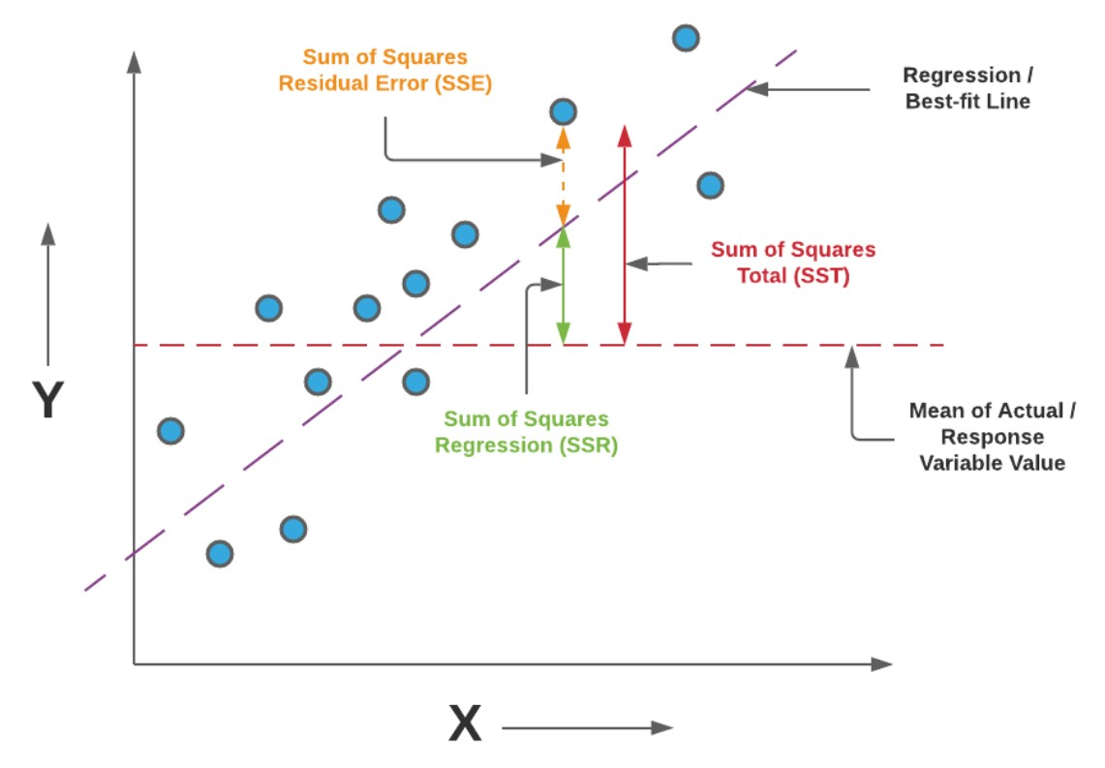
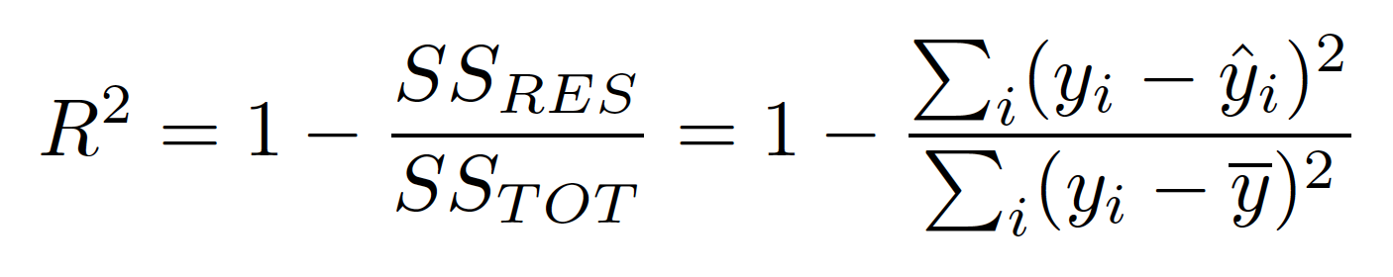
R-squared in Linear Regression

Slide 6
Article 3 Lebedeva-Nesevria, Natalia & Tsinker, Mihail. (2015). Methodical approaches and practice of the assessment of risk associated with impact of social and economic factors on the population health in the regions of Russia. Health Risk Analysis. 19-26. 10.21668/health.risk/2015.3.03.eng.
Methodical approaches and practice of the assessment of risk associated with impact of social and economic factors on the population health in the regions of Russia
Goal: The article proposes the algorithm and methods for assessing the risks of the population health deterioration associated with impact of social and economic factors at the macro level. The methods are tested on the materials under 78 entities of the Russian Federation for 2010–2013. The high level of risk in relation to indicators “infant mortality”, “morbidity with the blood circulatory system diseases” and “mortality of population from infectious and parasitic diseases” is established in a number of regions of the Russian Federation.
Methodology: The assessment of health risks associated with the impact of socio-economic factors on public health involves the following stages: hazard identification, dose-response assessment 3) exposure assessment, hazard characterization.
Results: Assessment of the health risk associated with socio-economic factors conducted with the use of the above method showed a high level of risk in terms of “infant mortality” in 8 re gions, “circulatory morbidity” – in 6 regions, andin terms of the indicator “mortality related to infectious and parasitic diseases” – in 1 region. In these these regions actions are needed to reduce socially-determined risk. The level of risk is aver-age in some regions which indicates the necessityof mitigation measures.
Article Link: https://www.researchgate.net/publication/360665409_A_Geo-Stratified_Analysis_of_Associations_Between_Socio-Economic_Factors_and_Diabetes_Risk
This Photo by Unknown author is licensed under CC BY-NC-ND.

Slide 7
Article 7 Jun Qi. 2021. Analysis on the Influencing Factors of College Students' Mental Health Based on Data Mining. In The 2nd International Conference on Computing and Data Science (CONF-CDS 2021). Association for Computing Machinery, New York, NY, USA, Article 112, 1–5.
Analysis on the Influencing Factors of College Students' Mental Health Based on Data Mining
Goal: This paper uses the method of association rules in data mining to analyze and research the psychological evaluation data of college students. Taking the psychological evaluation data of 2017 and 2018 college students in a university as the research object, the decision-making attributes of suspiciousness, depression, abnormal personality, and personal evaluation are respectively analyzed using Apriori algorithm. The association rules obtained from the experiment are further analyzed to find out the unfavorable factors affecting the mental health of college students.
Dataset:
Methodology:
Results:
Article Link: https://doi.org/10.1145/3448734.3450842
This Photo by Unknown author is licensed under CC BY-NC-ND.

Slide 8
Article 6 Chacha Chen, Junjie Liang, Fenglong Ma, Lucas Glass, Jimeng Sun, and Cao Xiao. 2021. UNITE: Uncertainty-based Health Risk Prediction Leveraging Multi-sourced Data. In Proceedings of the Web Conference 2021 (WWW '21). Association for Computing Machinery, New York, NY, USA, 217–226.
UNITE: Uncertainty-based Health Risk Prediction Leveraging Multi-sourced Data
Goal: To fill the gap, we propose UNcertaInTy-based health risk prediction (UNITE) model. Building upon an adaptive multimodal deep kernel and a stochastic variational inference module, UNITE provides accurate disease risk prediction and uncertainty estimation leveraging multi-sourced health data including EHR data, patient demographics, and public health data collected from the web.
Dataset:
Methodology:
Results:
Article Link: https://doi.org/10.1145/3442381.3450087
This Photo by Unknown author is licensed under CC BY-NC-ND.

Slide 9

Thank You

