Slide 1

Exploratory Data Analysis on Aspiring Mind Employment Outcomes
(AMEO) 2015 From AMCAT
Submitted by:
~Syed Huzaifa
Intern ID- IN9240378

Slide 2
About me
I am pursuing 3rd B.Tech in Artificial Intelligence and Data Science in Aditya college of engineering madanapalle (ACEM).
Passionate about AI, Machine Learning, and Data Science, with a focus on using data to solve real-world challenges.
Eager to work on innovative projects, participate in hackathons, and pursue internships to apply and expand my skills in AI and Data Science.
Experience
Previously, I completed an Data Science internship at InternX pvt ltd, where I gained practical experience in Python programming, data analysis, and machine learning, including a project on IPL data analysis that involved uncovering insights from complex datasets.
Linkedin: https://www.linkedin.com/in/syed-huzaifa-b4b64a27b/
Github: https://github.com/SyedHuzaifa12

Slide 3
Introduction
Objective Of The Project
Analyze the employment outcomes of engineering graduates based on Salary, Job Titles and Job Locations along with the standardized scores from three different areas - cognitive skills, technical skills and personality skills.
Summary Of The Data
The dataset was released by Aspiring Minds from the Aspiring Mind Employment Outcome 2015 (AMEO). The study is primarily limited only to students with engineering disciplines. The dataset contains the employment outcomes of engineering graduates as dependent variables (Salary, Job Titles, and Job Locations) along with the standardized scores from three different areas - cognitive skills, technical skills and personality skills.

Slide 4
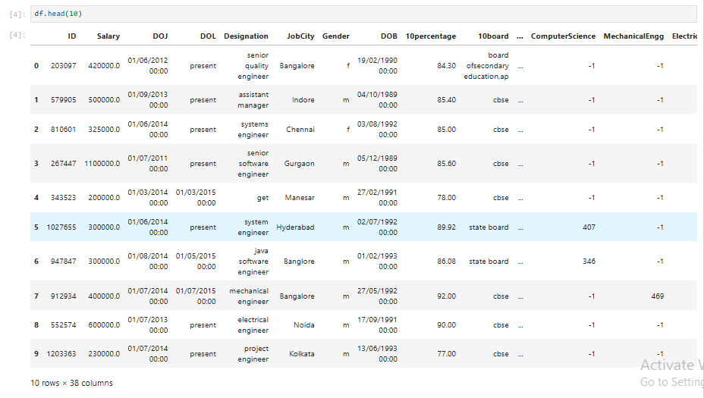
Dataset Overview
The Dataset consists of 3998 rows and 40 columns.
Including fields such as ID, Salary, Date of joining(DOJ), Date of Leaving(DOL), Designation, Job, City, Gender, Date of Birth(DOB), 10th and 12th Percentage, and many more.

Slide 5
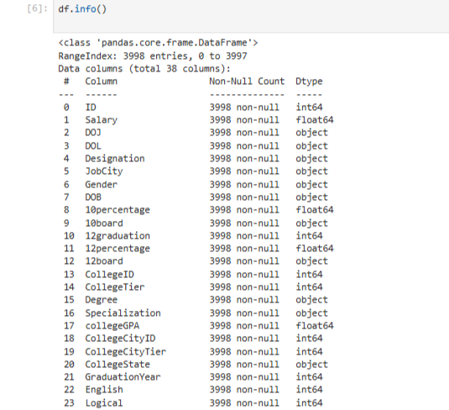
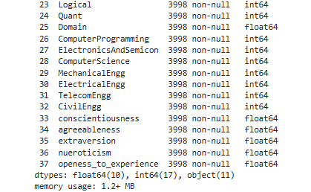
Data info

Slide 6
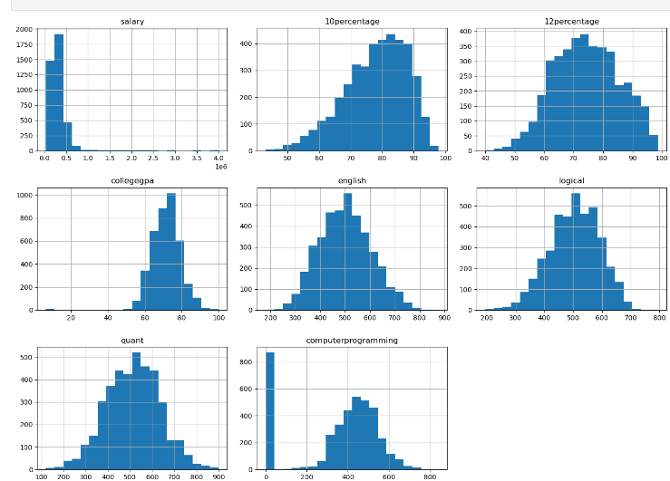
Univariate Analysis
Numerical columns- Histogram
We performed univariate analysis for numerical columns using histograms to visualize the distribution and identify patterns, trends, and outliers in the dataset.
The histograms help to summarize the distribution of each numerical variable, allowing us to assess skewness, concentration of values, and detect any potential anomalies in the data.

Slide 7
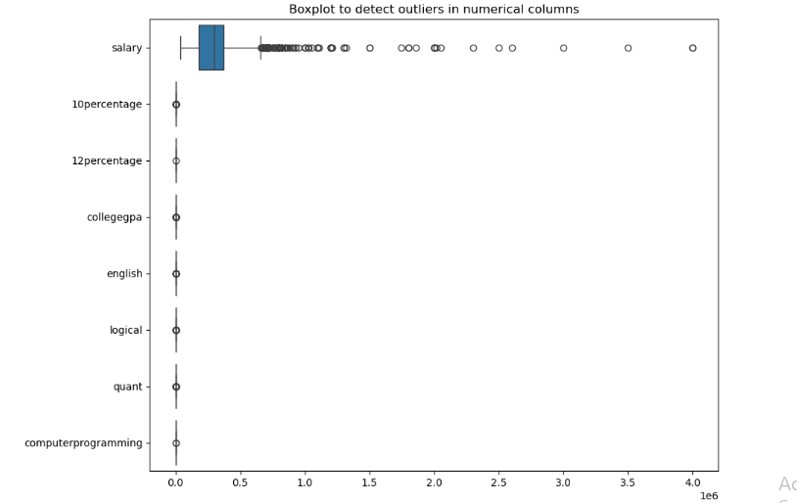
Univariate Analysis
Numerical columns- Box plot
The BoxPlot represents that the Salary feature has more outliers than all numerical columns and it has good Inter Quartile Range(IQR) than others.

Slide 8
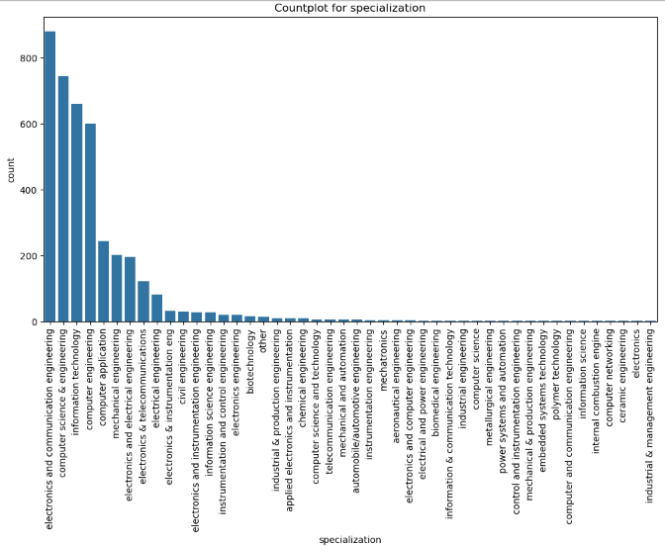
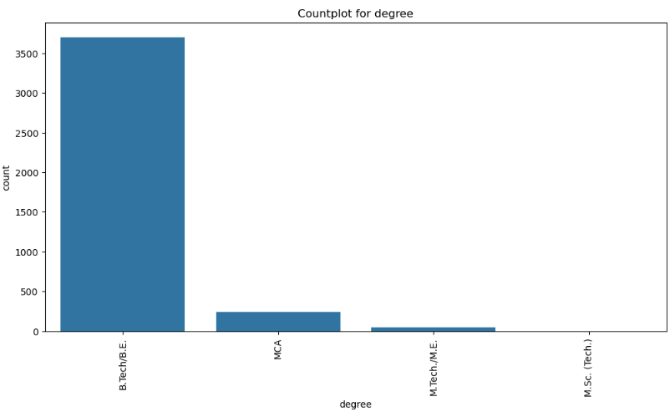
Univariate Analysis
Categorical columns - Count plot
The count plots describe that there are more B.Tech/B.E students as Degree holders than MCA, Mtech, Msc. And in Specialization stream ECE, CSE and Information technology are top 3 streams.

Slide 9
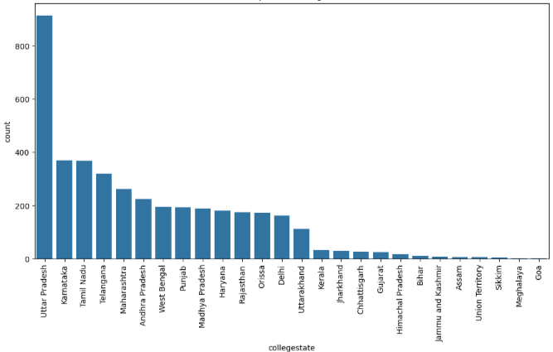
Univariate Analysis
Categorical columns - Count plot
This Count plot represents that there are huge no.of students from Uttar Pradesh Colleges than rest of all.

Slide 10
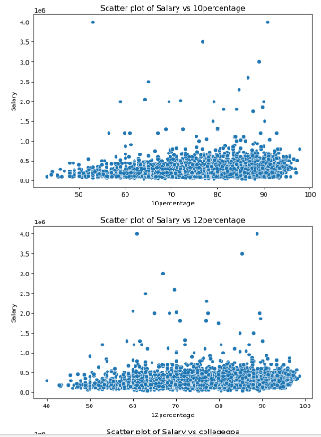
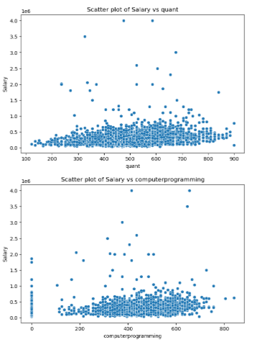
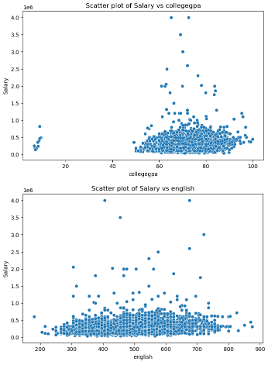
Bi-variate Analysis- Num vs Num (Scatter plot)
The Scatter plot represents how Salary feature is affecting on 10th , 12th percentage, CollegeCGPA, English, Logical, Quant and Computer programming.

Slide 11
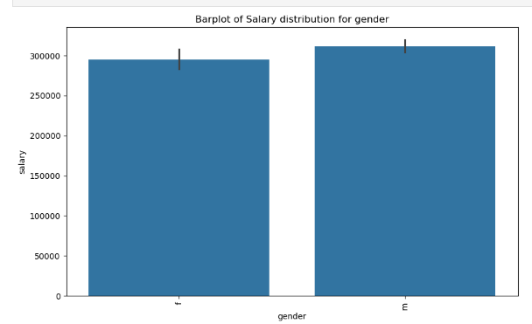
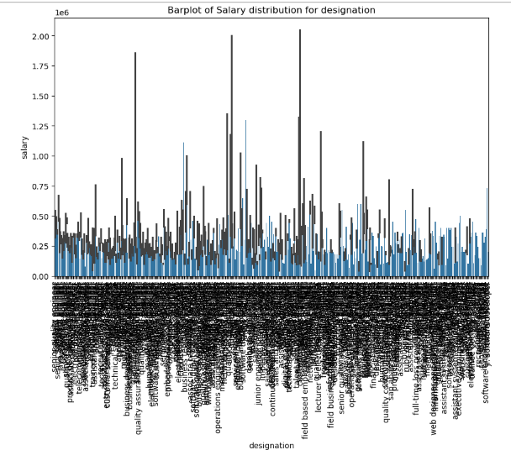
Bi-variate Analysis- Num vs Cat (Bar plot)
The 1st Bar plot represents that males a bit more salary than females.
The 2nd Bar plot represents that which job designation(role) has highest salary.

Slide 12
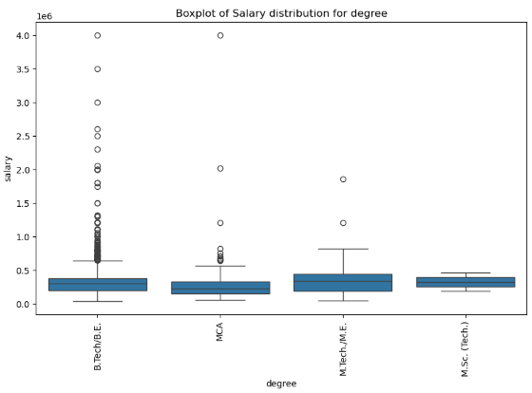
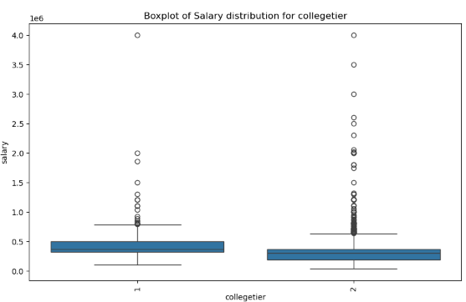
Bi-variate Analysis- Num vs Cat (Bar plot)
We performed bivariate analysis for num vs cat variables i.e; Salary feature vs college tier and Degree feature, from 1st bar plot we conclude that tier-1 colleges affect more on the salary whereas tier-2 has more outliers and from 2nd box plot we conclude that M.tech students have salary than other and B.tech variable has several outliers..

Slide 13
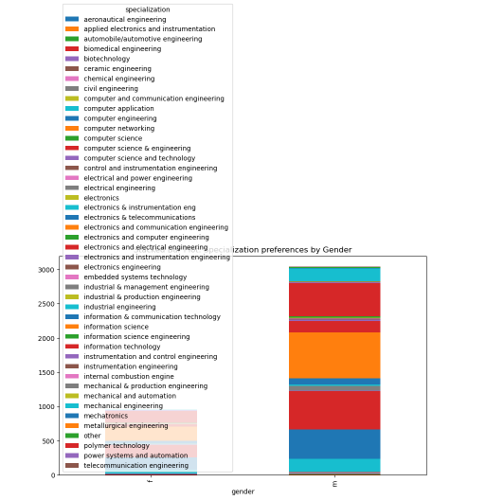
Bi-variate Analysis- Cat vs Cat (Stacked Bar plot)
We created a stacked bar plot to visualize the relationship between gender and specialization, highlighting how preferences for different specializations vary across male and female candidates.

Slide 14
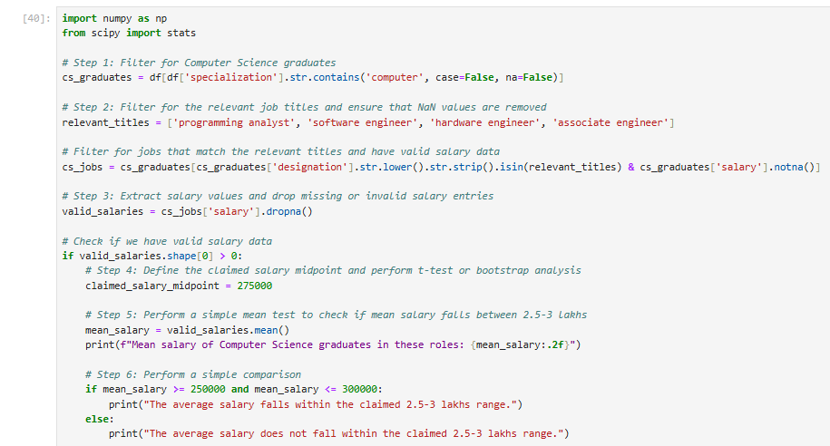
Research Questions-
Times of India article dated Jan 18, 2019 states that “After doing your Computer Science Engineering if you take up jobs as a Programming Analyst, Software Engineer, Hardware Engineer and Associate Engineer you can earn up to 2.5-3 lakhs as a fresh graduate.” Test this claim with the data given to you.

Slide 15
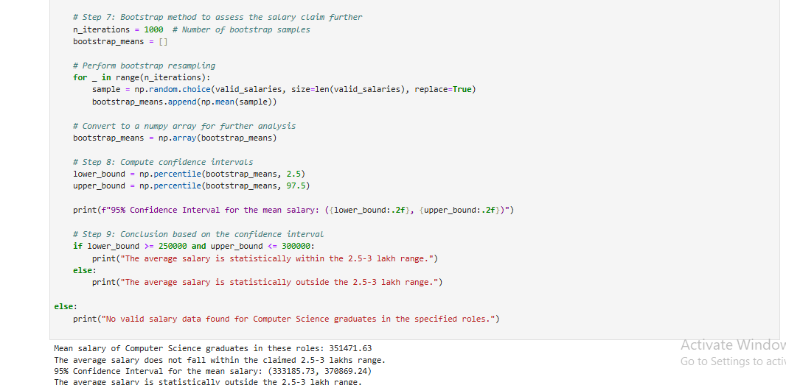
Yes, it is true that fresh graduates can earn upto 2.5-3 lakhs after doing graduation in Computer Science Engineering (cse), if they take up jobs as a Programming Analyst, Software Engineer, Hardware Engineer and Associate Engineer.

Slide 16
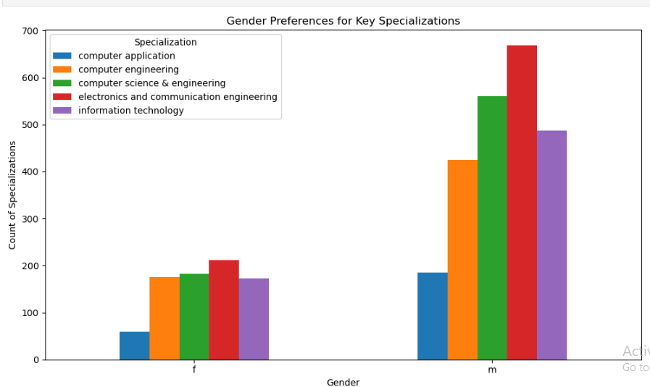
Research Questions
Is there a relationship between gender and specialization? (i.e. Does the preference of Specialisation depend on the Gender?)
By looking at plot we cam see males are doing more specialization than females.
Females are preferring less specialization, in some cases it is less than half the number of males.

Slide 17
Conclusion
Salary Distribution: Analyzed salary distribution, uncovering trends and variability across the dataset.
Claim Validation: Tested the claim about fresh graduate salaries (2.5-3 lakhs) for specific engineering roles.
Gender vs Specialization: Explored the relationship between gender and specialization, identifying potential gender-based preferences.
Insights on Data Trends: Provided insights into salary trends, specialization choices, and possible biases within the data.
Actionable Outcomes: The analysis offers data-driven guidance on addressing disparities in salaries and specializations.

Slide 18
“ANY QUESTIONS”

Slide 19

THANK YOU

