Slide 1
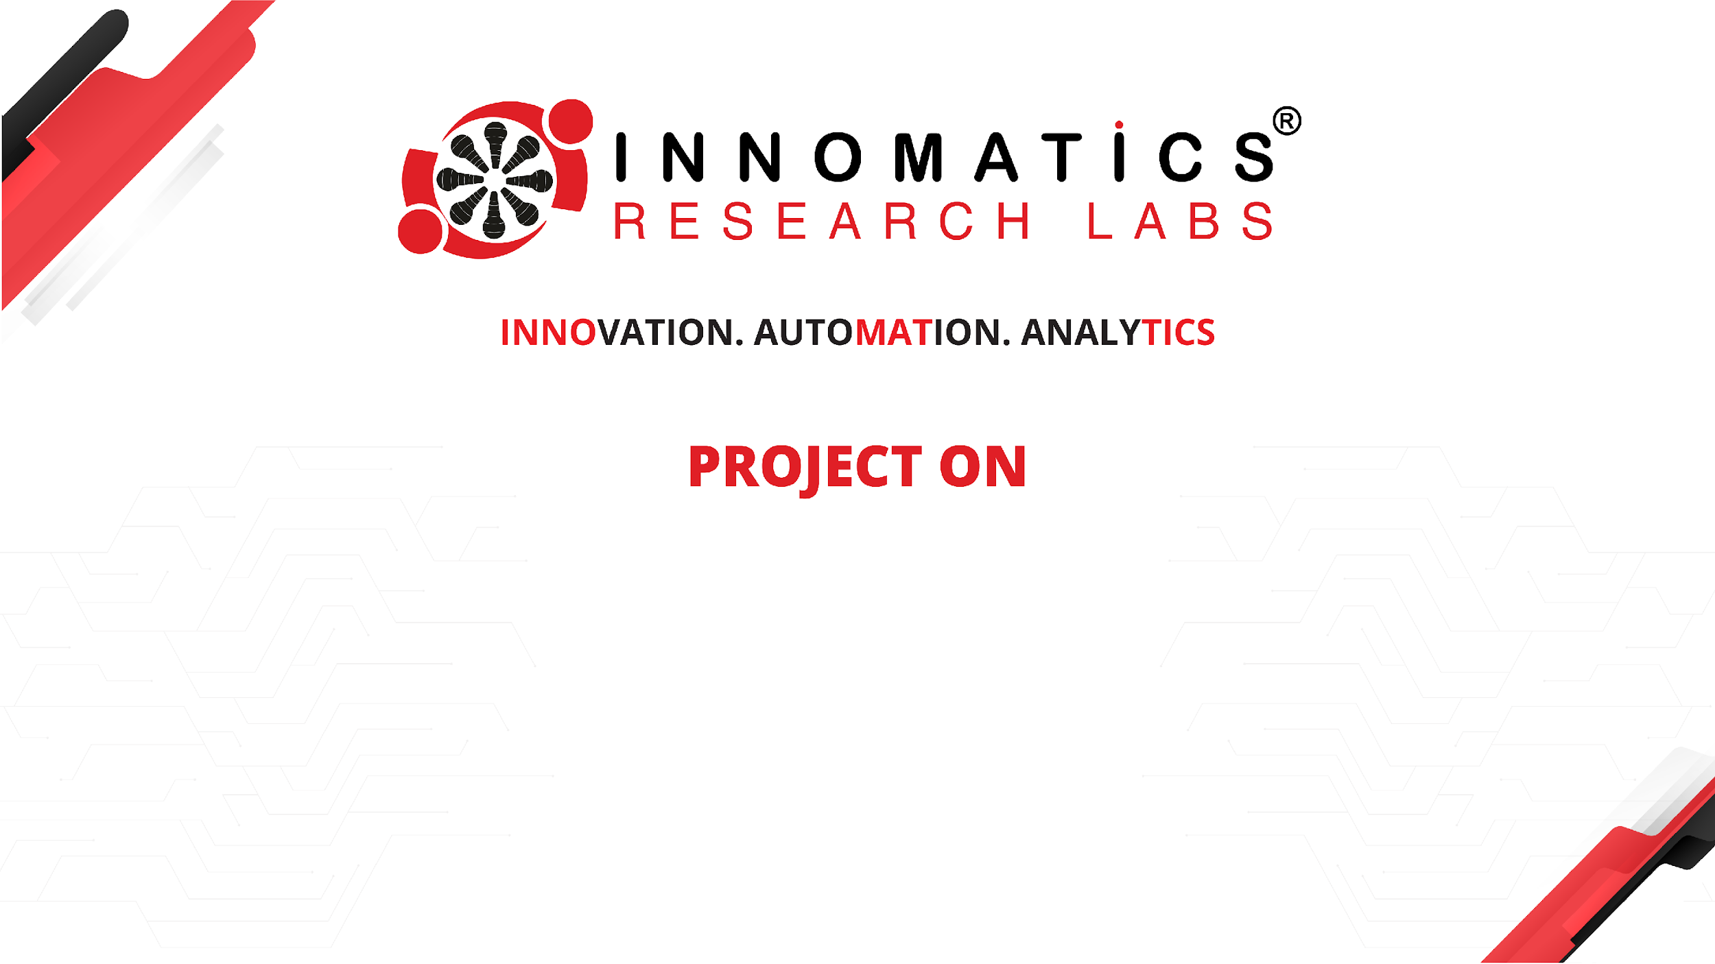
SmartVisionAI -> AI- Powered solution for visually impaired users
Name: Syed Huzaifa (InternID:IN9240378)
Date: 01-12-2024

Slide 2


About me
I am currently in pre-final year of my B.Tech in AI&Data Science.
Aspiring Data Scientist with expertise in AI, Machine Learning, NLP, and Generative AI, passionate about innovation and pushing the boundaries of AI research while leveraging data science techniques to build impactful, user-centric solutions.
I am currently an intern in Innomatics Research Labs, where I have been working on various data driven projects. Previously, I have done a internship in AI/ML
www.linkedin.com/in/syedhuzaifa34
www.github.com/SyedHuzaifa12

Slide 3
Project Documentation
1: Problem Statement
Title: The Challenge
Visually impaired individuals struggle to perceive and interact with their surroundings.
Challenges include:
Understanding their environment.
Reading visual content.
Performing sight-dependent tasks.

Slide 4
2: Project Overview
Title: SmartVisionAI - The Solution
AI-powered application designed for accessibility.
Combines advanced technologies to:
Provide real-time scene understanding
Offer text-to-speech conversion.
Detect objects and obstacles.
Deliver personalized assistance.

Slide 5
3: Features
Title: Key Features
📸Describe Scene: Provides detailed image descriptions.
📝Extract Text: Extracts text using OCR.
🔊Text-to-Speech: Converts text to audio output.
🔍Object Detection: Identify objects in image for safe navigation.
💬 Personalized Assistance: Provides context-specific information.

Slide 6
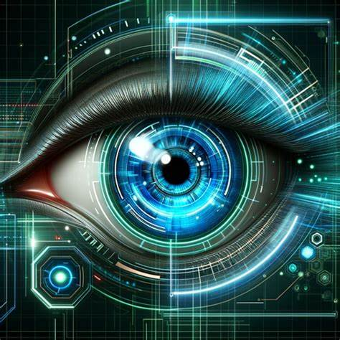
Scene Description Feature
Users can generate a detailed description of the image.
The system uses the Google Gemini API to analyze the image and generate the description.
The description includes items detected, their purpose, and overall image details.

Slide 7
4: Technologies Used
Title: Technology Stack
Google Generative AI: Scene description and insights.
Langchain: API integration and object detection.
Tesseract OCR: Text recognition from images.
Pyttsx3: Text to speech engine
Streamlit: Interactive user interface.

Slide 8
Technologies Used
Tesseract OCR: For text extraction from images.
Google Gemini API: For generating scene descriptions.
pyttsx3: For converting text to speech.
Streamlit: For building the web interface.
Langchain : To integrate API key .

Slide 9
5: Implementation
Title: How It Works
Select a feature among 4 features.
Users upload an image (JPG, JPEG, PNG).
AI processes the image to extract features (scene description, text, objects).
Outputs include descriptions, text read aloud, and highlighted objects.

Slide 10
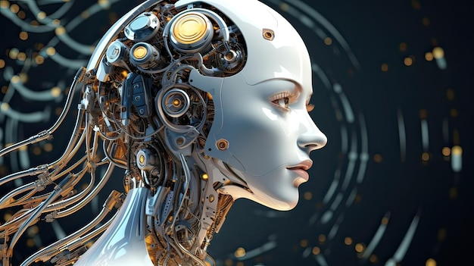
Upload Image Section
Users can drag and drop or browse images (JPG, JPEG, PNG).
Once uploaded, the image is displayed on the interface.

Slide 11
6: Results
Title: Outputs and Demonstration
Accurate scene descriptions for uploaded images.
Seamless text-to-speech conversion for accessibility.
Clear detection of objects and obstacles.

Slide 12
7: Impact
Title: Why It Matters
Empowers visually impaired individuals.
Simplifies daily activities like reading and navigation.
Promotes inclusivity through technology
8: Future Enhancements
Add multilingual support for text-to-speech.
Integrate real-time camera feed for live assistance.
Expand to wearable devices for portability.

Slide 13
9: Conclusion
SmartVisionAI helps visually impaired individuals interact with the world using AI-driven technologies.
Future enhancements can include multi-language support, faster processing, and deeper integrations with accessibility tools.
Allows a downloadable option in each task.
A step towards an inclusive future powered by AI

Slide 14

THANK YOU

