Slide 1
SMARTUPIFRAUDDETECT: AN INTELLIGENT ML-BASED SYSTEM FOR IDENTIFYING ANOMALIES IN UPI PAYMENT NETWORKS

Slide 2
Abstract:
With the rapid growth of digital payments, the Unified Payments Interface (UPI) has become a popular and convenient method for financial transactions in India. However, this widespread adoption has also led to a significant rise in fraudulent activities within the payment ecosystem. This project introduces SMARTUPIFRAUDDETECT, a machine learning-powered system designed to detect suspicious patterns and flag potentially fraudulent UPI transactions. The system analyzes key transaction features such as amount, frequency, transaction type, and user behavior to identify anomalies that deviate from normal financial activities. A user-friendly web application built using the Django framework enables seamless interaction, allowing stakeholders to upload transaction data, view flagged cases, and understand risk patterns through intuitive visualizations. By enhancing the transparency and security of UPI payments, this system serves as a valuable tool in safeguarding digital financial infrastructure.

Slide 3
Existing System:
Credit card fraud is a severe issue that causes significant losses for both cardholders and issuing banks. Existing methods utilize machine learning-based classifiers to identify fraudulent transactions from labeled transaction records. However, labeled data are often scarce compared to the billions of real transactions due to the high cost of annotation, which means that previous methods do not fully utilize the rich features of unlabeled data. What’s more, contemporary methods succumb to a fallacy of unawareness of the local risk structure and the inability to capture certain risk patterns. Therefore, we propose the Risk-aware Gated Temporal Attention Network (RGTAN) for fraud detection in this work. Specifically, we first build a temporal transaction graph based on the transaction records, which consists of temporal transactions (nodes) and their interactions (edges). Then we leverage a Gated Temporal Graph Attention (GTGA) Mechanism to propagate messages among the nodes and learn adaptive representations of transactions. We also model the fraud patterns through risk propagation, taking advantage of the relations among transactions. More importantly, we devise a neighbor risk-aware representation learning layer to enhance our method’s perception of multi-hop risk structures. We conduct extensive experiments on a real-world credit card transaction dataset and two public fraud detection datasets. The results show that our proposed method, RGTAN, outperforms other state-of-the-art methods on three fraud detection datasets. The risk-aware semi-supervised experiments also demonstrate the excellent performance of our model with only a small fraction of manually labeled data. Moreover, RGTAN has been deployed in a world-leading credit card issuer for credit card fraud detection, and the case study results show the effectiveness of our method in uncovering real-world fraud patterns.

Slide 4
DEMERITS:
Requires complex graph-based modeling, increasing system implementation and maintenance effort.
Depends on temporal graph construction, which may not scale efficiently with massive transaction volumes.
Still needs some labeled data, limiting performance in completely unlabeled or new domains.
Gated Temporal Attention mechanisms add computational overhead during training and inference.
Local risk structure modeling may lead to false positives in highly dynamic or diverse transaction environments.

Slide 5
Proposed System:
The proposed system, SMARTUPIFRAUDDETECT, aims to enhance the security of UPI payment networks by identifying anomalous and potentially fraudulent transactions using machine learning techniques. The system processes transaction data to uncover suspicious patterns based on behavioral and contextual features such as transaction amount, frequency, recipient diversity, and time of transaction. A core component of the system is a trained machine learning model capable of distinguishing normal transactions from outliers. The model is integrated into a Django-based web application, allowing users to upload transaction datasets, analyze results, and visualize detected anomalies through interactive dashboards. The system continuously learns from new data to improve its anomaly detection capabilities. By providing a robust and intelligent analysis platform, SMARTUPIFRAUDDETECT supports early fraud detection and strengthens trust in digital financial systems.

Slide 6
Advantages:
Enhances detection of suspicious UPI transactions using intelligent pattern analysis.
Continuously improves performance through machine learning-based learning from new data.
Provides a user-friendly Django web interface for seamless interaction and result visualization.
Supports better decision-making for stakeholders through clear insights into transaction behavior.

Slide 7
LITERATURE REVIEW:
Title : Fraud Detection using Machine Learning
Author: Aditya Oza
Year : 2021
Recent research has shown that machine learning techniques have been applied very effectively to the problem of payments related fraud detection. Such ML based techniques have the potential to evolve and detect previously unseen patterns of fraud. In this paper, we apply multiple ML techniques based on Logistic regression and Support Vector Machine to the problem of payments fraud detection using a labeled dataset containing payment transactions. We show that our proposed approaches are able to detect fraud transactions with high accuracy and reasonably low number of false positives.

Slide 8
LITERATURE REVIEW:
Title : Deep Learning for Credit Card Fraud Detection: A Review of Algorithms, Challenges, and Solutions
Author: IBOMOIYE DOMOR MIENYE
Year : 2024
Deep learning (DL), a branch of machine learning (ML), is the core technology in today’s technological advancements and innovations. Deep learning-based approaches are the state-of-the-art methods used to analyse and detect complex patterns in large datasets, such as credit card transactions. However, most credit card fraud models in the literature are based on traditional ML algorithms, and recently, there has been a rise in applications based on deep learning techniques. This study reviews the recent DL-based literature and presents a concise description and performance comparison of the widely used DL techniques, including convolutional neural network (CNN), simple recurrent neural network (RNN), long short-term memory (LSTM), and gated recurrent unit (GRU). Additionally, an attempt is made to discuss suitable performance metrics, common challenges encountered when training credit card fraud models using DL architectures and potential solutions, which are lacking in previous studies and would benefit deep learning researchers and practitioners. Meanwhile, the experimental results and analysis using a real-world dataset indicate the robustness of the deep learning architectures in credit card fraud detection.

Slide 9
LITERATURE REVIEW:
Title : Review Paper on UPI Fraud Detection Using Machine Learning
Author: Miss. Sayalee S.
Year : 2023
With the rapid growth of digital transactions, the Unified Payments Interface (UPI) has emerged as a popular and convenient method for financial transactions in the modern era. However, the increasing reliance on digital platforms has also led to a rise in fraudulent activities. This paper proposes a robust UPI fraud detection system employing advanced machine learning techniques to enhance the security of digital transactions. The proposed system leverages a diverse set of features, including transactional patterns, user behaviour, and device information, to create a comprehensive model for fraud detection. Machine learning algorithms, such as supervised learning classifiers and anomaly detection techniques, are employed to analyse historical transaction data and identify patterns indicative of fraudulent activities. The model is trained on a labelled dataset that includes both genuine and fraudulent transactions, ensuring its ability to distinguish between normal and suspicious behaviour

Slide 10
LITERATURE REVIEW:
Title : Online Payment Fraud Detection using Machine Learning Techniques.
Author: Taranjyot Singh Chawla
Year : 2022
When it comes to the simplicity of making a payment while sitting anywhere in the world, online payments have been a source of attractiveness. Over the past few decades, there has been an increase in online payments. E-payments enable businesses earn a lot of money in addition to consumers. However, because electronic payments are so simple, there is also a risk of fraud associated with them. A consumer must ensure that the payment he is paying is going exclusively to the appropriate service provider. Online fraud exposes users to the possibility of their data being compromised, as well as the inconvenience of having to report the fraud, block their payment method, and other things. When businesses are involved, it causes some issues; occasionally, they must issue refunds in order to keep customers. Therefore, it is crucial that both consumers and businesses are aware of these internet scams. A model to determine if an online payment is fraudulent or not is put forth in this study. To determine if a certain Online payment is fraudulent or not, some features like the type of payment, the recipient’s identity, etc. would be taken into account.

Slide 11
LITERATURE REVIEW:
Title : Implementation Paper on UPI Fraud Detection using Machine Learning
Author: Miss. Sayalee S. Bodade,
Year : 2024
The UPI fraud detection system are to enhance the security and reliability of digital payment transactions, ultimately safeguarding users from fraudulent activities. Firstly, the paper aims to employ advanced machine learning algorithms and data analytics to analyze transaction patterns and detect anomalies that may indicate potential fraud. Secondly, it seeks to develop a robust system that can identify and mitigate various types of UPI fraud, including phishing, identity theft, and unauthorized transactions. The paper also aims to create a real-time monitoring mechanism to promptly identify suspicious activities and trigger alerts for immediate intervention. The scope of developing a UPI fraud detection system is vast and holds significant potential in addressing the emerging challenges in the digital payment landscape. Firstly, the paper encompasses the implementation of cutting-edge technologies such as machine learning, artificial intelligence, and data analytics to create a sophisticated fraud detection model. This model will have the capability to analyze massive datasets of UPI transactions in real-time, identifying patterns, anomalies, and trends associated with fraudulent activities.

Slide 12
SYSTEM STUDY:
Aim:
The aim of the UPI transaction fraud prediction project is to develop a robust machine learning model capable of identifying fraudulent transactions based on various transaction features. The data preprocessing involves handling missing values, encoding categorical variables, and scaling numerical data to ensure optimal model performance. Data visualization techniques like histograms, box plots, and correlation matrices will be employed to uncover patterns and relationships in the data. Various algorithms, will be compared to select the best model based on accuracy metrics.
Objectives:
1. To develop a machine learning model that predicts UPI transaction fraud with high accuracy by analyzing transaction data patterns.
2. To identify key transaction features that contribute to fraud, enhancing the model's interpretability and performance.
3. To build a scalable system that can provide real-time fraud detection and alerts for UPI transactions.

Slide 13
SCOPE
The scope of the project "UPI Transaction Fraud Predictions with Advanced Machine Learning" focuses on leveraging machine learning techniques to detect and predict fraudulent activities in UPI (Unified Payments Interface) transactions. This project aims to analyze transaction data in real-time, identifying patterns and anomalies that indicate potential fraud. By utilizing advanced machine learning algorithms such as decision trees, random forests, support vector machines (SVM), or deep learning models, the system will classify transactions as legitimate or suspicious. The project will involve data preprocessing, feature engineering, and the development of an efficient fraud detection model capable of handling large-scale transaction datasets with high accuracy. Additionally, the system will incorporate various factors such as transaction amount, time, location, user behavior, and device information to build robust predictive models. The goal is to enhance the security and reliability of UPI transactions by minimizing the risks associated with fraudulent activities, providing a alert system for both users and financial institutions.

Slide 14
LIST OF MODULES:
Data Pre-processing
Data Analysis of Visualization
Linear Regression Algorithm
Naïve Bayes Algorithm
Decisoin Tree Algorithm
RFC Algorithm
Deployment

Slide 15
Environmental Requirements:
1. Software Requirements:
Operating System : Windows
Tool : Anaconda with Jupyter Notebook
2. Hardware requirements:
Processor : Intel® Core™ i7 processor 14650HX (30M Cache, up to 5.20 GHz)
Hard disk : minimum 80 GB
RAM : minimum 4 GB

Slide 16
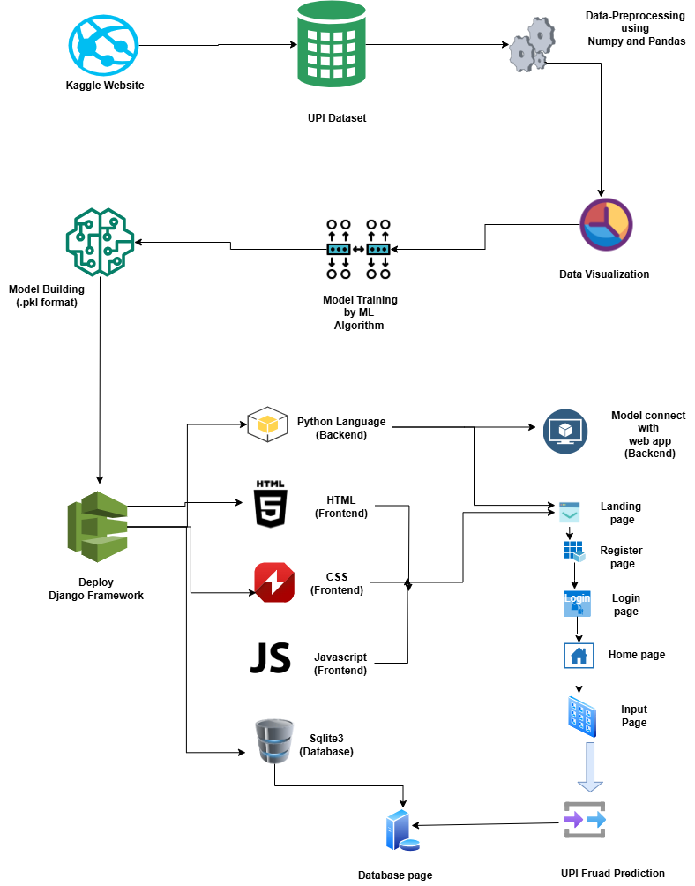
System Architecture:

Slide 17
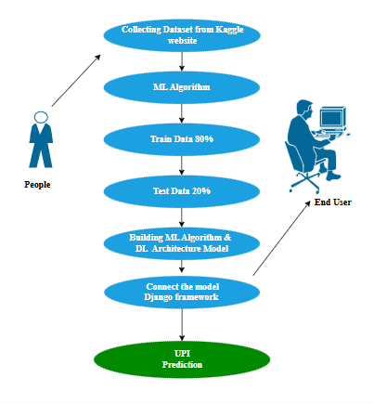
Use Case Diagram:

Slide 18
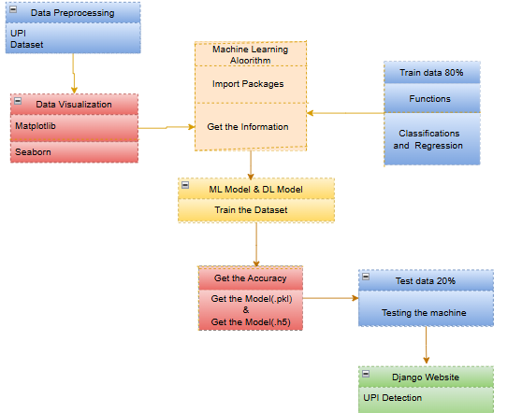
Class Diagram:

Slide 19
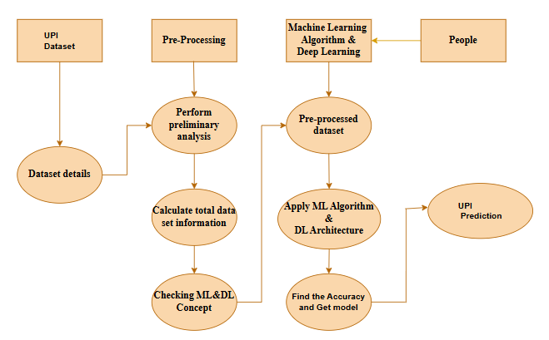
Activity Diagram:

Slide 20
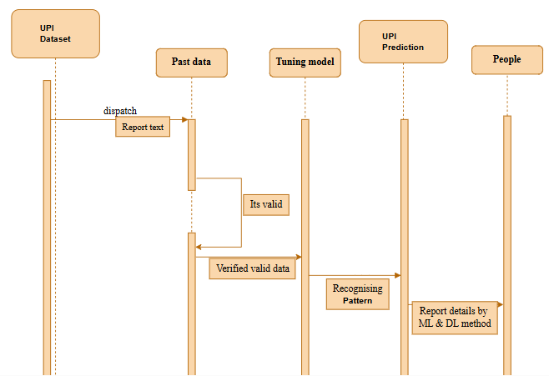
Sequence Diagram:

Slide 21
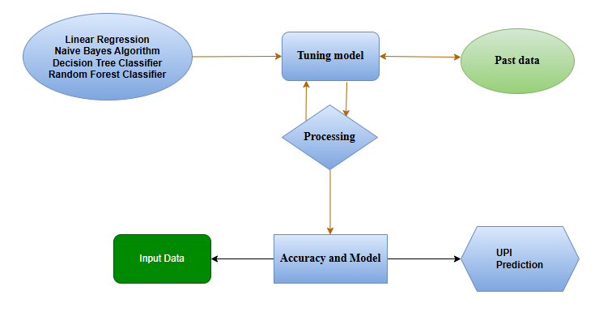
Entity Relationship Diagram (ERD)

Slide 22
MODULE DESCRIPTION:
Data Pre-processing:
Validation techniques in machine learning are used to get the error rate of the Machine Learning (ML) model, which can be considered as close to the true error rate of the dataset. If the data volume is large enough to be representative of the population, you may not need the validation techniques. However, in real-world scenarios, to work with samples of data that may not be a true representative of the population of given dataset. To finding the missing value, duplicate value and description of data type whether it is float variable or integer. The sample of data used to provide an unbiased evaluation of a model fit on the training dataset while tuning model hyper parameters.

Slide 23
Exploration Data Analysis of Visualization
Data visualization is an important skill in applied statistics and machine learning. Statistics does indeed focus on quantitative descriptions and estimations of data. Data visualization provides an important suite of tools for gaining a qualitative understanding. This can be helpful when exploring and getting to know a dataset and can help with identifying patterns, corrupt data, outliers, and much more. With a little domain knowledge, data visualizations can be used to express and demonstrate key relationships in plots and charts that are more visceral and stakeholders than measures of association or significance. Data visualization and exploratory data analysis are whole fields themselves and it will recommend a deeper dive into some the books mentioned at the end.

Slide 24
LINEAR REGRESSION:
Linear Regression is a fundamental machine learning algorithm used for predicting a continuous dependent variable based on one or more independent variables. It assumes a linear relationship between the input variables (features) and the output variable (target). The model fits a linear equation to the data, which can be represented as \( y = \beta_0 + \beta_1x_1 + \beta_2x_2 + \dots + \beta_nx_n \), where \( y \) is the predicted value, \( \beta_0 \) is the intercept, and \( \beta_1, \beta_2, \dots, \beta_n \) are the coefficients for each feature \( x_1, x_2, \dots, x_n \).

Slide 25
NAÏVE BAYES CLASSIFIER ALGORITHM:
The Naive Bayes Classifier is a probabilistic machine learning algorithm based on Bayes' Theorem, which is used for classification tasks. It assumes that the features used for classification are conditionally independent of each other, given the class label, which is why it is called "naive." Despite this simplifying assumption, it often performs surprisingly well in various real-world applications, especially when dealing with large datasets.
The algorithm works by calculating the conditional probability of each class given the input features. For each class, it multiplies the probability of the features occurring in that class and assigns the class with the highest probability as the predicted label. This process is based on Bayes' Theorem, which states that the probability of a class given the data is proportional to the probability of the data given the class multiplied by the prior probability of the class.

Slide 26
DECISION TREE CLASSIFIER
The Decision Tree Classifier is a supervised machine learning algorithm used for both classification and regression tasks. It works by recursively partitioning the feature space into distinct regions and making predictions based on majority class labels for classification tasks or the average value for regression. The model splits the data at each node using a feature that best separates the data, often by selecting the feature that maximizes information gain or minimizes impurity (e.g., Gini index or entropy in classification). These splits continue until a stopping criterion is met, such as a node reaching a predefined depth or the data being homogeneous within a node.
The main strength of Decision Trees lies in their simplicity and interpretability. The model can be visualized as a tree structure, with each internal node representing a feature, each branch representing a decision rule, and each leaf node representing the predicted outcome. This makes it easy for users to understand how decisions are made and why certain predictions are reached. Additionally, Decision Trees handle both numerical and categorical data well and do not require extensive data preprocessing like feature scaling.

Slide 27
RANDOM FOREST CLASSIFIER ALGORITHM:
Random Forest is an ensemble learning algorithm that can be used for both classification and regression tasks. It builds multiple decision trees and merges them together to get a more accurate and stable prediction.
Here's a step-by-step explanation of how Random Forest works:
Bootstrapping:
Random Forest starts by creating multiple subsets of the original dataset through a process called bootstrapping. This involves randomly sampling the data with replacement, creating new datasets of the same size as the original.

Slide 28
Django (Web FrameWork) :
Django is an extremely popular and fully featured server-side web framework, written in Python. This module shows you why Django is one of the most popular web server frameworks, how to set up a development environment, and how to start using it to create your own web applications. In this first Django article we answer the question "What is Django?" and give you an overview of what makes this web framework special. We'll outline the main features, including some advanced functionality that we won't have time to cover in detail in this module.

Slide 29
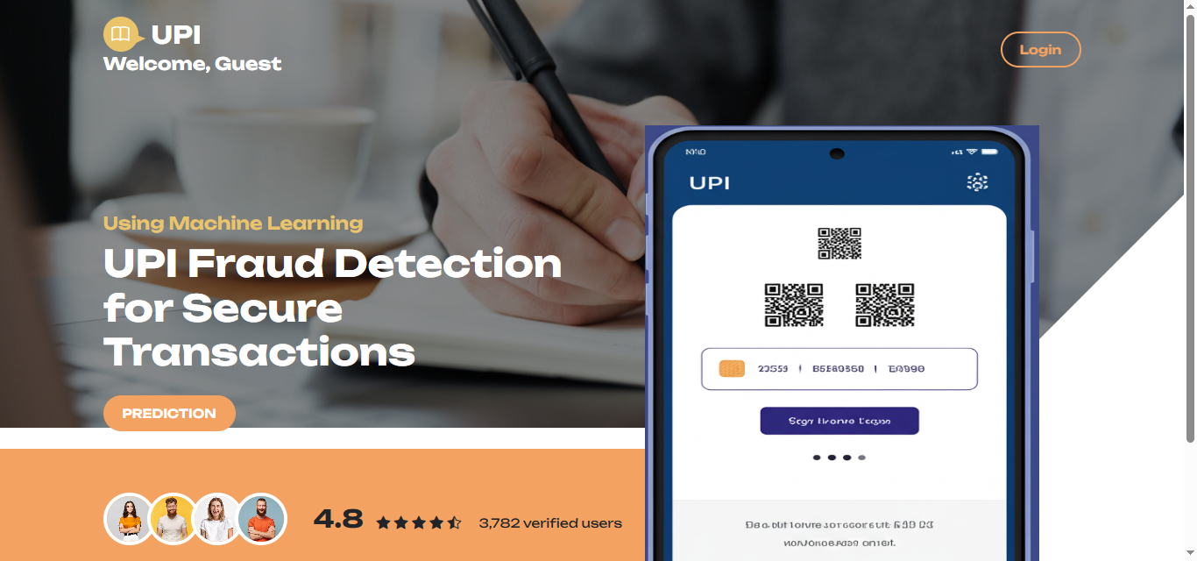
LANDING PAGE

Slide 30
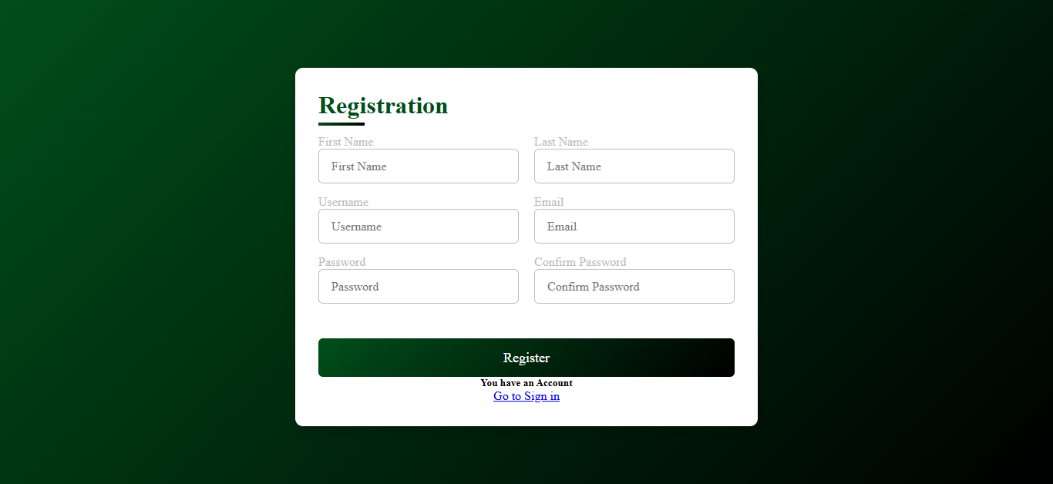
REGISTER

Slide 31

LOGIN

Slide 32

HOME

Slide 33
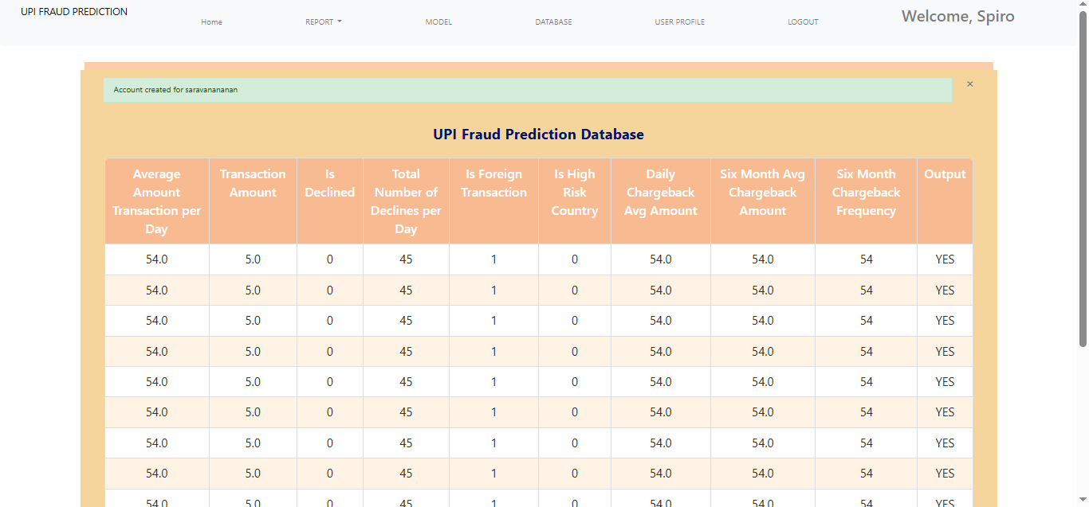
DATABASE

Slide 34
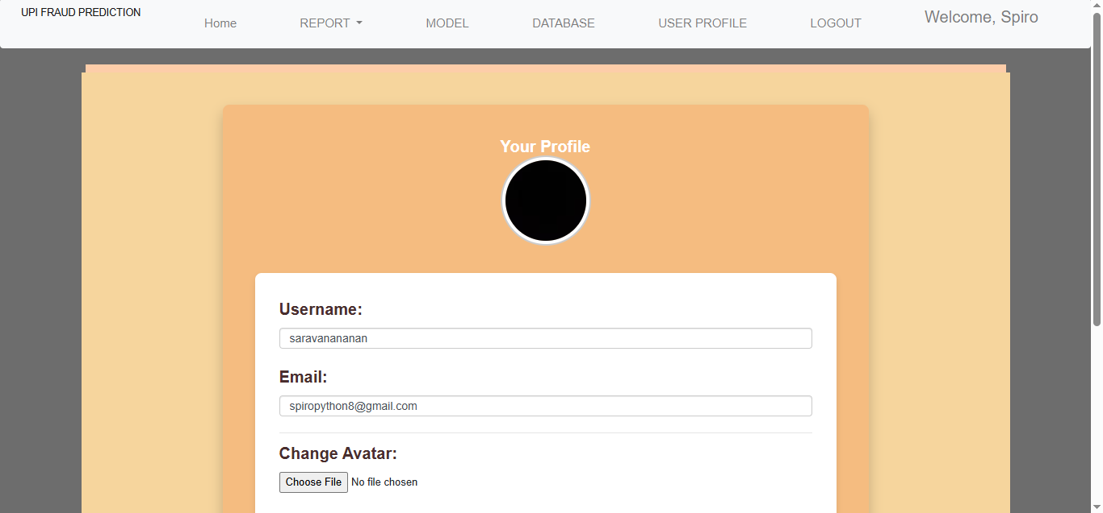
PROFILE

Slide 35
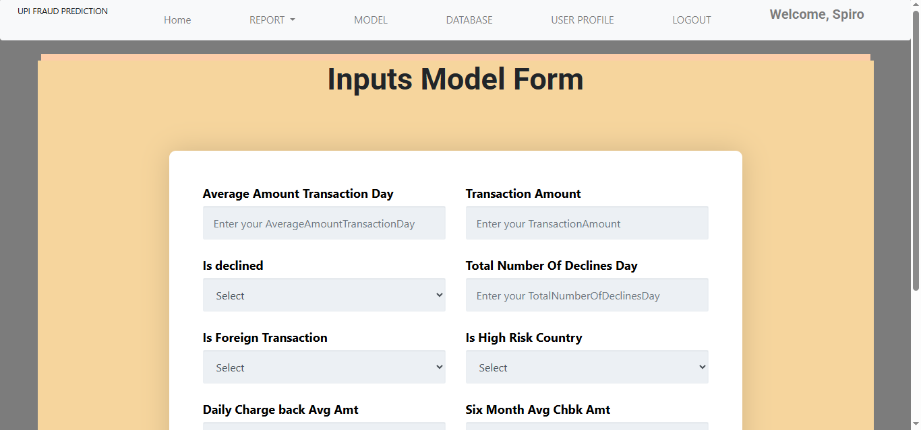
PREDICTION

Slide 36
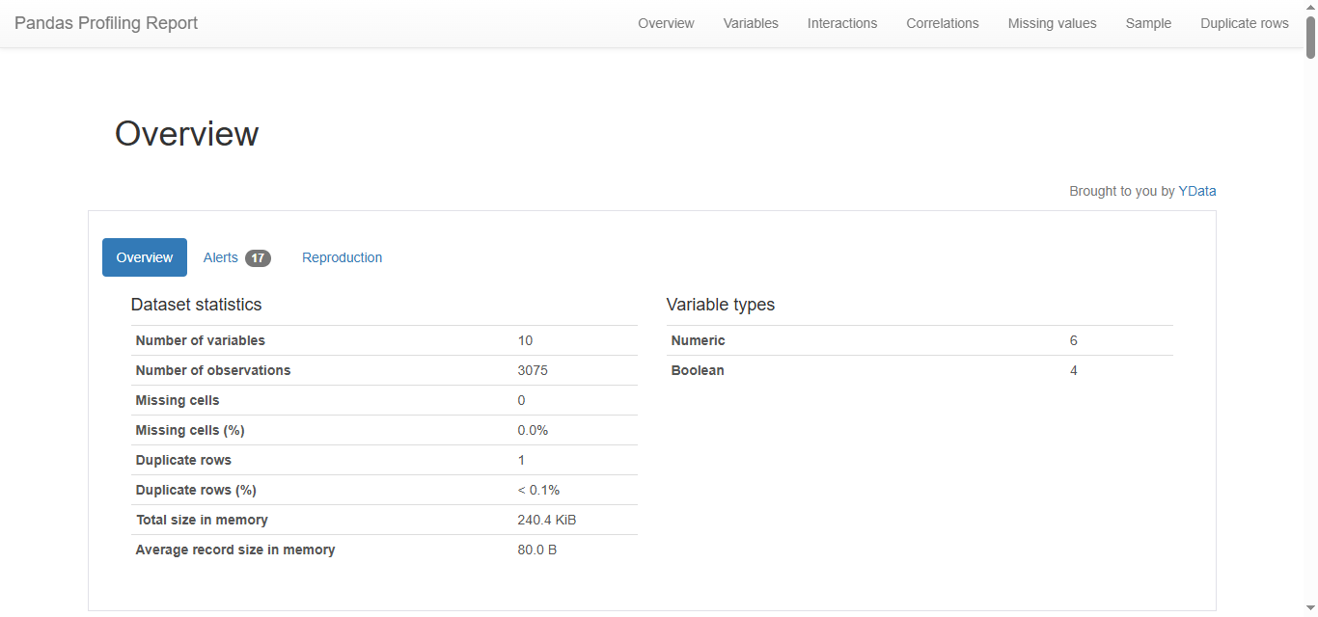
REPORT

Slide 37
Conclusion:
Predictive analytics for Hepatitis C represents a significant advancement in enhancing patient care through data science techniques. By leveraging sophisticated machine learning algorithms and statistical models, healthcare professionals can gain invaluable insights into patient outcomes, treatment responses, and disease progression. These insights enable more accurate risk assessments, personalized treatment plans, and proactive management strategies. As a result, predictive analytics facilitates timely interventions, potentially improving overall treatment efficacy and patient quality of life. The integration of these data-driven approaches not only streamlines clinical workflows but also empowers healthcare providers with the tools needed to make informed decisions, ultimately contributing to more effective and individualized patient care.

Slide 38
Future Work:
Prediction methods to connect with cloud model.
To optimize the work to implement in IOT System.

