Slide 1
CHAPTER:1 INTRODUCTION TO BIOPSYCHOLOGY
BSc Psychology 1st year BATCH – 2026-29
Semester-1

Slide 2
Definition of Biopsychology
Biological psychology is the study of the physiological, evolutionary, and developmental mechanisms of behavior and experience. It studies how biological processes influence behavior, thoughts, and emotions. The term “biological psychology” emphasizes that the goal is to relate biology to issues of psychology.

Slide 3
Biological Explanations of Behaviour
Physiological
Ontogenetic
Relates an activity to how the brain and other organ's function, even at cellular and chemical levels.
How does the behaviour work?
The term “ontogenetic” – Greek word, meaning “origin”. This describes how a behavior develops. It traces how genes combine with the influence of the environment to produce a behavior.
How did the behaviour develop in this individual?
Evolutionary
Functional
Relates a behavior to the evolutionary history of a species.
How did the behaviour evolve in the species?
Describes why a behaviour evolve as it did.
Why is the behaviour useful?

Slide 4

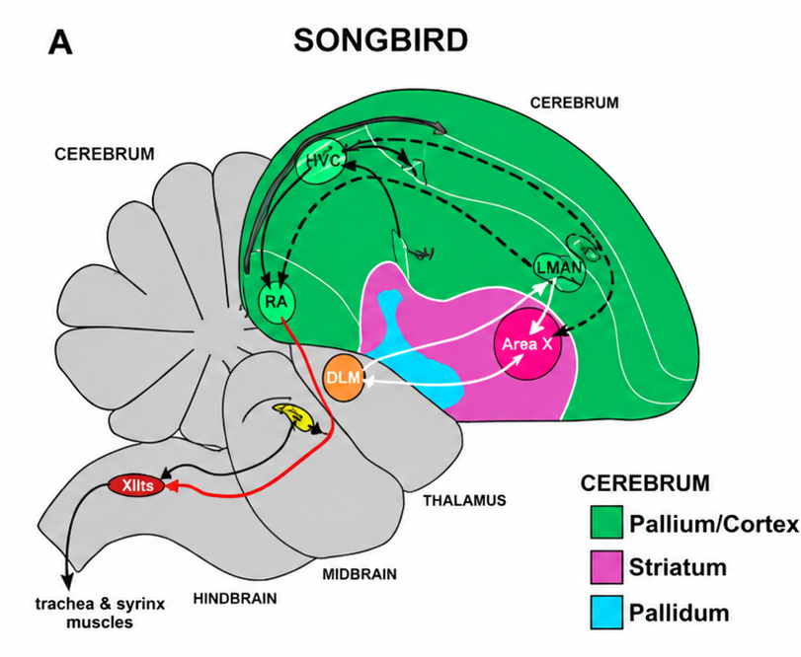
Example: Birdsong
Why do birds sing? → Not all birds sing.
Among songbirds, adult males generally do most of the singing, while females and immature males may sing less or not at all
Adult males sing vigorously in spring and early summer (mating season) while during fall and winter they become silent or sing occasionally.
PHYSIOLOGICAL EXPLANATION OF BIRDSONG
2 brain areas responsible for learning and production of singing behaviour in songbirds
  Caudal nucleus of hyperstriatum ventral
  Robust nucleus of archistriatum
These areas are well developed in songbirds and are larger in size in males.
Size of these brain areas depends on testosterone which is generally higher in levels in males.
At the start of the breeding season, testosterone levels rise in males, causing the brain areas responsible for birdsong to increase in size.
What if the testes are surgically removed from a male song bird? - testosterone levels drops → size of the relevant brain area decreases → stops singing.

Slide 5
Example: Birdsong (Cont.)
What happens if large amounts of testosterone is injected into a female? – relevant brain areas grow in size → female songbirds start singing. This indicates that both size of the brain areas and the ability to sing depends on testosterone and not being a genetic male.
What happens if song control brain areas are damaged in male and female songbirds? – the ability to sing gets disrupted in males, whereas in females, damage cannot decrease her singing because she did not sing even with an intact brain. Effect of her behaviour is that she no longer recognizes the song of her species.
ONTOGENETIC EXPLANATION OF BIRDSONG
How does songbirds know what to sing? – They learn songs by listening to others of its species during a sensitive period early in life.
Sensitive period varies from species to species. Eg: In song sparrows, sensitive period lasts from about the age 20 days to about 60 days. Exposure to songs or recordings before age of 20 days or after 60 days has little effect.
How does male sparrow learn a song? – Through listening to the song of its species for a certain period of time, male sparrows set a template of what their song should sound like. Later, when testosterone levels are high enough to enable them to sing, they engage in apparent trial-and-error process to match their own song to the template.
What about female song sparrows? – In nature, females do not sing, but they do learn their song so that they would be able to recognize whether a singing male belongs to their own species.

Slide 6
Example: Birdsong (Cont.)
EVOLUTIONARY EXPLANATION OF BIRDSONG
Through natural selection, each species evolves adaptations that distinguishes it from other species.
Because such changes are slow and gradual, we can see in each species certain remnant characteristics of its ancestors.
Eg: Certain pairs of species have similar songs. For example, dunlins and Baird’s sandpipers, two shorebird species, give their calls in distinct pulses, unlike other shorebirds. The similarity suggests that the two evolved from a single ancestor.
FUNCTIONAL EXPLANATION OF BIRDSONG
Two reasons why songbirds favor genes for learning and singing unique songs through natural selection
  Attract female species and prime them to engage in reproductive behaviours
  Alerts other males to his presence and announces that he is defending that territory
  Choosing to sing unique songs because this will help females easily distinguish between other species
  Male songbirds choose to sing only at the note ranging from 1kHz – so that frequences don’t get carried over long distances and attract predators.

Slide 7
Research Methods of Biopsychology
Methods of Studying the Nervous System
Methods of Visualizing and Stimulating the Living Human Brain
Biopsychologists use various methods to understand how the brain, nervous system, hormones, and behavior are related. These methods help researchers observe brain structure, measure brain activity, and sometimes stimulate specific brain areas to study their functions.
X-Ray-Based Techniques | Contrast x-ray (Cerebral Angiography), Computed tomography (CT)
Radioactivity-Based Techniques | Positron emission tomography (PET)
Magnetic-Field-Based Techniques | Magnetic resonance imaging (MRI), Magnetoencephalography, Functional MRI (fMRI)
Transcranial Stimulation | Transcranial magnetic stimulation (TMS).

Slide 8
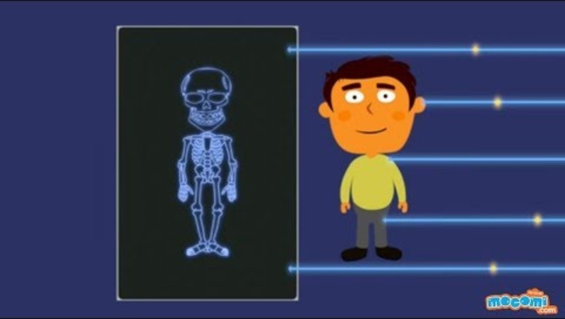
X-Ray-Based Techniques
Conventional x-ray photography is ineffective in obtaining images of human brain because, when an x-ray photograph is taken, an x-ray beam is passed through an object and then onto a photographic plate.
Each molecule the beam has passed through absorbs some of the radiation; thus, only the unabsorbed portions of the beam reach the photographic plate. (Eg: Bones absorb more photons thus image on photographic plate is white in colour. Whereas, tissues absorb less photons thus image on photographic plate is black in colour)
This makes x-ray photography effective in characterizing internal structures that absorb x-rays differently than their surroundings
However, by the time an x-ray beam has passed through the numerous overlapping structures of the brain, which differ only slightly in their ability to absorb x-rays, it carries little information about the structures through which it has passed.

Slide 9
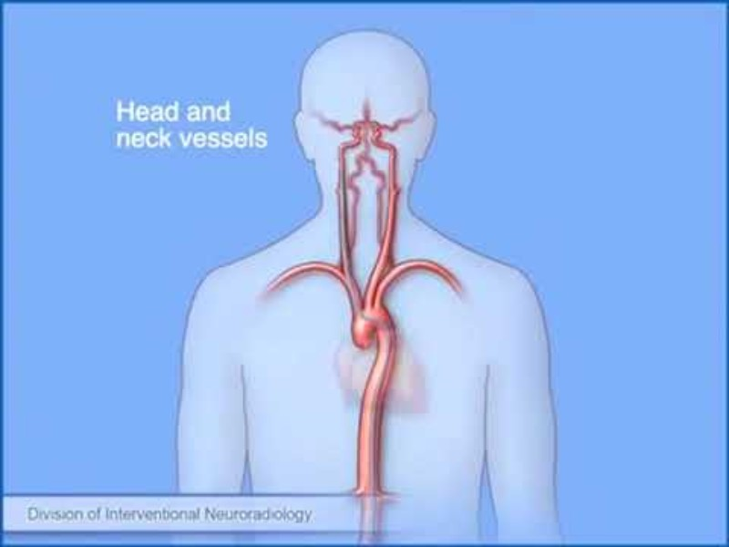
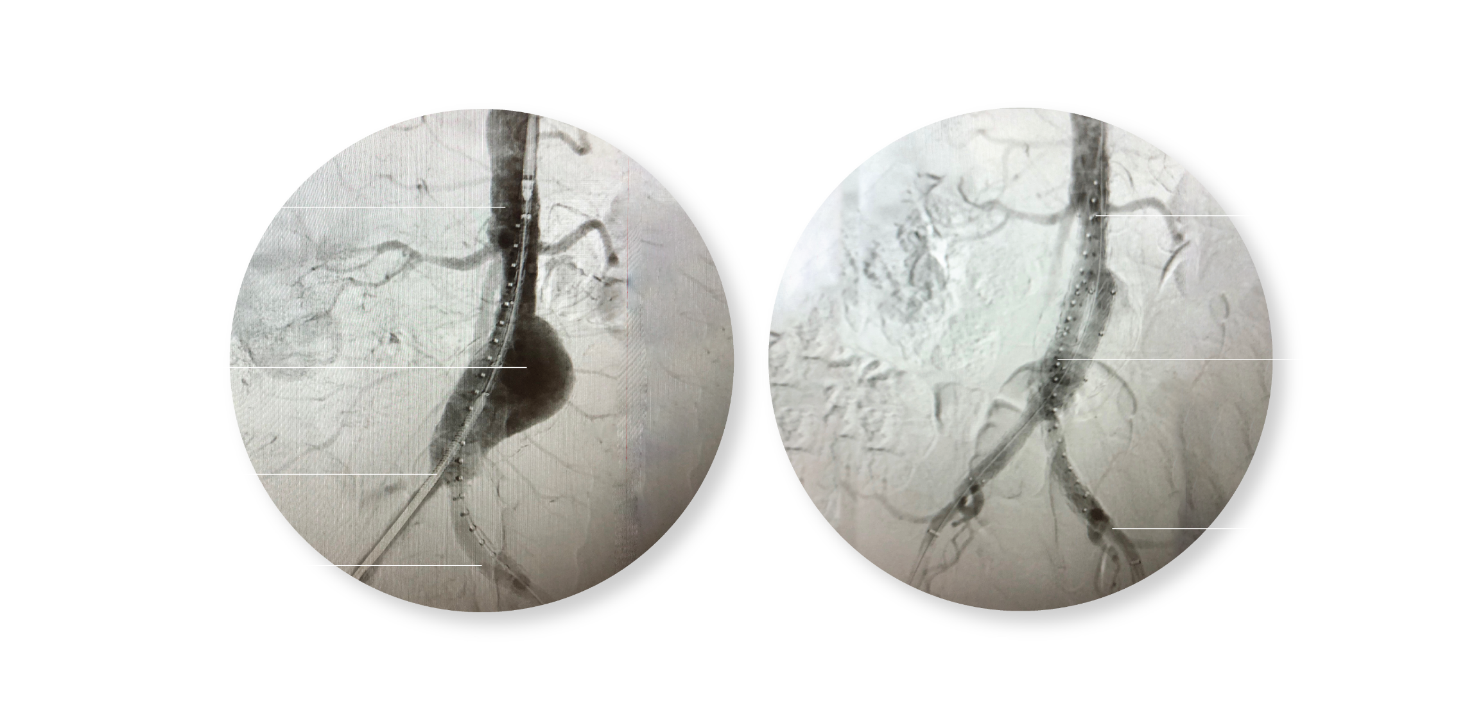
X-Ray-Based Techniques (Cont.)
CONTRAST X-RAYS
Contrast x-ray techniques involve injecting into one compartment of the body a substance that absorbs x-rays either less than or more than the surrounding tissue.
The injected substance then heightens the contrast between the compartment and the surrounding tissue during x-ray photography.
One contrast x-ray technique, cerebral angiography, uses the infusion of a radio-opaque dye (a dye that strongly absorbs X-rays) into a cerebral artery to visualize the cerebral circulatory system during x-ray photography
Cerebral angiograms are most useful for localizing vascular damage, but the displacement of blood vessels from their normal position also can indicate the location of a tumor.

Slide 10
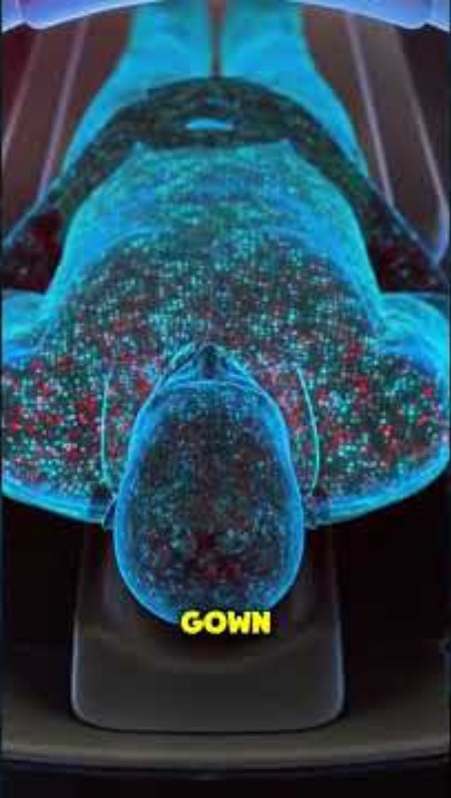
X-Ray-Based Techniques (Cont.)
COMPUTED TOMOGRAPHY
Computed tomography (CT) is a computer-assisted x-ray procedure that can be used to visualize the brain and other internal structures of the living body.
During cerebral CT, the neurological patient lies with his or her head positioned in the center of a large cylinder.
On one side of the cylinder is an x-ray tube that projects an x-ray beam through the head to an x-ray detector mounted on the other side.
The x-ray tube and detector rotate rapidly around the head of the patient at one level of the brain, taking many individual x-ray photographs as they rotate.
The meager information in each x-ray photograph is combined by a computer to generate a CT scan of one horizontal section of the brain.
Then the x-ray tube and detector are moved along the axis of the patient’s body to another level of the brain, and the process is repeated.
Scans of eight or nine horizontal brain sections are typically obtained from a patient.
When combined, these images provide three-dimensional representations of the brain.

Slide 11

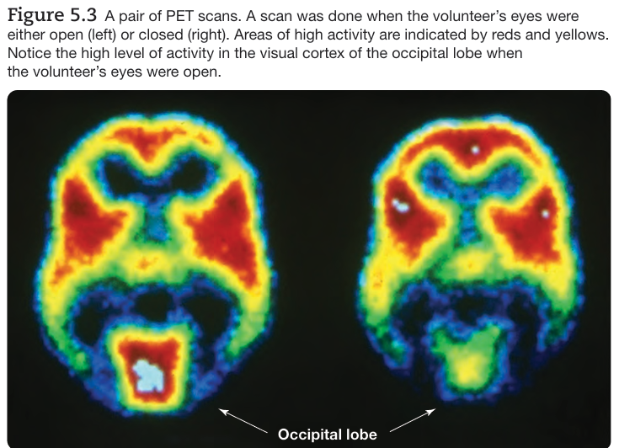
Radioactivity-Based Techniques
POSITRON EMISSION TOMOGRAPHY (PET)
PET was the first brain imaging technique to provide images of brain activity (functional brain images) rather than images of brain structure (structural brain images).
In one common version of PET, radioactive fluorodeoxyglucose (FDG) is injected into the patient’s carotid artery (an artery of the neck that feeds the ipsilateral cerebral hemisphere).
Because of its similarity to glucose, the primary metabolic fuel of the brain, fluorodeoxyglucose is rapidly taken up by active (energy-consuming) cells.
However, unlike glucose, fluorodeoxyglucose cannot be metabolized; it therefore accumulates in active neurons and astrocytes until it is gradually broken down
Thus, if a PET scan is taken of a patient who engages in an activity such as reading for about 30 seconds after the FDG injection, the resulting scan will indicate the areas of the target brain level that were most active during the 30 seconds
Each PET scan is merely a colored map of the amount of radioactivity in each of the tiny cubic voxels (volume pixels) that compose the scan.
The most significant current application of PET technology is its use in identifying the distribution of particular molecules (e.g., neurotransmitters, receptors, trans porters) in the brain.

Slide 12
Magnetic-Field-Based Techniques
MAGNETIC RESONANCE IMAGING (MRI)
MRI is a structural brain-imaging procedure in which high-resolution images are constructed from the measurement of radio-frequency waves that hydrogen atoms emit as they align with a powerful magnetic field.
Such imaging is possible because:
  Water contains 2 hydrogen atoms (H2O)
  Different brain structures contain different amounts of water.
This, in turn, means that the number of hydrogen atoms differs between brain structures, and, therefore, the radio-frequency waves emitted by a particular brain structure will be different from its neighboring brain structures.
MRI provides clearer images of the brain than does CT. In addition to providing relatively high spatial resolution (the ability to detect and represent differences in spatial location), MRI can produce images in three dimensions.
https://youtu.be/E44W54z_Ykw?si=r6o7jtiDeT5QDnIb
MAGNETOENCEPHALOGRAPHY
Magnetoencephalography (MEG). measures changes in magnetic fields on the surface of the scalp that are produced by changes in underlying patterns of neural activity.
Its major advantage over fMRI is its temporal resolution; it can record fast changes in neural activity

Slide 13

Magnetic-Field-Based Techniques
FUNCTIONAL MRI.
Functional MRI is often used to determine if a brain is dysfunctional and also used for a variety of other purposes; for example, to infer the content of an individual’s dreams
Functional MRI (fMRI) produces images representing the increase in oxygenated blood flow to active areas of the brain.
Functional MRI is possible because of two attributes of oxygenated blood.
  Active areas of the brain take up more oxygenated blood than they need for their energy requirements, and thus oxygenated blood accumulates in active areas of the brain
  Oxygenated blood has different magnetic properties than does deoxygenated blood, and this difference influences the radio-frequency waves emitted by hydrogen atoms in an MRI.
The signal recorded by fMRI is called the BOLD signal (the blood-oxygen-level dependent signal). The BOLD signal indicates the parts of the brain that are active or inactive during a cognitive or behavioral test, and thus it suggests the types of analyses the brain is performing. Because the BOLD signal is the result of blood flow through the brain, it is important to remember that it is not directly measuring the electrical activity of the brain.
Functional MRI has three advantages over PET:
  Nothing has to be injected into the volunteer
  It provides both structural and functional information in the same image
  Its spatial resolution is better.

Slide 14
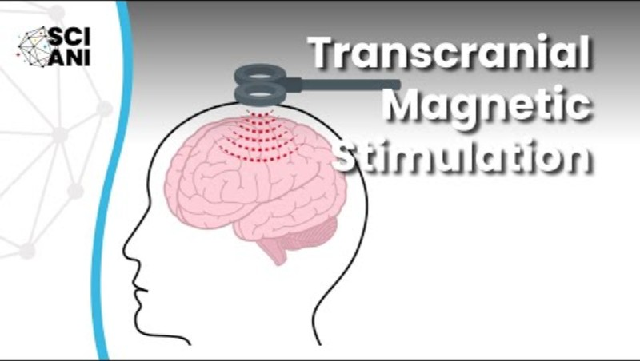
Transcranial Magnetic Stimulation
PET, fMRI, and magnetoencephalography → used to show a correlation between brain activity and cognitive activity, but they can’t prove that the brain activity caused the cognitive activity
For example, a brain imaging technique may show that the cingulate cortex becomes active when subjects view disturbing photographs, but it can’t prove that the cingulate activity causes the emotional experience there are many other explanations.
Transcranial magnetic stimulation (TMS) is a technique for affecting the activity in an area of the cortex by creating a magnetic field under a coil positioned next to the skull
In effect, the magnetic stimulation temporarily turns off part of the brain while the effects of the disruption on cognition and behavior are assessed.
Although there are still fundamental questions about safety, depth of effect, and mechanisms of neural disruption, TMS is often employed to circumvent the difficulty that brain imaging studies have in determining causation.

Slide 15
Recording Human Psychophysiological Activity
Psycho-physiological recording methods → methods of recording physiological activity from the surface of the human body
Measure of brain activity | Scalp Electroencephalography
Measures of somatic nervous system activity | Muscle tension and Eye movement
Measures of autonomic nervous system activity | Skin conductance and Cardiovascular activity

Slide 16
Scalp Electroencephalography
Electroencephalogram (EEG) is a measure of the gross electrical activity of the brain.
It is recorded through large electrodes by a device called an electroencephalograph (EEG machine), and the technique is called electroencephalography.
How is it recorded?
Each channel of EEG activity is usually recorded from disk-shaped electrodes, which are taped to the scalp.
These electrodes detect the summed electrical activity generated throughout the head, including brain activity (primarily postsynaptic potentials and some action potentials) as well as electrical signals from the skin, muscles, blood, and eyes.
Significance of Scalp EEG
EEG is an important research and diagnostic tool.
Certain EEG wave patterns are associated with specific states of consciousness or particular brain disorders. For example, alpha waves are regular, high-amplitude brain waves with a frequency of 8–12 Hz (cycles per second) and are typically observed when a person is awake, relaxed, and has their eyes closed.
EEG is also useful in diagnosing conditions such as epilepsy, which produces characteristic abnormal EEG patterns.

Slide 17
Scalp Electroencephalography (Cont.)
Because EEG signals decrease in amplitude as they spread from their source, a comparison of signals recorded from various sites on the scalp can sometimes indicate the origin of particular waves. This is why it is usual to record EEG activity from many sites simultaneously. Thus, So an electrode close to the source records a larger signal, while distant electrodes record a smaller signal.
Event-related potentials (ERPs) → small changes in the EEG that occur in response to a specific event or stimulus.
Commonly studied type of event-related potential → sensory evoked potential (the change in the cortical EEG signal that is elicited by the momentary presentation of a sensory stimulus)
Cortical EEG that follows a sensory stimulus has two components: the response to the stimulus (the signal) and the ongoing background EEG activity (the noise).
The problem in recording sensory evoked potentials is that the noise of the background EEG is often so great that the sensory evoked potential is masked. Measuring a sensory evoked potential can be like detecting a whisper at a rock concert
A method used to reduce the noise of the background EEG is signal averaging.
Analysis of average evoked potentials (AEPs) focuses on the various waves in the averaged signal. Each wave is characterized by its direction, positive or negative, and by its latency.

Slide 18
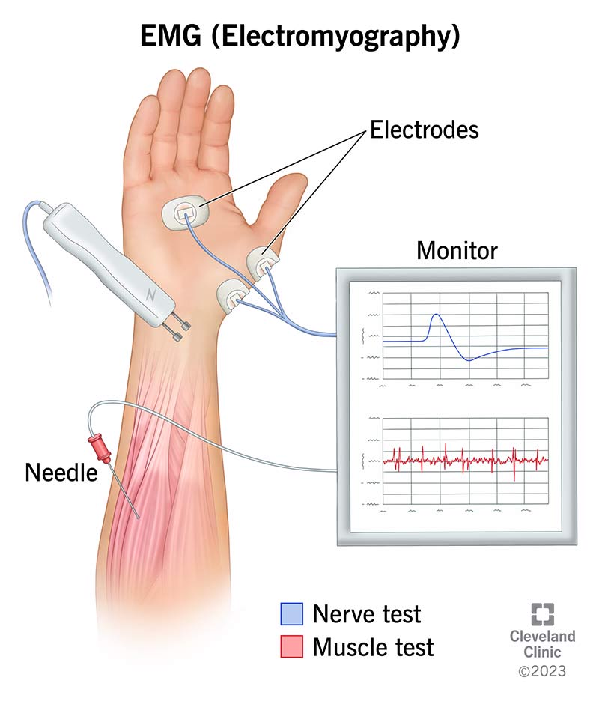
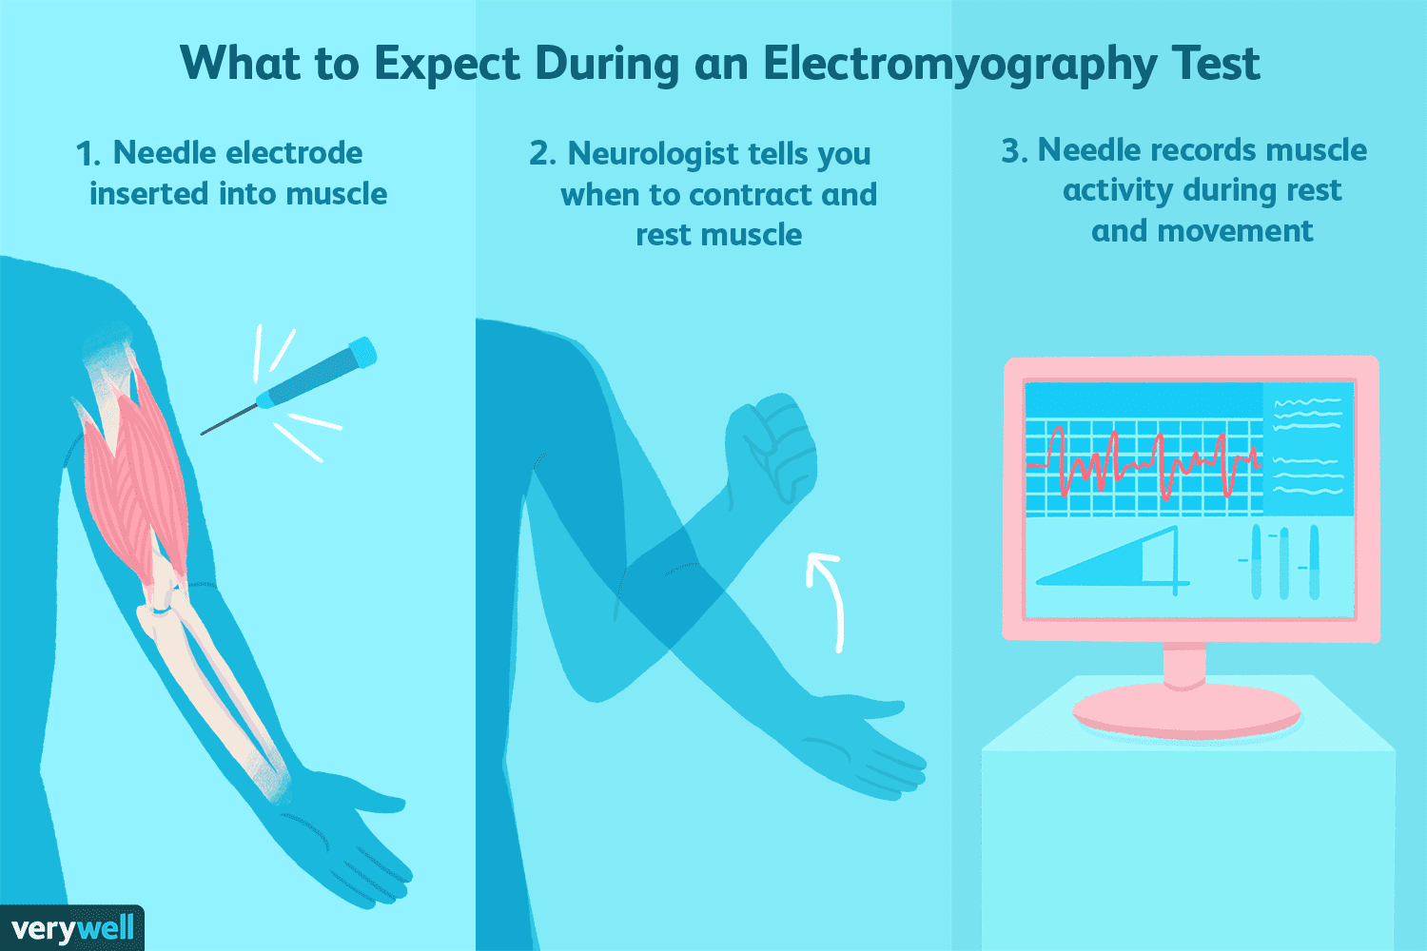
Muscle Tension
Electromyography is the usual procedure for measuring muscle tension.
The resulting record is called an electromyogram (EMG).
EMG activity is usually recorded between two electrodes taped to the surface of the skin over the muscle of interest.
Most psychophysiologists do not work with raw EMG signals; they convert them to a more workable form.
The raw signal is fed into a computer that calculates the total amount of EMG spiking per unit of time in consecutive 0.1-second intervals, for example.
The integrated signal (i.e., the total EMG activity per unit of time) is then plotted. The result is a smooth curve, the amplitude of which is a simple, continuous measure of the level of muscle tension

Slide 19
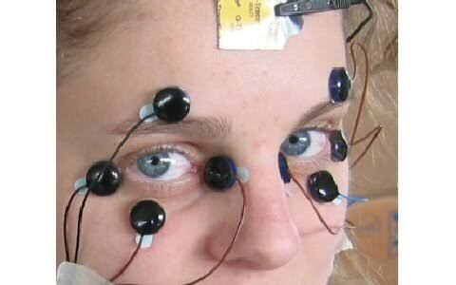
Eye Movement
The electrophysiological technique for recording eye movements is called electrooculography and the resulting record is called an electrooculogram (EOG).
Electrooculography is based on the fact that there is a steady potential difference between the front (positive) and back (negative) of the eyeball.
Because of this steady potential, when the eye moves, a change in the electrical potential between electrodes placed around the eye can be recorded.
It is usual to record EOG activity between two electrodes placed on each side of the eye to measure its horizontal movements and between two electrodes placed above and below the eye to measure its vertical movements.

Slide 20

Skin Conductance
Measures changes in the skin's ability to conduct electricity due to sweat gland activity
The two most commonly employed indexes of electrodermal activity are the skin conductance level (SCL) and the skin conductance response (SCR).
The SCL is a measure of the background level of skin conductance that is associated with a particular situation
SCR is a measure of the transient changes in skin conductance that are associated with discrete experiences.
The physiological bases of skin conductance changes are not fully understood, but there is considerable evidence implicating the sweat glands.
Although the main function of sweat glands is to cool the body, these glands tend to be come active in emotional situations. Sweat glands are distributed over most of the body surface; but, as you are almost certainly aware, those of the hands, feet, armpits, and forehead are particularly responsive to emotional stimuli.

Slide 21
Cardiovascular Activity
Three different measures of cardiovascular activity are frequently employed in psychophysiological research:
i) Heart Rate
The electrical signal that is associated with each heartbeat can be recorded through electrodes placed on the chest.
The recording is called an electro cardiogram (ECG).
ii) Blood Pressure
Measuring arterial blood pressure involves two independent measurements:
  Systole → a measurement of the peak pressure during the periods of heart contraction
  Diastole → a measurement of the minimum pressure during the periods of relaxation.
Blood pressure is usually expressed as a ratio of systolic over diastolic blood pressure in millimeters of mercury (mmHg).
The normal resting blood pressure for an adult is about 130/70 mmHg.
A chronic blood pressure of more than 140/90 mmHg is viewed as a serious health hazard and is called hypertension.
You have likely had your blood pressure measured with a sphygmomanometer, a crude device composed of a hollow cuff, a rubber bulb for inflating it, and a pressure gauge for measuring the pressure in the cuff (sphygmos means pulse ).

Slide 22
Cardiovascular Activity (Cont.)
Blood Volume
Changes in the volume of blood in particular parts of the body are associated with psychological events.
Example- engorgement of the genitals that is associated with sexual arousal in both males and females.
Plethysmography refers to the various techniques for measuring changes in the volume of blood in a particular part of the body (plethysmos means an enlargement).
One method of measuring these changes is to record the volume of the target tissue by wrapping a strain gauge around it.
Although this method has utility in measuring blood flow in fingers or similarly shaped organs, the possibilities for employing it are somewhat limited.
Another plethysmographic method is to shine a light through the tissue under investigation and to measure the amount of the light that is absorbed by it. The more blood there is in a structure, the more light it will absorb.

Slide 23
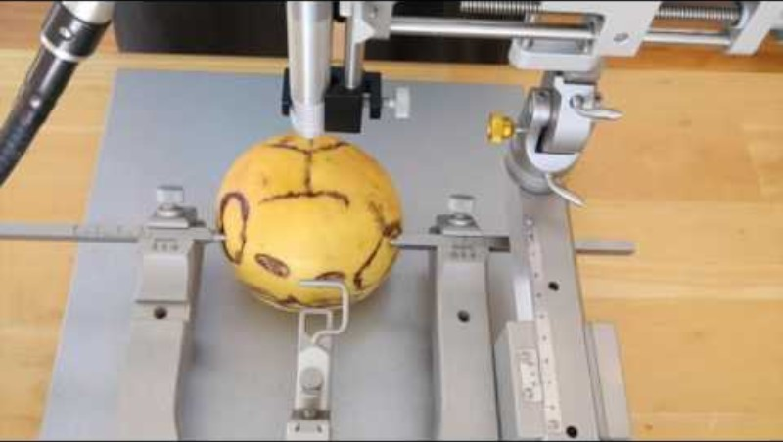
Invasive Physiological Research Methods
Stereotaxic Surgery
Stereotaxic surgery → means by which experimental devices are precisely positioned in the depths of the brain.
Two things are required in stereotaxic surgery:
  An atlas to provide directions to the target site
  An instrument for getting there
The stereotaxic atlas
Used to locate brain structures
Since the brain has three dimensions (Anterior–Posterior; Medial–Lateral & Dorsal–Ventral), the brain is represented in a stereotaxic atlas by a series of individual maps, one per page, each representing the structure of a single, two-dimensional frontal brain slice.
In stereotaxic atlases, all distances are given in millimeters from a designated reference point.
In some rat atlases, the reference point is bregma, the point on the top of the skull where two of the major sutures (seams in the skull) intersect.
The stereotaxic instrument
Has two parts: a head holder, which firmly holds each subjects brain in the prescribed position and orientation; and an electrode holder, which holds the device to be inserted.
A system of precision gears allows the electrode holder to be moved in three dimensions

Slide 24
Invasive Physiological Research Methods
Lesion methods
In lesion methods, a part of the brain is removed, damaged, or destroyed; then, the behavior of the subject is carefully assessed in an effort to determine the functions of the lesioned structure.
Four types of lesions are as follows:
Aspiration Lesions
When a lesion is to be made in an area of cortical tissue that is accessible to the eyes and instruments of the surgeon, aspiration is frequently the method of choice.
The cortical tissue is drawn off by suction through a fine tipped handheld glass pipette. Modern researchers use fine needles as well.
Because the underlying white matter is slightly more resistant to suction than the cortical tissue itself, a skilled surgeon can delicately peel off the layers of cortical tissue from the surface of the brain, leaving the underlying white matter and major blood vessels undamaged. This is important because it minimizes unintended damage to neural connections and blood supply and allows researchers to attribute behavioral changes more accurately to the loss of the target brain region rather than to widespread damage caused by severed axons or reduced blood flow.

Slide 25
Invasive Physiological Research Methods
Lesion methods
Radio-Frequency Lesions
Small subcortical lesions are commonly made by passing radio-frequency current (high-frequency current) through the target tissue from the tip of a stereotaxically positioned electrode.
The heat from the current destroys the tissue.
The size and shape of the lesion are determined by the duration and intensity of the current and the configuration of the electrode tip.
Knife Cuts
Sectioning (cutting) is used to eliminate conduction in a nerve or tract.
A tiny, well-placed cut can unambiguously accomplish this task without producing extensive damage to surrounding tissue.
Cryogenic Blockade
An alternative to destructive lesions is cryogenic blockade.
When coolant is pumped through an implanted cryoprobe, neurons near the tip are cooled until they stop firing.
The temperature is maintained above the freezing level, so there is no structural damage.
Then, when the tissue is allowed to warm up, normal neural activity returns.
Cryogenic blockades are sometimes referred to as reversible lesions.
Reversible lesions can also be produced with microinjections into the brain of local anesthetics such as lidocaine.

Slide 26
Invasive Physiological Research Methods
Lesion methods
Interpreting Lesion Effects
Lesion effects are difficult to interpret because the structures of the brain are small, convoluted, and tightly packed together, even a highly skilled surgeon cannot completely destroy a structure without producing significant damage to adjacent structures.
Eg: A surgeon tries to damage the amygdala, but because the brain structures are so close together, part of the amygdala remains undamaged, while nearby brain areas are accidentally damaged. Even so, researchers often call it an "amygdala lesion." This can be misleading because
The behavioral changes may also be due to damage to adjacent brain areas (Eg: While damaging the amygdala, the nearby hippocampus is also damaged. If the animal later has memory problems, the change may be due to hippocampal damage, not just the amygdala)
Normal behavior after a lesion does not necessarily mean that the amygdala has no role in that behavior. It may be because the lesion did not destroy the entire amygdala. (Eg: Only part of the amygdala is damaged, but the animal still shows normal fear responses. The remaining healthy part of the amygdala may still be producing the fear response)
Bilateral and Unilateral Lesions
Behavioral effects of unilateral lesions (lesions restricted to one half of the brain) are much milder than those of symmetrical bilateral lesions (lesions involving both sides of the brain), particularly in non-human species.
Indeed, behavioral effects of unilateral lesions to some brain structures can be difficult to detect.
As a result, most experimental studies of lesion effects are studies of bilateral, rather than unilateral lesions.

Slide 27
Invasive Physiological Research Methods
Electrical Stimulation
Clues about the function of a neural structure can be obtained by stimulating it electrically.
Electrical brain stimulation is usually delivered across the two tips of a bipolar electrode two insulated wires wound tightly together and cut at the end.
Weak pulses of current produce an immediate increase in the firing of neurons near the tip of the electrode.
Electrical stimulation of the brain is an important biopsychological research tool because it often has behavioral effects, usually opposite to those produced by a lesion to the same site.
It can elicit a number of behavioral sequences, including eating, drinking, attacking, copulating, and sleeping.
The particular behavioral response that is elicited depends on the location of the electrode tip, the parameters of the current, and the test environment in which the stimulation is administered.

Slide 28
Invasive Electrophysiological Recording Methods
Intracellular Unit Recording
Intracellular unit recording, provides a moment-by-moment record of the graded fluctuations in one neurons membrane potential.
Most experiments using this recording procedure are performed on chemically immobilized animals because it is next to impossible to keep the tip of a microelectrode positioned inside a neuron of a freely moving animal.
Extracellular Unit Recording
It is possible to record the action potentials of a neuron through a microelectrode whose tip is positioned in the extracellular fluid next to it each time the neuron fires, there is an electrical disturbance and a blip is recorded at the electrode tip.
Accordingly, extracellular unit recording provides a record of the firing of a neuron but no information about the neurons membrane potential.
It is difficult to record extracellularly from a single neuron in a freely moving animal without the electrode tip shifting away from the neuron, but it can be accomplished with special flexible microelectrodes that can shift slightly with the brain.

Slide 29
Invasive Electrophysiological Recording Methods
Multiple-Unit Recording
In multiple-unit recording, the electrode tip is much larger than that of a microelectrode; thus, it picks up signals from many neurons, and slight shifts in its position due to movement of the subject have little effect on the overall signal.
The many action potentials picked up by the electrode are fed into an integrating circuit, which adds them together.
A multiple-unit recording is a graph of the total number of recorded action potentials per unit of time (e.g., per 0.1 second).
Invasive EEG Recording
In laboratory animals, EEG signals are recorded through large implanted electrodes rather than through scalp electrodes.
Cortical EEG signals are frequently recorded through stainless steel skull screws, whereas subcortical EEG signals are typically recorded through stereotaxically implanted wire electrodes.

Slide 30
Thank You ☺
REFERENCE
Kalat, J. W. (2013). Biological psychology (11th ed.). Cengage Learning.
Pinel, J. P. J. (2011). Biopsychology (8th ed.). Pearson.
By
P. SOWMYASHREE,
ASSISTANT PROFESSOR, DEPT OF PSYCHOLOGY
ETHIRAJ COLLEGE FOR WOMEN,
CHENNAI - 600008

