Slide 1
Welcome to Front-End Development Bootcamp
Course Name: Front-End Development Bootcamp
Instructor: Syed Kifayat
Duration: 3 to 4 months
Lecture No: 7
Week No: 6

Slide 2
Previous Lecture
CSS Outline
CSS Text
CSS Fonts

Slide 3
CSS Icon
The simplest way to add an icon to your HTML page, is with an icon library, such as Font Awesome.
Add the name of the specified icon class to any inline HTML element (like <i> or <span>).
To use the Font Awesome icons, go to fontawesome.com, sign in, and get a code to add in the <head> section of your HTML page:
<script src="https://kit.fontawesome.com/yourcode.js" crossorigin="anonymous"></script>
Note: No downloading or installation is required!

Slide 4
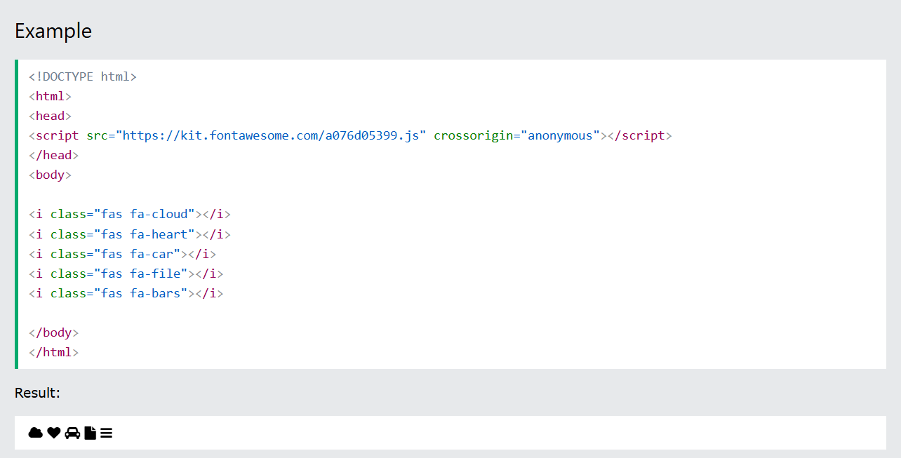
CSS Icon

Slide 5
CSS Links
Links can be styled with any CSS property (e.g. color, font-family, background, etc.).
Links can be styled differently depending on what state they are in.
The four links states are:
a:link - a normal, unvisited link
a:visited - a link the user has visited
a:hover - a link when the user mouses over it
a:active - a link the moment it is clicked
When setting the style for several link states, there are some order rules:
a:hover MUST come after a:link and a:visited
a:active MUST come after a:hover

Slide 6
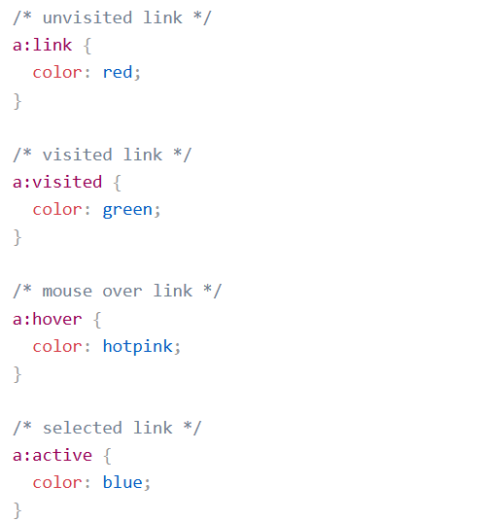
CSS Links

Slide 7
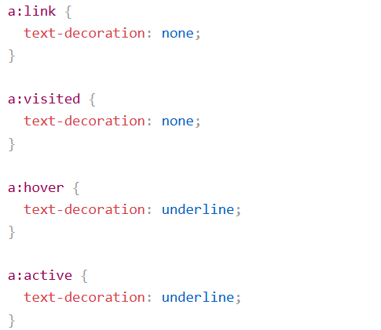
Text Decoration
The text-decoration property is mostly used to remove underlines from links:

Slide 8
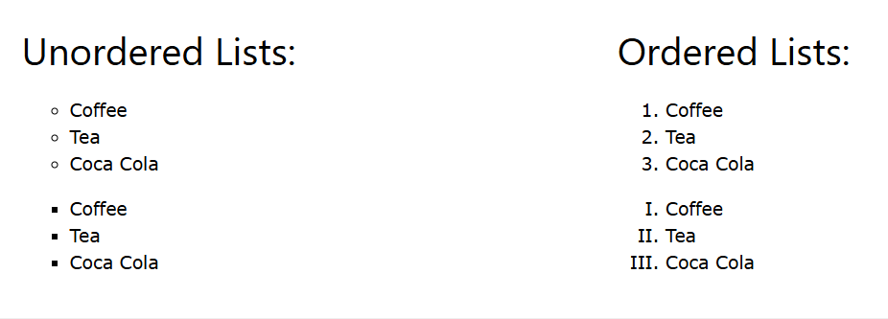
CSS Lists

Slide 9
CSS Lists
In HTML, there are two main types of lists:
unordered lists (<ul>) - the list items are marked with bullets
ordered lists (<ol>) - the list items are marked with numbers or letters
The CSS list properties allow you to:
Set different list item markers for ordered lists
Set different list item markers for unordered lists
Set an image as the list item marker
Add background colors to lists and list items

Slide 10
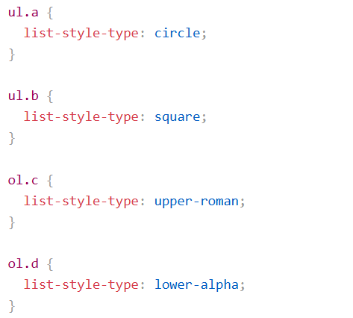
Different List Item Markers
The list-style-type property specifies the type of list item marker.
Note: Some of the values are for unordered lists, and some for ordered lists.

Slide 11
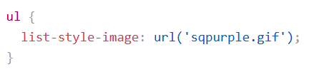
An Image as The List Item Marker
The list-style-image property specifies an image as the list item marker:
The list-style-position property specifies the position of the list-item markers (bullet points).
"list-style-position: outside;" means that the bullet points will be outside the list item. The start of each line of a list item will be aligned vertically. This is default mode.
"list-style-position: inside;" means that the bullet points will be inside the list item. As it is part of the list item, it will be part of the text and push the text at the start.

Slide 12

Remove Default Settings
The list-style-type:none property can also be used to remove the markers/bullets. Note that the list also has default margin and padding. To remove this, add margin:0 and padding:0 to <ul> or <ol>.
The list-style property is a shorthand property. It is used to set all the list properties in one declaration:

Slide 13
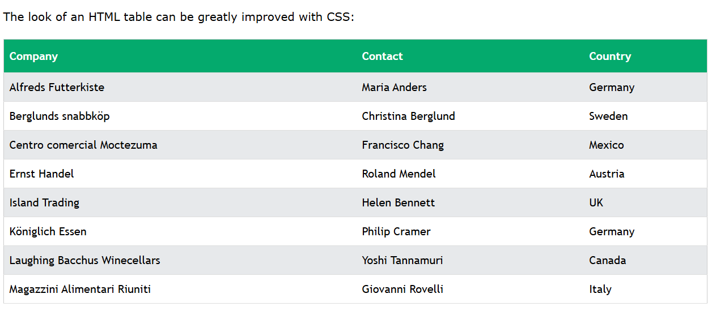
CSS Tables

Slide 14

CSS Tables
Table Borders
To specify table borders in CSS, use the border property.
Full-Width Table
The table above might seem small in some cases. If you need a table that should span the entire screen (full-width), add width: 100% to the <table> element.
Double Borders
Notice that the table in the examples above have double borders. This is because both the table and the <th> and <td> elements have separate borders.

Slide 15


CSS Tables
Collapse Table Borders
The border-collapse property sets whether the table borders should be collapsed into a single border.
If you only want a border around the table, only specify the border property for <table>:

Slide 16
CSS Tables
Table Horizontal Alignment
The text-align property sets the horizontal alignment (like left, right, or center) of the content in <th> or <td>.
By default, the content of <th> elements are center-aligned and the content of <td> elements are left-aligned.
To center-align the content of <td> elements as well, use text-align: center;
Table Vertical Alignment
The vertical-align property sets the vertical alignment (like top, bottom, or middle) of the content in <th> or <td>.
By default, the vertical alignment of the content in a table is middle (for both <th> and <td> elements).

Slide 17
CSS Responsive Table
A responsive table will display a horizontal scroll bar if the screen is too small to display the full content.
Add a container element (like <div>) with overflow-x:auto around the <table> element to make it responsive.
Note: In OS X Lion (on Mac), scrollbars are hidden by default and only shown when being used (even though "overflow:scroll" is set).

Slide 18
CSS Layout - The display Property
The display property is the most important CSS property for controlling layout.
The display property is used to specify how an element is shown on a web page.
Every HTML element has a default display value, depending on what type of element it is. The default display value for most elements is block or inline.
The display property is used to change the default display behavior of HTML elements.

Slide 19
Block-level Elements
A block-level element ALWAYS starts on a new line and takes up the full width available (stretches out to the left and right as far as it can).
Examples of block-level elements:
<div>
<h1> - <h6>
<p>
<form>
<header>
<footer>
<section>

Slide 20
Inline Elements
An inline element DOES NOT start on a new line and only takes up as much width as necessary.
Examples of inline elements:
<span>
<a>
<img>

Slide 21
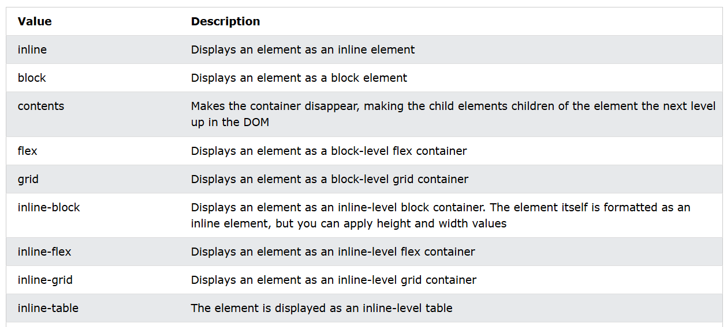
The display Property Values

Slide 22
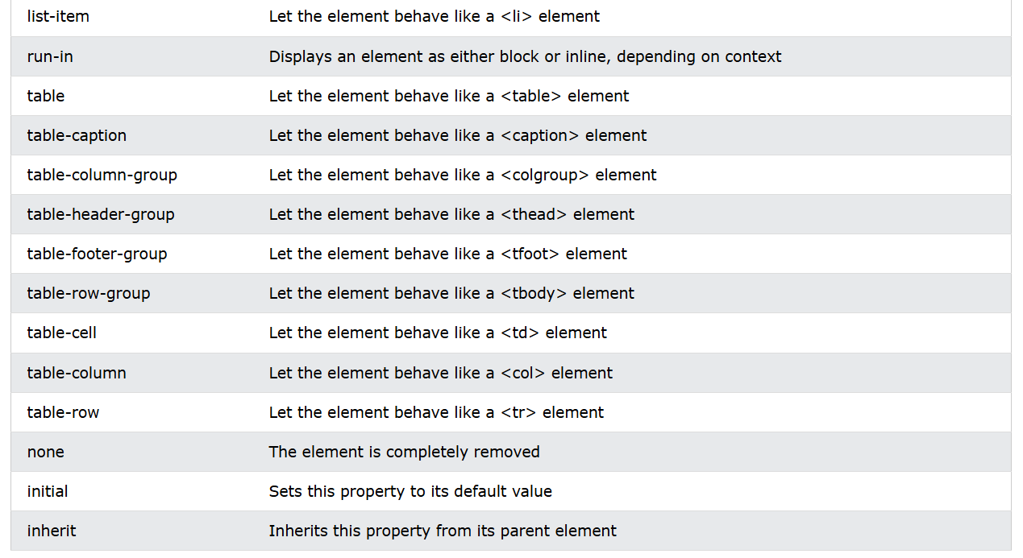
The display Property Values

Slide 23
The display Property
Display: none;
display: none; is commonly used with JavaScript to hide and show elements without deleting and recreating them. Take a look at our last example on this page if you want to know how this can be achieved.
The <script> element uses display: none; as default.
Override The Default Display Value
As mentioned, every element has a default display value. However, you can override this.
Changing an inline element to a block element, or vice versa, can be useful for making the page look a specific way, and still follow the web standards.
Note: Setting the display property of an element only changes how the element is displayed, NOT what kind of element it is. So, an inline element with display: block; is not allowed to have other block elements inside it.

Slide 24
Next Lecture
CSS Max-width
CSS Position
CSS Z-index
CSS Overflow
CSS float

Slide 25
Q&A
Q&A: Ask any questions about today’s lesson.

Slide 26
Thank You!
Happy Coding!
(Design by Syed Kifayat)

