Slide 1
Welcome to Front-End Development Bootcamp
Course Name: Front-End Development Bootcamp
Instructor: Syed Kifayat
Duration: 3 to 4 months
Lecture No: 11
Week No: 8

Slide 2
Previous Lecture
CSS Dropdowns
CSS Image Gallery
CSS Attribute Selector
CSS Forms
CSS Counter

Slide 3
CSS Flexbox
Flexbox is short for the Flexible Box Layout module.
Flexbox is a layout method for arranging items in rows or columns.
Flexbox makes it easier to design a flexible responsive layout structure, without using float or positioning.
Flexbox vs. Grid
The CSS Flexbox Layout should be used for one-dimensional layout, with rows OR columns.
The CSS Grid Layout should be used for two-dimensional layout, with rows AND columns.

Slide 4
CSS Flexible Box Layout Module
Before the Flexible Box Layout module, there were four layout modes:
Block, for sections in a webpage
Inline, for text
Table, for two-dimensional table data
Positioned, for explicit position of an element
CSS flexbox is supported in all modern browsers.

Slide 5
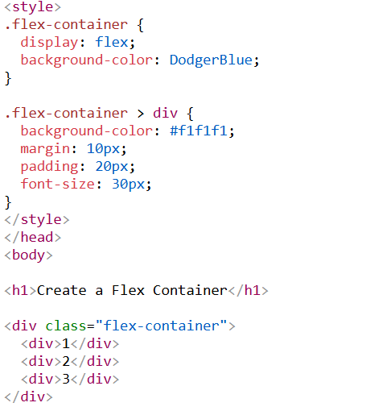
CSS Flexbox Components
A flexbox always consists of:
a Flex Container - the parent (container) <div> element
Flex Items - the items inside the container <div>

Slide 6
The CSS Flex Container
The CSS properties we use for the flex container are:
flex-direction
flex-wrap
flex-flow
justify-content
align-items
align-content

Slide 7
The CSS flex-direction Property
The flex-direction property specifies the display-direction of flex items in the flex container.
The flex-direction property can have one of the following values:
row
column
row-reverse
column-reverse

Slide 8
The CSS flex-direction Property
The row value is the default value, and it displays the flex items horizontally (from left to right)
The column value displays the flex items vertically (from top to bottom)
The row-reverse value displays the flex items horizontally (but from right to left)
The column-reverse value displays the flex items vertically (but from bottom to top)

Slide 9
The CSS flex-wrap Property
The flex-wrap property specifies whether the flex items should wrap or not, if there is not enough room for them on one flex line.
The flex-wrap property can have one of the following values:
nowrap
wrap
wrap-reverse

Slide 10
The CSS flex-wrap Property
The nowrap value specifies that the flex items will not wrap (this is default)
The wrap value specifies that the flex items will wrap if necessary
The wrap-reverse value specifies that the flex items will wrap if necessary, in reverse order

Slide 11
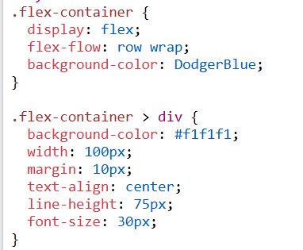
The CSS flex-flow Property
The flex-flow property is a shorthand property for setting both the flex-direction and flex-wrap properties.

Slide 12
The CSS justify-content Property
The justify-content property is used to align the flex items when they do not use all available space on the main-axis (horizontally).
The justify-content property can have one of the following values:
center
flex-start
flex-end
space-around
space-between
space-evenly

Slide 13
The CSS justify-content Property
The center value positions the flex items in the center of the container
The flex-start value positions the flex items at the beginning of the container (this is default)
The flex-end value positions the flex items at the end of the container
The space-around value displays the flex items with space around them
The space-between value displays the flex items with space between them
The space-evenly value displays the flex items with equal space around them

Slide 14
The CSS align-items Property
The align-items property is used to align the flex items when they do not use all available space on the cross-axis (vertically).
The align-items property can have one of the following values:
center
flex-start
flex-end
stretch
baseline
normal

Slide 15
The CSS align-items Property
The center value positions the flex items in the middle of the container
The flex-start value positions the flex items at the top of the container
The flex-end value positions the flex items at the bottom of the container
The stretch value stretches the flex items to fill the container (this is equal to "normal" which is default)
The baseline value positions the flex items at the baseline of the container

Slide 16
The CSS align-content Property
The align-content property is used to align the flex lines.
The align-content property is similar to align-items, but instead of aligning flex items, it aligns the flex lines.
The align-content property can have one of the following values:
center
stretch
flex-start
flex-end
space-around
space-between

Slide 17
The CSS align-content Property
With center, the flex lines are packed toward the center of the container
With stretch, the flex lines stretch to take up the remaining space of the container (this is default)
With flex-start, the flex lines are packed toward the start of the container
With flex-end, the flex lines are packed toward the end of the container
With space-between, the space between the flex lines are equal, but the first item is flush with the start edge of the container, and the last item is flush with the end edge of the container
With space-around, the space between the flex lines are equal, but the space before the first item and after the last item is set to half of the space between the flex lines
With space-evenly, the flex lines are evenly distributed in the flex container, with equal space on top, bottom and between

Slide 18

Perfect Centering
SOLUTION: Set both the justify-content and align-items properties to center, and the flex item will be perfectly centered

Slide 19
CSS Flex Items
The direct child elements of a flex container automatically becomes flex items.
The element above represents four blue flex items inside a grey flex container.
The CSS properties we use for flex items are:
order
flex-grow
flex-shrink
flex-basis
flex
align-self

Slide 20
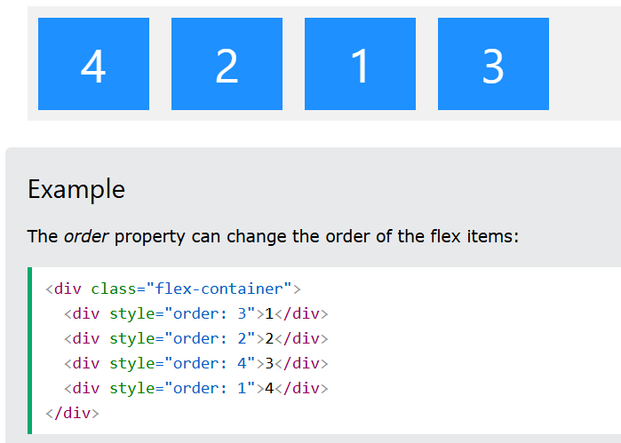
The order Property
The order property specifies the order of the flex items inside the flex container.
The first flex item in the code does not have to appear as the first item in the layout.
The order value must be a number, default value is 0.

Slide 21
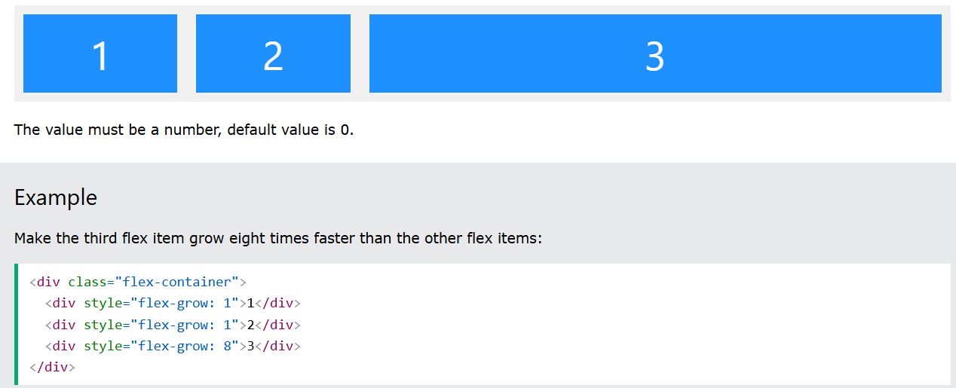
The flex-grow Property
The flex-grow property specifies how much a flex item will grow relative to the rest of the flex items.
The value must be a number, default value is 0.

Slide 22
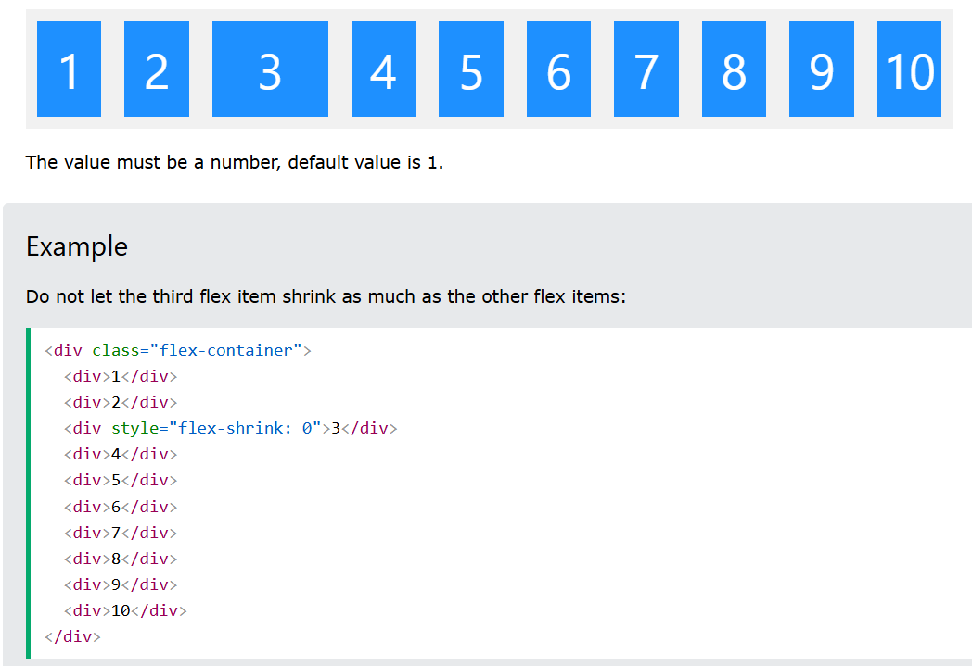
The flex-shrink Property
The flex-shrink property specifies how much a flex item will shrink relative to the rest of the flex items.

Slide 23
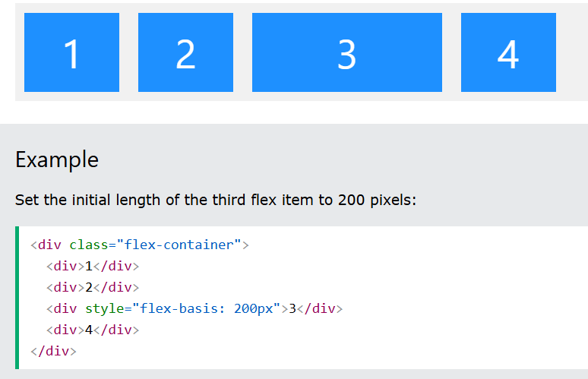
The flex-basis Property
The flex-basis property specifies the initial length of a flex item.

Slide 24
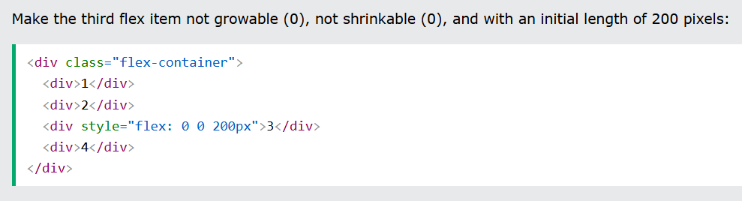
The flex Property
The flex property is a shorthand property for the flex-grow, flex-shrink, and flex-basis properties.

Slide 25
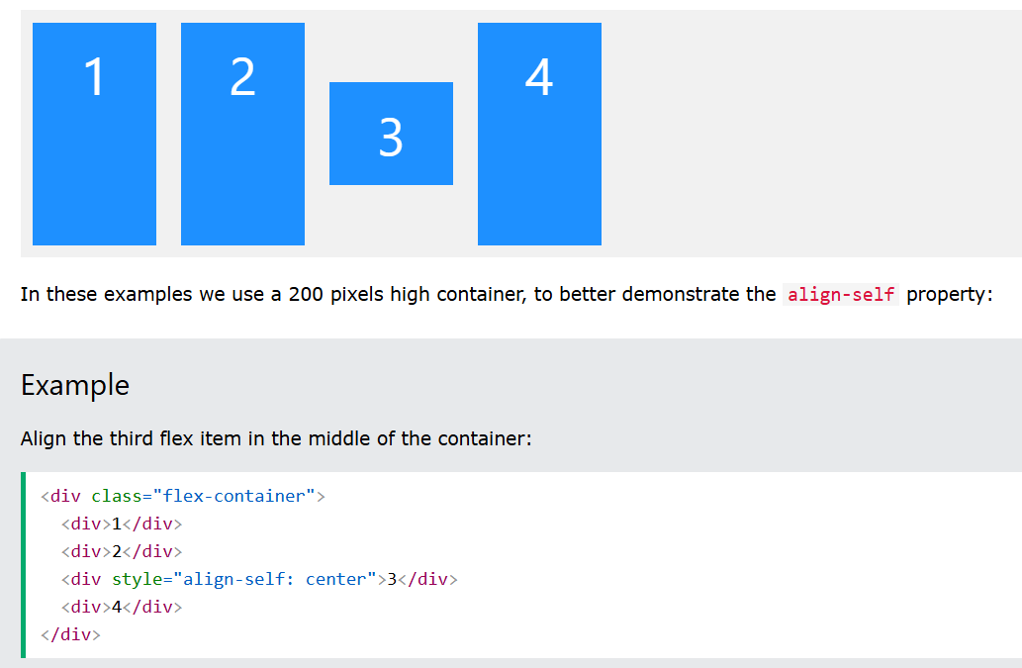
The align-self Property
The align-self property specifies the alignment for the selected item inside the flexible container.
The align-self property overrides the default alignment set by the container's align-items property.

Slide 26
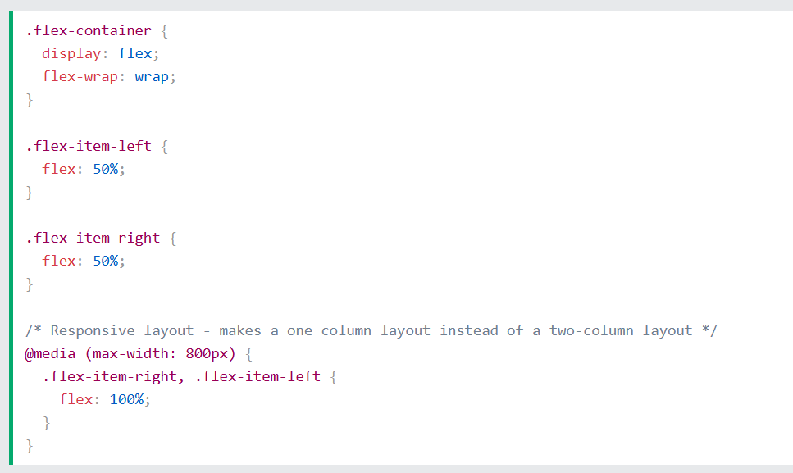
CSS Responsive Flexbox

Slide 27
Next Lecture
CSS Grid

Slide 28
Q&A
Q&A: Ask any questions about today’s lesson.

Slide 29
Thank You!
Happy Coding!
(Design by Syed Kifayat)

