Slide 1
Welcome to Front-End Development Bootcamp
Course Name: Front-End Development Bootcamp
Instructor: Syed Kifayat
Duration: 3 to 4 months
Lecture No: 10
Week No: 7

Slide 2
Previous Lecture
CSS Combinators
CSS Pseudo-classes
CSS Pseudo-element
CSS Opacity
CSS Navigation Bar

Slide 3
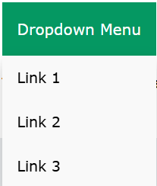
CSS Dropdowns
Basic Dropdown
Create a dropdown box that appears when the user moves the mouse over an element.
Dropdown Menu
Create a dropdown menu that allows the user to choose an option from a list:

Slide 4

CSS Dropdowns
Right-aligned Dropdown Content
If you want the dropdown menu to go from right to left, instead of left to right, add right: 0;
Dropdown Image
How to add an image and other content inside the dropdown box.

Slide 5
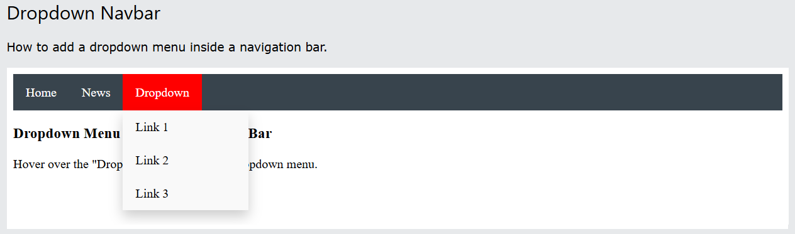
CSS Dropdowns

Slide 6
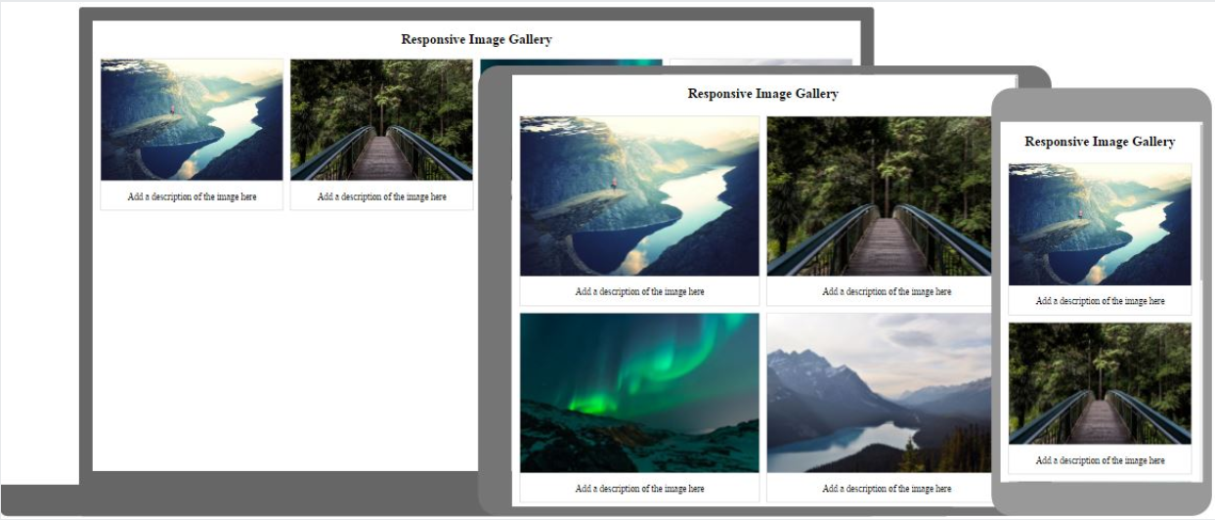
Responsive Image Gallery

Slide 7


CSS Attribute Selectors
CSS [attribute] Selector
The [attribute] selector is used to select elements with a specified attribute.
CSS [attribute="value"] Selector
The [attribute="value"] selector is used to select elements with a specified attribute and value.

Slide 8


CSS Attribute Selectors
CSS [attribute~="value"] Selector
The [attribute~="value"] selector is used to select elements with an attribute value containing a specified word.
The [attribute|="value"] selector is used to select elements with the specified attribute, whose value can be exactly the specified value, or the specified value followed by a hyphen (-).
Note: The value has to be a whole word, either alone, like class="top", or followed by a hyphen( - ), like class="top-text".

Slide 9


CSS Attribute Selectors
CSS [attribute^="value"] Selector
The [attribute^="value"] selector is used to select elements with the specified attribute, whose value starts with the specified value.
Note: The value does not have to be a whole word!
CSS [attribute$="value"] Selector
The [attribute$="value"] selector is used to select elements whose attribute value ends with a specified value.

Slide 10

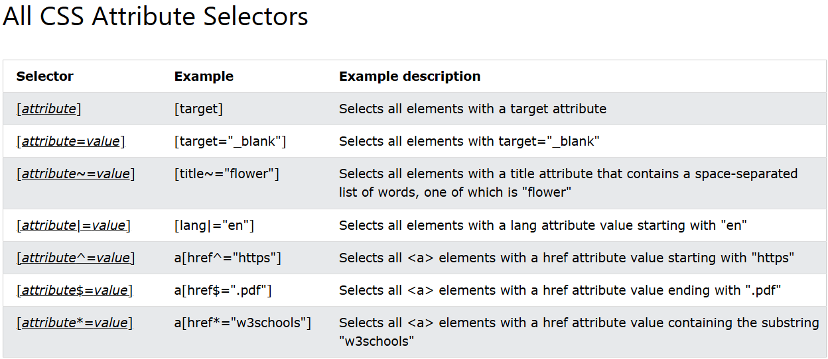
CSS Attribute Selectors
CSS [attribute*="value"] Selector
The [attribute*="value"] selector is used to select elements whose attribute value contains a specified value.

Slide 11
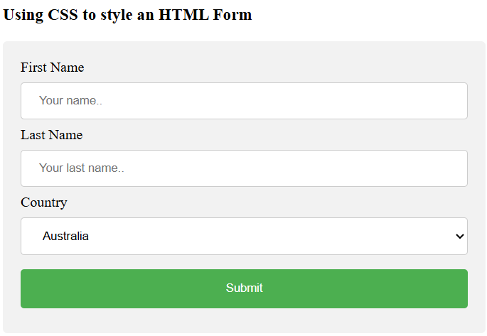
CSS Forms

Slide 12
CSS Forms
Note that we have set the box-sizing property to border-box. This makes sure that the padding and eventually borders are included in the total width and height of the elements.
By default, some browsers will add a blue outline around the input when it gets focus (clicked on). You can remove this behavior by adding outline: none; to the input.
Use the :focus selector to do something with the input field when it gets focus

Slide 13
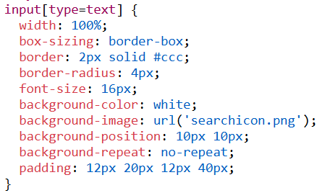

CSS Forms
Input with icon/image
If you want an icon inside the input, use the background-image property and position it with the background-position property. Also notice that we add a large left padding to reserve the space of the icon:

Slide 14
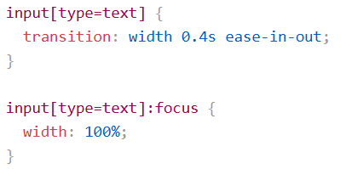
CSS Forms
Animated Search Input
In this example we use the CSS transition property to animate the width of the search input when it gets focus.

Slide 15
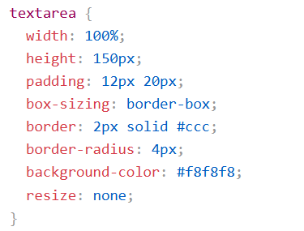
CSS Forms
Styling Textareas
Tip: Use the resize property to prevent textareas from being resized (disable the "grabber" in the bottom right corner)

Slide 16
CSS Counters
Automatic Numbering With Counters
CSS counters are like "variables". The variable values can be incremented by CSS rules (which will track how many times they are used).
To work with CSS counters we will use the following properties:
counter-reset - Creates or resets a counter
counter-increment - Increments a counter value
content - Inserts generated content
counter() or counters() function - Adds the value of a counter to an element
To use a CSS counter, it must first be created with counter-reset.

Slide 17
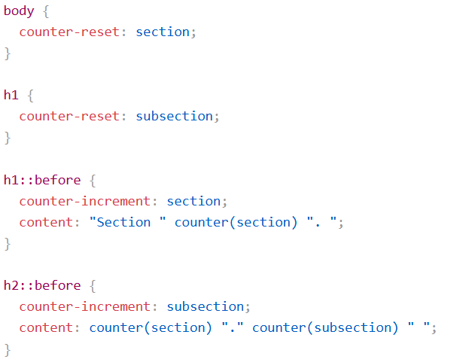
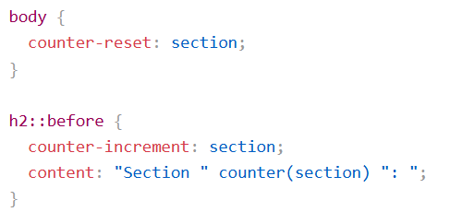
CSS Counters
Simple and Nesting Counters

Slide 18
Next Lecture
CSS Website Layout
CSS Units
CSS Specificity
CSS !important
CSS Math Function

Slide 19
Q&A
Q&A: Ask any questions about today’s lesson.

Slide 20
Thank You!
Happy Coding!
(Design by Syed Kifayat)

