Slide 1
Welcome to Front-End Development Bootcamp
Course Name: Front-End Development Bootcamp
Instructor: Syed Kifayat
Duration: 3 to 4 months
Lecture No: 5
Week No: 4

Slide 2
Previous Lecture
CSS Intro
CSS Syntax
CSS Selectors
Ways to Insert CSS
CSS Colors

Slide 3
CSS Backgrounds
The CSS background properties are used to add background effects for elements.
Background Properties:
background-color
background-image
background-repeat
background-attachment
background-position
background (shorthand property)

Slide 4
CSS background-color
The background-color property specifies the background color of an element.
With CSS, a color is most often specified by:
a valid color name - like "red“
a HEX value - like "#ff0000“
an RGB value - like "rgb(255,0,0)"
Opacity / Transparency
The opacity property specifies the opacity/transparency of an element. It can take a value from 0.0 - 1.0. The lower value, the more transparent

Slide 5
CSS background-image
The background-image property specifies an image to use as the background of an element.
By default, the image is repeated so it covers the entire element.
Note: When using a background image, use an image that does not disturb the text.

Slide 6
CSS background-repeat
By default, the background-image property repeats an image both horizontally and vertically.
Tip: To repeat an image vertically, set background-repeat: repeat-y;
CSS background-repeat: no-repeat
Showing the background image only once is also specified by the background-repeat property

Slide 7
CSS Background and background - Shorthand property
The background-position property is used to specify the position of the background image.
The background-attachment property specifies whether the background image should scroll or be fixed (will not scroll with the rest of the page)
To shorten the code, it is also possible to specify all the background properties in one single property. This is called a shorthand property.
body { background-color: #ffffff; background-image: url("img_tree.png"); background-repeat: no-repeat; background-position: right top; }
body { background: #ffffff url("img_tree.png") no-repeat right top; }

Slide 8
CSS background - Shorthand property
When using the shorthand property the order of the property values is:
background-color
background-image
background-repeat
background-attachment
background-position
It does not matter if one of the property values is missing, as long as the other ones are in this order. Note that we do not use the background-attachment property in the examples above, as it does not have a value.

Slide 9
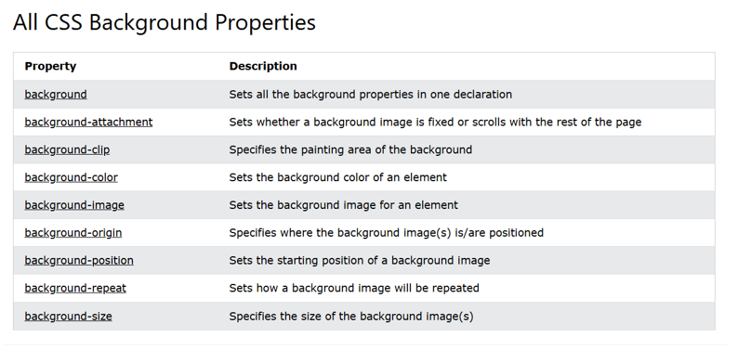
CSS background - Shorthand property

Slide 10
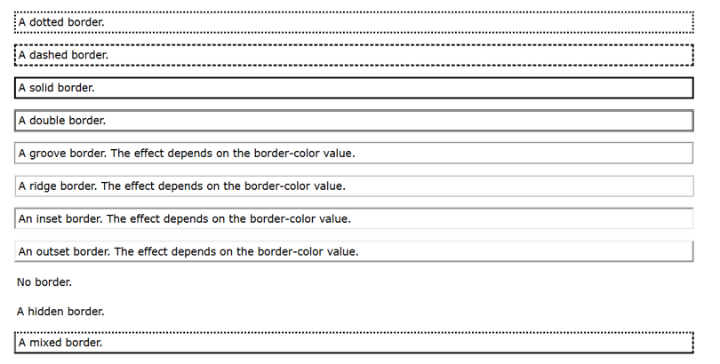
CSS Borders
The CSS border properties allow you to specify the style, width, and color of an element's border.
The border-style property specifies what kind of border to display.
The border-style property can have from one to four values (for the top border, right border, bottom border, and the left border).

Slide 11
CSS Border Width
The border-width property specifies the width of the four borders.
The width can be set as a specific size (in px, pt, cm, em, etc) or by using one of the three pre-defined values: thin, medium, or thick
The border-width property can have from one to four values (for the top border, right border, bottom border, and the left border)
The border-color property is used to set the color of the four borders.
Note: If border-color is not set, it inherits the color of the element.

Slide 12
CSS Border - Individual Sides
In CSS, there are also properties for specifying each of the borders (top, right, bottom, and left)
border-top-style: dotted;
border-right-style: solid;
border-bottom-style: dotted;
border-left-style: solid;

Slide 13
CSS Border Style
border-style: dotted solid double dashed;
top border is dotted
right border is solid
bottom border is double
left border is dashed
border-style: dotted solid double;
top border is dotted
right and left borders are solid
bottom border is double

Slide 14
CSS Border Style
border-style: dotted solid;
top and bottom borders are dotted
right and left borders are solid
border-style: dotted;
all four borders are dotted

Slide 15
CSS Border - Shorthand Property
Like you saw in the previous page, there are many properties to consider when dealing with borders.
To shorten the code, it is also possible to specify all the individual border properties in one property.
The border property is a shorthand property for the following individual border properties:
border-width
border-style (required)
border-color
border: 5px solid red;

Slide 16
CSS Rounded Borders
The border-radius property is used to add rounded borders to an element
border: 2px solid red;
border-radius: 5px;

Slide 17
CSS Margins
The CSS margin properties are used to create space around elements, outside of any defined borders.
With CSS, you have full control over the margins. There are properties for setting the margin for each side of an element (top, right, bottom, and left).
margin-top
margin-right
margin-bottom
margin-left
auto - the browser calculates the margin
length - specifies a margin in px, pt, cm, etc.
% - specifies a margin in % of the width of the containing element
inherit - specifies that the margin should be inherited from the parent element
Tip: Negative values are allowed.

Slide 18
Margin - Shorthand Property
To shorten the code, it is possible to specify all the margin properties in one property.
The margin property is a shorthand property for the following individual margin properties:
margin-top
margin-right
margin-bottom
margin-left
margin: 25px 50px 75px 100px;

Slide 19
The auto Value
You can set the margin property to auto to horizontally center the element within its container.
The element will then take up the specified width, and the remaining space will be split equally between the left and right margins.

Slide 20
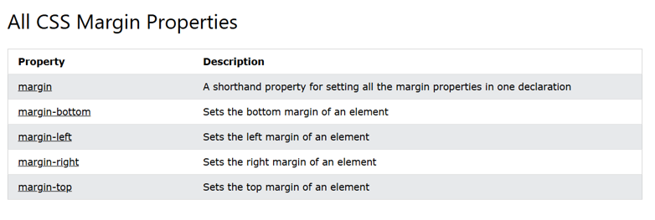
The inherit Value
This example lets the left margin of the <p class="ex1"> element be inherited from the parent element (<div>)
border: 1px solid red;
margin-left: 100px;
margin-left: inherit;

Slide 21
CSS Margin Collapse
Top and bottom margins of elements are sometimes collapsed into a single margin that is equal to the largest of the two margins.
This does not happen on left and right margins! Only top and bottom margins!
Demonstration of margin collapse:
h1 { margin: 0 0 50px 0; } h2 { margin: 20px 0 0 0; }

Slide 22
CSS Margin Collapse
In the example above, the <h1> element has a bottom margin of 50px and the <h2> element has a top margin set to 20px.
Common sense would seem to suggest that the vertical margin between the <h1> and the <h2> would be a total of 70px (50px + 20px). But due to margin collapse, the actual margin ends up being 50px.

Slide 23
CSS Padding
Padding is used to create space around an element's content, inside of any defined borders.
The CSS padding properties are used to generate space around an element's content, inside of any defined borders.
With CSS, you have full control over the padding. There are properties for setting the padding for each side of an element (top, right, bottom, and left).

Slide 24
Padding - Individual Sides
CSS has properties for specifying the padding for each side of an element:
padding-top
padding-right
padding-bottom
padding-left
All the padding properties can have the following values:
length - specifies a padding in px, pt, cm, etc.
% - specifies a padding in % of the width of the containing element
inherit - specifies that the padding should be inherited from the parent element
Note: Negative values are not allowed.

Slide 25
Padding - Shorthand Property
To shorten the code, it is possible to specify all the padding properties in one property.
The padding property is a shorthand property for the following individual padding properties:
padding-top
padding-right
padding-bottom
padding-left
padding: 25px 50px 75px 100px;
padding: 25px 50px 75px;
padding: 25px 50px;
padding: 25px;

Slide 26
CSS Height, Width and Max-width
The CSS height and width properties are used to set the height and width of an element.
The CSS max-width property is used to set the maximum width of an element.
The height and width properties do not include padding, borders, or margins. It sets the height/width of the area inside the padding, border, and margin of the element.

Slide 27
CSS height and width Values
The height and width properties may have the following values:
auto - This is default. The browser calculates the height and width
length - Defines the height/width in px, cm, etc.
% - Defines the height/width in percent of the containing block
initial - Sets the height/width to its default value
inherit - The height/width will be inherited from its parent value
Note: Remember that the height and width properties do not include padding, borders, or margins! They set the height/width of the area inside the padding, border, and margin of the element!

Slide 28
Setting max-width
The max-width property is used to set the maximum width of an element.
The max-width can be specified in length values, like px, cm, etc., or in percent (%) of the containing block, or set to none (this is default. Means that there is no maximum width).
The problem with the <div> above occurs when the browser window is smaller than the width of the element (500px). The browser then adds a horizontal scrollbar to the page.
In this situation, using max-width will improve the browser's handling of small windows.
Tip: Drag the browser window to smaller than 500px wide, to see the difference between the two divs!
Note: If you for some reason use both the width property and the max-width property on the same element, and the value of the width property is larger than the max-width property; the max-width property will be used (and the width property will be ignored).

Slide 29
The CSS Box Model
In CSS, the term "box model" is used when talking about design and layout.
The CSS box model is essentially a box that wraps around every HTML element. It consists of: content, padding, borders and margins. The image below illustrates the box model
Explanation of the different parts:
Content - The content of the box, where text and images appear
Padding - Clears an area around the content. The padding is transparent
Border - A border that goes around the padding and content
Margin - Clears an area outside the border. The margin is transparent
The box model allows us to add a border around elements, and to define space between elements.

Slide 30
Width and Height of an Element
In order to set the width and height of an element correctly in all browsers, you need to know how the box model works.
Important: When you set the width and height properties of an element with CSS, you just set the width and height of the content area. To calculate the total width and height of an element, you must also include the padding and borders.
320px (width of content area) + 20px (left padding + right padding) + 10px (left border + right border) = 350px (total width) 50px (height of content area) + 20px (top padding + bottom padding) + 10px (top border + bottom border) = 80px (total height)
Total element width = width + left padding + right padding + left border + right border
Total element height = height + top padding + bottom padding + top border + bottom border
Note: The margin property also affects the total space that the box will take up on the page, but the margin is not included in the actual size of the box. The box's total width and height stops at the border.

Slide 31
Next Lecture
CSS Outline
CSS Text
CSS Fonts
CSS Icon
CSS Links

Slide 32
Q&A
Q&A: Ask any questions about today’s lesson.

Slide 33
Thank You!
Happy Coding!
(Design by Syed Kifayat)

