Slide 1
Welcome to Front-End Development Bootcamp
Course Name: Front-End Development Bootcamp
Instructor: Syed Kifayat
Duration: 3 to 4 months
Lecture No: 6
Week No: 5

Slide 2
Previous Lecture
CSS Backgrounds (Color and Style)
CSS Borders (Width and Style)
Margin
Padding
Height and Width
Box Model

Slide 3
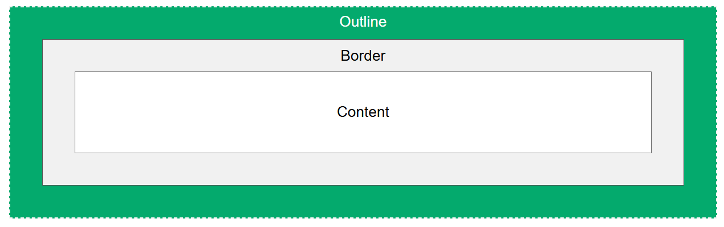
CSS Outline
An outline is a line drawn outside the element's border.
An outline is a line that is drawn around elements, OUTSIDE the borders, to make the element "stand out".

Slide 4
CSS Outline Properties
Outline-style
Outline-color
Outline-width
Outline-offset
Outline
Note: Outline differs from borders! Unlike border, the outline is drawn outside the element's border, and may overlap other content. Also, the outline is NOT a part of the element's dimensions; the element's total width and height is not affected by the width of the outline.

Slide 5
CSS Outline Style
The outline-style property specifies the style of the outline, and can have one of the following values:
dotted - Defines a dotted outline
dashed - Defines a dashed outline
solid - Defines a solid outline
double - Defines a double outline
groove - Defines a 3D grooved outline
ridge - Defines a 3D ridged outline
inset - Defines a 3D inset outline
outset - Defines a 3D outset outline
hidden - Defines a hidden outline
none - Defines no outline

Slide 6
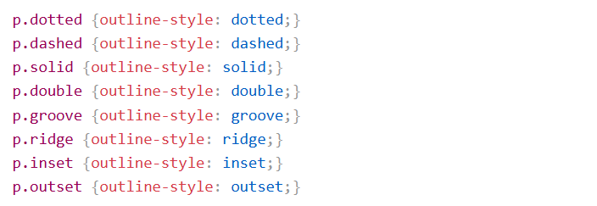
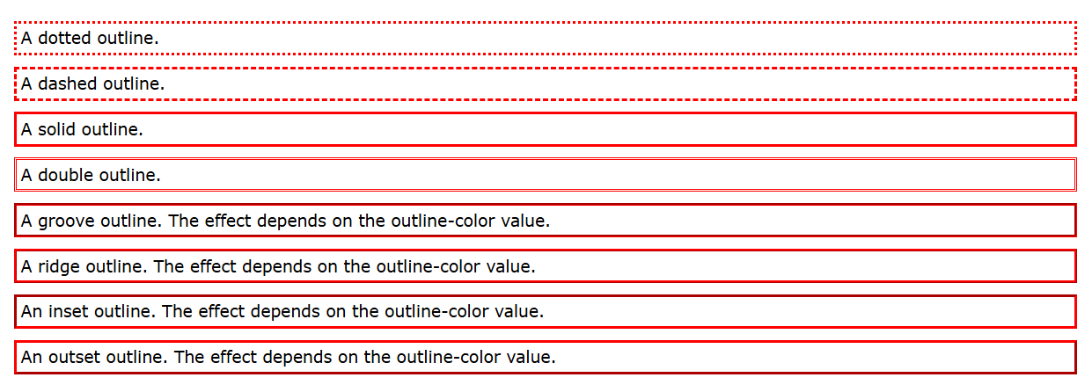
CSS Outline Style

Slide 7
CSS Outline Width
The outline-width property specifies the width of the outline, and can have one of the following values:
thin (typically 1px)
medium (typically 3px)
thick (typically 5px)
A specific size (in px, pt, cm, em, etc)

Slide 8
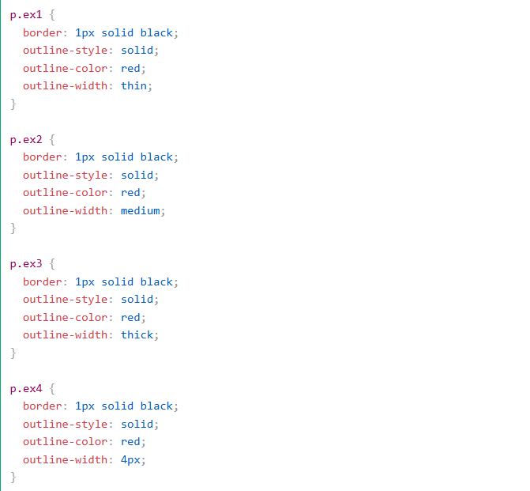
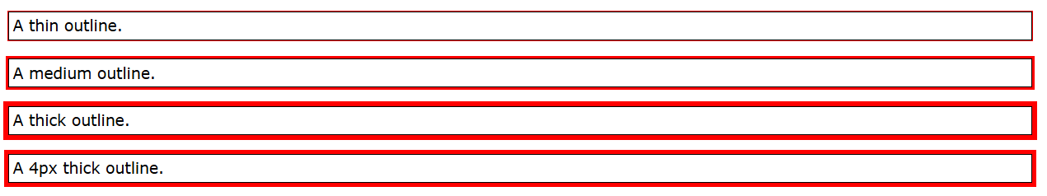
CSS Outline Width

Slide 9
CSS Outline Color
The outline-color property is used to set the color of the outline.
The color can be set by:
name - specify a color name, like "red"
HEX - specify a hex value, like "#ff0000“
RGB - specify a RGB value, like "rgb(255,0,0)"
HSL - specify a HSL value, like "hsl(0, 100%, 50%)"
invert - performs a color inversion (which ensures that the outline is visible, regardless of color background)

Slide 10
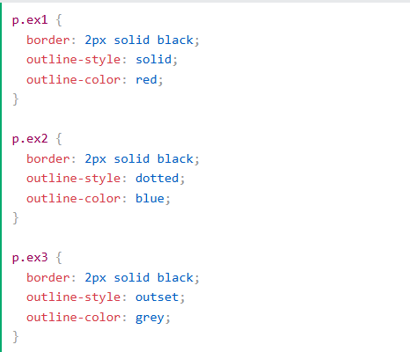
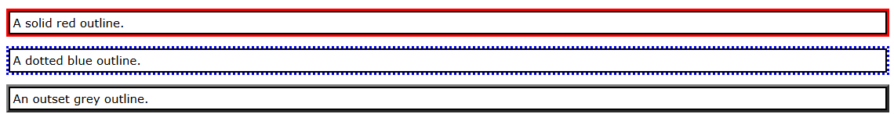
CSS Outline Color

Slide 11
CSS Outline Shorthand
The outline property is a shorthand property for setting the following individual outline properties:
outline-width
outline-style (required)
outline-color
The outline property is specified as one, two, or three values from the list above. The order of the values does not matter.

Slide 12
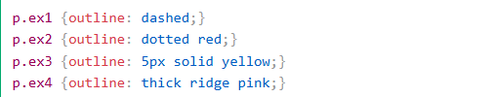
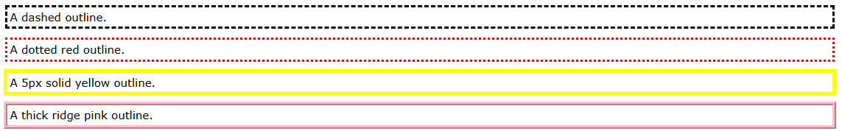
CSS Outline Shorthand

Slide 13
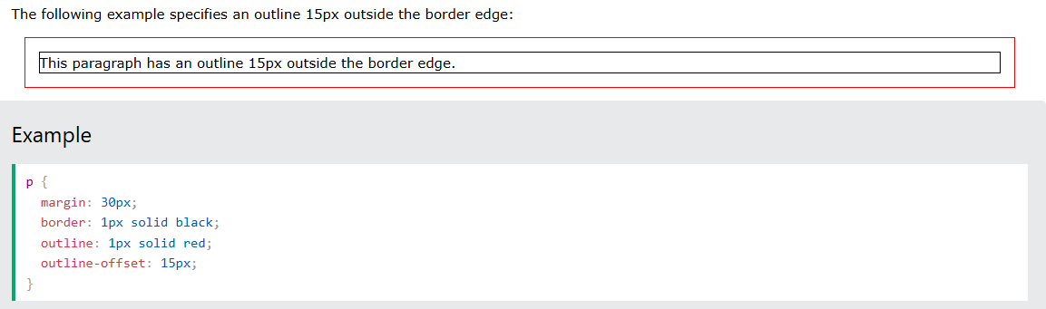
CSS Outline Offset
The outline-offset property adds space between an outline and the edge/border of an element. The space between an element and its outline is transparent.

Slide 14
CSS Text and background Color
The color property is used to set the color of the text. The color is specified by:
a color name - like "red"
a HEX value - like "#ff0000"
an RGB value - like "rgb(255,0,0)"
background-color: lightgrey;
color: blue;

Slide 15
Text Alignment and Text Direction
The text-align property is used to set the horizontal alignment of a text.
A text can be left or right aligned, centered, or justified.
text-align: center; left and right
When the text-align property is set to "justify", each line is stretched so that every line has equal width, and the left and right margins are straight (like in magazines and newspapers)

Slide 16
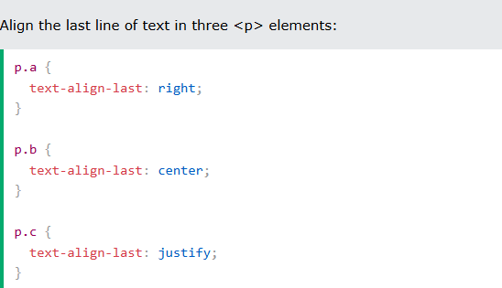
Text Alignment and Text Direction
The text-align-last property specifies how to align the last line of a text.

Slide 17
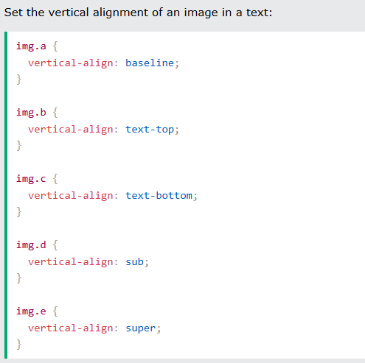
Text Alignment and Text Direction
The direction and unicode-bidi properties can be used to change the text direction of an element:
p {direction: rtl;unicode-bidi: bidi-override;}
The vertical-align property sets the vertical alignment of an element.

Slide 18
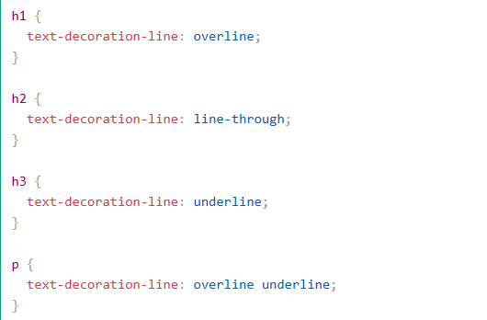
CSS Text Decoration
The text-decoration-line property is used to add a decoration line to text.
Tip: You can combine more than one value, like overline and underline to display lines both over and under a text.

Slide 19
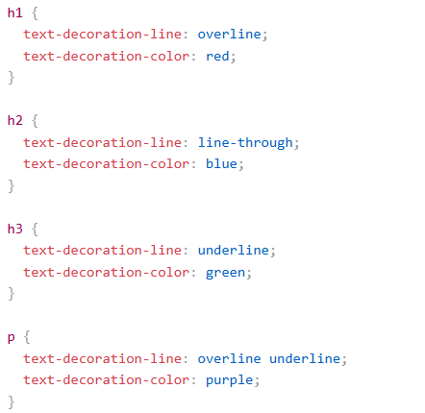
Specify a Color for the Decoration Line
The text-decoration-color property is used to set the color of the decoration line.

Slide 20
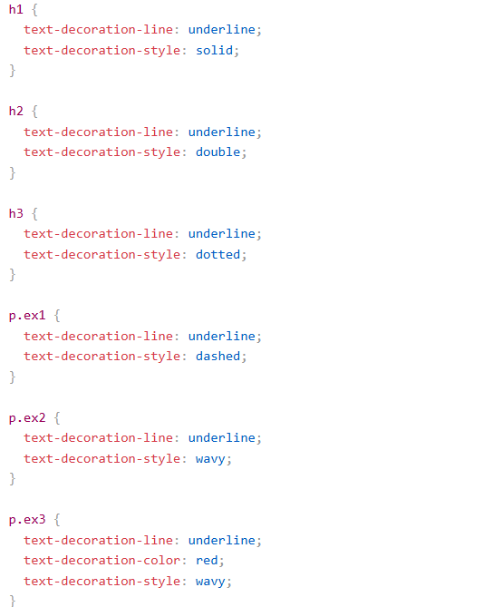
Specify a Style for the Decoration Line
The text-decoration-style property is used to set the style of the decoration line.

Slide 21
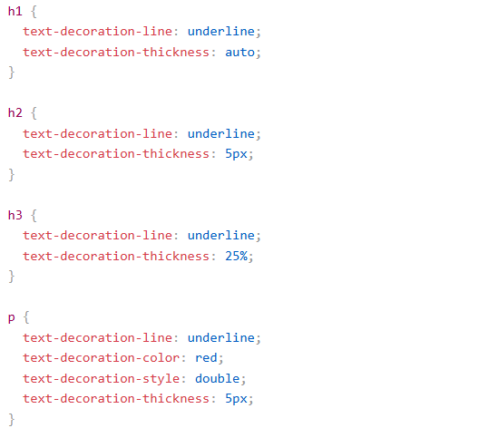
Specify the Thickness for the Decoration Line
The text-decoration-thickness property is used to set the thickness of the decoration line.

Slide 22
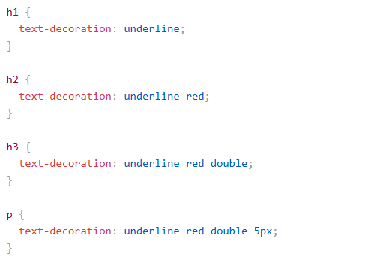
The Shorthand Property
The text-decoration property is a shorthand property for:
text-decoration-line (required)
text-decoration-color (optional)
text-decoration-style (optional)
text-decoration-thickness (optional)

Slide 23
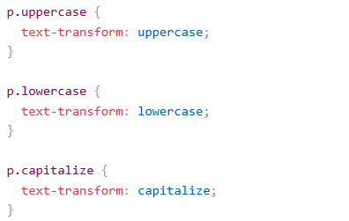
Text Transformation
The text-transform property is used to specify uppercase and lowercase letters in a text.
It can be used to turn everything into uppercase or lowercase letters, or capitalize the first letter of each word:

Slide 24
Text Spacing
The text-indent property is used to specify the indentation of the first line of a text like (text-indent: 50px;).
The letter-spacing property is used to specify the space between the characters in a text like (letter-spacing: -2px; and letter-spacing: 5px;).
The line-height property is used to specify the space between lines like (line-height: 0.8; line-height: 1.6;).
The word-spacing property is used to specify the space between the words in a text like (word-spacing: 10px; word-spacing: -2px;).
The white-space property specifies how white-space inside an element is handled like (white-space: nowrap;).

Slide 25
Text Shadow
The text-shadow property adds shadow to text.
text-shadow: 2px 2px;
text-shadow: 2px 2px red;
text-shadow: 2px 2px 5px red;
text-shadow: 2px 2px 4px #000000;
text-shadow: 0 0 3px #FF0000, 0 0 5px #0000FF;
text-shadow: 1px 1px 2px black, 0 0 25px blue, 0 0 5px darkblue;

Slide 26
CSS Fonts
Choosing the right font has a huge impact on how the readers experience a website.
The right font can create a strong identity for your brand.
Using a font that is easy to read is important. The font adds value to your text. It is also important to choose the correct color and text size for the font.

Slide 27
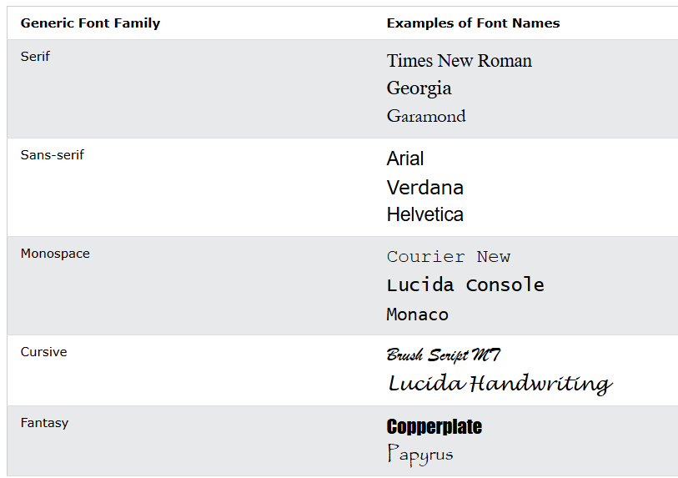
Generic Font Families
In CSS there are five generic font families:
Serif fonts have a small stroke at the edges of each letter. They create a sense of formality and elegance.
Sans-serif fonts have clean lines (no small strokes attached). They create a modern and minimalistic look.
Monospace fonts - here all the letters have the same fixed width. They create a mechanical look.
Cursive fonts imitate human handwriting.
Fantasy fonts are decorative/playful fonts.

Slide 28
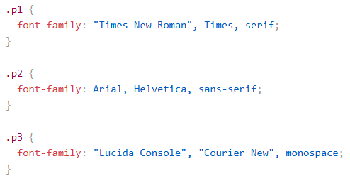
The CSS font-family Property
In CSS, we use the font-family property to specify the font of a text.
Note: If the font name is more than one word, it must be in quotation marks, like: "Times New Roman".
Tip: The font-family property should hold several font names as a "fallback" system, to ensure maximum compatibility between browsers/operating systems. Start with the font you want, and end with a generic family (to let the browser pick a similar font in the generic family, if no other fonts are available). The font names should be separated with a comma.

Slide 29
CSS Web Safe Fonts
Web safe fonts are fonts that are universally installed across all browsers and devices.
However, there are no 100% completely web safe fonts. There is always a chance that a font is not found or is not installed properly.
Therefore, it is very important to always use fallback fonts.
This means that you should add a list of similar "backup fonts" in the font-family property. If the first font does not work, the browser will try the next one, and the next one, and so on. Always end the list with a generic font family name.

Slide 30
Best Web Safe Fonts for HTML and CSS
Arial (sans-serif)
Verdana (sans-serif)
Tahoma (sans-serif)
Trebuchet MS (sans-serif)
Times New Roman (serif)
Georgia (serif)
Garamond (serif)
Courier New (monospace)
Brush Script MT (cursive)
Note: Before you publish your website, always check how your fonts appear on different browsers and devices, and always use fallback fonts!
Tip: Also check out all available Google Fonts and how to use them.

Slide 31
Best Web Safe Fonts for HTML and CSS
Arial is the most widely used font for both online and printed media. Arial is also the default font in Google Docs.
Arial is one of the safest web fonts, and it is available on all major operating systems.
Verdana is a very popular font. Verdana is easily readable even for small font sizes.
The Tahoma font has less space between the characters.
Trebuchet MS was designed by Microsoft in 1996. Use this font carefully. Not supported by all mobile operating systems.
Times New Roman is one of the most recognizable fonts in the world. It looks professional and is used in many newspapers and "news" websites. It is also the primary font for Windows devices and applications.
Georgia is an elegant serif font. It is very readable at different font sizes, so it is a good candidate for mobile-responsive design.
Garamond is a classical font used for many printed books. It has a timeless look and good readability.
Courier New is the most widely used monospace serif font. Courier New is often used with coding displays, and many email providers use it as their default font. Courier New is also the standard font for movie screenplays.
The Brush Script MT font was designed to mimic handwriting. It is elegant and sophisticated, but can be hard to read. Use it carefully.

Slide 32
CSS Font Fallbacks
Below are some commonly used font fallbacks, organized by the 5 generic font families.
Serif
Sans-serif
Monospace
Cursive
Fantasy

Slide 33
CSS Font Style
The font-style property is mostly used to specify italic text.
This property has three values:
normal - The text is shown normally
italic - The text is shown in italics
oblique - The text is "leaning" (oblique is very similar to italic, but less supported)
The font-weight property specifies the weight of a font
font-weight: normal;
font-weight: bold;

Slide 34
CSS Font Style
The font-variant property specifies whether or not a text should be displayed in a small-caps font.
In a small-caps font, all lowercase letters are converted to uppercase letters. However, the converted uppercase letters appears in a smaller font size than the original uppercase letters in the text.
font-variant: normal;
font-variant: small-caps;

Slide 35
CSS Font Size
The font-size property sets the size of the text.
Being able to manage the text size is important in web design. However, you should not use font size adjustments to make paragraphs look like headings, or headings look like paragraphs.
Always use the proper HTML tags, like <h1> - <h6> for headings and <p> for paragraphs.
The font-size value can be an absolute, or relative size.

Slide 36
CSS Font Size
Absolute size:
Sets the text to a specified size
Does not allow a user to change the text size in all browsers (bad for accessibility reasons)
Absolute size is useful when the physical size of the output is known
Relative size:
Sets the size relative to surrounding elements
Allows a user to change the text size in browsers
Note: If you do not specify a font size, the default size for normal text, like paragraphs, is 16px (16px=1em).

Slide 37
CSS Font Size
Setting the text size with pixels gives you full control over the text size.
Set Font Size With Em
To allow users to resize the text (in the browser menu), many developers use em instead of pixels.
1em is equal to the current font size. The default text size in browsers is 16px. So, the default size of 1em is 16px.
The size can be calculated from pixels to em using this formula: pixels/16=em
The solution that works in all browsers, is to set a default font-size in percent for the <body> element

Slide 38
Responsive Font Size
The text size can be set with a vw unit, which means the "viewport width".
That way the text size will follow the size of the browser window.
Viewport is the browser window size. 1vw = 1% of viewport width. If the viewport is 50cm wide, 1vw is 0.5cm.

Slide 39
Google Fonts
If you do not want to use any of the standard fonts in HTML, you can use Google Fonts.
Google Fonts are free to use, and have more than 1000 fonts to choose from.
Just add a special style sheet link in the <head> section and then refer to the font in the CSS.
<link rel="stylesheet" href="https://fonts.googleapis.com/css?family=Sofia">
Note: When specifying a font in CSS, always list at minimum one fallback font (to avoid unexpected behaviors). So, also here you should add a generic font family (like serif or sans-serif) to the end of the list.
Note: Requesting multiple fonts may slow down your web pages! So be careful about that.

Slide 40
CSS Great Font Pairings
Great font pairings are essential to great design.
Here are some basic rules to create great font pairings:
1. Complement
It is always safe to find font pairings that complement one another.
A great font combination should harmonize, without being too similar or too different.
2. Use Font Superfamilies
A font superfamily is a set of fonts designed to work well together. So, using different fonts within the same superfamily is safe.
For example, the Lucida superfamily contains the following fonts: Lucida Sans, Lucida Serif, Lucida Typewriter Sans, Lucida Typewriter Serif and Lucida Math.

Slide 41
CSS Great Font Pairings
3. Contrast is King
Two fonts that are too similar will often conflict. However, contrasts, done the right way, brings out the best in each font.
Example: Combining serif with sans serif is a well known combination.
A strong superfamily includes both serif and sans serif variations of the same font (e.g. Lucida and Lucida Sans).
4. Choose Only One Boss
One font should be the boss. This establishes a hierarchy for the fonts on your page. This can be achieved by varying the size, weight and color.

Slide 42
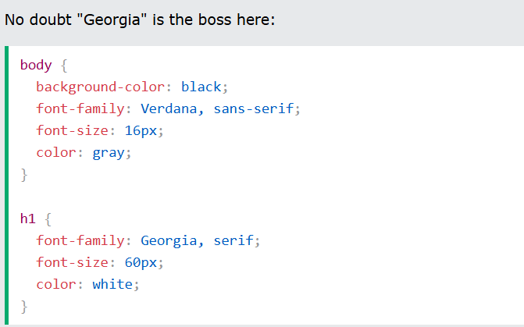
CSS Great Font Pairings

Slide 43
The CSS Font Property
To shorten the code, it is also possible to specify all the individual font properties in one property.
The font property is a shorthand property for:
font-style
font-variant
font-weight
font-size/line-height
font-family
Note: The font-size and font-family values are required. If one of the other values is missing, their default value are used.

Slide 44
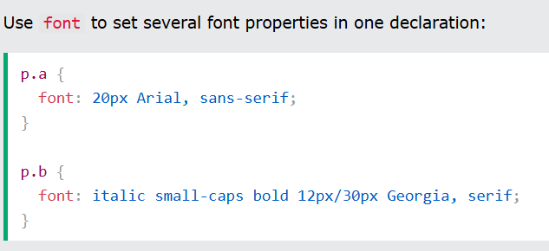
The CSS Font Property

Slide 45
Next Lecture
CSS Icon
CSS Links
CSS Lists
CSS Tables
CSS Display

Slide 46
Q&A
Q&A: Ask any questions about today’s lesson.

Slide 47
Thank You!
Happy Coding!
(Design by Syed Kifayat)

