Slide 1
Welcome to Front-End Development Bootcamp
Course Name: Front-End Development Bootcamp
Instructor: Syed Kifayat
Duration: 3 to 4 months
Lecture No: 8
Week No: 6

Slide 2
Previous Lecture
CSS Icon
CSS Links
CSS Lists
CSS Table
CSS Display

Slide 3
CSS Max-width
As mentioned in the previous chapter; a block-level element always takes up the full width available (stretches out to the left and right as far as it can).
Setting the width of a block-level element will prevent it from stretching out to the edges of its container. Then, you can set the margins to auto, to horizontally center the element within its container. The element will take up the specified width, and the remaining space will be split equally between the two margins:

Slide 4
CSS Max-width
Note: The problem with the <div> above occurs when the browser window is smaller than the width of the element. The browser then adds a horizontal scrollbar to the page.
Using max-width instead, in this situation, will improve the browser's handling of small windows. This is important when making a site usable on small devices:
Tip: Resize the browser window to less than 500px wide, to see the difference between the two divs!

Slide 5
CSS Position
The position property specifies the type of positioning method used for an element (static, relative, fixed, absolute or sticky).
Elements are then positioned using the top, bottom, left, and right properties. However, these properties will not work unless the position property is set first. They also work differently depending on the position value.
position: static;
HTML elements are positioned static by default.
Static positioned elements are not affected by the top, bottom, left, and right properties.
An element with position: static; is not positioned in any special way; it is always positioned according to the normal flow of the page

Slide 6
CSS Position
position: relative;
An element with position: relative; is positioned relative to its normal position.
Setting the top, right, bottom, and left properties of a relatively-positioned element will cause it to be adjusted away from its normal position. Other content will not be adjusted to fit into any gap left by the element.
position: fixed;
An element with position: fixed; is positioned relative to the viewport, which means it always stays in the same place even if the page is scrolled. The top, right, bottom, and left properties are used to position the element.
A fixed element does not leave a gap in the page where it would normally have been located.

Slide 7
CSS Position
position: absolute;
An element with position: absolute; is positioned relative to the nearest positioned ancestor (instead of positioned relative to the viewport, like fixed).
However; if an absolute positioned element has no positioned ancestors, it uses the document body, and moves along with page scrolling.
Note: Absolute positioned elements are removed from the normal flow, and can overlap elements.
position: sticky;
An element with position: sticky; is positioned based on the user's scroll position.
A sticky element toggles between relative and fixed, depending on the scroll position. It is positioned relative until a given offset position is met in the viewport - then it "sticks" in place (like position:fixed).
Note: You must specify at least one of top, right, bottom or left for sticky positioning to work.

Slide 8
CSS z-index
The z-index property specifies the stack order of an element.
When elements are positioned, they can overlap other elements.
The z-index property specifies the stack order of an element (which element should be placed in front of, or behind, the others).
An element can have a positive or negative stack order.
Note: z-index only works on positioned elements (position: absolute, position: relative, position: fixed, or position: sticky) and flex items (elements that are direct children of display: flex elements).

Slide 9
CSS Overflow
The CSS overflow property controls what happens to content that is too big to fit into an area.
The overflow property specifies whether to clip the content or to add scrollbars when the content of an element is too big to fit in the specified area.
The overflow property has the following values:
visible - Default. The overflow is not clipped. The content renders outside the element's box
hidden - The overflow is clipped, and the rest of the content will be invisible
scroll - The overflow is clipped, and a scrollbar is added to see the rest of the content
auto - Similar to scroll, but it adds scrollbars only when necessary
Note: The overflow property only works for block elements with a specified height.
Note: In OS X Lion (on Mac), scrollbars are hidden by default and only shown when being used (even though "overflow:scroll" is set).

Slide 10
CSS Overflow
overflow: visible
By default, the overflow is visible, meaning that it is not clipped and it renders outside the element's box.
overflow: hidden
With the hidden value, the overflow is clipped, and the rest of the content is hidden.
overflow: scroll
Setting the value to scroll, the overflow is clipped and a scrollbar is added to scroll inside the box. Note that this will add a scrollbar both horizontally and vertically (even if you do not need it).

Slide 11
CSS Overflow
overflow: auto
The auto value is similar to scroll, but it adds scrollbars only when necessary.
overflow-x and overflow-y
The overflow-x and overflow-y properties specifies whether to change the overflow of content just horizontally or vertically (or both):
overflow-x specifies what to do with the left/right edges of the content.
overflow-y specifies what to do with the top/bottom edges of the content.

Slide 12
CSS Float
The CSS float property specifies how an element should float.
The CSS clear property specifies what elements can float beside the cleared element and on which side.
The float property is used for positioning and formatting content e.g. let an image float left to the text in a container.
The float property can have one of the following values:
left - The element floats to the left of its container
right - The element floats to the right of its container
none - The element does not float (will be displayed just where it occurs in the text). This is default
inherit - The element inherits the float value of its parent
In its simplest use, the float property can be used to wrap text around images.

Slide 13
CSS Clear
When we use the float property, and we want the next element below (not on right or left), we will have to use the clear property.
The clear property specifies what should happen with the element that is next to a floating element.
The clear property can have one of the following values:
none - The element is not pushed below left or right floated elements. This is default
left - The element is pushed below left floated elements
right - The element is pushed below right floated elements
both - The element is pushed below both left and right floated elements
inherit - The element inherits the clear value from its parent
When clearing floats, you should match the clear to the float: If an element is floated to the left, then you should clear to the left. Your floated element will continue to float, but the cleared element will appear below it on the web page.

Slide 14
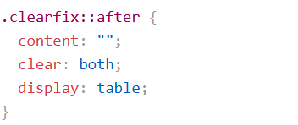
CSS Clear
If a floated element is taller than the containing element, it will "overflow" outside of its container. We can then add a clearfix hack to solve this problem.
The overflow: auto clearfix works well as long as you are able to keep control of your margins and padding (else you might see scrollbars). The new, modern clearfix hack however, is safer to use, and the following code is used for most webpages:
You will learn more about the ::after pseudo-element in a later chapter.

Slide 15
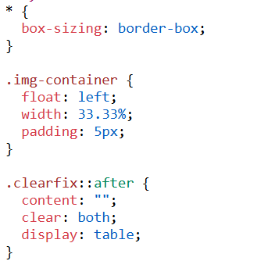

CSS Clear

Slide 16
CSS Layout - display: inline-block
Compared to display: inline, the major difference is that display: inline-block allows to set a width and height on the element.
Compared to display: block, the major difference is that display: inline-block does not add a line-break after the element, so the element can sit next to other elements.
One common use for display: inline-block is to display list items horizontally instead of vertically.

Slide 17
CSS Layout - Horizontal & Vertical Align
To horizontally center a block element (like <div>), use margin: auto;
Setting the width of the element will prevent it from stretching out to the edges of its container.
The element will then take up the specified width, and the remaining space will be split equally between the two margins.
Note: Center aligning has no effect if the width property is not set (or set to 100%).
To just center the text inside an element, use text-align: center;

Slide 18
CSS Layout - Horizontal & Vertical Align
One method for aligning elements is to use position: absolute;
Note: Absolute positioned elements are removed from the normal flow, and can overlap elements.
Another method for aligning elements is to use the float property.
Note: If an element is taller than the element containing it, and it is floated, it will overflow outside of its container. You can use the "clearfix hack" to fix.
There are many ways to center an element vertically in CSS. A simple solution is to use top and bottom padding.

Slide 19
CSS Layout - Horizontal & Vertical Align
To center both vertically and horizontally, use padding and text-align: center.
Center Vertically - Using line-height
Another trick is to use the line-height property with a value that is equal to the height property.
Center Vertically - Using position & transform
If padding and line-height are not options, another solution is to use positioning and the transform property.
Center Vertically - Using Flexbox
You can also use flexbox to center things. Just note that flexbox is not supported in IE10 and earlier versions

Slide 20
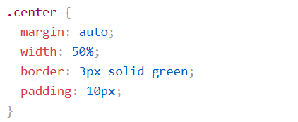
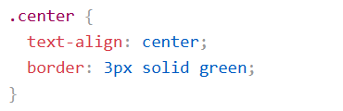
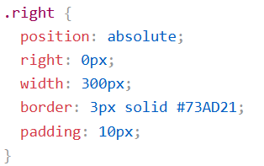
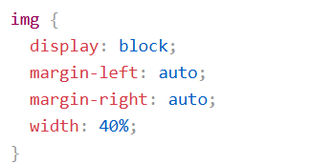
CSS Layout - Horizontal & Vertical Align Code

Slide 21
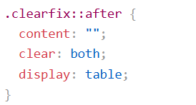
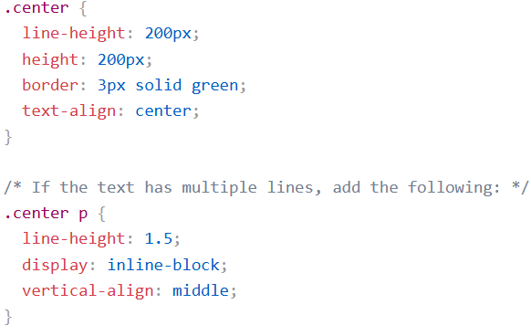
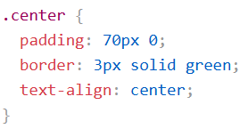
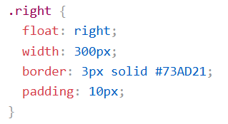
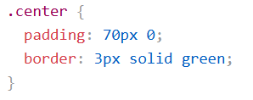
CSS Layout - Horizontal & Vertical Align Code

Slide 22
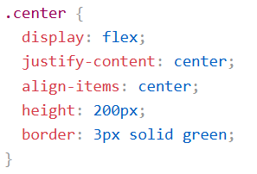
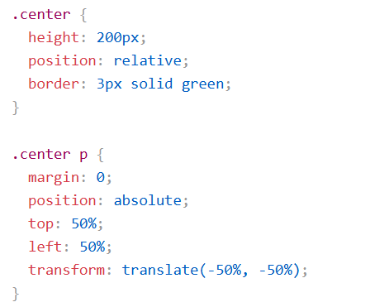
CSS Layout - Horizontal & Vertical Align Code

Slide 23
Next Lecture
CSS Combinators
CSS Pseudo-classes
CSS Pseudo-elements
CSS Opacity
CSS Navigation Bar

Slide 24
Q&A
Q&A: Ask any questions about today’s lesson.

Slide 25
Thank You!
Happy Coding!
(Design by Syed Kifayat)

