Slide 1
Welcome to Front-End Development Bootcamp
Course Name: Front-End Development Bootcamp
Instructor: Syed Kifayat
Duration: 3 to 4 months
Lecture No: 9
Week No: 7

Slide 2
Previous Lecture
CSS Max-width
CSS Position
CSS z-index
CSS Overflow
CSS Float
CSS Inline-block
CSS Align

Slide 3
CSS Combinators
A combinator is something that explains the relationship between the selectors.
A CSS selector can contain more than one simple selector. Between the simple selectors, we can include a combinator.
There are four different combinators in CSS:
Descendant combinator (space)
Child combinator (>)
Next sibling combinator (+)
Subsequent-sibling combinator (~)

Slide 4
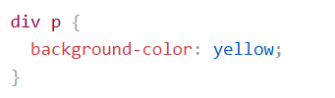
Descendant Combinator
The descendant combinator matches all elements that are descendants of a specified element.
The following example selects all <p> elements inside <div> elements:

Slide 5

Child Combinator (>)
The child combinator selects all elements that are the children of a specified element.
The following example selects all <p> elements that are children of a <div> element:

Slide 6

Next Sibling Combinator (+)
The next sibling combinator is used to select an element that is directly after another specific element.
Sibling elements must have the same parent element, and "adjacent" means "immediately following".
The following example selects the first <p> element that are placed immediately after <div> elements:

Slide 7

Subsequent-sibling Combinator (~)
The subsequent-sibling combinator selects all elements that are next siblings of a specified element.
The following example selects all <p> elements that are next siblings of <div> elements:

Slide 8

CSS Pseudo-classes
A pseudo-class is used to define a special state of an element.
For example, it can be used to:
Style an element when a user moves the mouse over it
Style visited and unvisited links differently
Style an element when it gets focus
Style valid/invalid/required/optional form elements
The syntax of pseudo-classes:

Slide 9
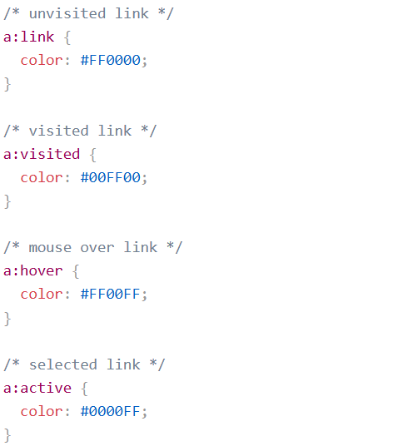
Anchor Pseudo-classes
Note: a:hover MUST come after a:link and a:visited in the CSS definition in order to be effective! a:active MUST come after a:hover in the CSS definition in order to be effective! Pseudo-class names are not case-sensitive.

Slide 10
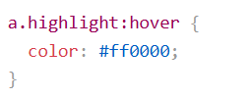
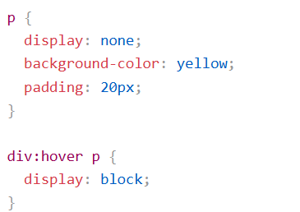
Pseudo-classes and HTML Classes
Pseudo-classes can be combined with HTML classes.
Hover over a <div> element to show a <p> element (like a tooltip)

Slide 11

Pseudo-classes and HTML Classes
CSS - The :first-child Pseudo-class
The :first-child pseudo-class matches a specified element that is the first child of another element.
Match the first <p> element
In the following example, the selector matches any <p> element that is the first child of any element:

Slide 12


Pseudo-classes and HTML Classes
Match the first <i> element in all <p> elements
In the following example, the selector matches the first <i> element in all <p> elements
Match all <i> elements in all first child <p> elements
In the following example, the selector matches all <i> elements in <p> elements that are the first child of another element:

Slide 13
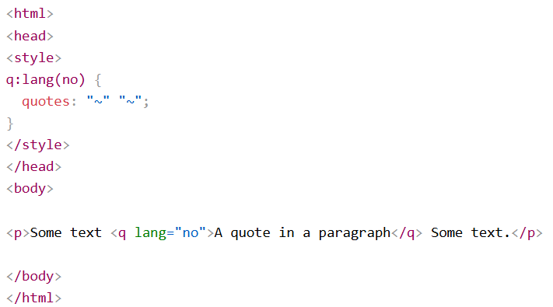
Pseudo-classes and HTML Classes
CSS - The :lang Pseudo-class
The :lang pseudo-class allows you to define special rules for different languages.
In the example below, :lang defines the quotation marks for <q> elements with lang="no":

Slide 14

CSS Pseudo-elements
A CSS pseudo-element is used to style specific parts of an element.
For example, it can be used to:
Style the first letter or line, of an element
Insert content before or after an element
Style the markers of list items
Style the viewbox behind a dialog box
The syntax of pseudo-elements:

Slide 15
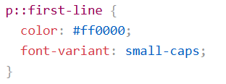
CSS Pseudo-elements
The ::first-line Pseudo-element
The ::first-line pseudo-element is used to add a special style to the first line of a text.
The following example formats the first line of the text in all <p> elements:
Note: The ::first-line pseudo-element can only be applied to block-level elements.

Slide 16
CSS Pseudo-elements
The following properties apply to the ::first-line pseudo-element:
font properties
color properties
background properties
word-spacing
letter-spacing
text-decoration
vertical-align
text-transform
line-height
clear

Slide 17
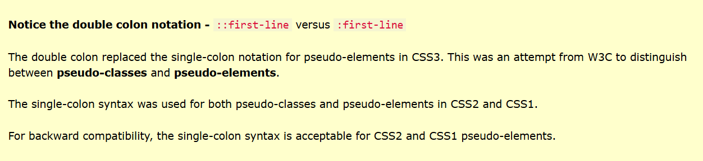
CSS Pseudo-elements

Slide 18
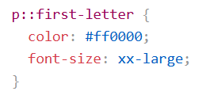
CSS Pseudo-elements
The ::first-letter Pseudo-element
The ::first-letter pseudo-element is used to add a special style to the first letter of a text.
The following example formats the first letter of the text in all <p> elements:
Note: The ::first-letter pseudo-element can only be applied to block-level elements.

Slide 19
CSS Pseudo-elements
The following properties apply to the ::first-letter pseudo- element:
font properties
color properties
background properties
margin properties
padding properties
border properties
text-decoration
vertical-align (only if "float" is "none")
text-transform
line-height
float
clear

Slide 20
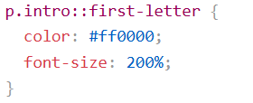
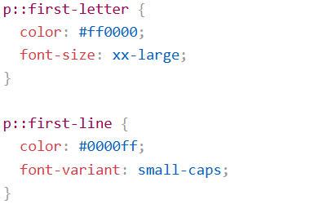
CSS Pseudo-elements
Pseudo-elements and HTML Classes
Pseudo-elements can be combined with HTML classes:
Multiple Pseudo-elements: Several pseudo-elements can also be combined.
In the following example, the first letter of a paragraph will be red, in an xx-large font size. The rest of the first line will be blue, and in small-caps. The rest of the paragraph will be the default font size and color:

Slide 21

CSS Pseudo-elements
CSS - The ::before Pseudo-element
The ::before pseudo-element can be used to insert some content before the content of an element.
The following example inserts an image before the content of each <h1> element:

Slide 22

CSS Pseudo-elements
CSS - The ::after Pseudo-element
The ::after pseudo-element can be used to insert some content after the content of an element.
The following example inserts an image after the content of each <h1> element:

Slide 23
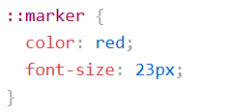
CSS Pseudo-elements
CSS - The ::marker Pseudo-element
The ::marker pseudo-element selects the markers of list items.
The following example styles the markers of list items:

Slide 24
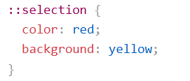
CSS Pseudo-elements
CSS - The ::selection Pseudo-element
The ::selection pseudo-element matches the portion of an element that is selected by a user.
The following CSS properties can be applied to ::selection: color, background, cursor, and outline.
The following example makes the selected text red on a yellow background:

Slide 25
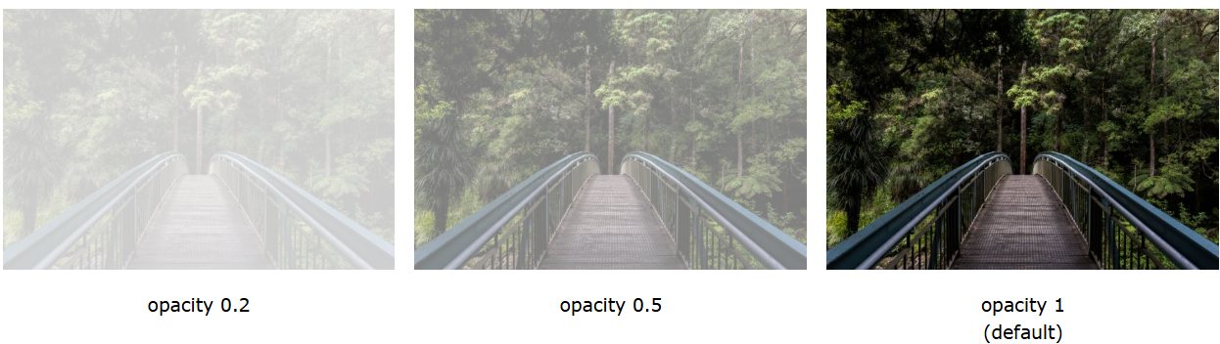
CSS Opacity / Transparency
The opacity property specifies the opacity/transparency of an element.
Transparent Image
The opacity property can take a value from 0.0 - 1.0. The lower the value, the more transparent:

Slide 26

CSS Opacity / Transparency
Transparent Hover Effect
The opacity property is often used together with the :hover selector to change the opacity on mouse-over:

Slide 27
CSS Navigation Bar
Having easy-to-use navigation is important for any web site.
With CSS you can transform boring HTML menus into good-looking navigation bars.
Navigation Bar = List of Links
A navigation bar needs standard HTML as a base.
In our examples we will build the navigation bar from a standard HTML list.
A navigation bar is basically a list of links, so using the <ul> and <li> elements makes perfect sense.

Slide 28
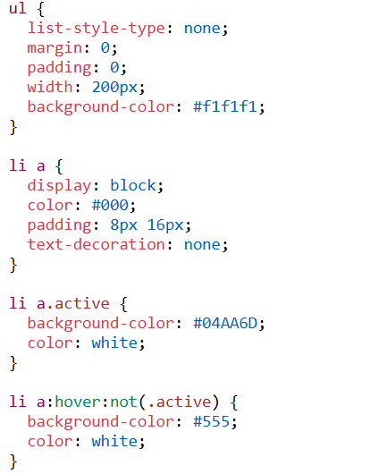
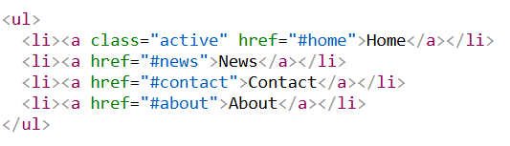
CSS Navigation Bar

Slide 29
Horizontal Navigation Bar
There are two ways to create a horizontal navigation bar. Using inline or floating list items.
Inline List Items
One way to build a horizontal navigation bar is to specify the <li> elements as inline, in addition to the "standard" code from the previous page:

Slide 30
Next Lecture
CSS Dropdowns
CSS Image Gallery
CSS Attribute Selector
CSS Forms
CSS Counter

Slide 31
Q&A
Q&A: Ask any questions about today’s lesson.

Slide 32
Thank You!
Happy Coding!
(Design by Syed Kifayat)

