Slide 1
Welcome to Front-End Development Bootcamp
Course Name: Front-End Development Bootcamp
Instructor: Syed Kifayat
Duration: 3 to 4 months
Objective: Learn how to build responsive and interactive websites

Slide 2
What is Front-End Development?
The front end is what users interact with on a website.
It includes HTML, CSS, and JavaScript.
Front-end developers focus on UI/UX and website responsiveness.

Slide 3
Technologies Used in Front-End
HTML: Structure of the webpage
CSS: Styling and layout
JavaScript: Interactivity
Frameworks & Libraries: React.js, Vue.js, Bootstrap, Tailwind CSS

Slide 4
How Websites Work?
The browser requests a webpage from a server.
The server responds with HTML, CSS, and JavaScript files.
The browser renders the files into a visible website.

Slide 5
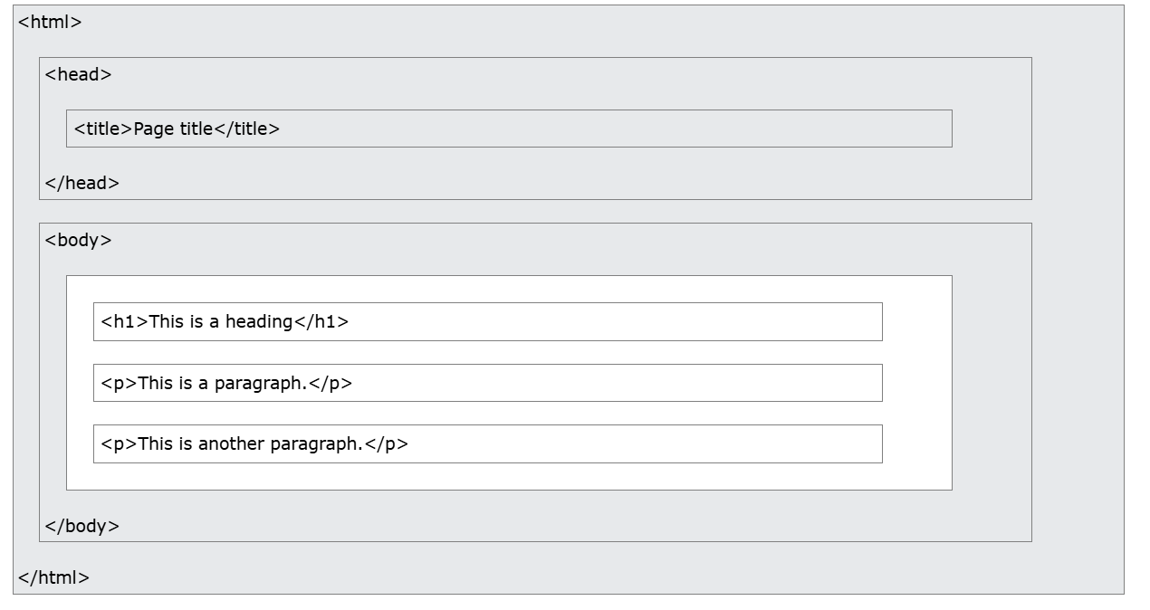
Web Browsers
The purpose of a web browser (Chrome, Edge, Firefox, Safari) is to read HTML documents and display them correctly.
A browser does not display the HTML tags, but uses them to determine how to display the document

Slide 6
Setting Up Your Development Environment
Install: VS Code (Code Editor)
Extensions: Live Server, Prettier
Tools: Chrome DevTools (Inspect, Console)
Write & Run: A simple HTML file in the browser

Slide 7
Introduction to HTML
What is HTML? The backbone of a webpage.
Basic Structure:
<!DOCTYPE html>
<html>
<head>
<title>My First Page</title>
</head>
<body>
<h1>Hello, World!</h1>
</body>
</html>

Slide 8
Html Tags/ Html Element

Slide 9
Common HTML Tags
Headings: <h1> to <h6>
Paragraphs: <p>
Links: <a href='URL'>
Images: <img src='image.jpg' alt='Description’>
Line break: <br>
Horizontal Rules: <hr>
Lists: <ul>, <ol>, <li>

Slide 10
HTML Elements
The HTML element is everything from the start tag to the end tag:
<tagname>Content goes here...</tagname>
Examples of some HTML elements:
<h1>My First Heading</h1>
<p>My first paragraph.</p>
Note: Some HTML elements have no content (like the <br> element). These elements are called empty elements. Empty elements do not have an end tag!

Slide 11
HTML Formatting Elements
<b> - Bold text
<strong> - Important text
<i> - Italic text
<em> - Emphasized text
<mark> - Marked text
<small> - Smaller text
<del> - Deleted text
<ins> - Inserted text
<sub> - Subscript text
<sup> - Superscript text

Slide 12
HTML Quotation and Citation Elements
<blockquote> for Quotations
<q> for Short Quotations
<abbr> for Abbreviations
<address> for Contact Information
<cite> for Work Title
<bdo> for Bi-Directional Override

Slide 13
HTML Comment Tag
You can add comments to your HTML source by using the following syntax: <!—comment-- >
Notice that there is an exclamation point (!) in the start tag, but not in the end tag.
Note: Comments are not displayed by the browser, but they can help document your HTML source code.
This can be helpful if you hide content temporarily

Slide 14
HTML Links - Syntax
<a href="url">link text</a>
The target attribute specifies where to open the linked document.
Target value: _self, _blank, _parent, _top.

Slide 15
Absolute URLs vs. Relative URLs
<h2>Absolute URLs</h2> <p><a href="https://www.w3.org/">W3C</a></p> <p><a href="https://www.google.com/">Google</a></p>
<h2>Relative URLs</h2> <p><a href="html_images.asp">HTML Images</a></p> <p><a href="/css/default.asp">CSS Tutorial</a></p>

Slide 16
HTML Attributes
All HTML elements can have attributes
Attributes provide additional information about elements
Attributes are always specified in the start tag
Attributes usually come in name/value pairs like: name="value“
Example:
href, src ,width, height, alt, style, title, type.

Slide 17
Hands-on Activity
Create a simple webpage with:
- A heading (<h1>)
- A paragraph (<p>)
- An image (<img>)
- A clickable link (<a>)
-Use every HTML Formatting Elements
-Use every HTML Quotation and Citation Elements

Slide 18
Next Class Preview
What is html table.
What is html lists
Html block and inline elements
Html class and Id Attribute
Html Iframes

Slide 19
Q&A
Q&A: Ask any questions about today’s lesson.

Slide 20
Thank You!
Happy Coding!
(Design by Syed Kifayat)

