Slide 1
Welcome to Front-End Development Bootcamp
Course Name: Front-End Development Bootcamp
Instructor: Syed Kifayat
Duration: 3 to 4 months
Lecture No: 2
Week No: 2

Slide 2
Previous Lecture
Introduction to Front-End Development
Front-End Technologies
Tags and Element in html
Formatting Elements
Quotation and citation Elements
Absolute and Relative URL’s
HTML Attributes

Slide 3
HTML Tables (table cell)
HTML tables allow web developers to arrange data into rows and columns.
A table in HTML consists of table cells inside rows and columns.
Each table cell is defined by a <td> and a </td> tag.
td stand for table data.
Everything between <td> and </td> is the content of a table cell.
Note: A table cell can contain all sorts of HTML elements: text, images, lists, links, other tables, etc.

Slide 4
HTML Tables (table row)
Each table row starts with a <tr> and end with a </tr> tag.
tr stand for table row.
You can have as many rows as you like in a table; just make sure that the number of cells are the same in each row.
Note: There are times when a row can have less or more cells than another. You will learn about that in a later chapter.

Slide 5
HTML Tables (table header)
Sometimes you want your cells to be table header cells. In those cases use the <th> tab instead of the <td> tag.
th stands for table header.
By default, the text in <th> elements are bold and centered, but you can change that with CSS.

Slide 6
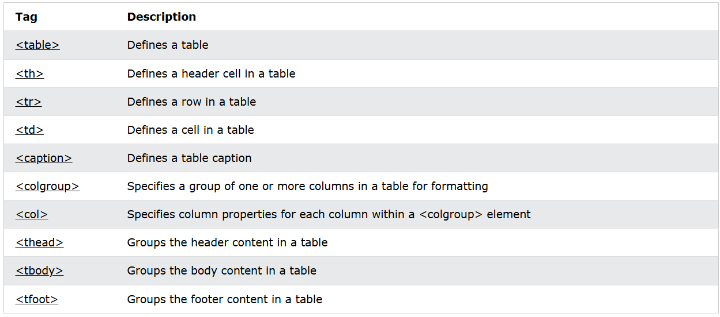
HTML Table tags

Slide 7
HTML Tables (table border)
HTML tables can have borders of different styles and shapes.
To add a border, use the CSS border property on table, th and td elements.
To avoid having double borders like in the example above, set the CSS border-collapse property to collapse.
This will make the borders collapse into a single border.
With the border-radius property, the borders get rounded corners.
border-style property: dotted, dashed, solid, double, groove, ridge, inset, outset, none and hidden.

Slide 8
Header for Multiple Columns and Caption
You can have a header that spans over two or more columns.
To do, this use the colspan attribute on the <th> element.
You can add a caption that serves as a heading for the entire table.
To add a caption to a table, use the <caption> tag.
Note: The <caption> tag should be inserted immediately after the <table> tag.

Slide 9
HTML Table Padding & Spacing
HTML tables can adjust the padding inside the cells, and also the space between the cells.
Cell padding is the space between the cell edges and the cell content.
By default the padding is set to 0.
Padding properties: padding, padding-top, padding-left, padding-right and padding-bottom.
Cell spacing is the space between each cell.
By default the space is set to 2 pixels.
To change the space between table cells, use the CSS border-spacing property on the table element.

Slide 10
HTML Table – Colspan/Rowspan
To make a cell span over multiple columns, use the colspan attribute.
Note: The value of the colspan attribute represents the number of columns to span.
To make a cell span over multiple rows, use the rowspan attribute
Note: The value of the rowspan attribute represents the number of rows to span.

Slide 11
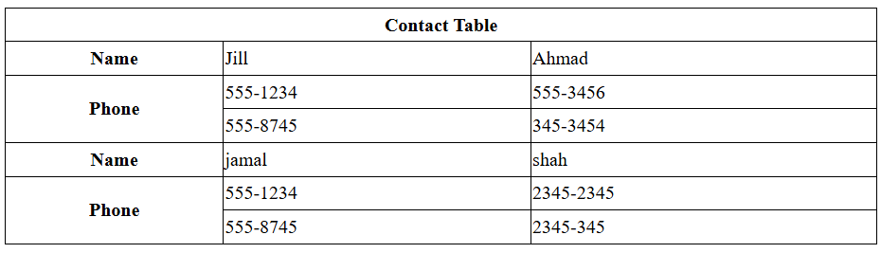
Colspan/Rowspan in HTML Table

Slide 12
HTML Table Colgroup
If you want to style the first two columns of a table, use the <colgroup> and <col> elements.
The <colgroup> element should be used as a container for the column specifications.
Each group is specified with a <col> element .
The span attribute specifies how many columns get the style.
Note: There is a very limited selection of legal CSS properties for colgroups.
Note: The <colgroup> tag must be a child of a <table> element and should be placed before any other table elements, like <thead>, <tr>, <td> etc., but after the <caption> element, if present.

Slide 13
Legal CSS Properties for colgroup
There is only a very limited selection of CSS properties that are allowed to be used in the colgroup:
width property
visibility property
background properties
border properties
All other CSS properties will have no effect on your tables.

Slide 14
Multiple/Empty Col Elements
If you want to style multiple columns with different styles, use more than one <col> element inside the <colgroup>
If you want to style columns in the middle of a table, insert an "empty" <col> element (with no styles) for the columns before
You can hide columns with the visibility: collapse property

Slide 15
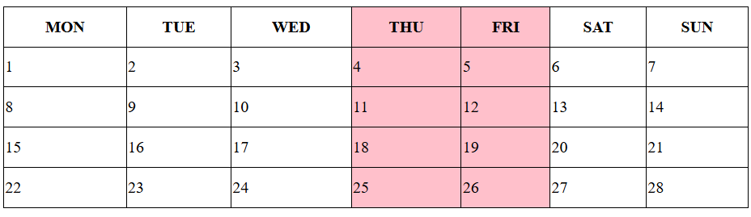
Multiple/Empty Col Elements

Slide 16
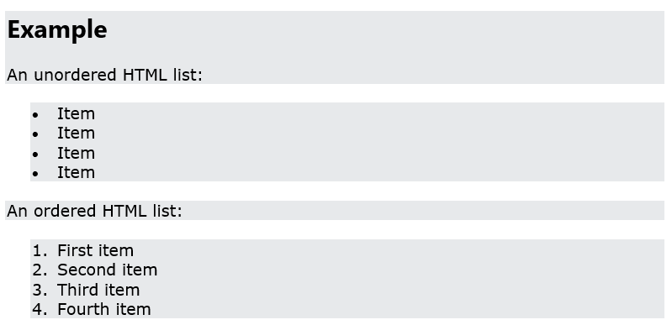
HTML Lists
HTML lists allow web developers to group a set of related items in lists.

Slide 17
Unordered/Ordered HTML List
An unordered list starts with the <ul> tag. Each list item starts with the <li> tag.
The list items will be marked with bullets (small black circles) by default.
An ordered list starts with the <ol> tag. Each list item starts with the <li> tag.
The list items will be marked with numbers by default

Slide 18
HTML Description Lists
HTML also supports description lists.
A description list is a list of terms, with a description of each term.
The <dl> tag defines the description list, the <dt> tag defines the term (name), and the <dd> tag describes each term

Slide 19
HTML Block and Inline Elements
Every HTML element has a default display value, depending on what type of element it is.
The two most common display values are block and inline.

Slide 20
Block-level Elements
A block-level element always starts on a new line, and the browsers automatically add some space (a margin) before and after the element.
A block-level element always takes up the full width available (stretches out to the left and right as far as it can).
Two commonly used block elements are: <p> and <div>.
The <p> element defines a paragraph in an HTML document.
The <div> element defines a division or a section in an HTML document.

Slide 21
Block-level Elements List
<address>
<article>
<aside>
<blockquote>
<canvas>
<dd>
<div>
<dl>
<dt>
<fieldset>
<ul>
<video>
<figcaption>
<figure>
<footer>
<form>
<h1>-<h6>
<header>
<hr>
<li>
<main>
<nav>
<noscript>
<ol>
<pre>
<section>
<table>
<tfoot>
<p>

Slide 22
Inline Elements
An inline element does not start on a new line.
An inline element only takes up as much width as necessary.
This is a <span> element inside a paragraph.
Note: An inline element cannot contain a block-level element!

Slide 23
Inline Elements
<q>
<samp>
<script>
<select>
<small>
<span>
<strong>
<sub>
<sup>
<textarea>
<time>
<a>
<abbr>
<acronym>
<b>
<bdo>
<big>
<br>
<button>
<cite>
<code>
<dfn>
<em>
<i>
<img>
<input>
<kbd>
<label>
<map>
<object>
<output>
<tt>
<var>

Slide 24
HTML class Attribute
The HTML class attribute is used to specify a class for an HTML element.
Multiple HTML elements can share the same class.
The class attribute is often used to point to a class name in a style sheet. It can also be used by a JavaScript to access and manipulate elements with the specific class name.
Tip: The class attribute can be used on any HTML element.
Note: The class name is case sensitive!
To create a class; write a period (.) character, followed by a class name. Then, define the CSS properties within curly braces {}
HTML elements can belong to more than one class.

Slide 25
HTML id Attribute
The HTML id attribute is used to specify a unique id for an HTML element.
You cannot have more than one element with the same id in an HTML document.
The id attribute specifies a unique id for an HTML element. The value of the id attribute must be unique within the HTML document.
The id attribute is used to point to a specific style declaration in a style sheet. It is also used by JavaScript to access and manipulate the element with the specific id.
The syntax for id is: write a hash character (#), followed by an id name. Then, define the CSS properties within curly braces {}
Note: The id name is case sensitive!
Note: The id name must contain at least one character, cannot start with a number, and must not contain whitespaces (spaces, tabs, etc.).

Slide 26
Difference Between Class and ID
A class name can be used by multiple HTML elements, while an id name must only be used by one HTML element within the page
HTML bookmarks are used to allow readers to jump to specific parts of a webpage.
Bookmarks can be useful if your page is very long.
To use a bookmark, you must first create it, and then add a link to it.
Then, when the link is clicked, the page will scroll to the location with the bookmark.

Slide 27
HTML Iframes
An HTML iframe is used to display a web page within a web page.
The HTML <iframe> tag specifies an inline frame.
<iframe src="url" title="description"></iframe>
Tip: It is a good practice to always include a title attribute for the <iframe>. This is used by screen readers to read out what the content of the iframe is.
Use the height and width attributes to specify the size of the iframe.
The height and width are specified in pixels by default
By default, an iframe has a border around it.

Slide 28
HTML Iframes
An iframe can be used as the target frame for a link.
The target attribute of the link must refer to the name attribute of the iframe
Use border:none; to remove the border around the iframe
Always include a title attribute (for screen readers)

Slide 29
💡 Activity 1 Create a Simple HTML Table
Objective: Learn how to create an HTML table with rows, columns, and headers.
Task:
Create a table with 3 columns: Product Name, Price, Category.
Add 3 rows with sample product data.
Use the <th> tag for headers and <td> for data.
Add a table caption and apply border-collapse using CSS.

Slide 30
💡 Activity 2 Create HTML Listing
Objective: Understand different types of HTML lists.
Task:
Create an unordered list of your 5 favorite foods.
Create an ordered list of your daily routine (morning to night).
Create a description list explaining 3 programming languages (HTML, CSS, JavaScript).

Slide 31
💡 Activity 3 Use Class & ID in HTML and CSS
Objective: Learn how to use class and ID for styling.
Task:
Create a div container with a class called box and an ID called unique-box.
Apply CSS styles to the class (background color, padding, border).
Apply different styles to the ID (font size, text color).

Slide 32
💡 Activity Embed a Website Using Iframe
Objective: Learn how to use <iframe> to embed external content.
Embed Google Maps for your city inside an <iframe>.
Embed a YouTube video of your favorite tutorial.
Adjust the width and height of the iframe.
Remove the iframe border using CSS.

Slide 33
Next Class Preview
HTML Head Element
HTML Layout Elements
HTML Responsive Web Design
HTML Computer Code Elements
HTML Semantic Elements
HTML Forms
HTML Multimedia
HTML Video
HTML Audio
HTML YouTube Videos

Slide 34
Q&A
Q&A: Ask any questions about today’s lesson.

Slide 35
Thank You!
Happy Coding!
(Design by Syed Kifayat)

