Slide 1
Marketing Campaign Analysis
Project Demonstration

Slide 2
Presented By
Syed Baqar, Reg # 2024-MS-DS-119

Slide 3
Agenda of Discussion
Problem Statement
Adopted Methodology
EDA Summary
Concepts Used in the Project
Project Reports (Snippets from the Workbook)
Future Direction

Slide 4
Problem Statement
Company wants to predict which customers to target in their next marketing campaign. They have the previous campaign data which they want to utilize to gain further insights. Their objective is to first identify the ideal customer profile and then train a model on previous marketing campaign data to predict whether the user will accept the offer in which campaign. Company wants to send up to 5 marketing campaigns. But to optimize their cost, they want to know in which marketing campaign the user will convert.

Slide 5
Methodology
Data Hygiene
Handle missing values
Remove unnecessary columns
Determine Most Useful Feature
Random forest classifier – to extract feature importance
Determine Best Cluster of Customer
Categorical feature transformation
Outlier Handling
DecisionTreeClassifier – to generate cluster descriptions
KMeans clustering to determine best cluster for business

Slide 6
EDA Summary
29 features
2240 feature vectors
2 x Categorical Features (Education, Martial Status)
1 x Date feature (Dt_Customer)
No duplicate IDs found – all customer records are unique
Dt_Customer feature transformed to ‘days_since_customer’ feature
Income feature has 24 null entries, which were removed.
Income feature also has outliers, which were also removed.
49 features after transformation
Data Source: kaggle

Slide 7
Concept Used In the Project
EDA
Information
Null values handling
Duplicate records check
Models
Random Forest Classifier
KMeans
Libraries
Data exploration
Categorical variable handling
Datetime variables handling
Outlier Handling
Correlation Analysis
Feature Scaling
Others
Hyper Parameter Optimization
Seaborn
Matplotlib
Pandas
Plotly
Confusion Matrix
Model Evaluation

Slide 8
Achievements so far
EDA
Selection of Most Important Features
Generation of Ideal Customer Profile

Slide 9
EDA & Ideal Customer Profile
How do our ideal customers look like

Slide 10
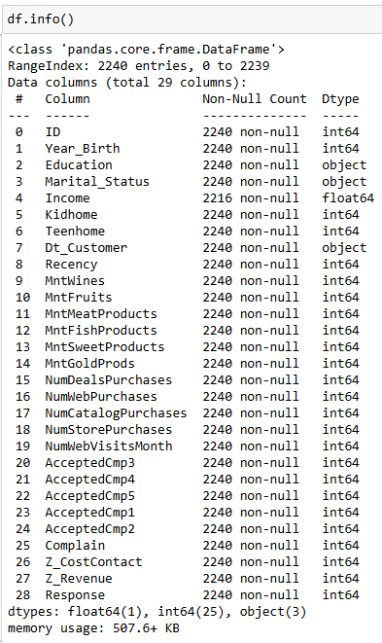
Info()
Info of original dataframe

Slide 11
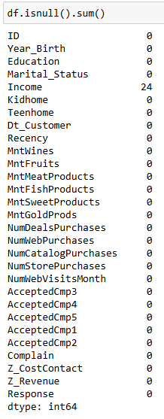
Null Values
Income columns only

Slide 12
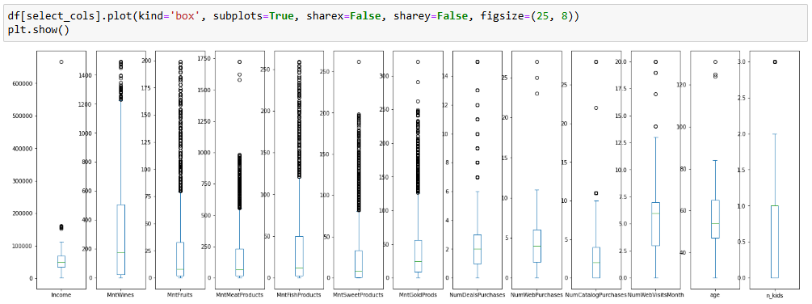
Outlier Handling

Slide 13
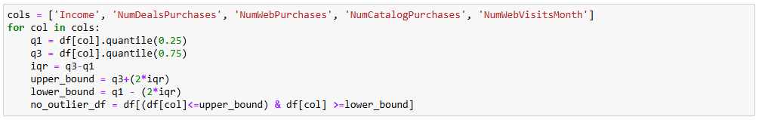
Outlier Removal

Slide 14
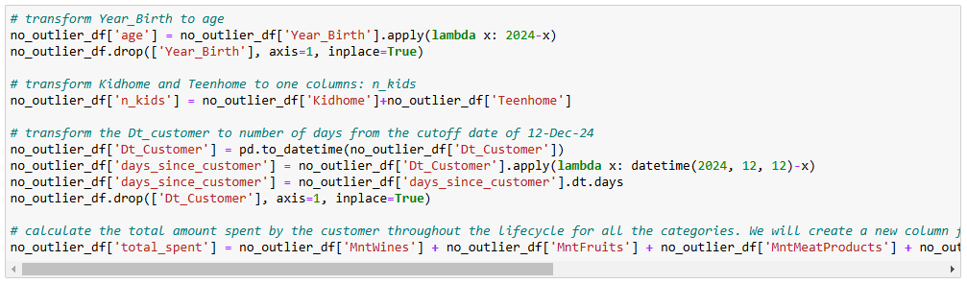
Data Transformation

Slide 15
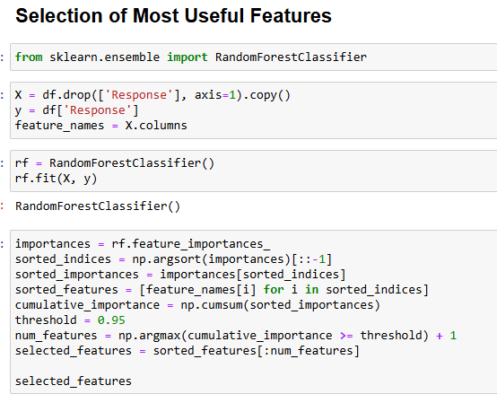
Selection of Most Useful Features
RandomForestClassifier

Slide 16
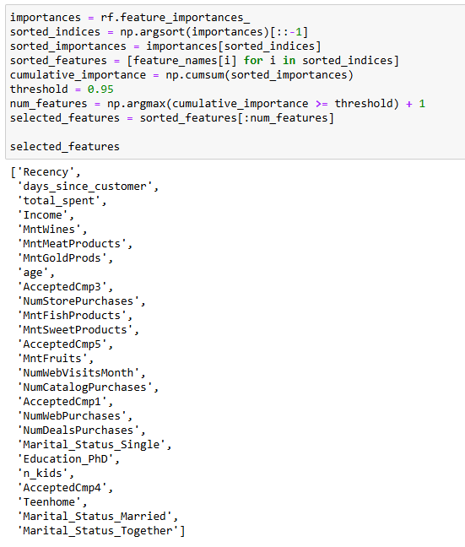
Most Useful Features

Slide 17
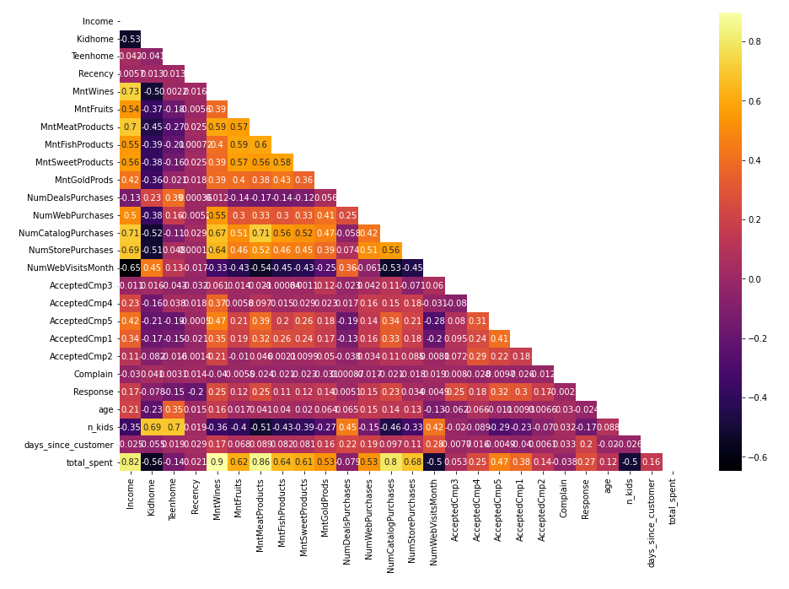
Correlation Analysis

Slide 18
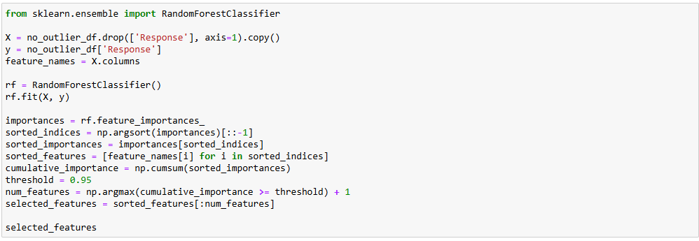
Selection of Most Useful Features
Selected features: ['Recency', 'days_since_customer', 'total_spent', 'Income', 'MntMeatProducts', 'MntWines', 'MntGoldProds', 'age', 'MntSweetProducts', 'AcceptedCmp3', 'AcceptedCmp5', 'MntFishProducts', 'NumStorePurchases', 'NumCatalogPurchases', 'MntFruits', 'AcceptedCmp1', 'NumWebVisitsMonth', 'NumDealsPurchases', 'NumWebPurchases', 'n_kids', 'Marital_Status_Single', 'Education_PhD', 'Marital_Status_Married', 'AcceptedCmp2', 'Teenhome', 'Marital_Status_Together']

Slide 19
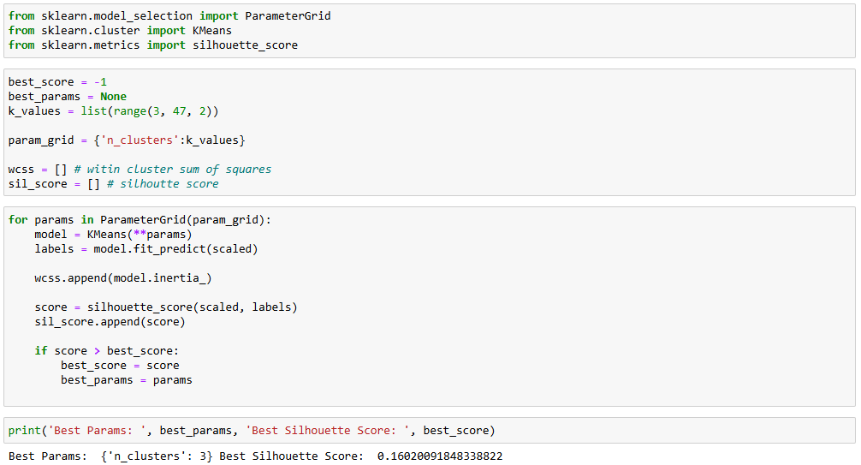
Clustering
Feature Scaling
KMeans Algorithm
Parameter Grid Implementation

Slide 20
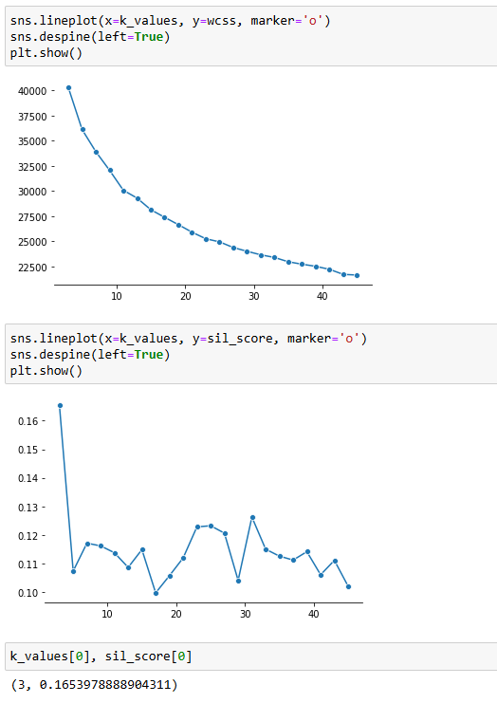
Selection of Optimal Number of Clusters
Within Cluster Sum of Squares
Silhouette Score

Slide 21
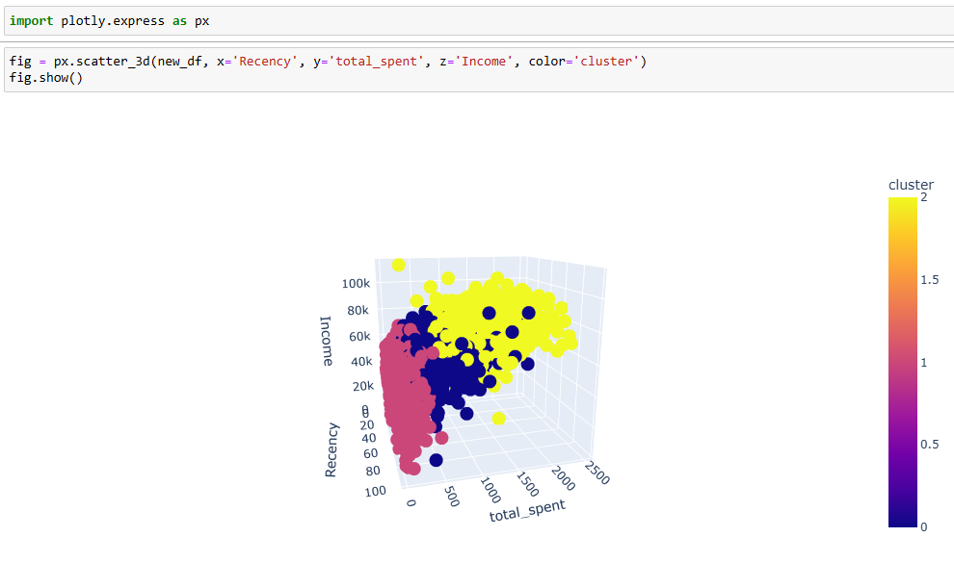
Ploty – 3D Plot for Recency, Total Spent, and Income
Segregated against different clusters

Slide 22
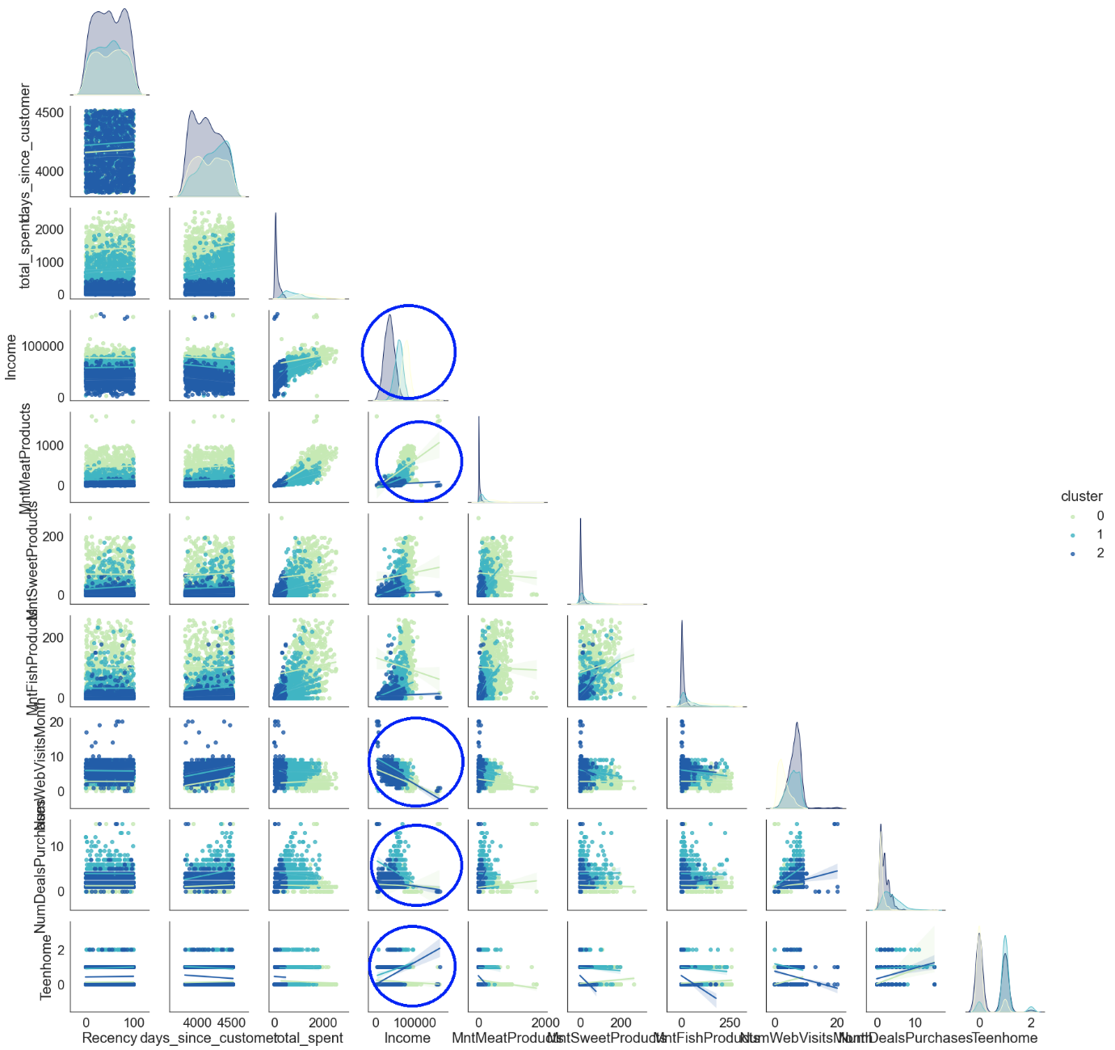
Pair Plot
Observations:
The cluster 0 contains the high-income customers.
Strong positive correlation between income and amount spent on meat products
Strong negative correlation between income and purchases from the web
Strong negative correlation between income and number of deal purchases
Negative correlation between income and number of teens at home for cluster 0 customers, and strong positive correlation for cluster 1 and 2 customers

Slide 23
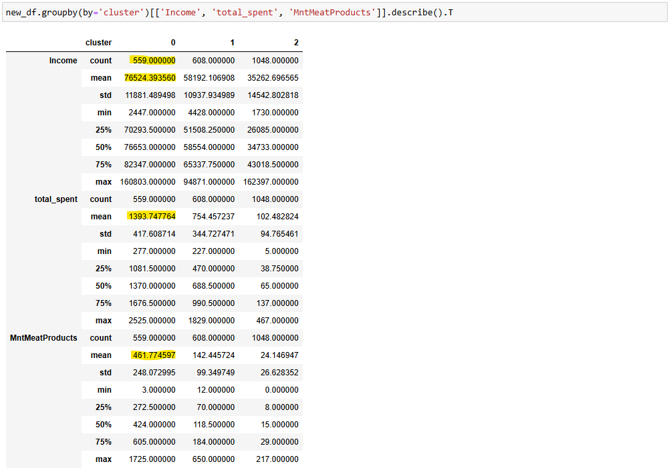
Cluster, Income, Spending

Slide 24
Cluster Descriptions
Using DecisionTreeClassifier

Slide 25
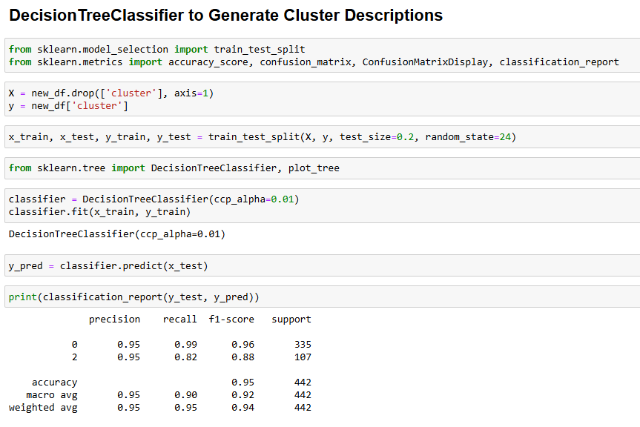
Cluster Description
Decision Tree Classifier

Slide 26
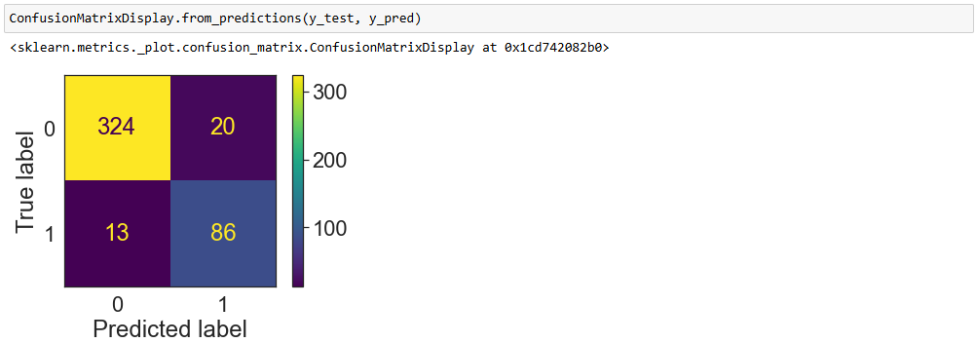
Confusion Matrix

Slide 27
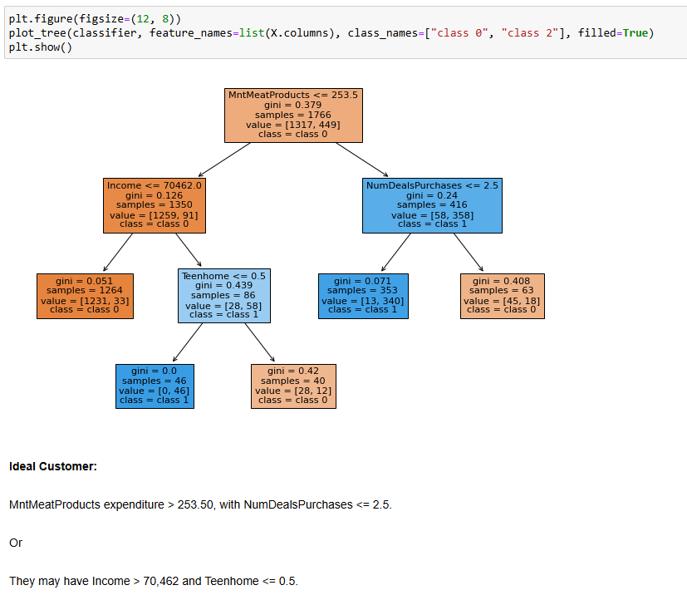
Cluster Description
Ideal Customer

Slide 28
Future Direction
Evaluation of the model to see if it’s of any good for the business use case

Slide 29
Post Project Review
Outlier Treatment: Outliers in six features were not removed, leaving their impact on the results uncertain. Further analysis can be conducted by removing these outliers and reassessing cluster quality.
Model Performance: The confusion matrix for the DecisionTreeClassifier indicates the presence of false positives and false negatives. There is an opportunity to refine the model by tuning its hyperparameters and re-evaluating its performance using the confusion matrix.
Business Relevance: Is there a difference between profitable customers and the average customer? Utilization of statistical tests is required to confirm or disconfirm it.

