Slide 1

Sprocket Central Pty Ltd
Data analytics approach
[Business Unit] - [Data Analyst]

Slide 2
Agenda
Introduction
Data Exploration
Model Development
Interpretation

Slide 3
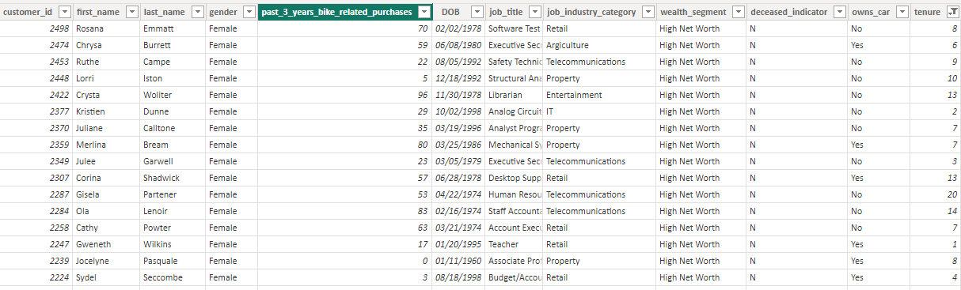
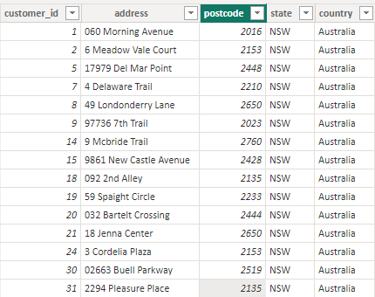
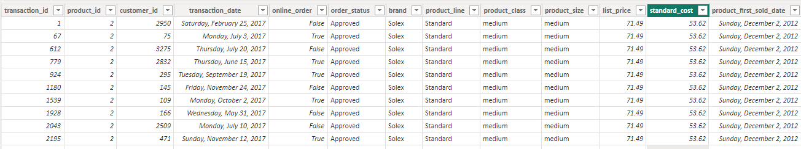
Introduction
We’ll Start with the Data Cleaning
We have cleaned the data and removed unwanted columns.

Slide 4
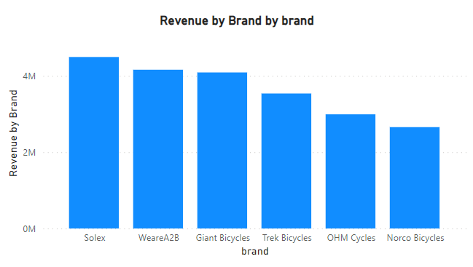
Data Exploration
These are the Data Exploration techniques we are going to implement in this project
Descriptive Statistics
Data Visualization
Data Profile
Exploratory Data Analysis
Correlation Analysis
Place any supporting images, graphs, data or extra text here.

Slide 5
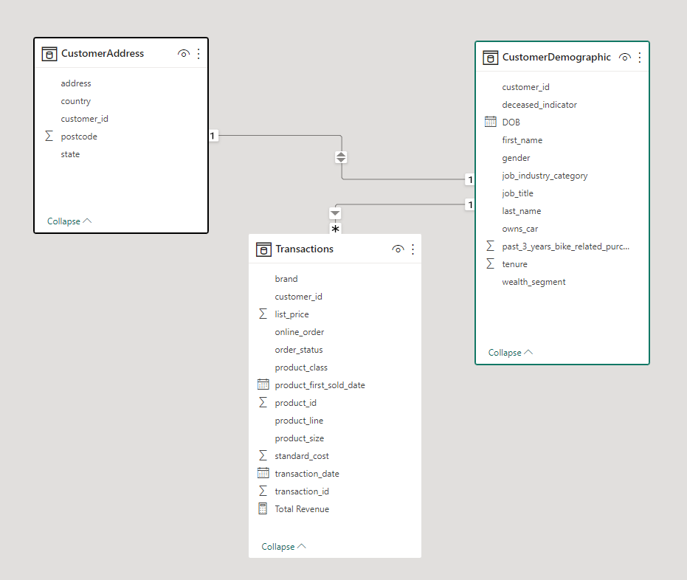
Model Development
Creating the Data Model
We have created a efficient data model as shown in the picture
Transactions table as Fact Table
CustomerDemographic as Dimension Table
CustomerAddress as Dimension Table
Place any supporting images, graphs, data or extra text here.
Relationships
Many to One Relationship (CustomerDemographic to Transactions)
One to One Relationship (CustomerAddress to CustomerDemographic)

Slide 6
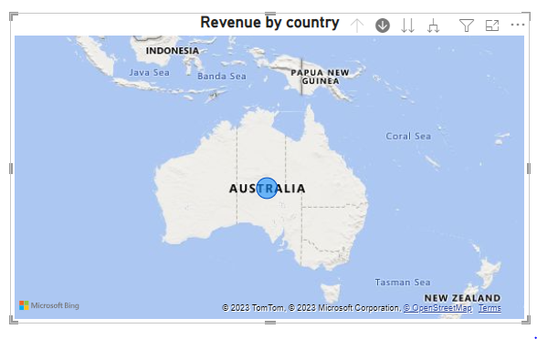
Interpretation
Interpreting Data for Marketing Campaign
We’ll create visual based on the data we received and create a interactive dashboard for data interpretation
Top Customer by Area
Top Customer by Age Group
Top Customer by Product Class
Top Customer by Gender
Place any supporting images, graphs, data or extra text here.

Slide 7
Appendix

Slide 8
Appendix
Data Collection Methods: This section provides details about the methods used to collect the data, including surveys, experiments, observations, or data obtained from secondary sources.
Data Cleaning Process: Describe the steps taken to clean and preprocess the raw data. This may include handling missing values, removing outliers, standardizing data formats, and performing data transformations.
Descriptive Statistics: Present a table or summary of the descriptive statistics calculated for the variables in your dataset, including measures of central tendency (mean, median, mode) and measures of dispersion (standard deviation, variance).
Data Visualization: Include additional visual representations of the data that were not shown in the main presentation. This can include additional charts, graphs, or plots that provide further insights or highlight specific trends.
Correlation Analysis: Present a correlation matrix or correlation coefficients between relevant variables to demonstrate the relationships among them. This can help identify significant associations and guide further analysis.
Regression Analysis: If regression analysis was performed, include the regression models used, coefficients, p-values, and measures of goodness of fit (R-squared, adjusted R-squared). Present any important findings or relationships discovered through regression analysis.
Time Series Analysis: If time series analysis was conducted, include any additional plots or charts showcasing patterns, trends, or seasonality in the data. Highlight any significant findings or insights gained from the analysis.
Cluster Analysis: If cluster analysis was performed, provide the results and interpretations of the clusters. Include visual representations, such as dendrograms or cluster plots, to illustrate the groupings and characteristics of each cluster.

