Slide 1
Correlation
Finding the relationship between two quantitative variables without being able to infer causal relationships
Correlation is a statistical technique used to determine the degree to which two variables are related

Slide 2
Scatter diagram
Rectangular coordinate
Two quantitative variables
One variable is called independent (X) and the second is called dependent (Y)
Points are not joined
No frequency table

Slide 3
Example

Slide 4
Scatter diagram of weight and systolic blood pressure

Slide 5
Scatter diagram of weight and systolic blood pressure

Slide 6
Scatter plots
The pattern of data is indicative of the type of relationship between your two variables:
positive relationship
negative relationship
no relationship

Slide 7
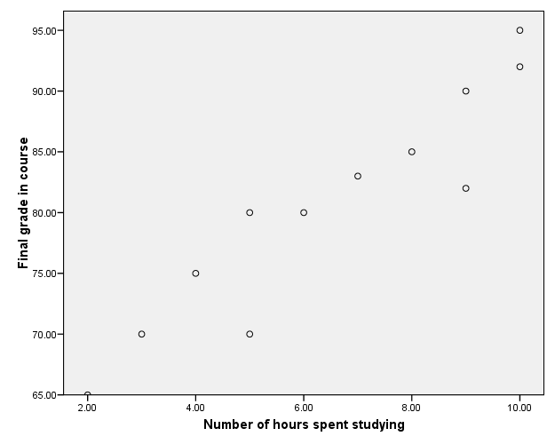
Positive relationship

Slide 9
Negative relationship
Reliability
Age of Car

Slide 10
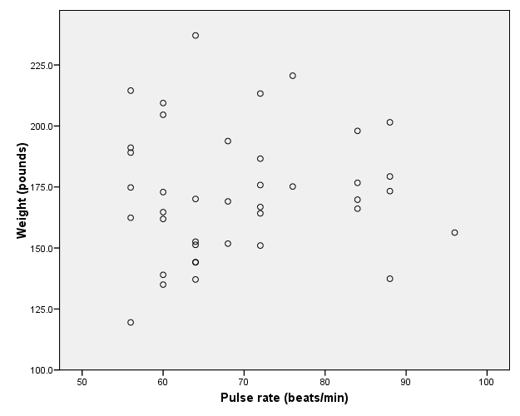
No relation

Slide 11
Correlation Coefficient
Statistic showing the degree of relation between two variables

Slide 12
Simple Correlation coefficient (r)
It is also called Pearson's correlation or product moment correlation coefficient.
It measures the nature and strength between two variables of the quantitative type.

Slide 13
The sign of r denotes the nature of association
while the value of r denotes the strength of association.

Slide 14
If the sign is +ve this means the relation is direct (an increase in one variable is associated with an increase in the other variable and a decrease in one variable is associated with a decrease in the other variable).
While if the sign is -ve this means an inverse or indirect relationship (which means an increase in one variable is associated with a decrease in the other).

Slide 15
The value of r ranges between ( -1) and ( +1)
The value of r denotes the strength of the association as illustrated by the following diagram.
strong
intermediate
weak
weak
intermediate
strong
-1
-0.75
-0.25
0
0.25
0.75
1
indirect
Direct
perfect correlation
perfect correlation
no relation

Slide 16
If r = Zero this means no association or correlation between the two variables.
If 0 < r < 0.25 = weak correlation.
If 0.25 ≤ r < 0.75 = intermediate correlation.
If 0.75 ≤ r < 1 = strong correlation.
If r = l = perfect correlation.

Slide 17
How to compute the simple correlation coefficient (r)

Slide 18
Example:
A sample of 6 children was selected, data about their age in years and weight in kilograms was recorded as shown in the following table . It is required to find the correlation between age and weight.
Weight (Kg) | Age (years) | serial No
12 | 7 | 1
8 | 6 | 2
12 | 8 | 3
10 | 5 | 4
11 | 6 | 5
13 | 9 | 6

Slide 19
These 2 variables are of the quantitative type, one variable (Age) is called the independent and denoted as (X) variable and the other (weight) is called the dependent and denoted as (Y) variables to find the relation between age and weight compute the simple correlation coefficient using the following formula:

Slide 20
Y² | X² | xy | Weight (Kg) (y) | Age (years) (x) | Serial n.
144 | 49 | 84 | 12 | 7 | 1
64 | 36 | 48 | 8 | 6 | 2
144 | 64 | 96 | 12 | 8 | 3
100 | 25 | 50 | 10 | 5 | 4
121 | 36 | 66 | 11 | 6 | 5
169 | 81 | 117 | 13 | 9 | 6
∑y2= 742 | ∑x2= 291 | ∑xy= 461 | ∑y= 66 | ∑x= 41 | Total

Slide 21
r = 0.759
strong direct correlation

Slide 22
EXAMPLE: Relationship between Anxiety and Test Scores
Anxiety (X) | Test score (Y) | X² | Y² | XY
10 | 2 | 100 | 4 | 20
8 | 3 | 64 | 9 | 24
2 | 9 | 4 | 81 | 18
1 | 7 | 1 | 49 | 7
5 | 6 | 25 | 36 | 30
6 | 5 | 36 | 25 | 30
∑X = 32 | ∑Y = 32 | ∑X² = 230 | ∑Y² = 204 | ∑XY=129

Slide 23
Calculating Correlation Coefficient
r = - 0.94
Indirect strong correlation

Slide 24
Spearman Rank Correlation Coefficient (r_{s})
It is a non-parametric measure of correlation.
This procedure makes use of the two sets of ranks that may be assigned to the sample values of x and Y.
Spearman Rank correlation coefficient could be computed in the following cases:
Both variables are quantitative.
Both variables are qualitative ordinal.
One variable is quantitative and the other is qualitative ordinal.

Slide 25
Procedure:
Rank the values of X from 1 to n where n is the numbers of pairs of values of X and Y in the sample.
Rank the values of Y from 1 to n.
Compute the value of di for each pair of observation by subtracting the rank of Yi from the rank of Xi
Square each di and compute ∑di2 which is the sum of the squared values.

Slide 26
Apply the following formula
The value of r_{s} denotes the magnitude and nature of association giving the same interpretation as simple r.

Slide 27
Example
In a study of the relationship between level education and income the following data was obtained. Find the relationship between them and comment.
Income (Y) | level education (X) | sample numbers
25 | Preparatory. | A
10 | Primary. | B
8 | University. | C
10 | secondary | D
15 | secondary | E
50 | illiterate | F
60 | University. | G

Slide 28
Answer:
di² | di | Rank Y | Rank X | (Y) | (X)
4 | 2 | 3 | 5 | 25 | Preparatory | A
0.25 | 0.5 | 5.5 | 6 | 10 | Primary. | B
30.25 | -5.5 | 7 | 1.5 | 8 | University. | C
4 | -2 | 5.5 | 3.5 | 10 | secondary | D
0.25 | -0.5 | 4 | 3.5 | 15 | secondary | E
25 | 5 | 2 | 7 | 50 | illiterate | F
0.25 | 0.5 | 1 | 1.5 | 60 | university. | G
∑ di²=64

Slide 29
Comment:
There is an indirect weak correlation between level of education and income.

Slide 30
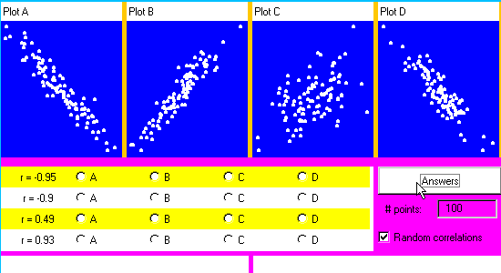
exercise

