Slide 1
Covariance

Slide 2
Covariance
Variables may change in relation to each other
Covariance measures how much the movement in one variable predicts the movement in a corresponding variable

Slide 3
Smoking and Lung Capacity
Example: investigate relationship between cigarette smoking and lung capacity
Data: sample group response data on smoking habits, and measured lung capacities, respectively

Slide 4
Smoking v Lung Capacity Data
N | Cigarettes (X ) | Lung Capacity (Y )
1 | 0 | 45
2 | 5 | 42
3 | 10 | 33
4 | 15 | 31
5 | 20 | 29

Slide 5
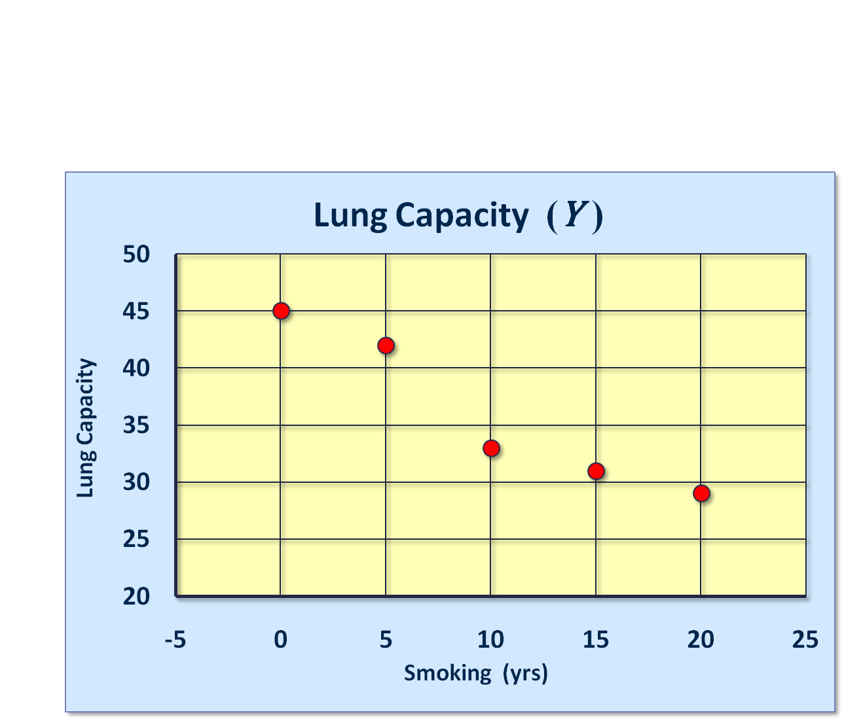
Smoking and Lung Capacity

Slide 6
Smoking v Lung Capacity
Observe that as smoking exposure goes up, corresponding lung capacity goes down
Variables covary inversely
Covariance and Correlation quantify relationship

Slide 7
Covariance
Variables that covary inversely, like smoking and lung capacity, tend to appear on opposite sides of the group means
  When smoking is above its group mean, lung capacity tends to be below its group mean.
Average product of deviation measures extent to which variables covary, the degree of linkage between them

Slide 8
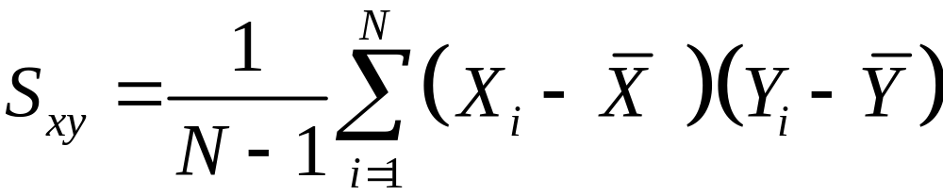
The Sample Covariance
Similar to variance, for theoretical reasons, average is typically computed using (N -1), not N . Thus,

Slide 9


Calculating Covariance
Cigs (X ) | Lung Cap (Y )
0 | 45
5 | 42
10 | 33
15 | 31
20 | 29
10 | 36

Slide 10
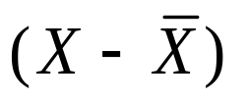
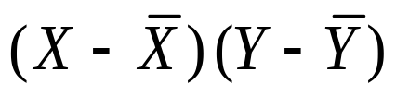
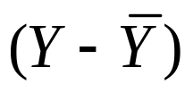
Calculating Covariance
Cigs (X ) |  |  |  | Cap (Y )
0 | -10 | -90 | 9 | 45
5 | -5 | -30 | 6 | 42
10 | 0 | 0 | -3 | 33
15 | 5 | -25 | -5 | 31
20 | 10 | -70 | -7 | 29
 |  | ∑= -215

Slide 11
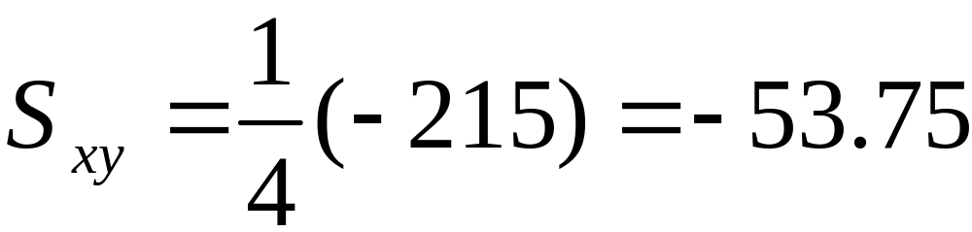
Covariance Calculation | (2)
Evaluation yields,

