Slide 1
INTRODUCTION TO DATA SCIENCE
Introduction and Administration

Slide 2
Plan
Why data science is important?
“Why are you here”
What is data science?
Mashup of disciplines
What this course is about?
Hopefully right mix of theory and practical skills
Course requirements
Syllabus
Exam, Homework assignments
Interviews

Slide 3
1. Why are you here?
Introduction: Media Buzz

Slide 4
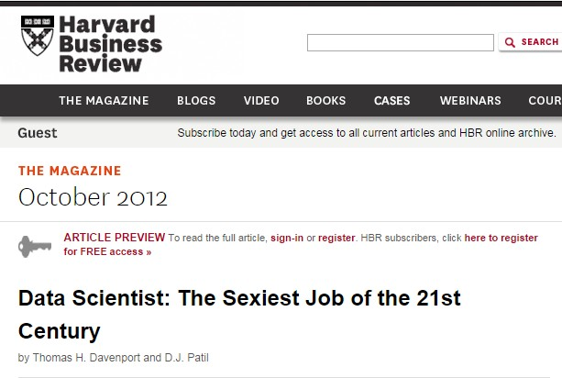
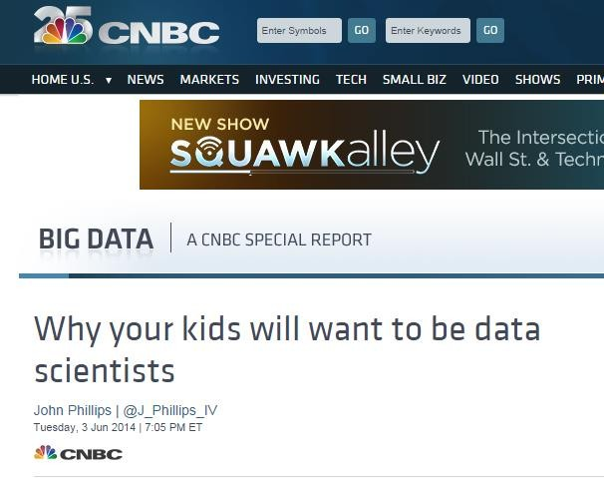

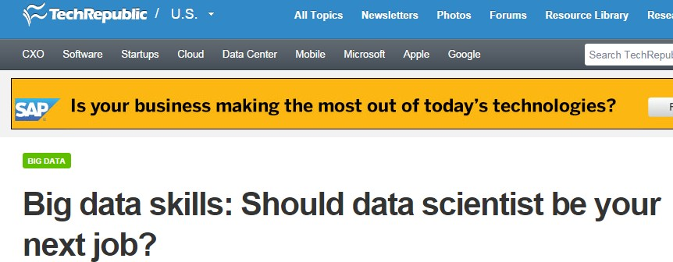
Data Scientists are in high demand

Slide 5
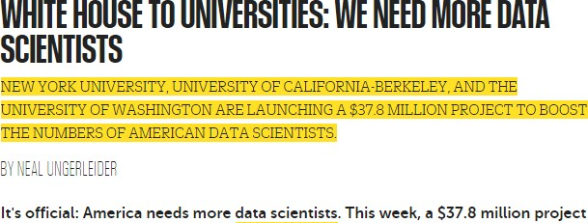
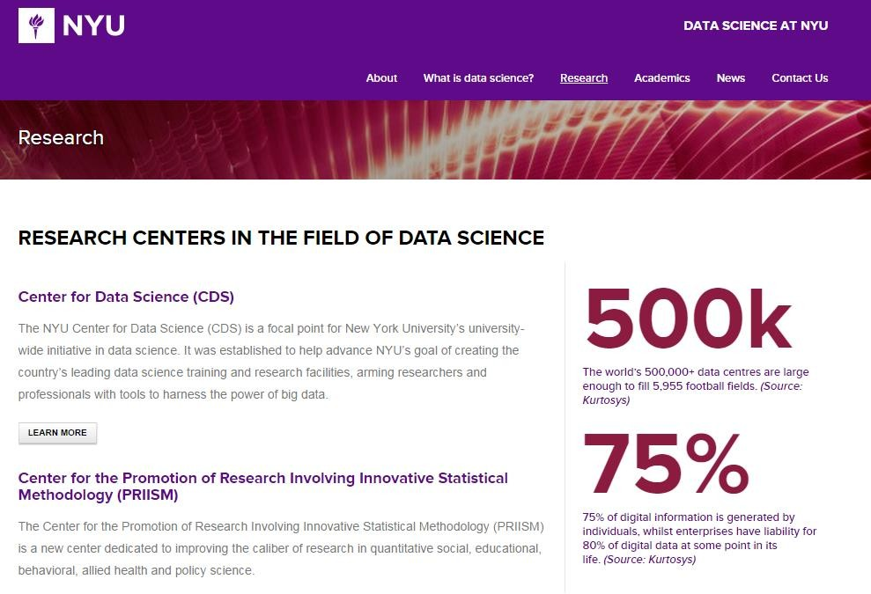
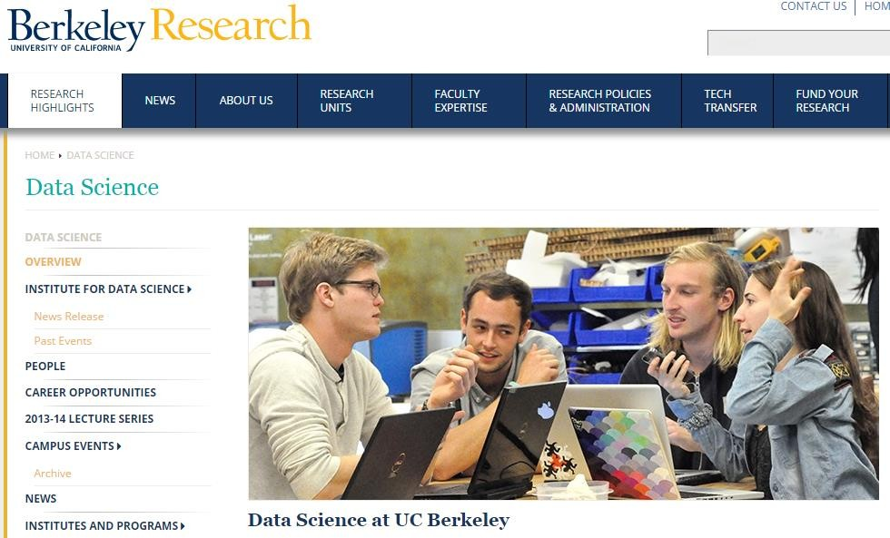
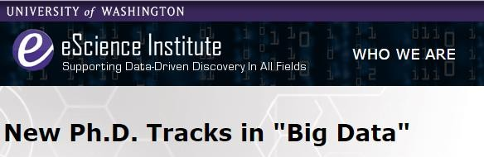
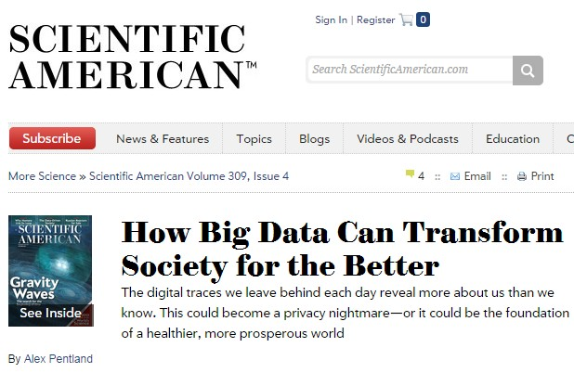
Also in Academia

Slide 6
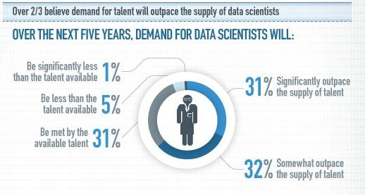
Demand will outpace the supply

Slide 7



Israel

Slide 8
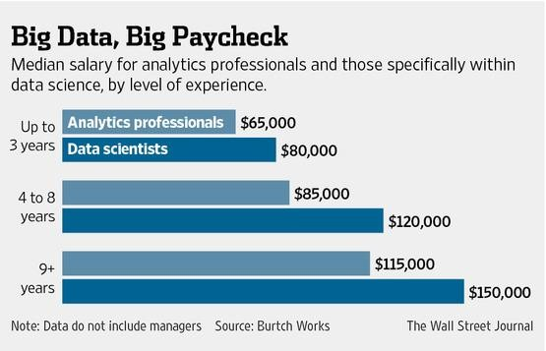
Pays well

Slide 9
2. What is data science?
Technology and raising expectations

Slide 10
Data Science
New Discipline
Very little/none textbooks/courses covering the discipline as a whole
Compare to Software Engineering/Compute Science during 70-80^{s} of the last century
Data Science is what data scientists do
Why data science and data scientists are needed?
Development of enabling technology
Raising Expectations from customers

Slide 11
2. What is data science?
Technological developments

Slide 12
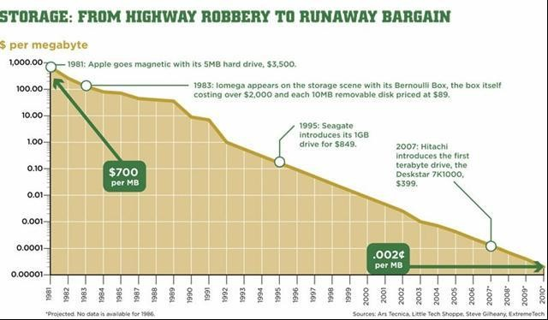
Declining cost of storage

Slide 13
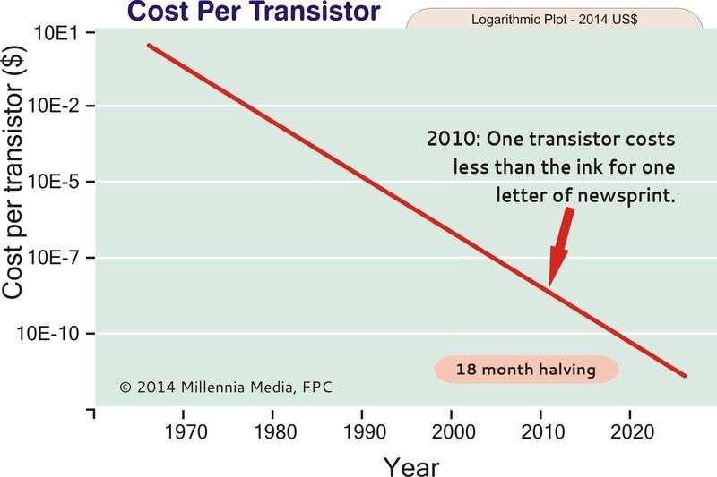
Declining cost of computing

Slide 14
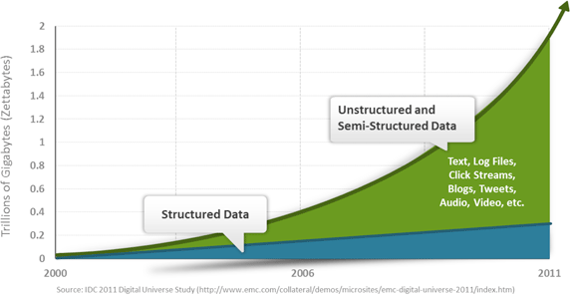
More data can be stored and processed

Slide 15
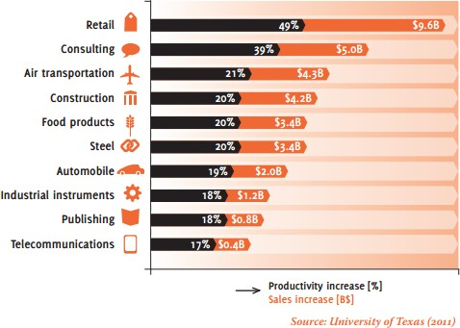
Value of Big Data

Slide 16
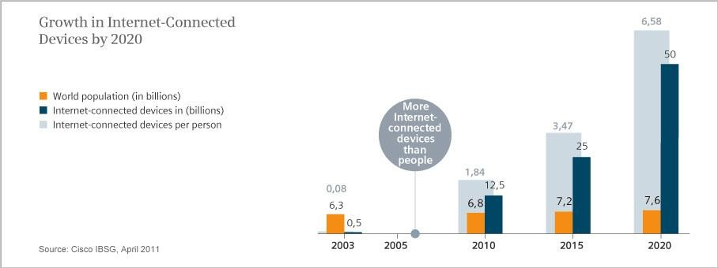
Devices vs. People

Slide 17
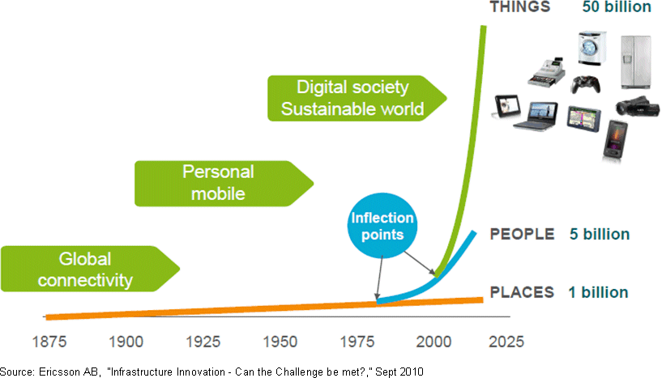
Internet of Things

Slide 18
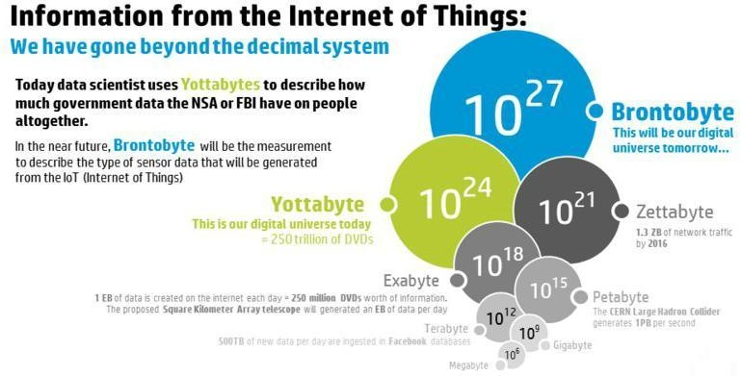
Next frontier: IoT

Slide 19
2. What is data science?
Raising expectations

Slide 20
Cognitive Computing
People expect systems to behave like humans
Be Adaptive
Learn as information and goals change
Be Interactive
Interact easily with people and other systems
Be Contextual
Understand meaning, exploit additional sources of information
Need to process large quantities of uncertain data of different types (text, speech, sensors, images etc.)

Slide 21
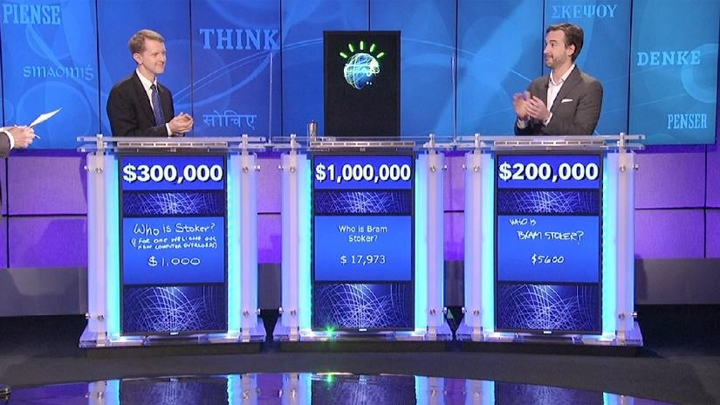

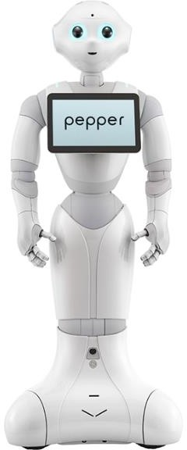
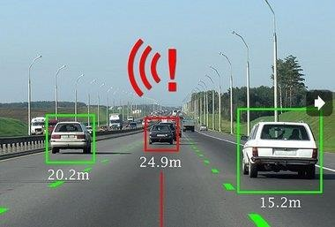
Cognitive Computing

Slide 22
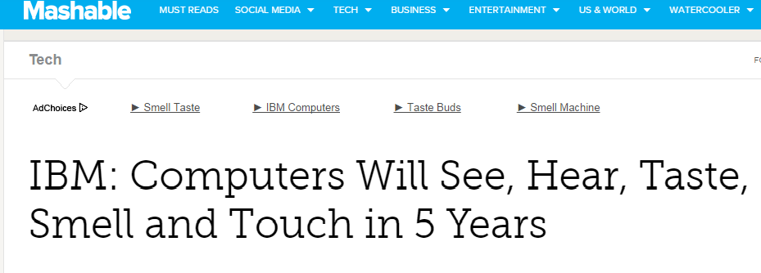
Cognitive Computing in 5 Years

Slide 23
Cognitive and Data Science
People want their systems/devices to behave smarter
Personal devices
Industrial systems
More data to acquire and analyze using more complex algorithms and technologies

Slide 24
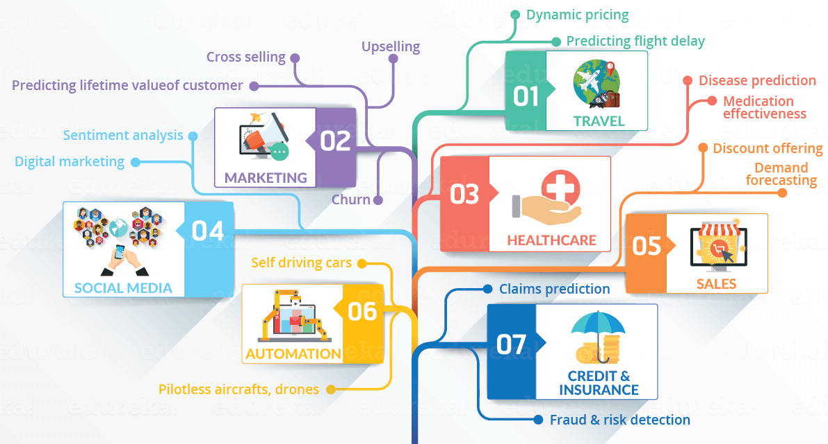

Slide 25
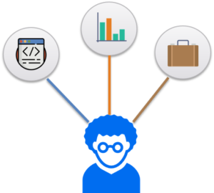
3. What is data science

Slide 26
Example I: Marketing
Predicting Lifetime Value (LTV)
what for: if you can predict the characteristics of high LTV customers, this supports customer segmentation, identifies upsell opportunities and supports other marketing initiatives
usage: can be both an online algorithm and a static report showing the characteristics of high LTV customers

Slide 27
Example II: Logistics
Demand forecasting
How many of what thing do you need and where will we need them? (Enables lean inventory and prevents out of stock situations.)
revenue impact: supports growth and militates against revenue leakage
usage: online algorithm and static report

Slide 28
Example III: Healthcare
Survival analysis
Analyze survival statistics for different patient attributes (age, blood type, gender, etc) and treatments
Medication (dosage) effectiveness
Analyze effects of admitting different types and dosage of medication for a disease
Readmission risk
Predict risk of re-admittance based on patient attributes, medical history, diagnose & treatment

Slide 29
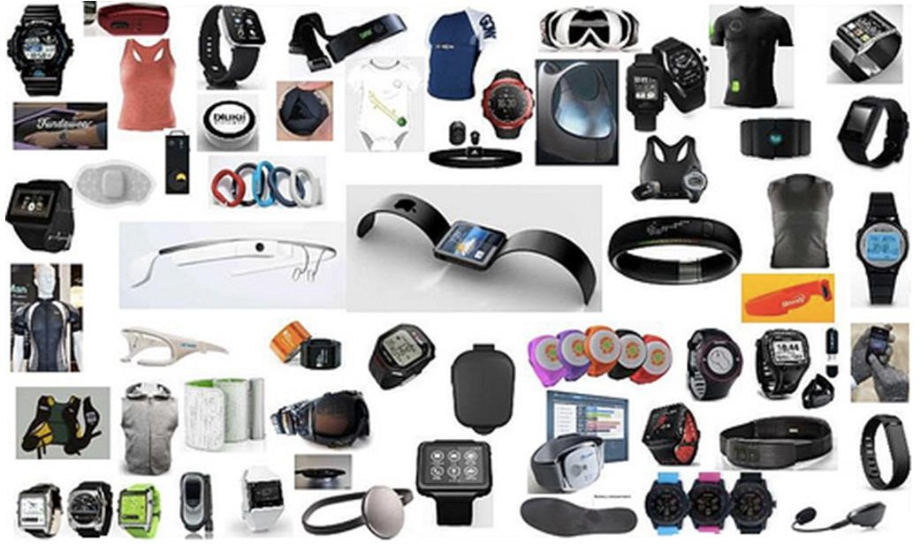
Example IV: Wearable Health and Fitness

Slide 30
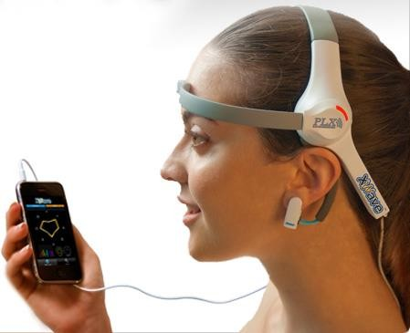
Example V: Brain Computer Interface

Slide 31
2. What is data science?
A Mashup of disciplines

Slide 32
A mashup of disciplines
Math and Theory
Statistics, Linear Algebra, Optimization, Time Series, etc.
Applied Algorithms
Machine Learning, Data Structures, Parallel Algorithms, etc.
Engineering and Technologies
Storage and computing platforms, statistical tools ,etc.
Domain Expertise
Text, Finance, Images, Econometrics etc.
Art
Visualization, Infographics
Best practices and hacks
Handle missed values in data, transform and represent data, etc.

Slide 33
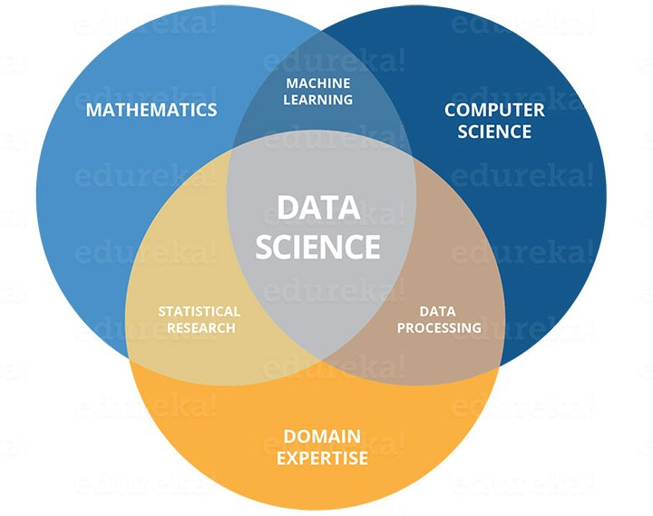
Yet Another View

Slide 34
Common data science deliverables:
Prediction (predict a value based on inputs)
Classification (e.g., spam or not spam)
Recommendations (e.g., Amazon and Netflix recommendations)
Pattern detection and grouping (e.g., classification without known classes)
Anomaly detection (e.g., fraud detection)
Recognition (image, text, audio, video, facial, …)
Actionable insights ( via dashboards, reports, visualizations, …)
Automated processes and decision-making (e.g., credit card approval)
Scoring and ranking (e.g., FICO score)
Segmentation (e.g., demographic-based marketing)
Optimization (e.g., risk management)
Forecasts (e.g., sales and revenue)

Slide 35
Data Science Process :
Data acquisition, collection, and storage
Discovery and goal identification (ask the right questions)
Access, ingest, and integrate data
Processing and cleaning data (munging/wrangling)
Initial data investigation and exploratory data analysis (EDA)
Choosing one or more potential models and algorithms
Apply data science methods and techniques (e.g., machine learning, statistical modeling, artificial intelligence, …)
Measuring and improving results (validation and tuning)
Delivering, communicating, and/or presenting final results
Business decisions and/or changes are made based on the results
Repeat the process to solve a new problem

Slide 36
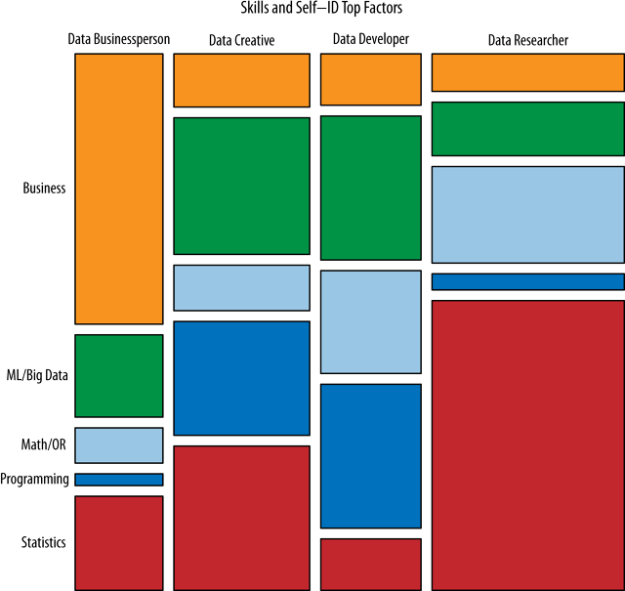
Types of Data Scientists

Slide 37
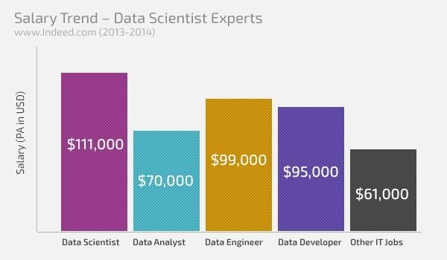
Roles and Paycheck

Slide 38
3. About this course
A mix of theory and practice

Slide 39
Tentative content(subject to change)
70% Mathematics & Statistical Machine Learning
Focus on practical aspects
Classes
Necessary theoretical background
20% Big Data Algorithms
Focus on algorithms not on big data technologies
10% Data Visualization
R , Python

Slide 40
This course is not
About big data tools or technologies
No: Hadoop technical details
Yes: Basic R programming
About statistical learning theory
No: Theoretical low bounds or other proofs
Yes: Some theory is necessary
About a specific domain
No: Deep discussions on Text, Finance, BI etc.
Yes: Some examples will be presented

Slide 41
Some case studies we will cover
PREDICTION OF FUTURE MOVEMENTS IN THE STOCK MARKET:
What is the next move of Sensex ?
PREDICTING INSURANCE PURCHASE
Will a potential customer purchase?
DIRECT MARKETING
Who will respond?
HOUSING VALUATIONS
What affect the price of a house?
MARKETING OF ORANGE
JUICE
What brand a customer will buy?
EMAIL SPAM
Is this a spam message?

Slide 42
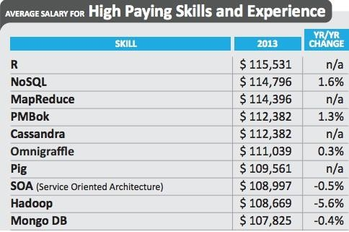
The course’s language of choice: R

Slide 43
What you are expected to know
Data is represented as a matrix
Basic linear algebra
Most problems are not well-defined/uncertain
Basic probability and statistics
Big data requires non-trivial data structures and algorithms
Basic data structures and algorithms concepts
Practical means programming
Basic Programming skills

Slide 44
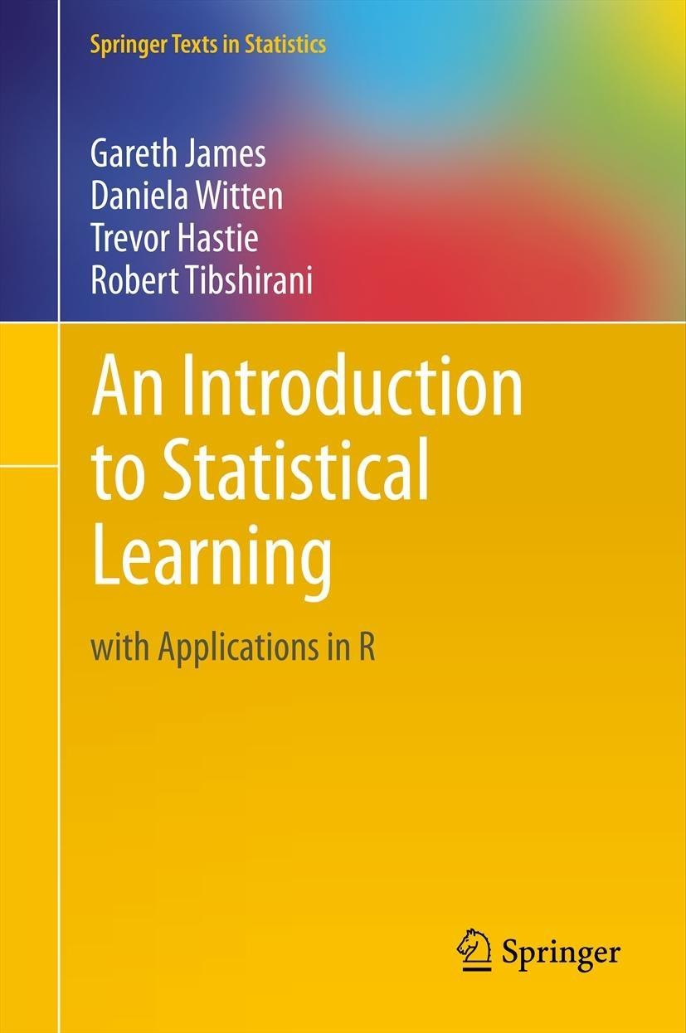
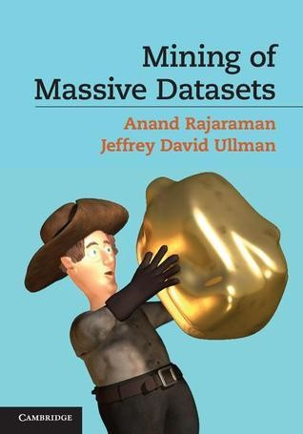
Textbooks are available online
Machine Learning and R
Big Data Algorithms

Slide 45

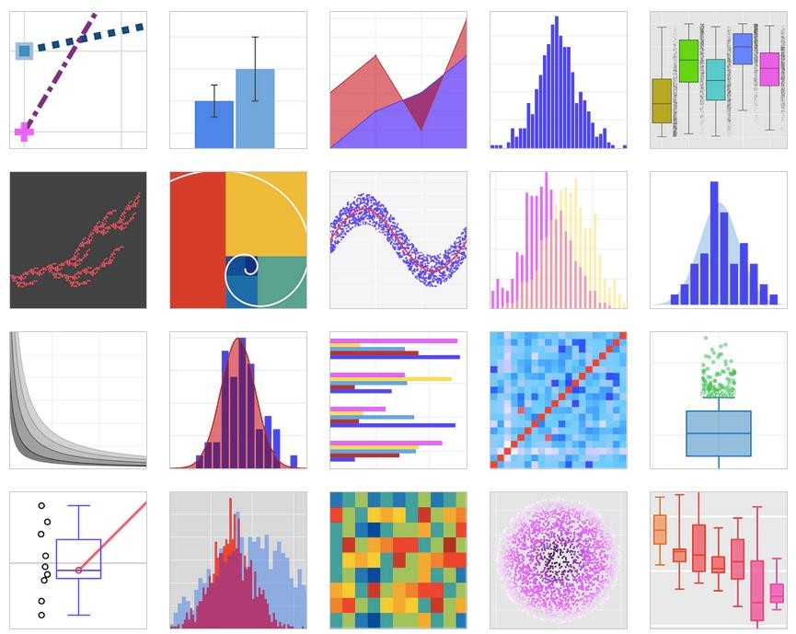
Visualization
Introduction from
On-going examples

Slide 46
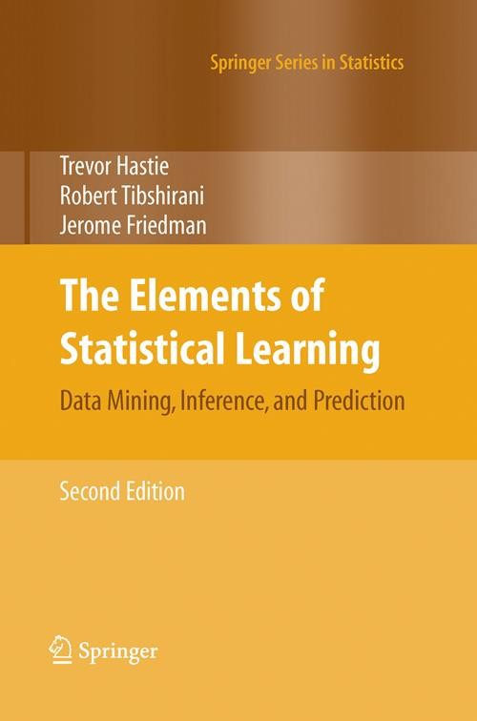
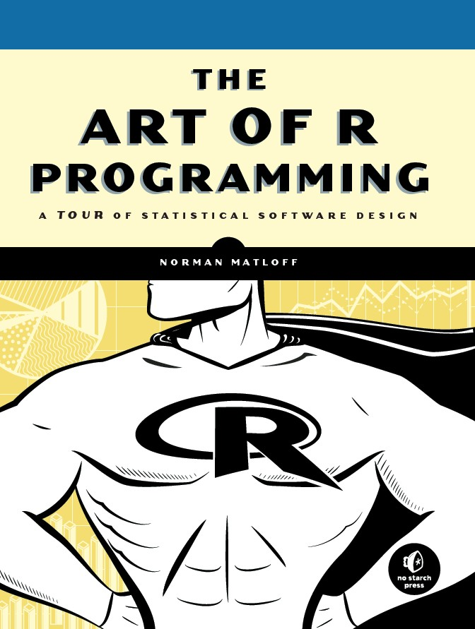
For curious minds
More on Machine Learning
More on R Programming

Slide 47
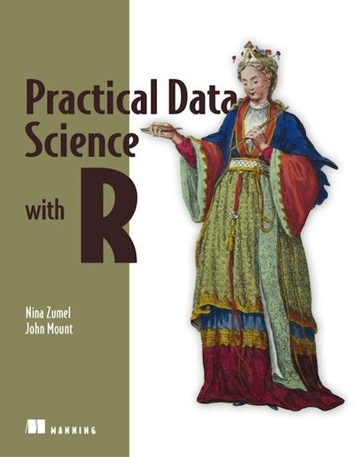
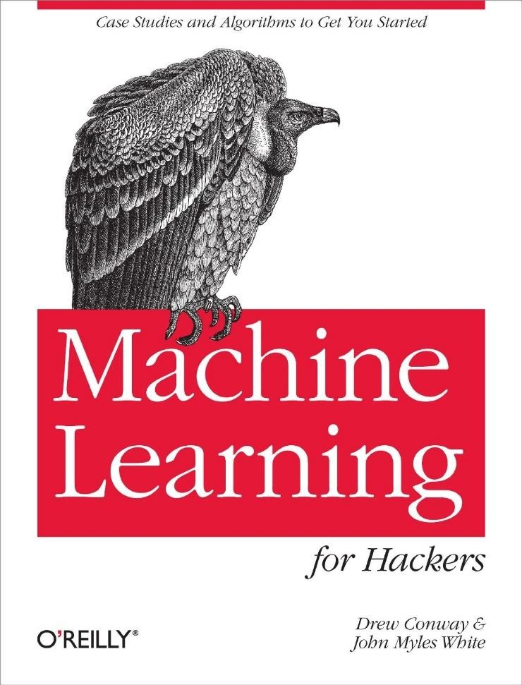
Becoming a data scientist
Data Scientist Skills
Quick Hacks/Examples

