Slide 1
Confidence Intervals

Slide 2
Confidence Interval Definition
Statisticians use confidence intervals to describe the amount of uncertainity associated with the sample estimate of population parameter within a particular range.
Confidence Interval depend on the amount of sample we take.
If we take larger segment then we will have large confidence interval and if it is small then we are going to have small confidence interval.

Slide 3
Confidence Interval
There are two main things to consider here
1.Point Estimate
2.Interval Estimate
Let us know about them briefly.

Slide 4
Point Estimate for Population μ
A point estimate is a single value estimate for a population parameter. The most unbiased point estimate of the population mean,μ, is the sample mean x
Example:
A random sample of 32 textbook prices (rounded to the nearest dollar) is taken from a local college bookstore. Find point estimate for the population mean μ?

Slide 5
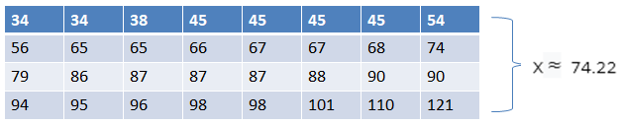
Point Estimate for population μ
Example:
A random sample of 32 textbook prices (rounded to the nearest dollar) is taken from a local college bookstore.Find a point estimate for the population mean, μ.
The point estimate for the population mean of textbooks in the bookstore is $74.22.

Slide 6
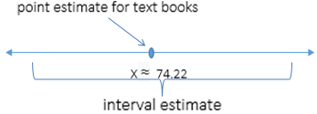
Interval Estimate
An interval estimate is an interval or range of values, used to estimate a population parameter.
How confident do we want to be that the interval estimate contains the population mean, μ?

Slide 7
Confidence Intervals of the mean (Large Samples)

Slide 8
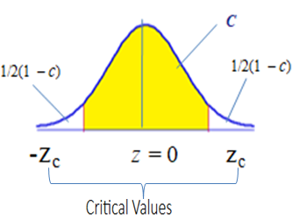
Level Of Confidence
The level of c onfidence c is the probability that the interval estimate contains the population parameter.
Where c is the area beneath the normal curve between the critical values.

Slide 9
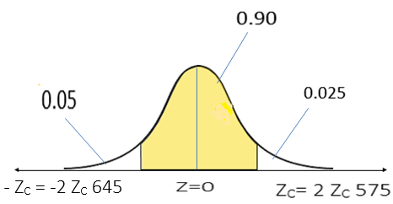
Common Levels of Confidence
If the level of confidence is 90%, this means that we are 90% confident that the interval contains the population mean, μ.
The corresponding z-scores are ± 1.645.

Slide 10
Margin of Error
The difference between the point estimate and the actual parameter value is called the sampling error.
Sampling Error= μ-x̅
Where as μ= population mean
x̅ = sample mean
Usually the population mean is unknown.
The maximum error of estimate/margin of error/error tolerance, E is E = ZC σ/√n
When n ≥ 30,the sample standard deviation, s , can be used for σ.

Slide 11
Margin of Error
Example:
A random sample of 32 textbook prices is taken from a local college book store. The mean of the sample is x̅=74.22, and the sample standard deviation is
s = 23.44.
Use a 95% confidence level and find the margin of error for the mean price of all textbooks in the bookstore.
E = ZC σ/ √n = 1.96 (23.44/√32) ≈ 8.12
Since n ≥ 30, s can be substituted for σ.
We are 95% confident that the margin of error for the population mean (all the textbooks in the bookstore) is about $8.12.

Slide 12
Confidence Intervals for μ
A C-confidence interval for the population mean μ is
x̅ -E< µ < x̅ +E
The probability that the confidence interval contains μ is c.
Example:
A random sample of 32 textbook prices is taken from a local college bookstore.The mean of the sample is x = 74.22, the sample standard deviation is s = 23.44, and the margin of error is E = 8.12. Construct a 95% confidence interval for the mean price of all textbooks in the bookstore.

Slide 13
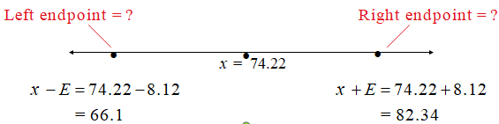
Confidence Intervals for μ
Example continued:
Construct a 95% confidence interval for the mean price of all textbooks in the bookstore.
With 95% confidence we can say that the cost for all textbooks in the bookstore is between $66.10 and $82.34.

Slide 14
Confidence Intervals for μ(σ known)
Example:
A random sample of 25 students had a grade point average with a mean of 2.86. Past studies have shown that the standard deviation is 0.15 and the population is normally distributed. Construct a 90% confidence interval for the population mean grade point average.

Slide 15
Confidence Intervals for μ(σ known)
Example continued:
n=25 x̅=2.86 σ = 0.15 Z_{C =} 1.645
E = Z_{C} σ/ √n= 1.645(0.15/√25) ≈ 0.05
x̅+E = 2.86 ± 0.05 2.81 < µ < 2.91
With 90% confidence we can say that the mean grade point average for all students in the population is between 2.81 and 2.91.

Slide 16


Sample Size
Example:
You want to estimate the mean price of all the
textbooks in the college book store. How many books
must be included in your sample if you want to be 99%
confident that the sample mean is within $5 of the
population mean?
x̅= 74.22 σ ≈ s = 23.44 Z_{C= 2.575}
You should include at least 146 books in your sample.

Slide 17
Confidence Intervals For The Mean (Small samples)

Slide 18
t-Distribution
When a sample size is less than 30, and the random variable x is approximately normally distributed, it follow a t-distribution.
Properties of the t-distribution
The t-distribution is bell shaped and symmetric about the mean.

Slide 19
t-Distribution
The t-distribution is a family of curves, each determined by a parameter called the degrees of freedom.
The degrees of freedom are the number of free choices left after a sample statistic such as is calculated.
When you use a t-distribution to estimate a population mean, the degrees of freedom are equal to one less than the sample size.
d.f. = n – 1 Degrees of freedom

Slide 20
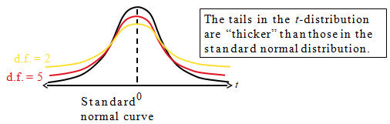
The t-Distribution
The total area under a t-curve is 1 or 100%.
The mean, median, and mode of the t-distribution are equal to zero.
As the degrees of freedom increase, the t-distribution approaches the normal distribution. After 30 d.f., the t-distribution is very close to the standard normal z-distribution.

Slide 21
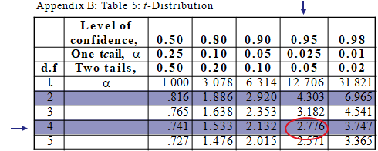
Critical Values of t
Example:
Find the critical value t_{c} for a 95% confidence when the
sample size is 5.
d.f. = n – 1 = 5 – 1 = 4 c = 0.95 t_{c} = 2.776

Slide 22
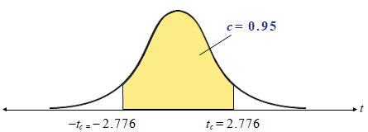
Critical Values of t
Example continued:
Find the critical value t_{c} for a 95% confidence when the
sample size is 5.
95% of the area under the t-distribution curve with 4 degrees of freedom lies between t = ±2.776.

Slide 23
Constructing a Confidence Interval
Example:
In a random sample of 20 customers at a local fast food restaurant, the mean waiting time to order is 95 seconds, and the standard deviation is 21seconds.Assume the wait times are normally distributed and construct a 90% confidence interval for the mean wait time of all customers.

Slide 24

Constructing a Confidence Interval
Example continued:
n =20 x̅ =95 s=21
d.f = 19 t_{c}= 1.729 =1.727(21/√20)=8.1
x̅ ± E = 95 ± 8.1 86.9 < µ < 103.1
We are 90% confident that the mean wait time for all customers is between 86.9 and 103.1 seconds.

Slide 25
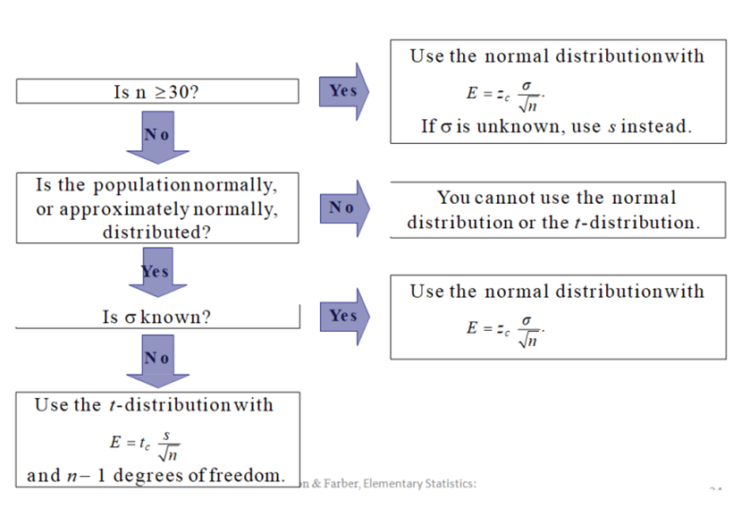
Normal or t-Distribution?

Slide 26
Normal or t-Distribution?
Determine whether to use the normal distribution, the
t-distribution, or neither.
a) n = 50, the distribution is skewed, s = 2.5
The normal distribution would be used because the sample size is 50.
b) n = 25, the distribution is skewed, s = 52.9

Slide 27
Normal or t-Distribution?
Neither distribution would be used because n < 30 and the distribution is skewed.
c) n = 25, the distribution is normal, σ = 4.12
The normal distribution would be used because although
d) n < 30, the population standard deviation is known.

Slide 28
Thank You

