Slide 1

Fitness Chef
Team innovators
Revanth Chakilam
Nageswara rao
Devender Sarda
Syed moin

Slide 2
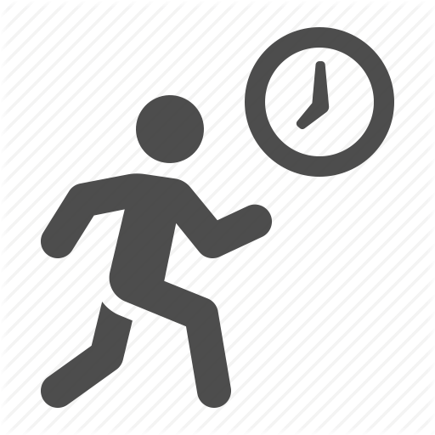
Motivation
Fitness Chef is a free calorie counter and weight management program which makes fast and easy to track your calories and maintain/gain/lose weight.
Anyone can manage their weight if they have the right tool and support system
Medical study shows keeping the food journal and tracking them doubles the chances of managing weight.
But most people believe they don't have time to keep track of food and exercises.

Slide 3
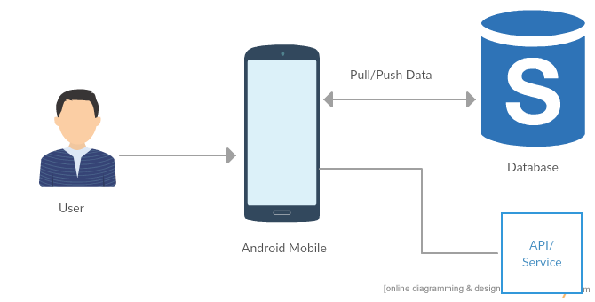
Architecture

Slide 4
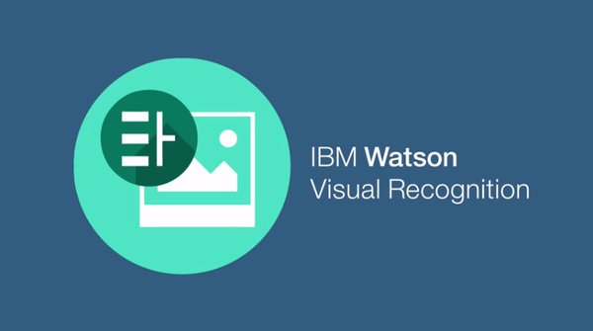




Technologies

Slide 5
features
User can log a meal/exercise in less than a minute
We provide health tips in the news feed of the home page
Cardio & Strength exercise guide for the beginners
Based on the user inputs, we calculate the target calories for daily intake
Image recognition: can add break fast, lunch and snacks by scanning the food item
User can track his weekly progress with intuitive graphs
User can see the pie chart and bar graph for his daily intake
User can view/update the historical data i.e. previous days calorie count/intake

