Slide 1
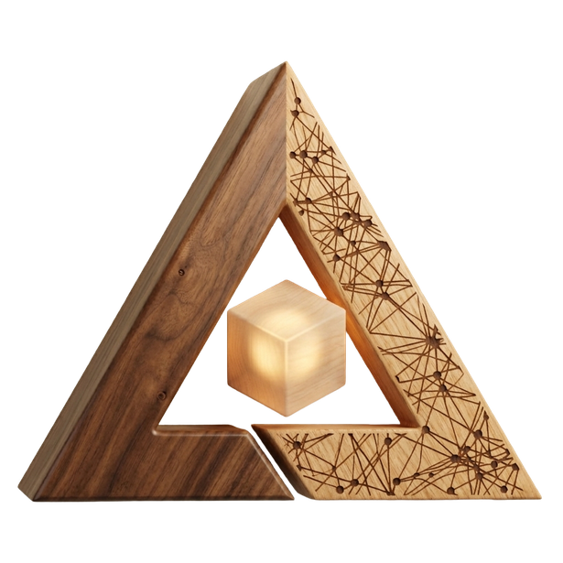
ARtisan
AI-powered 3D Product Generation & WebAR Visualization
Group Members:
Saim Jamil (SP23-BSE-145)
Syed Muaarij Nadeem (SP23-BSE-152)
Warda Saeed (SP23-BSE-172)
Supervised By:
Sir Amaid Zia
Notes:
1

Slide 2
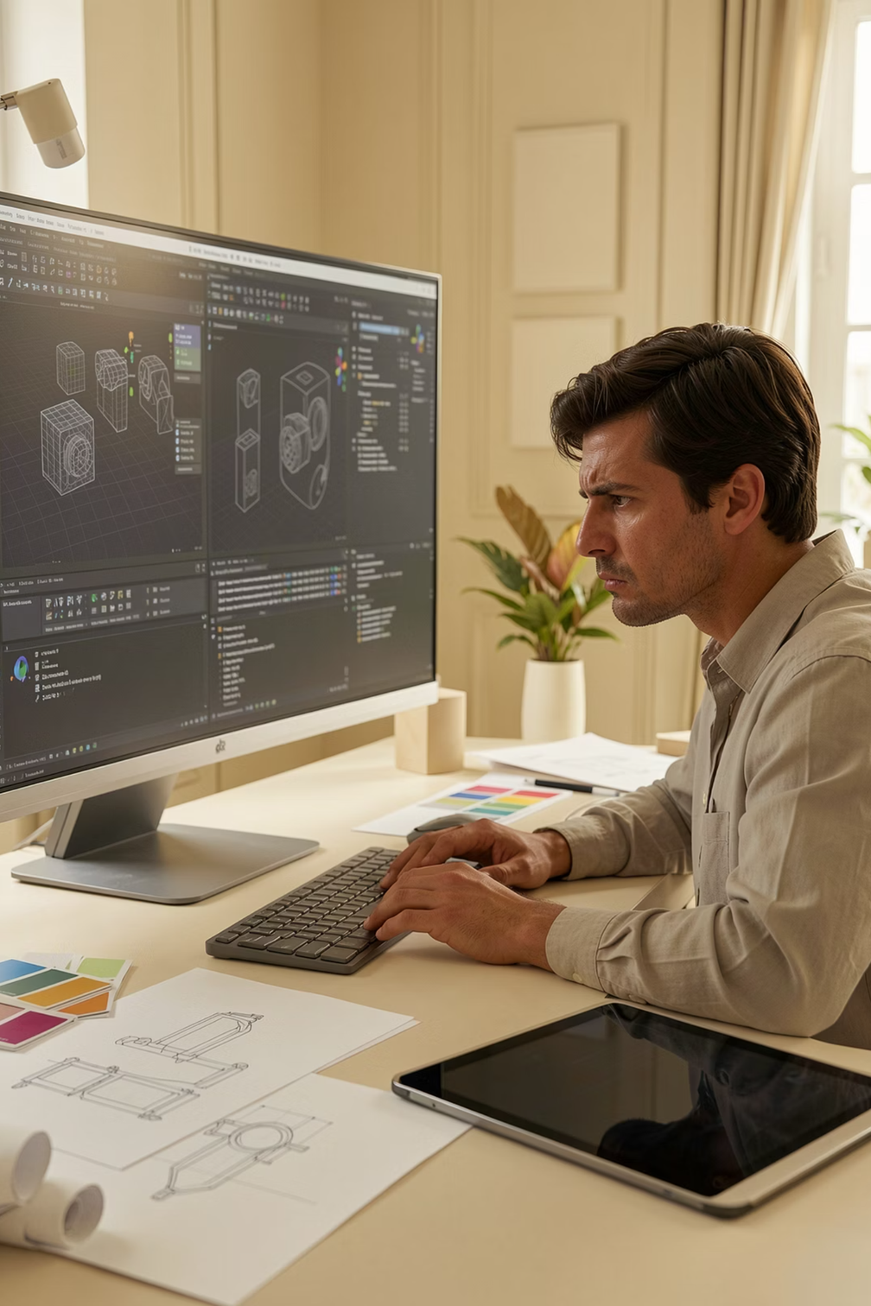
Problem Statement
Users struggle to imagine products in real environments
Designers require expensive 3D modeling expertise
Product visualization is time-consuming
Lack of personalization reduces customer confidence
Higher return rates
Notes:
1

Slide 3
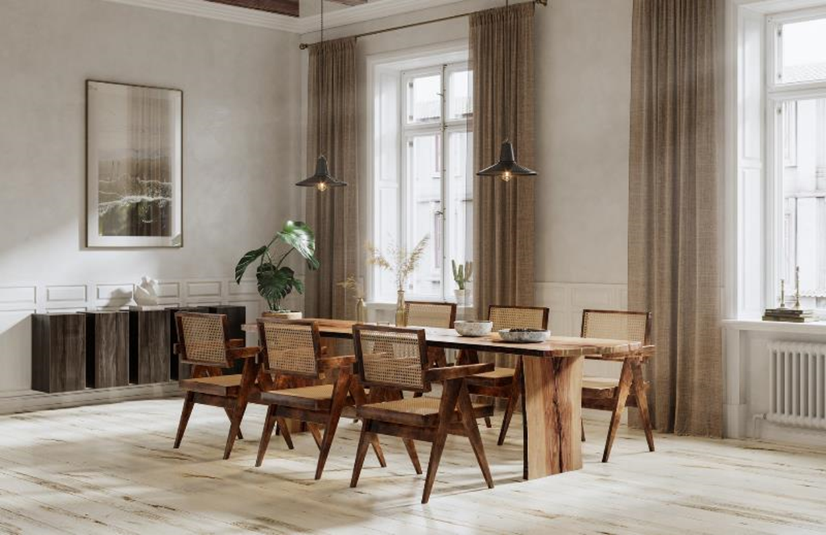
Proposed Solution - ARtisan
Web-based Generative AI + WebAR platform
Generate 3D models from text or image input
Real-time AR placement,
scaling, and rotation
No app download or high-end
hardware required
AI-powered prompt enhancement
and recommendations
Notes:
3

Slide 4


Major Functionalities
1
Text to 3D
3
AR Visualization
4
Designer Mode
2
Image to 3D
4
AI Suggestions
Notes:
5

Slide 5
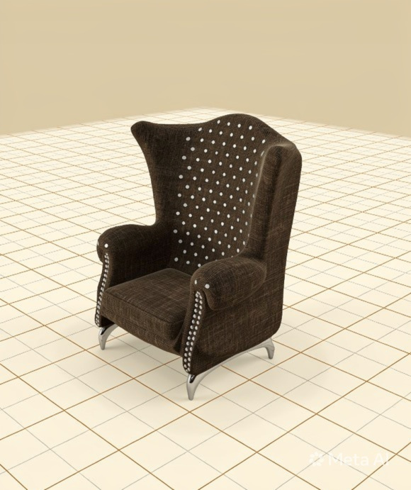
Text-to-3D
Users enter concise natural-language descriptions.
The system then calls a generative model Hunuyan3d-2 from Hugging Face spaces.
The Ai model then produces a detailed textured model based on the prompt.
Notes:
6

Slide 6
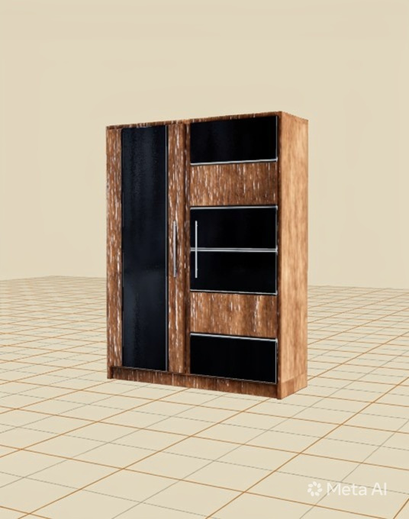
Image-to-3D
Upload your reference image
Adjust advanced setting as Background
removal and Model Detailing.
System then calls Hunyuan3D-2 API.
It generates detailed textured model same as in the image.
Notes:
6

Slide 7
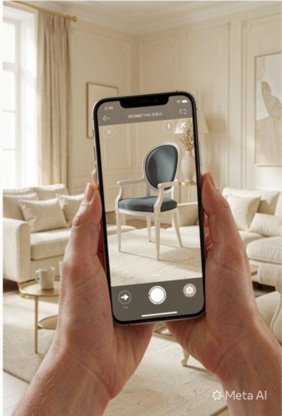

WebAR Visualization
Instant AR preview via browser via,
QR code
or
Instant link
Place the model on any surface and then
adjust, scale, rotate.
Zero-install
Accurate Scaling
Openable link, instant camera anchoring.
Real-world measurement tools and unit presets.
Notes:
8

Slide 8

Ai Suggestions
Prompt enhancement
Model suggestions
Model placement suggestions
Design Ideas
Notes:
9

Slide 9

Designer Mode
Scene Creation
Scene Management
Multiple model placement
Ready Made Templates
Notes:
9

Slide 10
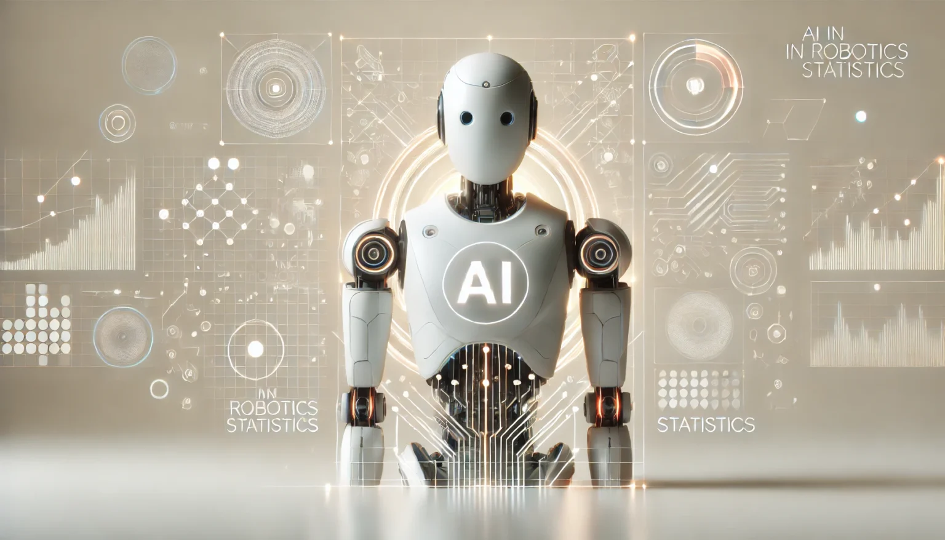
Tools & Technologies
Frontend
React.js
Three.js
GSAP, Framer motion (Animations)
Backend
Node.js
Firebase Authentication
Firebase Firestore(User model)
GenAi API used
Hunyuan3d-2 by tencent
accessible via API on
huggingface spaces
Notes:
10

Slide 11
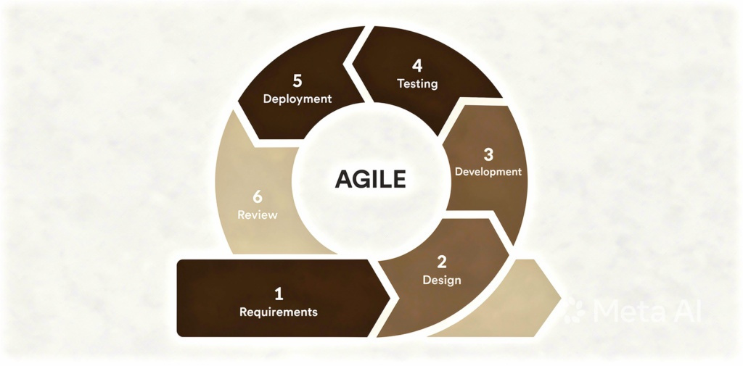
SDLC-Agile Methodology
The development of ARtisan follows an Agile-based methodology.
Enabling iterative progress
Continuous feedback &
Incremental improvement
especially suitable for AI and
AR-driven systems.
Notes:
10

Slide 12
System Architecture
Presentation Layer
React UI • Three.js Viewer • WebXR AR • Auth & Profile UI
Application Layer
Node.js API • JWT Auth • AR Controller • Scene Manager • AI Engine
Services Layer
Text-to-3D • Image-to-3D • Prompt Engine • Storage
Data Layer
Firebase • Assets • User Data • Scene Configs
Notes:
10

Slide 13
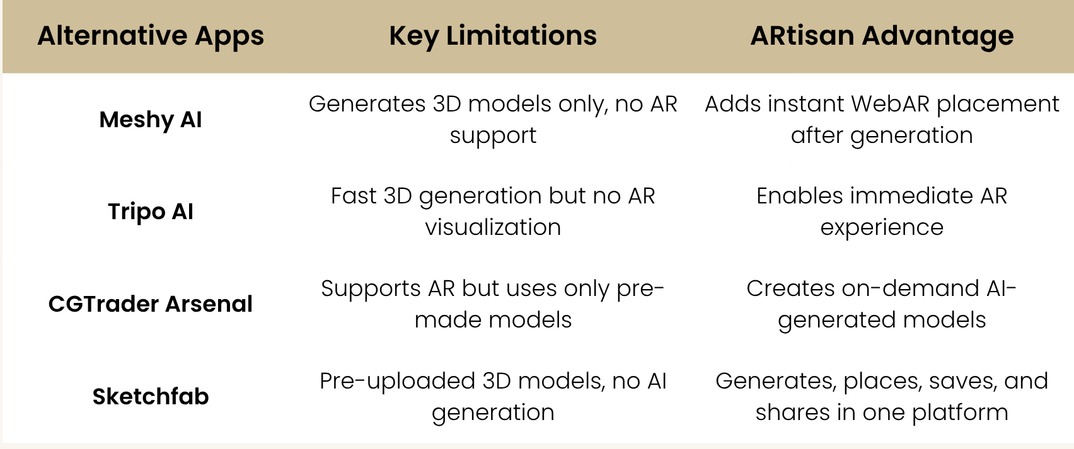
Comparison
Notes:
4

Slide 14
Thank You!
Notes:
1

Slide 15
Notes:
1

