Slide 1
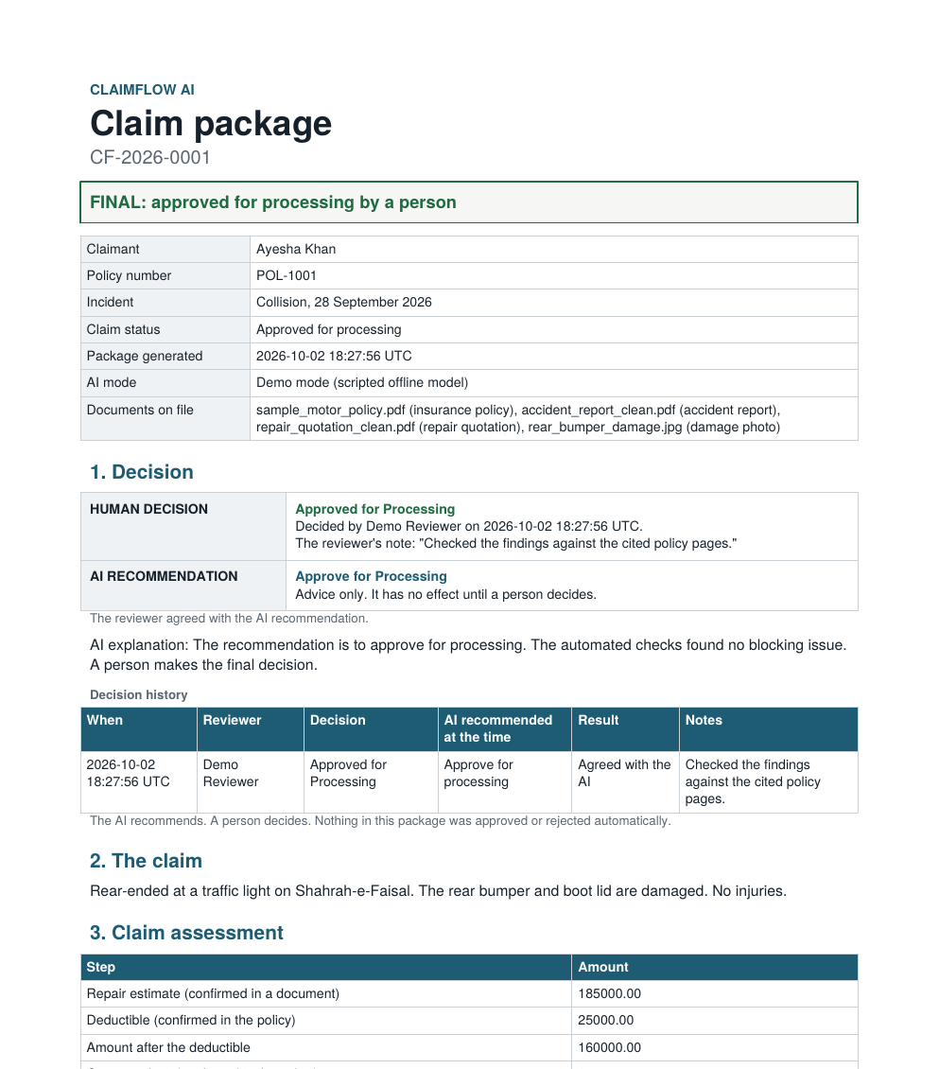
HACKATHON SUBMISSION
ClaimFlow AI
Seven AI agents prepare the claim file. A person makes the decision.
Generative AI
Agentic AI
Multi-agent system
RAG
Human in the loop
A real claim package, generated by the app
[Team name] [Hackathon name] [Date]
Notes:
Introduce the problem in one sentence: a claim review comes down to four questions. ClaimFlow AI prepares the file with seven agents and a person decides. The picture on the right is a real claim package produced by the app.

Slide 2
PROBLEM
A claim file is many documents that must agree
1
2
A chat model alone is not safe here
Is it covered?
Is the evidence complete?
It can invent a policy clause
It can miscalculate the amount
It can accuse a claimant
It can follow instructions hidden in an uploaded file
It can quietly make the decision
What does the policy say about this kind of loss, the excess and the limit?
Report, quotation, photos and the policy: attached and readable?
3
4
Do the documents agree?
How much could be paid?
Dates, names, policy number and amounts across the form and the files.
The estimate minus the excess, capped at the limit.
ClaimFlow AI is built around these five risks.
ClaimFlow AI
2
Notes:
Every claim review answers four questions. A plain chat model can invent clauses, get the arithmetic wrong, accuse people, obey hidden instructions or decide for you. Each of those is a failure here, so the design starts from them.

Slide 3
EXISTING PROCESS
Today one person does every step by hand
1
2
3
4
5
6
Receive the claim
Read each document
Search the policy
Compare details
Do the arithmetic
Write up and decide
Form, policy PDF, report, quotation and photos arrive as separate files.
Long, repetitive reading before any judgement.
Finding the right clause. The excess often differs by claim type.
Dates, names and amounts checked by eye. Mismatches slip through.
Calculator or spreadsheet. One slip changes the payout.
The reasoning is rarely recorded in one place for audit.
Typical manual process, described from general domain knowledge. We did not run a time study, so this deck makes no time-saved claim.
ClaimFlow AI
3
Notes:
This is the typical manual process. We are not quoting statistics because we did not measure them. The point is that every step depends on one person's attention and nothing connects them.

Slide 4
CLAIMFLOW AI
Agents prepare the file. A person decides.
What the agents produce
Models propose, code verifies
Structured claim facts from the documents
Policy findings with page citations
An evidence checklist and consistency checks
Risk indicators, never judgements of honesty
A potential amount with its working
A recommendation with an explanation
A claim package PDF with an audit trail
Every quote, date and figure a model gives is checked against the source text.
Money comes from code
The amount is a fixed formula in Decimal. A model never calculates it.
Cite it or say not found
A policy statement needs a quote found word for word on the cited page.
Two modes: Live AI uses Gemini, Groq or OpenRouter. Demo Mode runs the whole workflow offline with a scripted model, and is labelled as such.
ClaimFlow AI
4
Notes:
Agents extract, search, check and recommend. Three rules hold everywhere: code verifies what a model says, money comes from code, and a policy statement needs a verified quote. A person makes the decision.

Slide 5
MULTI-AGENT ARCHITECTURE
Seven agents, one shared claim state
Workflow orchestrator: runs steps in order, skips what cannot run, contains failures, saves every run
Independent steps
Need intake
Needs all four
1 Claim intake
4 Evidence verification
7 Compliance review
model proposes, code verifies
fixed rules, no model
Fixed rules choose approve, request information or escalate. A model words the explanation and code checks it.
Human review
2 Policy analyst
5 Risk analysis
A person decides. Then the package PDF.
RAG, every quote checked
fixed rules, never judges conduct
3 Damage analysis
6 Claim assessment
vision; limited demo in Demo Mode
fixed formula, no model
Shared claim state: the typed result of every step, one copy per agent. Agents never call each other.
ClaimFlow AI
5
Notes:
Seven agents, each with a typed output. Intake, policy and damage need nothing and run first. Evidence, risk and assessment need intake. Compliance needs four of them. They communicate only through the shared claim state, one copy per agent, and the orchestrator saves every result. Model use differs by agent: evidence and assessment use no model at all.

Slide 6
AI WORKFLOW
One click runs seven steps and survives failures
Four outcomes per step
What happens when
Maximum model calls per claim
Done
No policy attached
Finished, nothing to flag.
Evidence says so. The amount is not calculated. A person gets "request more information".
Warning
A vision call fails
Finished. A person should look.
The damage step warns. The photos stay visible.
Failed
Intake fails
Could not finish. The claim goes on.
Steps that need it are skipped, each with a reason.
Skipped
A quotation is attached
5 of 7 steps re-run. Policy and damage are not repeated.
At most 6. Risk skips its call with no documents to compare. Damage skips with no photos.
Something it needs is missing. Reason shown.
ClaimFlow AI
6
Notes:
Every step ends as done, warning, failed or skipped, and each is saved. A failure never stops the claim reaching a person. When a document is added, only the affected steps run again. Evidence and assessment make no model call, and the whole claim uses at most six.

Slide 7
POLICY RAG
Every finding cites its page, or says not found
1 Read
2 Split
3 Embed
4 Store
5 Retrieve
6 Verify
PyMuPDF, pypdf if it fails or finds no text
By section and page. Page and section kept.
bge-small, or offline hashing in Demo Mode
FAISS, or NumPy. Saved to disk.
Vector plus keyword search. The agent writes queries.
Quote found word for word? Amount inside it?
A verified finding
When the policy is silent
Deductible: 25,000.00
Is a rental car provided while my car is repaired?
Page 3, Section 4. Excess (sample_motor_policy.pdf)
This was not found in the policy.
"The excess for a collision and accidental damage claim is PKR 25,000 for each claim."
An answer whose quote cannot be found is dropped, not shown.
Sample policy: 6 pages, 29 chunks, 28 section labels. The index is saved and reused until the file changes.
ClaimFlow AI
7
Notes:
The policy is read, split by section, embedded and searched with vector and keyword search together. The policy agent writes its own search queries. A finding exists only if its quote is found word for word on the cited page, and an amount only if it is inside the quote. If the policy does not say, the answer is not found.

Slide 8
LIVE DEMO
One clean claim, start to finish
1
Load the demo claim: four readable documents attached
2
Run seven agents: live trace, four possible outcomes
3
Policy RAG: deductible 25,000 on page 3, Section 4
4
Evidence 4 of 4 present. Risk: every planned check ran
5
Calculation in code: 185,000 minus 25,000 gives 160,000.00
6
Human review: a person approves, beside the AI recommendation
7
Claim package PDF: decision, citations, working, audit trail
Demo Mode note: the damage step is a limited demo analysis. It reads file names and basic image checks, not the photo.
Real output: the package generated for this claim
ClaimFlow AI
8
Notes:
This is the live demonstration. Follow the demo script: load the claim, show the documents, run the seven agents, ask the policy, show evidence and risk, show the calculation, record the human decision, and generate the package. Say clearly that in Demo Mode the damage step is a limited demo analysis.

Slide 9
HUMAN IN THE LOOP AND RESPONSIBLE AI
A person decides, and the AI has guardrails
AI RECOMMENDATION
Responsible AI controls
Approve for Processing (advice only)
Policy quotes are checked word for word
Amounts are calculated by code, never by a model
Risk analysis never judges honesty. A wording guard blocks accusations
Text inside documents is untrusted. Hidden instructions are reported, not followed
Uploads are checked for type, size and real content
Demo Mode and its limited photo analysis are labelled
HUMAN DECISION
Pending, until a person decides
Only a person can approve, request information or escalate
Overriding the AI needs a written reason
The AI's recommendation is stored with the decision
The package is a draft until a person decides
ClaimFlow AI
9
Notes:
The AI recommends and a person decides. The review page and the package show the AI recommendation and the human decision as separate items. If the reviewer disagrees with the AI they must write why, and the package records that they overrode it. The guardrails on the right are all implemented and tested.

Slide 10
TECHNOLOGY STACK
Plain Python, local data, swappable AI models
Interface
Agents and workflow
AI models
Streamlit, pandas. Six pages.
Python 3.10+, typed dataclass schemas, a custom orchestrator.
Gemini, Groq or OpenRouter over REST. A scripted offline model for Demo Mode.
Policy RAG
Data and documents
Quality
PyMuPDF (pypdf fallback), fastembed bge-small, FAISS (NumPy fallback), BM25 keyword search.
SQLite, files on disk, Pillow for images, ReportLab for the PDF.
338 automated tests that need no network and no API key.
Configured with environment variables. Runs locally with pip install and streamlit run app.py.
ClaimFlow AI
10
Notes:
No agent framework: the orchestrator is plain Python. Models are swappable through one provider layer. The RAG stack uses PyMuPDF, fastembed, FAISS and BM25, with fallbacks so the app still starts if a library is missing.

Slide 11
BENEFITS
Consistent, traceable and under human control
7
6
0
338
agents, each with a typed output
model calls at most, per claim
amounts calculated by a model
automated tests, no network needed
Consistent
Traceable
The same checks run on every claim: evidence, consistency, risk and calculation.
Every policy finding cites a page. Every agent run is saved, and the package carries the audit trail.
Under control
Resilient
A person decides. Overrides need a reason. The AI recommendation is stored beside the decision.
A failed step is shown, not hidden. The whole workflow also runs offline in Demo Mode.
Impact is stated as what the system does. We have not measured time saved or accuracy on real claims.
ClaimFlow AI
11
Notes:
These are properties we can show, not performance claims. We did not measure time saved or accuracy on real claims, so we do not state any.

Slide 12
FUTURE SCOPE
What comes next, and what is limited today
Next
Limited today
OCR for scanned documents
Percentage and additional excesses
A check of the incident date against the policy period
More claim types and languages
User accounts, roles and a fuller audit log
A persistent database for hosted use
Evaluation on real, labelled claims
Integration with claim systems and email
Scanned PDFs are refused. There is no OCR
In Demo Mode the photo is not interpreted
Live AI has not been run against live APIs by the team
Percentage deductibles are flagged, not calculated
No login: the reviewer types a name
Only the first 60 pages of a PDF are read
ClaimFlow AI
12
Notes:
Close with honesty. These are the limits today, and the next steps are the obvious ones: OCR, more excess types, accounts, a persistent database, and evaluation on real claims.

