Slide 1
Communication Networks
Chapter 3

Slide 2
Types of Communication Networks
Traditional
  Traditional local area network (LAN)
  Traditional wide area network (WAN)
Higher-speed
  High-speed local area network (LAN)
  Metropolitan area network (MAN)
  High-speed wide area network (WAN)

Slide 3
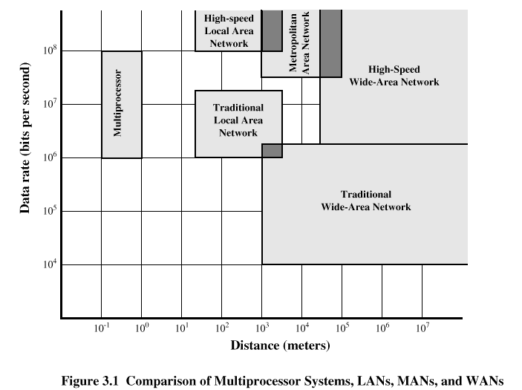
Speed and Distance of Communications Networks

Slide 4
Characteristics of WANs
Covers large geographical areas
Circuits provided by a common carrier
Consists of interconnected switching nodes
Traditional WANs provide modest capacity
  64000 bps common
  Business subscribers using T-1 service – 1.544 Mbps common
Higher-speed WANs use optical fiber and transmission technique known as asynchronous transfer mode (ATM)
  10s and 100s of Mbps common

Slide 5
Characteristics of LANs
Like WAN, LAN interconnects a variety of devices and provides a means for information exchange among them
Traditional LANs
  Provide data rates of 1 to 20 Mbps
High-speed LANS
  Provide data rates of 100 Mbps to 1 Gbps

Slide 6
Differences between LANs and WANs
Scope of a LAN is smaller
  LAN interconnects devices within a single building or cluster of buildings
LAN usually owned by organization that owns the attached devices
  For WANs, most of network assets are not owned by same organization
Internal data rate of LAN is much greater

Slide 7
The Need for MANs
Traditional point-to-point and switched network techniques used in WANs are inadequate for growing needs of organizations
Need for high capacity and low costs over large area
MAN provides:
  Service to customers in metropolitan areas
  Required capacity
  Lower cost and greater efficiency than equivalent service from telephone company

Slide 8
Switching Terms
Switching Nodes:
  Intermediate switching device that moves data
  Not concerned with content of data
Stations:
  End devices that wish to communicate
  Each station is connected to a switching node
Communications Network:
  A collection of switching nodes

Slide 9
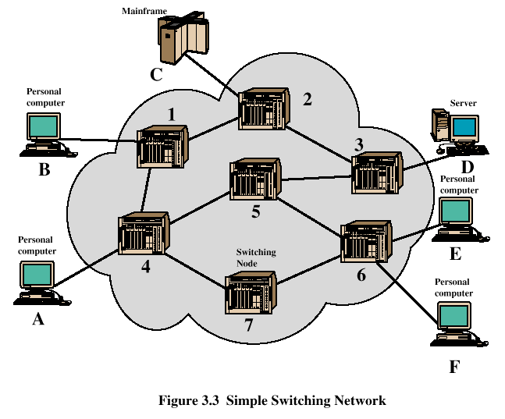
Switched Network

Slide 10
Observations of Figure 3.3
Some nodes connect only to other nodes (e.g., 5 and 7)
Some nodes connect to one or more stations
Node-station links usually dedicated point-to-point links
Node-node links usually multiplexed links
  Frequency-division multiplexing (FDM)
  Time-division multiplexing (TDM)
Not a direct link between every node pair

Slide 11
Techniques Used in Switched Networks
Circuit switching
  Dedicated communications path between two stations
  E.g., public telephone network
Packet switching
  Message is broken into a series of packets
  Each node determines next leg of transmission for each packet

Slide 12
Phases of Circuit Switching
Circuit establishment
  An end to end circuit is established through switching nodes
Information Transfer
  Information transmitted through the network
  Data may be analog voice, digitized voice, or binary data
Circuit disconnect
  Circuit is terminated
  Each node deallocates dedicated resources

Slide 13
Characteristics of Circuit Switching
Can be inefficient
  Channel capacity dedicated for duration of connection
  Utilization not 100%
  Delay prior to signal transfer for establishment
Once established, network is transparent to users
Information transmitted at fixed data rate with only propagation delay

Slide 14
Components of Public Telecommunications Network
Subscribers - devices that attach to the network; mostly telephones
Subscriber line - link between subscriber and network
  Also called subscriber loop or local loop
Exchanges - switching centers in the network
  A switching centers that support subscribers is an end office
Trunks - branches between exchanges

Slide 15
How Packet Switching Works
Data is transmitted in blocks, called packets
Before sending, the message is broken into a series of packets
  Typical packet length is 1000 octets (bytes)
  Packets consists of a portion of data plus a packet header that includes control information
At each node end route, packet is received, stored briefly and passed to the next node

Slide 16
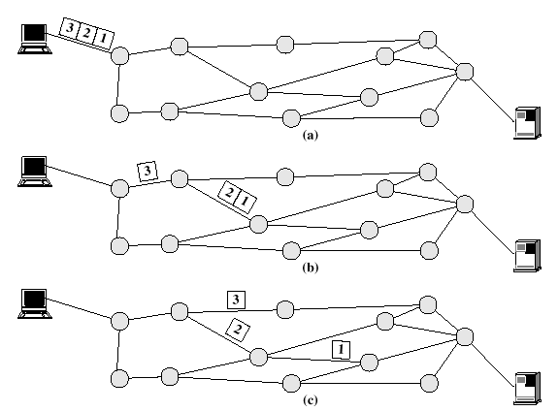
Packet Switching

Slide 17
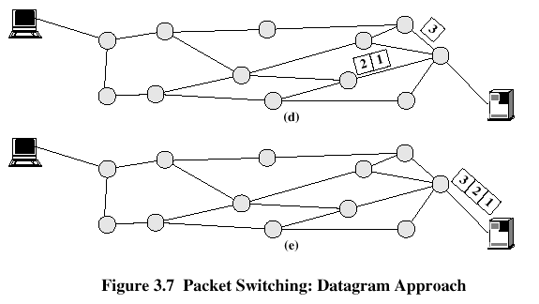
Packet Switching

Slide 18
Packet Switching Advantages
Line efficiency is greater
  Many packets over time can dynamically share the same node to node link
Packet-switching networks can carry out data-rate conversion
  Two stations with different data rates can exchange information
Unlike circuit-switching networks that block calls when traffic is heavy, packet-switching still accepts packets, but with increased delivery delay
Priorities can be used

Slide 19
Disadvantages of Packet Switching
Each packet switching node introduces a delay
Overall packet delay can vary substantially
  This is referred to as jitter
  Caused by differing packet sizes, routes taken and varying delay in the switches
Each packet requires overhead information
  Includes destination and sequencing information
  Reduces communication capacity
More processing required at each node

Slide 20
Packet Switching Networks - Datagram
Each packet treated independently, without reference to previous packets
Each node chooses next node on packet’s path
Packets don’t necessarily follow same route and may arrive out of sequence
Exit node restores packets to original order
Responsibility of exit node or destination to detect loss of packet and how to recover

Slide 21
Packet Switching Networks – Datagram
Advantages:
  Call setup phase is avoided
  Because it’s more primitive, it’s more flexible
  Datagram delivery is more reliable

Slide 22
Packet Switching Networks – Virtual Circuit
Preplanned route established before packets sent
All packets between source and destination follow this route
Routing decision not required by nodes for each packet
Emulates a circuit in a circuit switching network but is not a dedicated path
  Packets still buffered at each node and queued for output over a line

Slide 23
Packet Switching Networks – Virtual Circuit
Advantages:
  Packets arrive in original order
  Packets arrive correctly
  Packets transmitted more rapidly without routing decisions made at each node

Slide 24
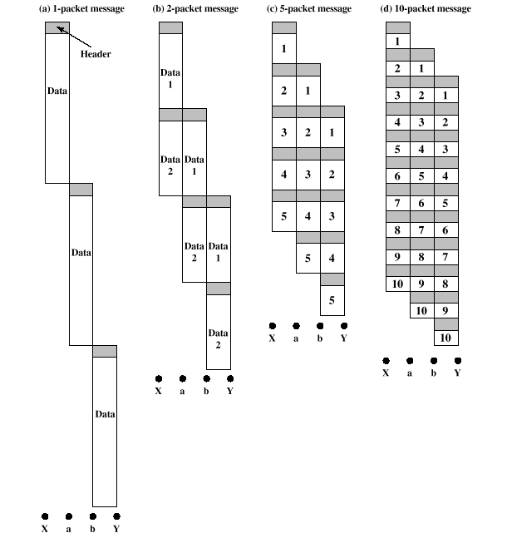
Effect of Packet Size on Transmission

Slide 25
Effect of Packet Size on Transmission
Breaking up packets decreases transmission time because transmission is allowed to overlap
Figure 3.9a
  Entire message (40 octets) + header information (3 octets) sent at once
  Transmission time: 129 octet-times
Figure 3.9b
  Message broken into 2 packets (20 octets) + header (3 octets)
  Transmission time: 92 octet-times

Slide 26
Effect of Packet Size on Transmission
Figure 3.9c
  Message broken into 5 packets (8 octets) + header (3 octets)
  Transmission time: 77 octet-times
Figure 3.9d
  Making the packets too small, transmission time starts increases
  Each packet requires a fixed header; the more packets, the more headers

Slide 27
Asynchronous Transfer Mode (ATM)
Also known as cell relay
Operates at high data rates
Resembles packet switching
  Involves transfer of data in discrete chunks, like packet switching
  Allows multiple logical connections to be multiplexed over a single physical interface
Minimal error and flow control capabilities reduces overhead processing and size
Fixed-size cells simplify processing at ATM nodes

Slide 28
ATM Terminology
Virtual channel connection (VCC)
  Logical connection in ATM
  Basic unit of switching in ATM network
  Analogous to a virtual circuit in packet switching networks
  Exchanges variable-rate, full-duplex flow of fixed-size cells
Virtual path connection (VPC)
  Bundle of VCCs that have the same end points

Slide 29
Advantages of Virtual Paths
Simplified network architecture
Increased network performance and reliability
Reduced processing and short connection setup time
Enhanced network services

Slide 30
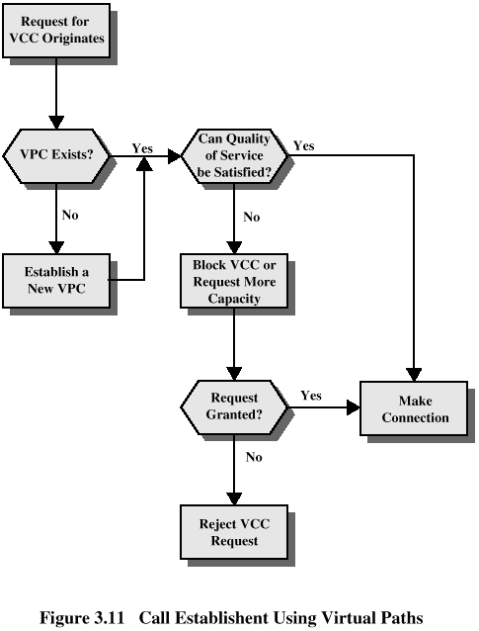
Call Establishment

Slide 31
Virtual Channel Connection Uses
Between end users
  Can carry end-to-end user data or control signaling between two users
Between an end user and a network entity
  Used for user-to-network control signaling
Between two network entities
  Used for network traffic management and routing functions

Slide 32
Virtual Path/Virtual Channel Characteristics
Quality of service
  Specified by parameters such as cell loss ratio and cell delay variation
Switched and semipermanent virtual channel connections
Cell sequence integrity
Traffic parameter negotiation and usage monitoring
Virtual channel identifier restriction within a VPC

Slide 33
ATM Cell Header Format
Generic flow control (GFC) – 4 bits, used only in user-network interface
  Used to alleviate short-term overload conditions in network
Virtual path identifier (VPI) – 8 bits at the user-network interface, 12 bits at network-network interface
  Routing field
Virtual channel identifier (VCI) – 8 bits
  Used for routing to and from end user

Slide 34
ATM Cell Header Format
Payload type (PT) – 3 bits
  Indicates type of information in information field
Cell loss priority (CLP) – 1 bit
  Provides guidance to network in the event of congestion
Header error control (HEC) – 8 bit
  Error code

Slide 35
ATM Service Categories
Real-time service
  Constant bit rate (CBR)
  Real-time variable bit rate (rt-VBR)
Non-real-time service
  Non-real-time variable bit rate (nrt-VBR)
  Available bit rate (ABR)
  Unspecified bit rate (UBR)

Slide 36
Examples of CBR Applications
Videoconferencing
Interactive audio (e.g., telephony)
Audio/video distribution (e.g., television, distance learning, pay-per-view)
Audio/video retrieval (e.g., video-on-demand, audio library)

Slide 37
Examples of UBR applications
Text/data/image transfer, messaging, distribution, retrieval
Remote terminal (e.g., telecommuting)

