Slide 1
Job Analysis

Slide 2
The Nature of Job Analysis
Job analysis
  The procedure for determining the duties and skill requirements of a job and the kind of person who should be hired for it.
Job description
  A list of a job’s duties, responsibilities, reporting relationships, working conditions, and supervisory responsibilities—one product of a job analysis.
Job specifications
  A list of a job’s “human requirements,” that is, the requisite education, skills, personality, and so on—another product of a job analysis.
4–<number>
© 2005 Prentice Hall Inc. All rights reserved.

Slide 3
Types of Information Collected
Work activities
Human behaviors
Machines, tools, equipment, and work aids
Performance standards
Job context
Human requirements
4–<number>
© 2005 Prentice Hall Inc. All rights reserved.

Slide 4
Uses of Job Analysis Information
Recruitment and Selection
Compensation
Performance Appraisal
Training
Discovering Unassigned Duties
EEO Compliance
4–<number>
© 2005 Prentice Hall Inc. All rights reserved.

Slide 5
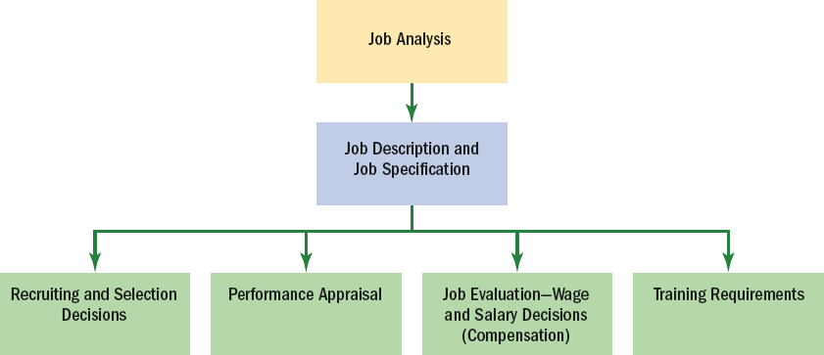
Uses of Job Analysis Information
Figure 4–1
4–<number>
© 2005 Prentice Hall Inc. All rights reserved.

Slide 6
Steps in Job Analysis
Step 1: Decide how you’ll use the
information.
Step 2: Review relevant background
information.
Step 3: Select representative positions.
Step 4: Actually analyze the job.
Step 5: Verify the job analysis information.
Step 6: Develop a job description and job
specification.
4–<number>
© 2005 Prentice Hall Inc. All rights reserved.

Slide 7

Charting the Organization
Organization chart
  A chart that shows the organizationwide distribution of work, with titles of each position and interconnecting lines that show who reports to and communicates to whom.
Process chart
  A work flow chart that shows the flow of inputs to and outputs from a particular job.
4–<number>
© 2005 Prentice Hall Inc. All rights reserved.

Slide 8
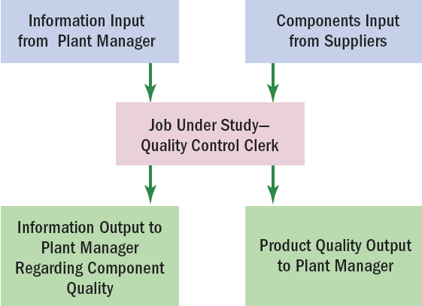
Process Chart for Analyzing a Job’s Workflow
Figure 4–2
4–<number>
© 2005 Prentice Hall Inc. All rights reserved.

Slide 9

Methods of Collecting Job Analysis Information: The Interview
Information sources
  Individual employees
  Groups of employees
  Supervisors with knowledge of the job
Advantages
  Quick, direct way to find overlooked information.
Disadvantages
  Distorted information
Interview formats
  Structured (Checklist)
  Unstructured
4–<number>
© 2005 Prentice Hall Inc. All rights reserved.

Slide 10
Interview Guidelines
The job analyst and supervisor should work together to identify the workers who know the job best.
Quickly establish rapport with the interviewee.
Follow a structured guide or checklist, one that lists open-ended questions and provides space for answers.
Ask the worker to list his or her duties in order of importance and frequency of occurrence.
After completing the interview, review and verify the data.
4–<number>
© 2005 Prentice Hall Inc. All rights reserved.

Slide 11
Methods of Collecting Job Analysis Information: Questionnaires
Information source
  Have employees fill out questionnaires to describe their job-related duties and responsibilities.
Questionnaire formats
  Structured checklists
  Opened-ended questions
Advantages
  Quick and efficient way to gather information from large numbers of employees
Disadvantages
  Expense and time consumed in preparing and testing the questionnaire
4–<number>
© 2005 Prentice Hall Inc. All rights reserved.

Slide 12

Methods of Collecting Job Analysis Information: Observation
Information source
  Observing and noting the physical activities of employees as they go about their jobs.
Advantages
  Provides first-hand information
  Reduces distortion of information
Disadvantages
  Time consuming
  Difficulty in capturing entire job cycle
  Of little use if job involves a high level of mental activity.
4–<number>
© 2005 Prentice Hall Inc. All rights reserved.

Slide 13

Methods of Collecting Job Analysis Information: Participant Diary/Logs
Information source
  Workers keep a chronological diary/ log of what they do and the time spent in each activity.
Advantages
  Produces a more complete picture of the job
  Employee participation
Disadvantages
  Distortion of information
  Depends upon employees to accurately recall their activities
4–<number>
© 2005 Prentice Hall Inc. All rights reserved.

Slide 14
Quantitative Job Analysis Techniques
The position analysis questionnaire (PAQ)
  A questionnaire used to collect quantifiable data concerning the duties and responsibilities of various jobs.
The Department of Labor (DOL) procedure
  A standardized method by which different jobs can be quantitatively rated, classified, and compared.
Functional job analysis
  Takes into account the extent to which instructions, reasoning, judgment, and mathematical and verbal ability are necessary for performing job tasks.
4–<number>
© 2005 Prentice Hall Inc. All rights reserved.

Slide 15
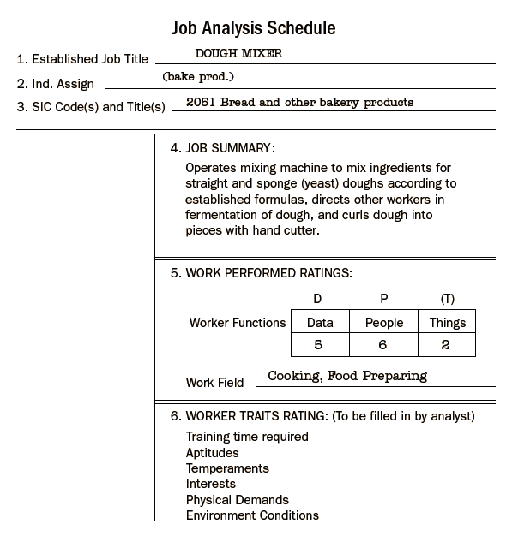
Sample Report Based on Department of Labor Job Analysis Technique
Figure 4–6
4–<number>
© 2005 Prentice Hall Inc. All rights reserved.

Slide 16
Writing Job Descriptions
A job description
  A written statement of what the worker actually does, how he or she does it, and what the job’s working conditions are.
Sections of a typical job description
  Job identification
  Job summary
  Responsibilities and duties
  Authority of incumbent
  Standards of performance
  Working conditions
  Job specifications
4–<number>
© 2005 Prentice Hall Inc. All rights reserved.

Slide 17
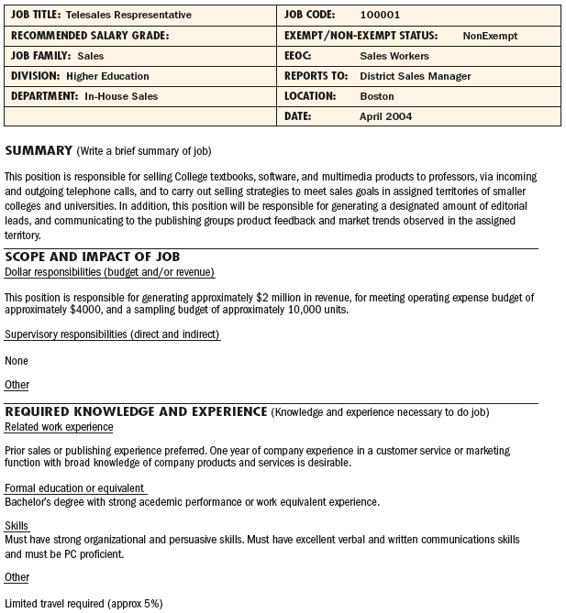
Sample Job Description, Pearson Education
Source: Courtesy of HR Department, Pearson Education.
Figure 4–7a
4–<number>
© 2005 Prentice Hall Inc. All rights reserved.

Slide 18
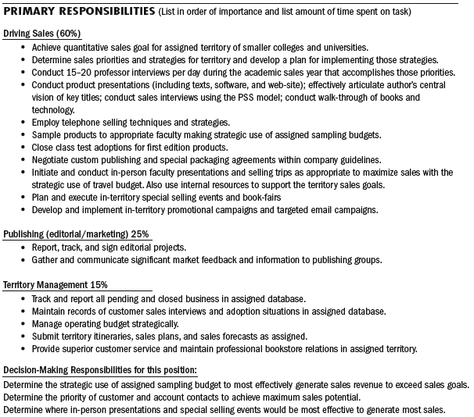
Sample Job Description, Pearson Education
Source: Courtesy of HR Department, Pearson Education.
Figure 4–7b
4–<number>
© 2005 Prentice Hall Inc. All rights reserved.

Slide 19
“Marketing Manager” Description from
Standard Occupational Classification
20. 11-2021 Marketing Managers
Abstract: 11-2021 Marketing Managers. Determine the demand for products and services offered by a firm and Its competitors and identify potential customers. Develop pricing strategies with the goal of maximizing the firm’s profits or share of the market while ensuring the firm’s customers are satisfied.
Source: www.bis.gov, accessed November 13, 2003.
Figure 4–8
4–<number>
© 2005 Prentice Hall Inc. All rights reserved.

Slide 20
The Job Description
Job identification
  Job title: name of job
  FLSA status section: Exempt or nonexempt
  Preparation date: when the description was written
  Prepared by: who wrote the description
Job summary
  Describes the general nature of the job
  Lists the major functions or activities
4–<number>
© 2005 Prentice Hall Inc. All rights reserved.

Slide 21
The Job Description (cont’d)
Relationships (chain of command)
  Reports to: employee’s immediate supervisor
  Supervises: employees that the job incumbent directly supervises
  Works with: others with whom the job holder will be expected to work and come into contact with internally.
  Outside the company: others with whom the job holder is expected to work and come into contact with externally.
4–<number>
© 2005 Prentice Hall Inc. All rights reserved.

Slide 22
The Job Description (cont’d)
Responsibilities and duties
  A listing of the job’s major responsibilities and duties (essential functions)
  Defines limits of jobholder’s decision-making authority, direct supervision, and budgetary limitations.
Standard Occupational Classification
  Classifies all workers into one of 23 major groups of jobs which are subdivided into 96 minor groups of jobs and detailed occupations.
4–<number>
© 2005 Prentice Hall Inc. All rights reserved.

Slide 23
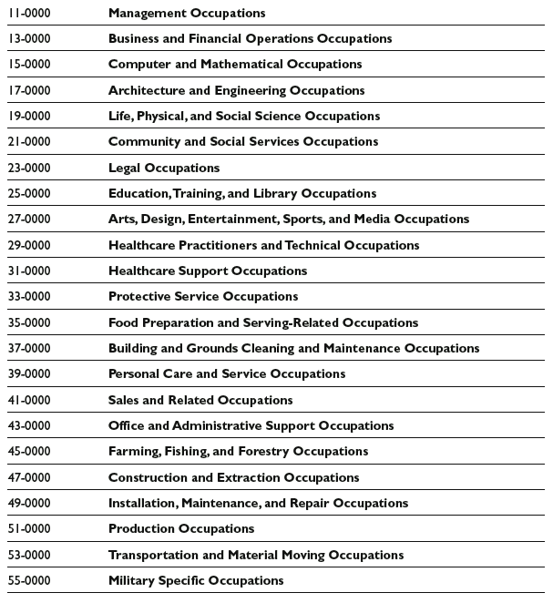
SOC’s Major Groups of Jobs
Note: Within these major groups are 96 minor groups, 449 broad occupations, and 821 detailed occupations.
Table 4–2
4–<number>
© 2005 Prentice Hall Inc. All rights reserved.

Slide 24
Is the Job Function Essential?
What three or four main activities actually constitute the job? Is each really necessary?
What is the relationship between each task? Is there a special sequence which the tasks must follow?
Do the tasks necessitate sitting, standing, crawling, walking, climbing, running, stooping, kneeling, lifting, carrying, digging, writing, operating, pushing, pulling, fingering, talking, listening, interpreting, analyzing, seeing, coordinating, etc.?
How many employees are available to perform the job function? Can the job function be distributed among other employees?
How much time is spent on the job performing each particular function? Are infrequent tasks less important to success?
Would removing a function fundamentally alter the job?
4–<number>
© 2005 Prentice Hall Inc. All rights reserved.

Slide 25
Is the Job Function Essential? (cont’d)
What happens if a task is not completed on time?
Does the position exist to perform that function?
Are employees in the position actually required to perform the function?
Is there a limited number of other employees available to perform the function?
What is the degree of expertise or skill required to perform the function?
What is the actual work experience of present or past employees in the job?
What is the amount of time an individual actually spends performing the function?
What are the consequences of not requiring the performance of the function?
4–<number>
© 2005 Prentice Hall Inc. All rights reserved.

Slide 26

The Job Description (cont’d)
Standards of performance and working conditions
  Lists the standards the employee is expected to achieve under each of the job description’s main duties and responsibilities.
4–<number>
© 2005 Prentice Hall Inc. All rights reserved.

Slide 27
Writing Job Specifications
Specifications for trained personnel
  Focus on traits like length of previous service, quality of relevant training, and previous job performance.
Specifications for untrained personnel
  Focus on physical traits, personality, interests, or sensory skills that imply some potential for performing or for being trained to do the job.
4–<number>
© 2005 Prentice Hall Inc. All rights reserved.

Slide 28
Writing Job Specifications (cont’d)
Specifications Based on Judgment
  Self-created judgments (common sense)
  List of competencies in Web-based job descriptions (e.g., www.jobdescription.com)
  O*NET online
  Standard Occupational Classification
Specifications Based on Statistical Analysis
  Attempts to determine statistically the relationship between a predictor or human trait and an indicator or criterion of job effectiveness.
4–<number>
© 2005 Prentice Hall Inc. All rights reserved.

Slide 29
Writing Job Specifications (cont’d)
Steps in the Statistical Approach
  Analyze the job and decide how to measure job performance.
  Select personal traits that you believe should predict successful performance.
  Test candidates for these traits.
  Measure the candidates’ subsequent job performance.
  Statistically analyze the relationship between the human trait and job performance.
4–<number>
© 2005 Prentice Hall Inc. All rights reserved.

Slide 30
Writing Job Descriptions
Step 1. Decide on a Plan
Step 2. Develop an Organization Chart
Step 3. Use a Job Analysis/Description Questionnaire
Step 4. Obtain Lists of Job Duties from O*NET
Step 5. Compile the Job’s Human Requirements
from O*NET
Step 6. Complete Your Job Description
4–<number>
© 2005 Prentice Hall Inc. All rights reserved.

Slide 31

Job Analysis in a “Jobless” World
Job
  Generally defined as “a set of closely related activities carried out for pay.”
4–<number>
© 2005 Prentice Hall Inc. All rights reserved.

Slide 32
From Specialized to Enlarged Jobs
Job enlargement
  Assigning workers additional same level activities, thus increasing the number of activities they perform.
Job enrichment
  Redesigning jobs in a way that increases the opportunities for the worker to experience feelings of responsibility, achievement, growth, and recognition.
4–<number>
© 2005 Prentice Hall Inc. All rights reserved.

Slide 33
From Specialized to Enlarged Jobs (cont’d)
Job rotation
  Moving a trainee from department to department to broaden his or her experience and identify strong and weak points to prepare the person for an enhanced role with the company
  Systematically moving workers from one job to another to enhance work team performance.
4–<number>
© 2005 Prentice Hall Inc. All rights reserved.

Slide 34
Why Managers Are Dejobbing Their Companies
Dejobbing
  Broadening the responsibilities of the company’s jobs
  Encouraging employee initiative.
Internal factors leading to dejobbing
  Flatter organizations
  Work teams
External factors leading to dejobbing.
  Rapid product and technological change
  Global competition
  Deregulation,
  Political instability,
  Demographic changes
  Rise of a service economy.
4–<number>
© 2005 Prentice Hall Inc. All rights reserved.

Slide 35
Competency-Based Job Analysis
Competencies
  Demonstrable characteristics of a person that enable performance of a job.
Competency-based job analysis
  Describing a job in terms of the measurable, observable, behavioral competencies (knowledge, skills, and/or behaviors) an employee must exhibit to do a job well.
4–<number>
© 2005 Prentice Hall Inc. All rights reserved.

Slide 36
Why Use Competency Analysis?
To support HPWS
  Traditional job descriptions (with their lists of specific duties) may actually backfire if a high-performance work system is the goal.
Maintain a strategic focus
  Describing the job in terms of the skills, knowledge, and competencies the worker needs is more strategic.
Measuring performance
  Measurable skills, knowledge, and competencies are the heart of any company’s performance management process.
4–<number>
© 2005 Prentice Hall Inc. All rights reserved.

Slide 37
Performance Management
Performance management
  Managing all elements of the organizational process that affect how well employees perform.
Types of competencies
  General competencies
    reading, writing, and mathematical reasoning.
  Leadership competencies
    leadership, strategic thinking, and teaching others.
  Technical competencies
    specific technical competencies required for specific types of jobs and/or occupations.
4–<number>
© 2005 Prentice Hall Inc. All rights reserved.

Slide 38
Background Data for Examples
Example of Job Title: Customer Service Clerk
Example of Job Summary:
Answers inquiries and gives directions to customers, authorizes cashing of customers’ checks, records and returns lost charge cards, sorts and reviews new credit applications, works at customer service desk in department store.
Example of One Job Duty:
Authorizes cashing of checks: authorizes cashing of personal or payroll checks (up to a specified amount) by customers desiring to make payment by check. Requests identification—such as driver’s license—from customers and examines check to verify date, amount, signature, and endorsement. Initials check and sends customer to cashier.
Figure 4–10
4–<number>
© 2005 Prentice Hall Inc. All rights reserved.

Slide 39
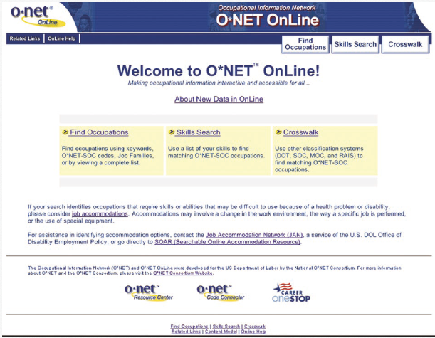
4–<number>
© 2005 Prentice Hall Inc. All rights reserved.

Slide 40
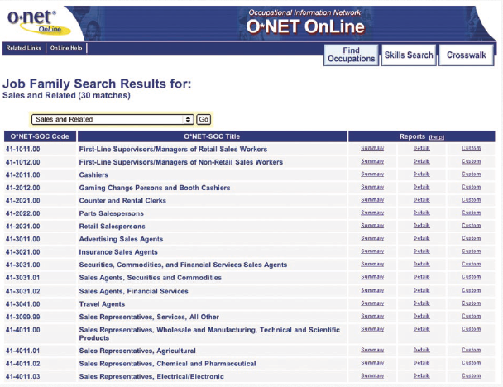
4–<number>
© 2005 Prentice Hall Inc. All rights reserved.

Slide 41
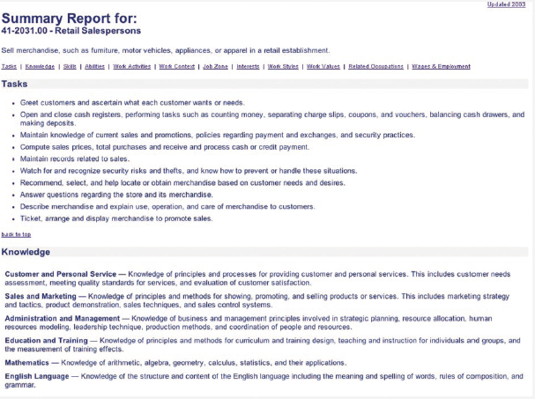
4–<number>
© 2005 Prentice Hall Inc. All rights reserved.

Slide 42
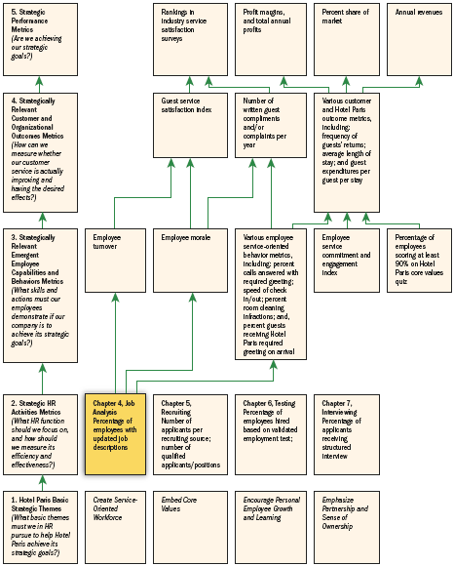
HR Scorecard for Hotel Paris International Corporation*
Note: *(An abbreviated example showing selected HR practices and outcomes aimed at implementing the competitive strategy,“ To use superior guest services to differentiate the Hotel Paris properties and thus increase the length of stays and the return rate of guests and thus boost revenues and profitability”)
Figure 4–11
4–<number>
© 2005 Prentice Hall Inc. All rights reserved.

Slide 43
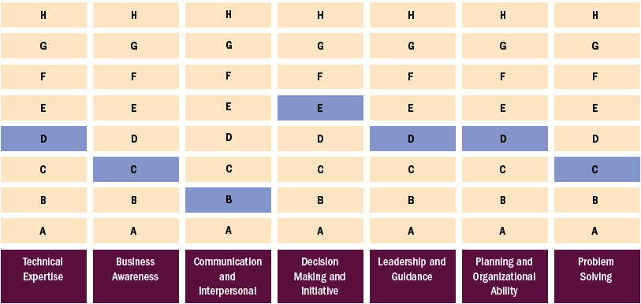
The Skills Matrix for One Job at BP
Note: The light blue boxes indicate the minimum level of skill required for the job.
Figure 4–12
4–<number>
© 2005 Prentice Hall Inc. All rights reserved.

Slide 44
Key Terms
job analysis
job description
job specifications
organization chart
process chart
diary/log
position analysis questionnaire (PAQ)
U.S. Department of Labor (DOL)
job analysis procedure
functional job analysis
Standard Occupational Classification (SOC)
job enlargement
job rotation
job enrichment
dejobbing
boundaryless organization
reengineering
competencies
competency-based job analysis
performance management
4–<number>
© 2005 Prentice Hall Inc. All rights reserved.

