Slide 1

Analysis of COVID Cases and Deaths Rates

Slide 2
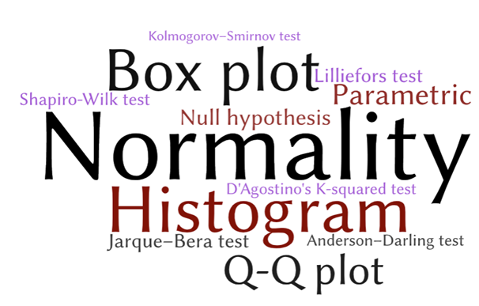
Abstract/Brief Summary
The novel coronavirus (COVID-19) that was first reported at the end of 2019 has impacted almost every aspect of life as we know it. This Data Analysis project focuses on the incidence of the disease in Pakistan where even the everyday viruses couldn’t be treated properly and this monstrous emerged as day of gloom for the citizens. We have selected COVID New and Total Cases as independent variables as they have a direct impact on Pakistan’s COVID situation including Total and New Deaths along with cured and vaccinated. Using two simple mathematical epidemiological models—the neutroscopic Kruskal Wallis H model and the linear regression model, we modeled the different variables further described related to COVID-19. The predictive ability of the log-linear regression model was found to give a better fit and simple estimates of the daily incidence when they were computed.

Slide 3



Objective
The main reason behind the selection of this topic is to analyze the affected, cured and death ratio so that if these kind of viruses further spread in the future we may have better technologies and assets to fight against them.
Why this analysis and what will be the outcome?

Slide 4
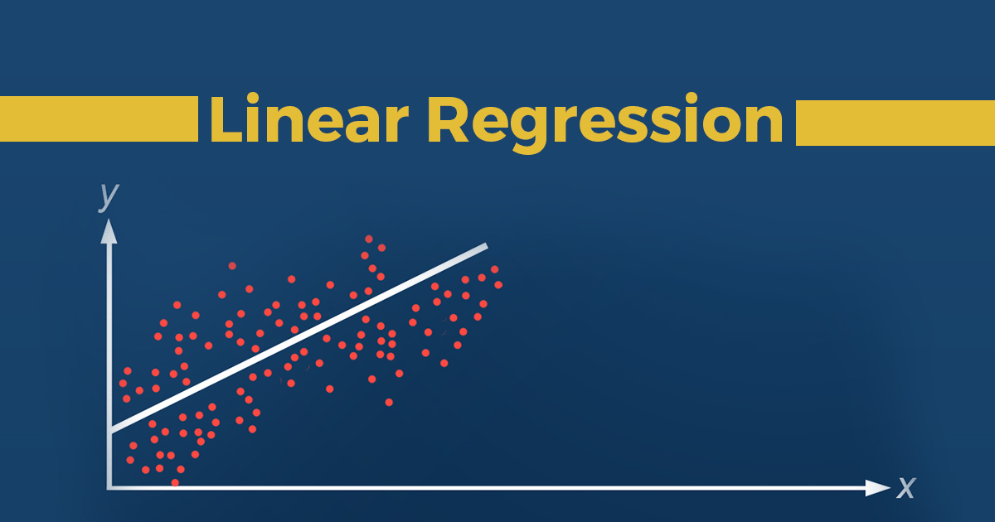

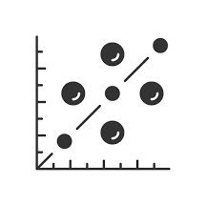
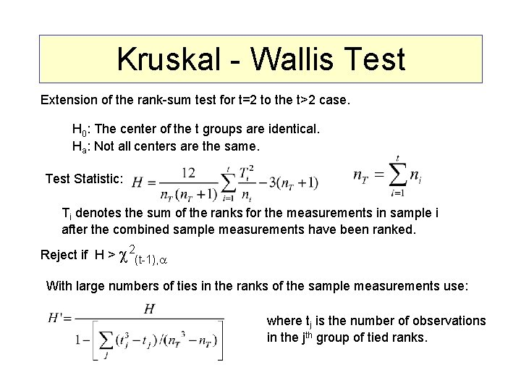
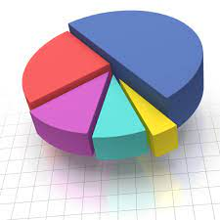
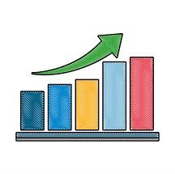
Data Analysis Methods
Linear Regression
Correlation
Scatter Plot
Kruskal Wallis Test
Pie Chart
Bar Chart

Slide 5


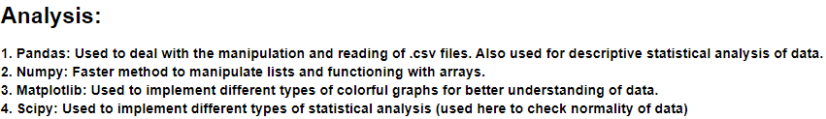
Software Used
What is Python and why did we use it?

Slide 6

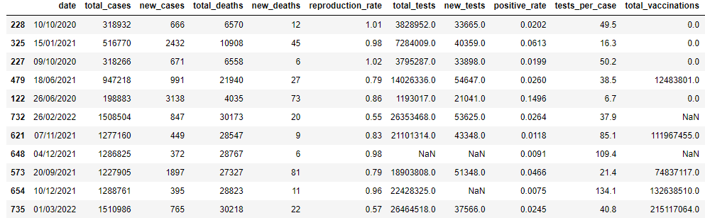
Data Collection/Methodology
Data has been collected through online database of ourworldindata.org (a website containing all the data of different events occurring in the world). We extracted the data of Covid Situation happened in Pakistan.
https://ourworldindata.org/coronavirus/country/pakistan

Slide 7




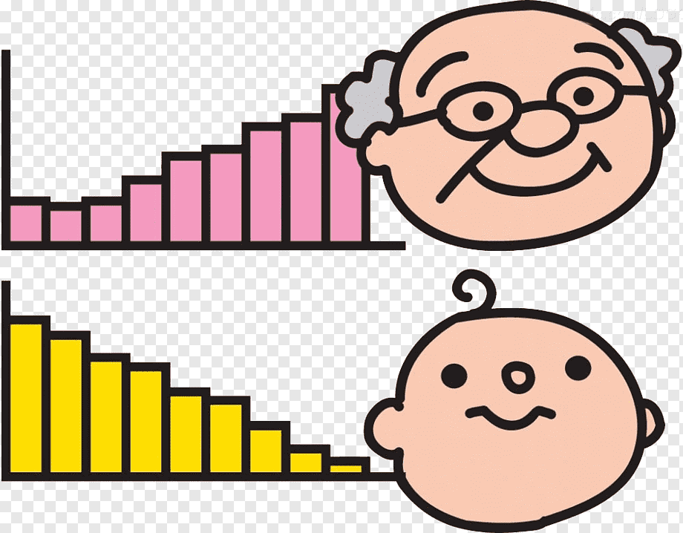

Variables Used
Total Cases
Cases
Total Deaths
New Deaths
Reproduction Rate
Total Tests

Slide 8



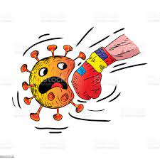
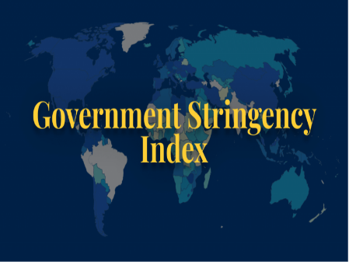
Variables Used (Cont.)
New Tests
Positivity Rate
Total Vaccines
New Vaccines
Stringency Index

Slide 9

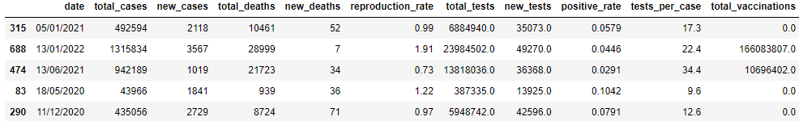

Data Cleaning
Data cleaning is the process of fixing or removing incorrect, corrupted, incorrectly formatted, duplicate, or incomplete data within a dataset.

Slide 10
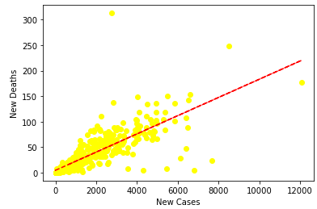

Linear Regression
Linear regression attempts to model the relationship between two variables by fitting a linear equation to observed data.
Here, New Cases are listed on the x-axis and
New Deaths are listed on the y-axis.
$$\hat{y}=a+bX \\ \text{where}\text{,} \\ \hat{y} \text{represents} \text{predicted} \text{average} \text{of} Y \text{at} \text{a} \text{given} X \\ a \text{represents} \text{the} \text{line}\text{′}\text{s} \text{intercept}$$ $b \text{represents} \text{the} \text{line}\text{′}\text{s} \text{slope}$.

Slide 11
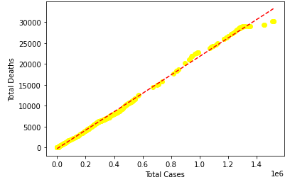
Linear Regression (Cont.)

Slide 12
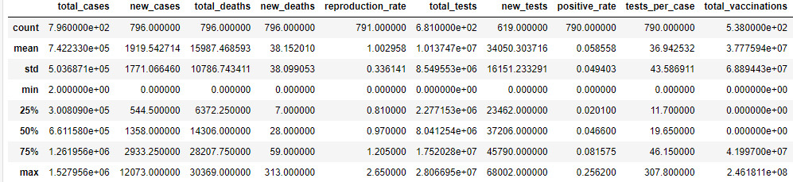
Descriptive Statistics
Descriptive statistics summarize and organize characteristics of a data set. A data set is a collection of responses or observations from a sample or entire population.
In quantitative research, after collecting data, the first step of statistical analysis is to describe characteristics of the responses.
In Inferential statistics, it helps you decide whether your data confirms or refutes your hypothesis.

Slide 13
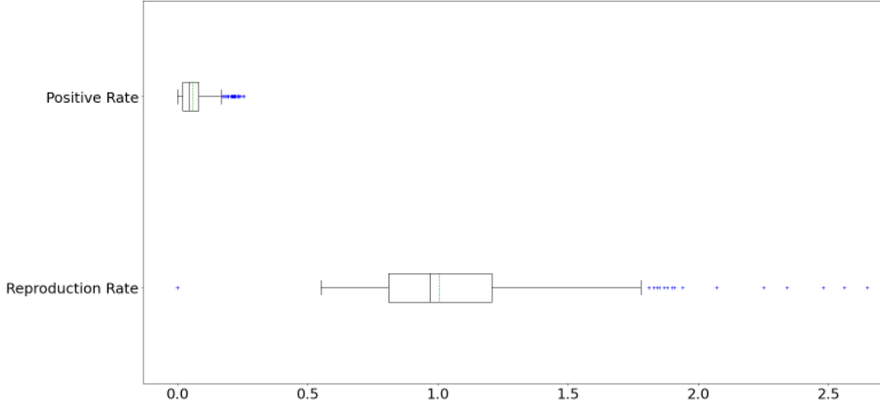
Box Plot
A box plot is a graph that shows the frequency of numeric data values.
Min Q₁ Median Q₃ Max
Lower Upper
Quartile Quartile

Slide 14
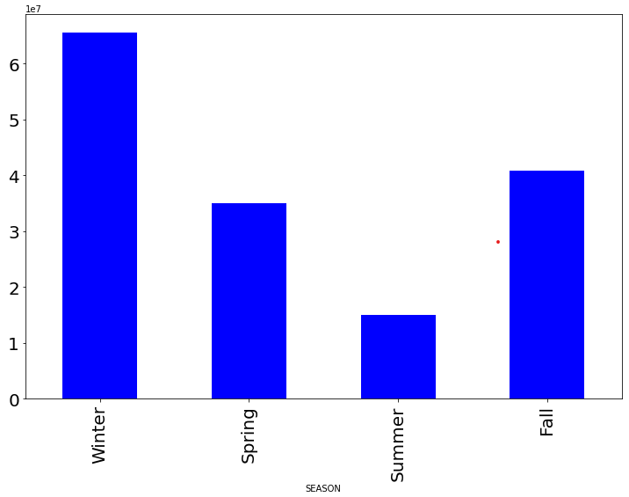
Bar Chart
A bar chart or bar graph is a chart or graph that presents categorical data with rectangular bars with heights or lengths proportional to the values that they represent. The bars can be plotted vertically or horizontally. A vertical bar chart is sometimes called a column chart.

Slide 15
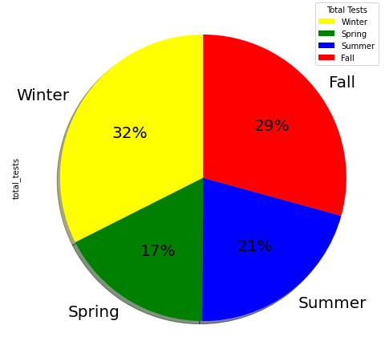
Pie Chart
A pie chart is a pictorial representation of data in the form of a circular chart or pie where the slices of the pie show the size of the data. A list of numerical variables along with categorical variables is needed to represent data in the form of a pie chart. The arc length of each slice and consequently the area and central angle it forms in a pie chart is proportional to the quantity it represents.

Slide 16
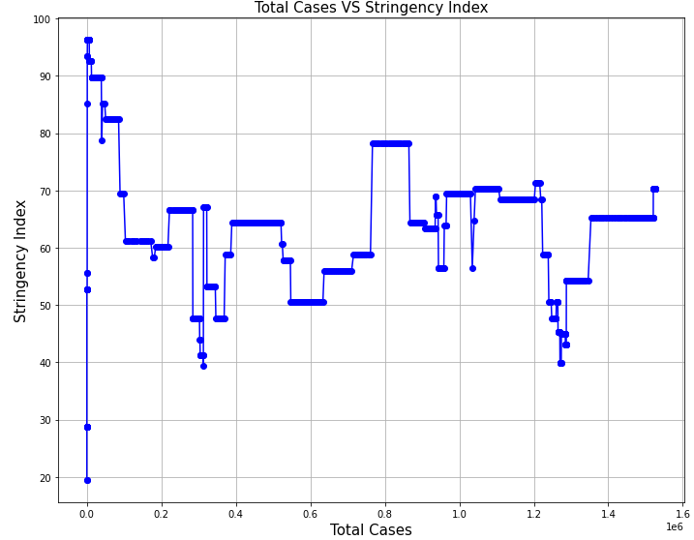
Line Plot
A Line plot can be defined as a graph that displays data as points or check marks above a number line, showing the frequency of each value.
To graph data on a line plot, we put a dot (or an X) above each number in the data set. If a number appears twice in the data, we put two dots above that number.

Slide 17
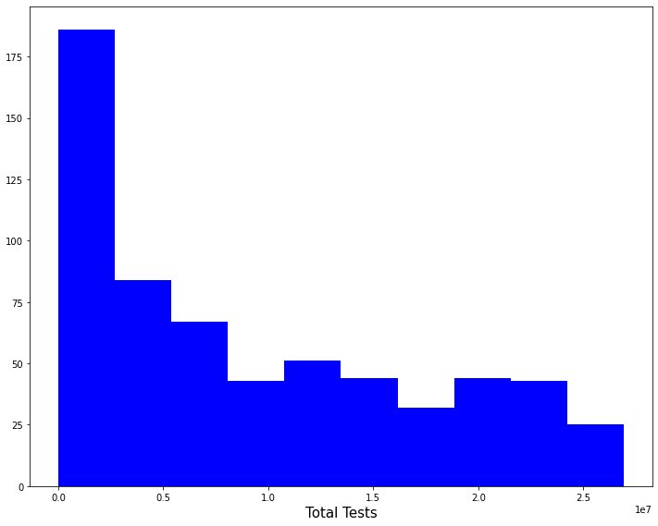
Histogram
A histogram is a graphical representation that organizes a group of data points into user-specified ranges. Similar in appearance to a bar graph, the histogram condenses a data series into an easily interpreted visual by taking many data points and grouping them into logical ranges or bins.
Here, the frequency of total tests are being calculated.

Slide 18
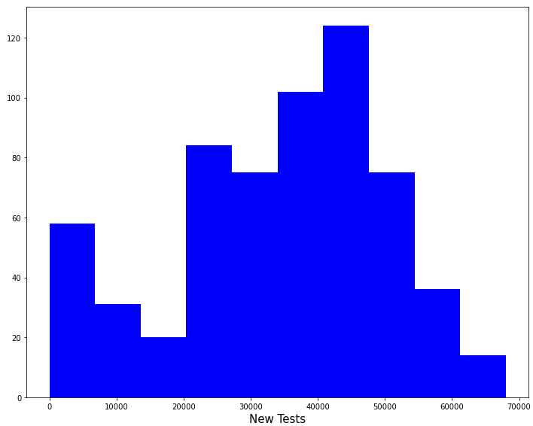
Histogram (Cont.)

Slide 19
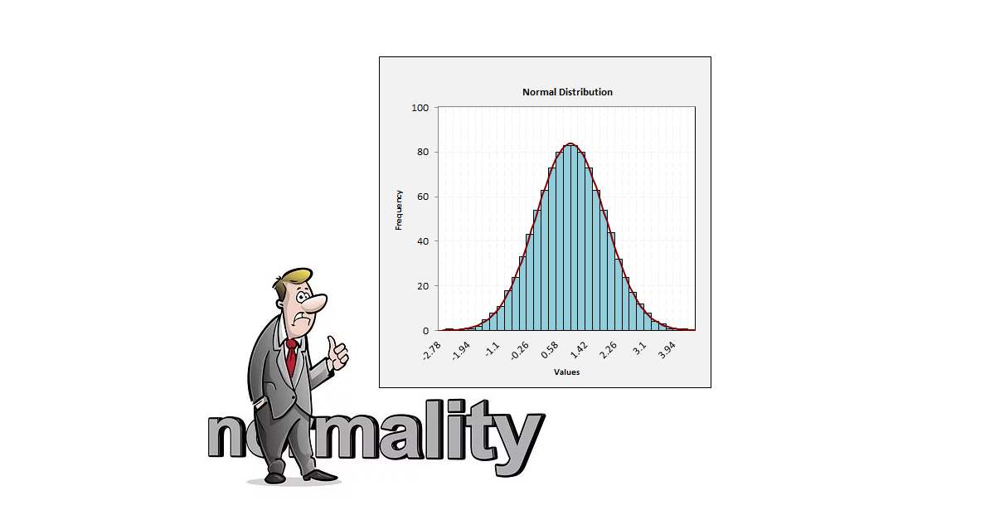
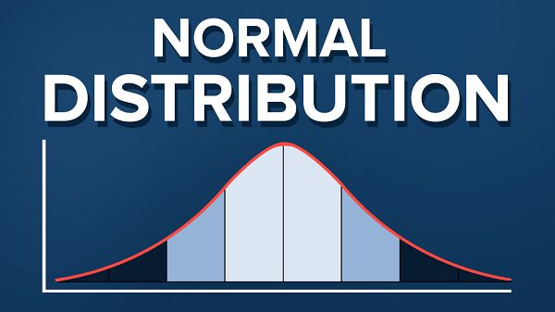
Normality of Data
Normality is a property of a random variable that is distributed according to the normal distribution .
Normality plays a central role in both theoretical and practical statistics: a great number of theoretical statistical methods rest on the assumption that the data, or test statistics derived from a sample of data, are normally distributed.

Slide 20
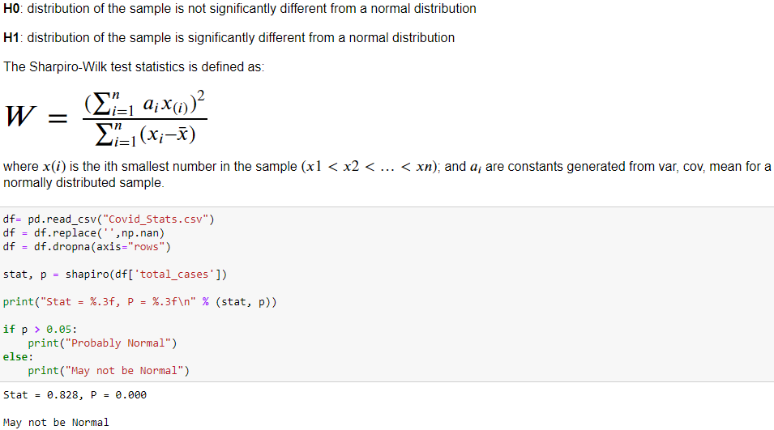
Shapiro-Wilk Test
The Shapiro-Wilks test for normality is one of three general normality tests designed to detect all departures from normality. It is comparable in power to the other two tests.

Slide 21
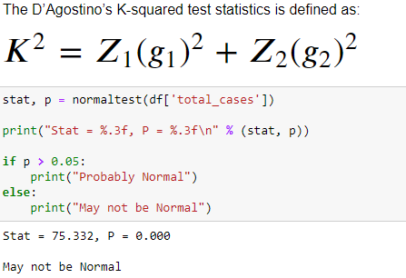
D’Agostino’s K-Squared Test
It is a goodness-of-fit measure of departure from normality, that is the test aims to establish whether or not the given sample comes from a normally distributed population. The test is based on transformations of the sample kurtosis and skewness.

Slide 22
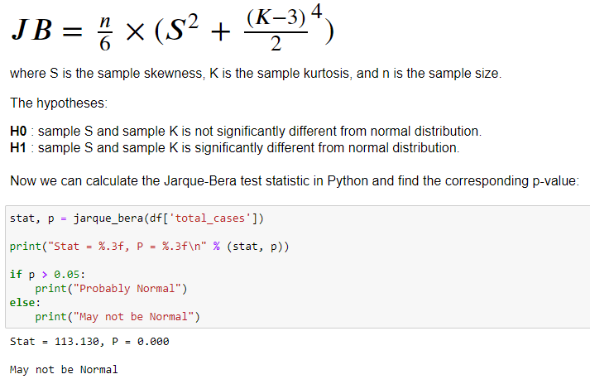
Jarque-Bera Test
The Jarque-Bera test is usually run before one of these tests to confirm normality. It is usually used for large data sets, because other normality tests are not reliable when n is large (for example, Shapiro-Wilk isn’t reliable with n more than 2,000).

Slide 23


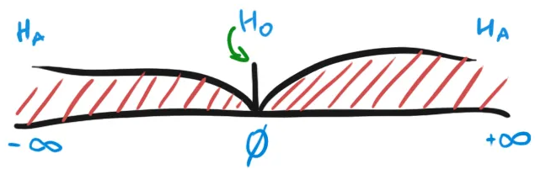
Hypothesis Testing
Hypothesis testing is a scientific process used to investigate the acceptance or rejection of a proposition under consideration.

Slide 24
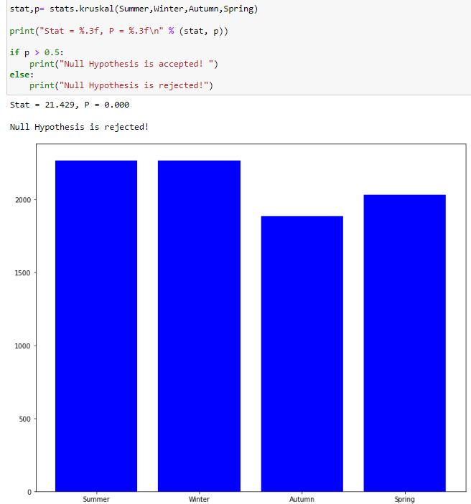
Kruskal Wallis H Test

Slide 25

Thankyou!
Syed Muhammad Faheem- 20K1054
Ishaqullah Siddique- 20K0148
Sarim Latif Khan- 20K1644
Syed Muhib Ahmed- 20K0405

