Slide 1


Lloyds Bank – Data Science Assignment
Syed Munazzir Ahmed

Slide 2

Problem Statement
Previous campaign comprising of a random selection of customers from mortgage customer base was unsuccessful as only a small number took the product.
The marketing team is looking for suggestions to improve the selection of customers so a higher proportion will purchase the product in a future marketing campaign.
Using the previous campaign data and existing mortage data, identify and suggest customers who will most likely buy an insurance product

Slide 3
Exploratory data analysis
Attributes | Campaign.csv | Mortgage.csv
shape | (32060, 16) | (32561, 18)
Missing values | Name title and created account (Target variable) | No
Duplicate rows | None | None
Numeric columns | 6 | 11
Categorical columns | 9 | 6
Boolean columns | 1 | 1
Note : More details are highlighted in their respective profiling files campaign_report.html and mortgage_report.html which are uploaded on GitHub

Slide 4
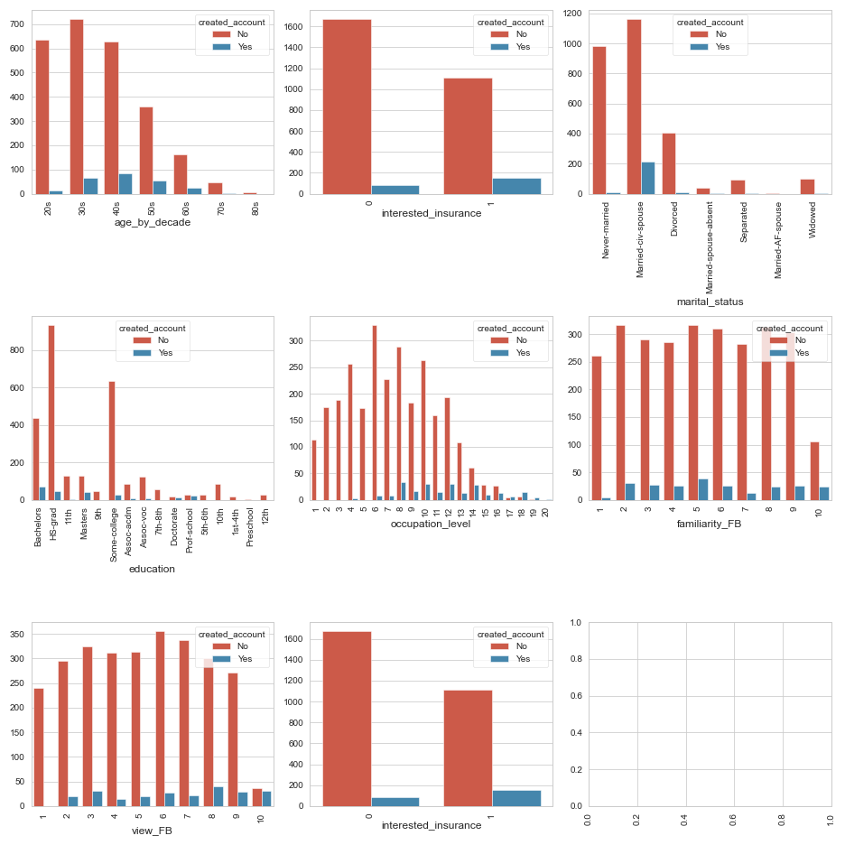
Exploratory data analysis (Contd...)
Distribution of independent features vs target column credited_account

Slide 5
Implementation and thought process
Following are the sequence of steps evaluated and explored while arriving at the two approaches. Details of both approaches are discussed in the subsequent slides.
Explored both the datasets.
Applied appropriate techniques for outlier analysis and treatment, encoding techniques such as one hot encoding, label encoding and frequency encoding.
Scaling and appropriate transformations applied are listed in subsequent slides
One example of a data cleaning activity on 'salary band'.
The column had varied representations
The idea was to convert the column values into annual salaries represented in GBP as the base currency.
Used regular expressions to clean the data.
Converted per week and per month representations to annual. Calculated mean if the representation was in the form of a range
Wrote a custom script(currency_conversion.py) to extract data from an API to access the conversion rates into GBP and transformed values from different currencies to GBP
Evaluated the presence of outliers using z-score, percentiles, histograms and boxplots. Capped outliers and transformed the data using an appropriate transformation such as log, sqrt or box cox to normalise.

Slide 6
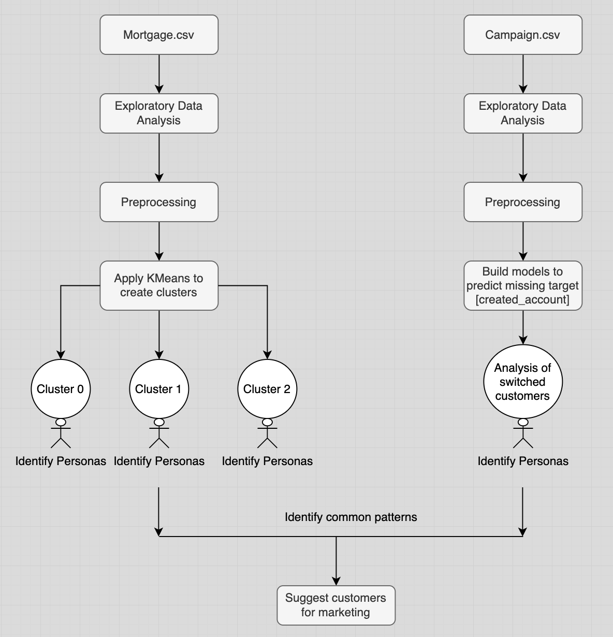
Approach 1: Clustering
Explored both the datasets
Applied appropriate preprocessing techniques to clean the data
Applied KMeans clustering on mortgage.csv to create clusters and performed persona identification of customers in each cluster
Built classification models on campaign.csv to predict missing target feature created_account
Analyzed the persona of customers who switched
Identified common patterns between the three clusters and the customers that switched.

Slide 7
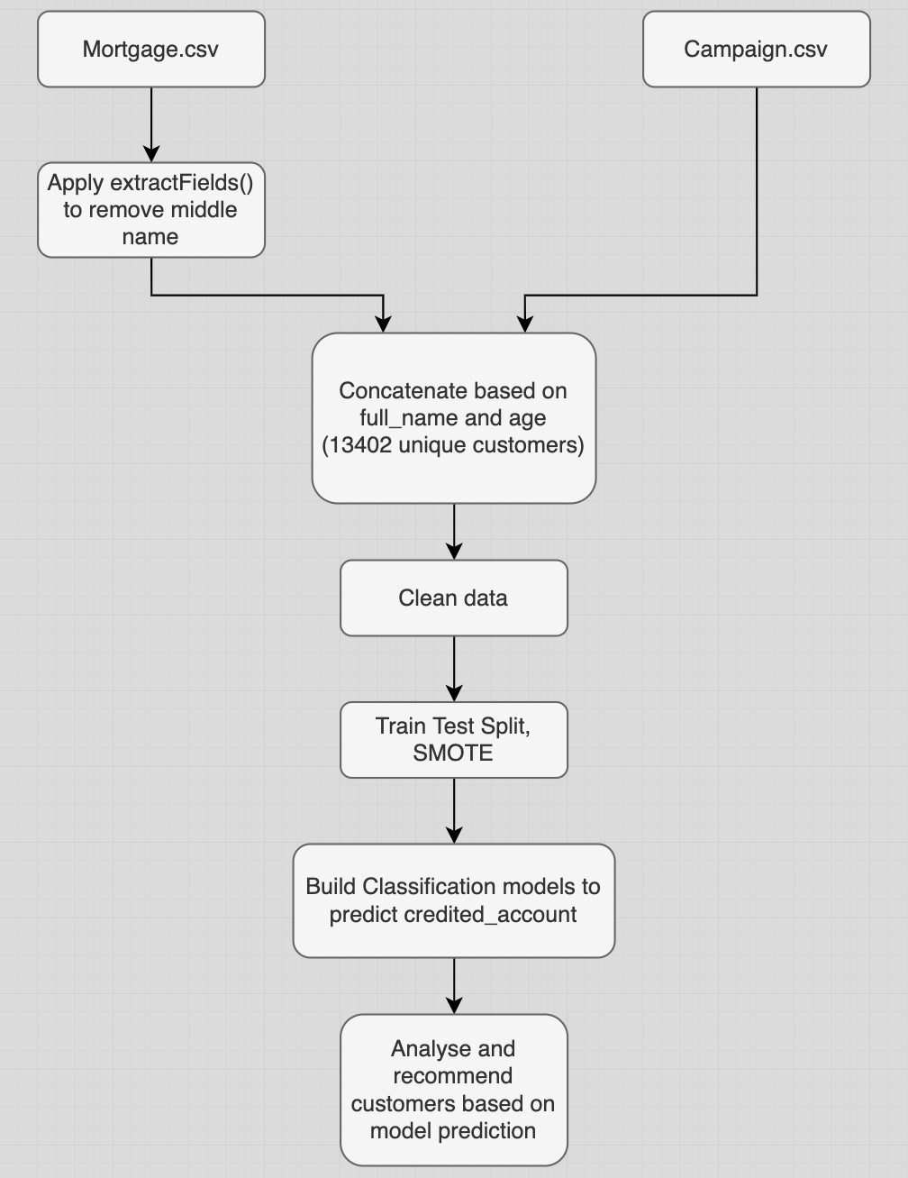
Approach 2: Combine both datasets
Evaluated the feasibility of combining the two datasets using name as a common feature. ​
Mortgage.csv has 'full_name' with a combination of title, first, middle and last name in some cases while the records in Campaign.csv has no middle name. ​
Wrote a custom function extractFields() to apply on Mortgage['full_name'] and eliminated middle name to extract name as title, first name and last name.​
Ideally there must be a primary key and a foreign key relationship between two datasets for a successful join.
In this scenario, I tried to join the two datasets based on full_name but the result was a cross join as there were multiple records of the same name in both the datasets. ​
Included age as another criteria along with title, first name and last name as the composite key. 13,402 unique customers were filtered​
Further experimented by removing title as it had multiple missing values. Included age, first name and last name as the composite key. 16,586 unique customers were filtered
Built classification models on the filtered data to predict the missing values in credited_account​
Analysed and concluded on the next customers for marketing campaign

Slide 8
Preprocessing – Campaign.csv
Sl No | Feature Name | Action | Reason
1,2,3,4,5 | participant_id, name title, first name, last name, company email | Drop | Not useful for model building
6 | age | Approach 1: Create bins to generate a new feature 'age_by_decade' and apply one hot encoding Approach 2: Same as above | Creating bins followed by one hot encoding brings stability in the model
7 | postcode | Approach 1: Apply label encoder and scaled Approach 2: Dropped as it has a high correlation with town | Approach 1: Features scaled exhibit properties of a standard normal distribution with a mean of zero and a standard deviation of one. Approach 2: To eliminate the issue of multi collinearity
8 | Marital status | Approach 1: Applied frequency encoder and scaled Approach 2: Dropped as it has a high correlation with relationship | Approach 1: Features scaled exhibit properties of a standard normal distribution with a mean of zero and a standard deviation of one. Approach 2: To eliminate the issue of multi collinearity
9 | education | Approach 1: Applied ordinal encoder and scaled Approach 2: Dropped education_num as it has a high correlation with education | Approach 1: To capture the hierarchy Approach 2: Convert to categorical for stability
10 | Job title | Approach 1: Applied frequency encoder Approach 2: Convert to categorical for stability | Approach 1: Applied frequency encoder Approach 2: Convert to categorical for stability
11,12,13,14 | Familiarity FB, view FB, occupation level, Education Num | Approach 1: Apply standardisation Approach 2: Apply standardisation | Features scaled exhibit properties of a standard normal distribution with a mean of zero and a standard deviation of one.

Slide 9
Preprocessing – Mortgage.csv
Sl No | Feature Name | Action | Reason
1,2 | full name, Paye | Drop | Not useful for models
3 | dob | Converted object datatype to datetime Derived age from dob [2018 as the current year] Capped outliers and applied sqrt transformation | To Remove outliers To normalise the data
4 | town | Applied frequency encoder | Frequency encoder works well on high cardinality features
5 | salary band | Represented the feature in GBP as base currency Used regular expressions and a custom script for currency conversion. Evaluated and capped the presence of outliers using z-score, percentiles (0.92), histograms and box plots. Applied sqrt transformation | Feature engineering Outlier treatment Normalise the data
6,7 | capital gain, capital loss | Derived net profit as (capital gain – capital loss) Evaluated and capped the presence of outliers using z-score, percentiles(0.97), histograms and box plots. Applied sqrt transformation | Feature engineering Outlier treatment Normalise the data
8 | employement_duration_years | Converted various representations into years Evaluated and capped the presence of outliers using z-score, percentiles(0.97), histograms and box plots. Applied sqrt transformation | Feature engineering Outlier treatment Normalise the data
9 | hours_per_week | Evaluated and capped the presence of outliers using z score, percentiles(0.97), histograms and box plots. Applied sqrt transformation | Outlier treatment Normalise the data

Slide 10
Preprocessing – Mortgage.csv(Contd...)
Sl No | Feature Name | Action | Reason
10 | demographic_characteristic | Approach 1: Evaluated and capped the presence of outliers using z-score, percentiles(0.99), histograms and box plots. Applied sqrt transformation Approach 2: One hot encoding | Outlier treatment Normalise the data Stabilise the variance in data
11 | religion | Approach 1: Applied frequency encoder Approach 2: One hot encoding | Numeric values required for clustering Stabilise the variance in data
12 | relationship | Approach 1: Applied frequency encoder Approach 2: One hot encoding | Numeric values required for clustering Stabilise the variance in data
13 | race | Approach 1: Applied frequency encoder Approach 2: One hot encoding | Numeric values required for clustering Stabilise the variance in data
14 | native_country | Approach 1: Applied frequency encoder Approach 2: One hot encoding | Numeric values required for clustering Stabilise the variance in data
15 | workclass | Approach 1: Applied frequency encoder Approach 2: One hot encoding | Numeric values required for clustering Stabilise the variance in data

Slide 11
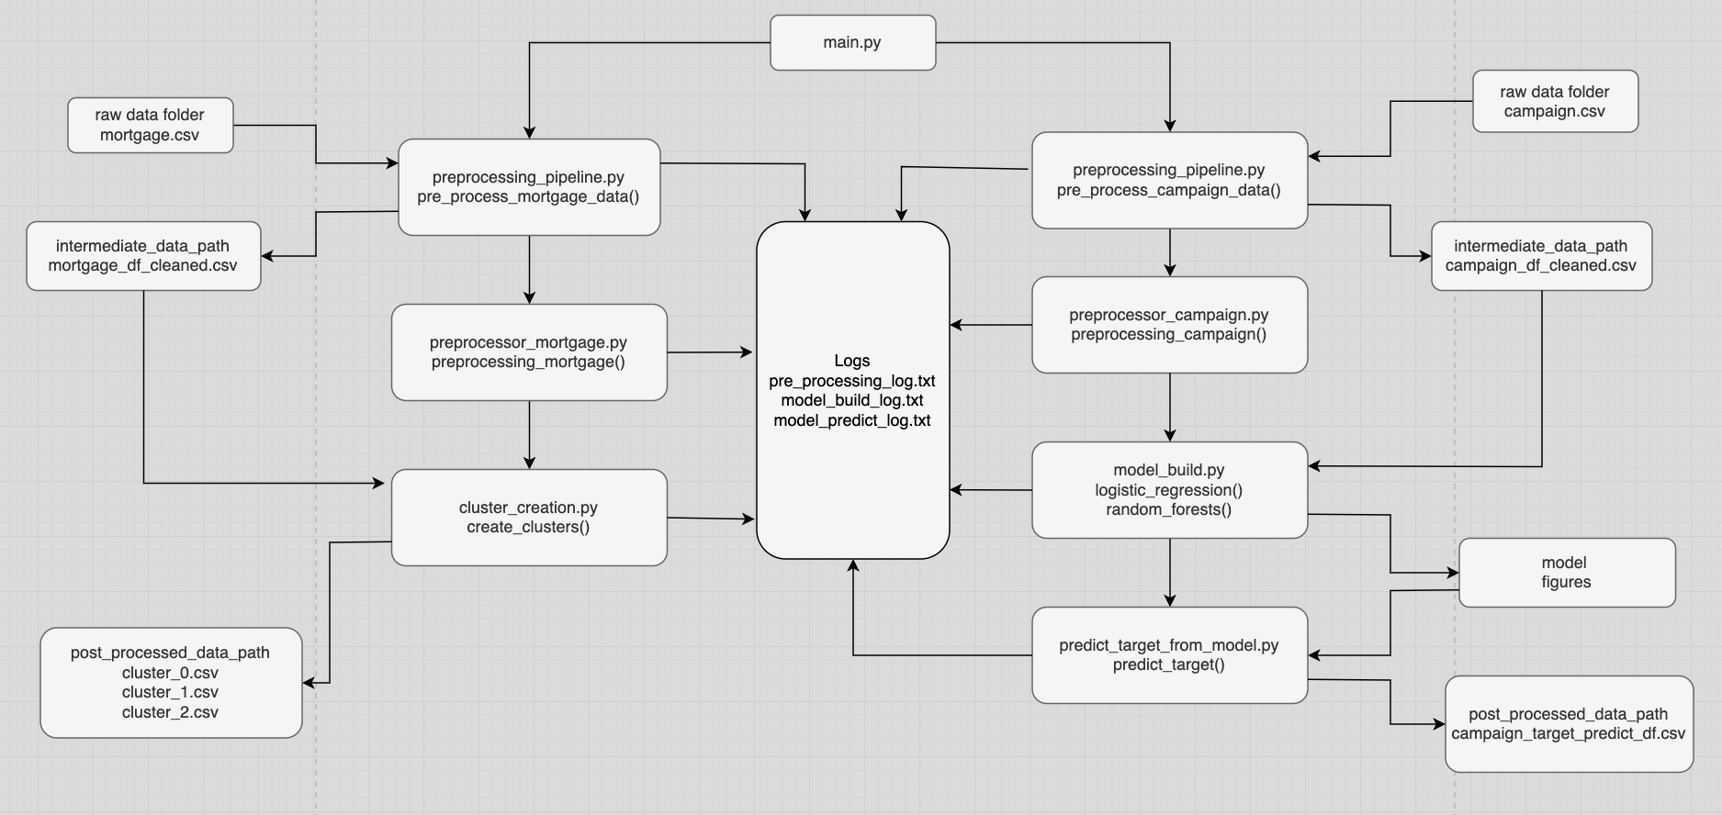
Methodology – Code flow

Slide 12
Model results
Approach 1: Clustering
Sl no | Approach | Model Name | Hopkins statistic | silhouette score | ROC Curve | F1 Score
1 | Clustering | KMeans | 77% | 0.23 at k =3 | NA | NA
2 | Classification | Logistic Regression | NA | NA | 0.83 | 0.90
3 | Classification | Random Forests | NA | NA | 0.91 | 0.95
Approach 2: Combine both datasets
Sl no | Approach | Model Name | ROC Curve | F1 Score
1 | Classification | Logistic Regression | 0.87 | 0.89
2 | Classification | Random Forests | 0.94 | 0.95

Slide 13
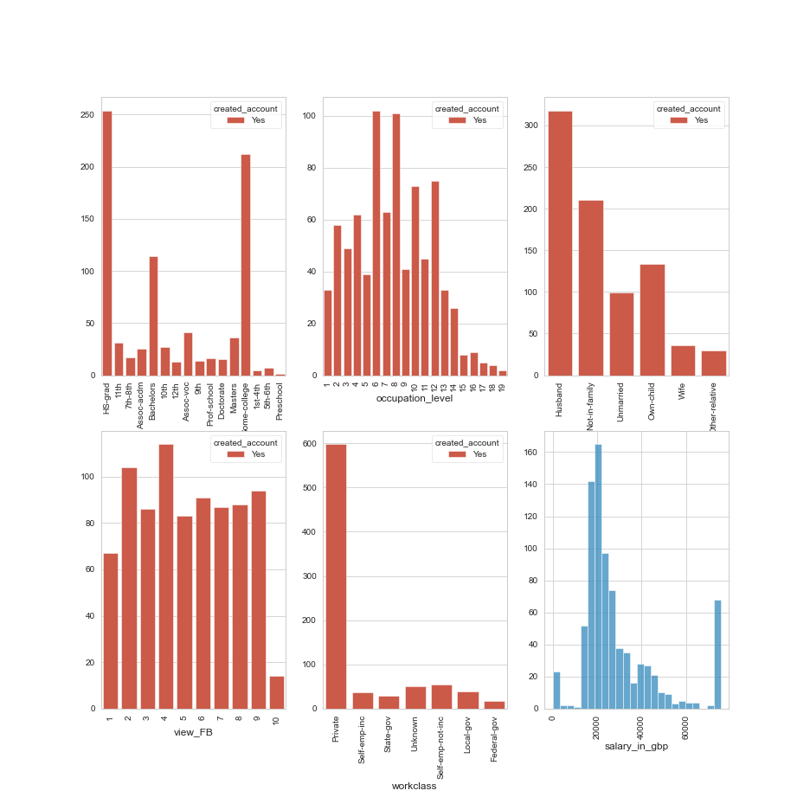
Recommendations
Target below customers on the basis of these most important features :
Town : Edinburgh and Swindon
Education : High school graduates, some college and bachelors
Occupation level : 6 and 8
Age : 30s and 40s
Relationship : Husband and not in family
Salary range : 20000 to 25000 GBP

Slide 14
Thank You!

