Slide 1
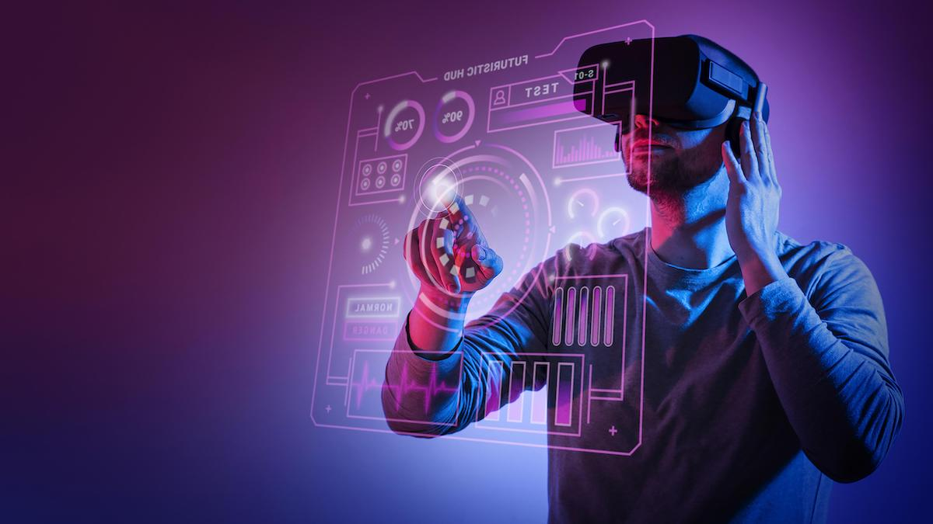
METAVERSE
Syed Rouhan Ali
Rollno. PIAIC172674

Slide 2

What is Metaverse ? The connections between the financial, virtual, and physical worlds have become increasingly linked. The devices we use to manage our lives give us access to almost anything we want at the touch of a button. The crypto ecosystem hasn't escaped this either. NFTs, blockchain games, and crypto payments aren't just limited to crypto geeks anymore. They're now all easily available as part of a developing metaverse.

Slide 3

Basically
The metaverse is a concept of a persistent, online, 3D universe that combines multiple different virtual spaces. You can think of it as a future iteration of the internet. The metaverse will allow users to work, meet, game, and socialize together in these 3D spaces.
The metaverse isn’t fully in existence, but some platforms contain metaverse-like elements. Video games currently provide the closest metaverse experience on offer. Developers have pushed the boundaries of what a game is through hosting in-game events and creating virtual economies.
Although not required, cryptocurrencies can be a great fit for a metaverse. They allow for creating a digital economy with different types of utility tokens and virtual collectibles (NFTs). The metaverse would also benefit from the use of crypto wallets, such as Trust Wallet and MetaMask. Also, blockchain technology can provide transparent and reliable governance systems.
Blockchain, metaverse-like applications already exist and provide people with liveable incomes. Axie Infinity is one play-to-earn game that many users play to support their income. SecondLive and Decentraland are other examples of successfully mixing the blockchain world and virtual reality apps.
When we look to the future, big tech giants are trying to lead the way. However, the decentralized aspects of the blockchain industry is letting smaller players participate in the metaverse’s development as well.

Slide 4

Success of Metaverse
Bloomberg analysts predict the metaverse market will be worth nearly $800 billion by 2024
the future metaverse would be something very similar to our real world in many aspects and even replace some real-world activities

Slide 5
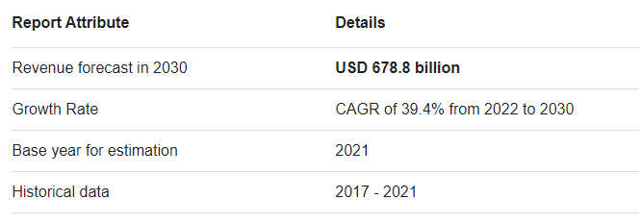
Revenue Of Metaverse

Slide 6

THE END
Hope To See We All Together In Metaverse Industry

