Slide 1
KHULNA UNIVERSITY OF ENGINEERING & TECHNOLOGY
Department of Electronics and Communication Engineering
Course Title: Database System Laboratory
Course No: CSE 3210
Project on: Creating a Database for Online Blood donation
Management System
Syed Nazib Sabnan
Roll: 1909037

Slide 2
Blood Donation Management
An online blood donation system is designed to efficiently manage and facilitate the process of blood donation and distribution. It connects donors, patients, hospitals, and blood banks through a centralized digital interface. This system typically includes features such as donor registration, blood inventory tracking, appointment scheduling, and real-time coordination between healthcare institutions, ensuring a steady supply of blood products to those in need while simplifying the donation process for donors and enhancing patient care.

Slide 3
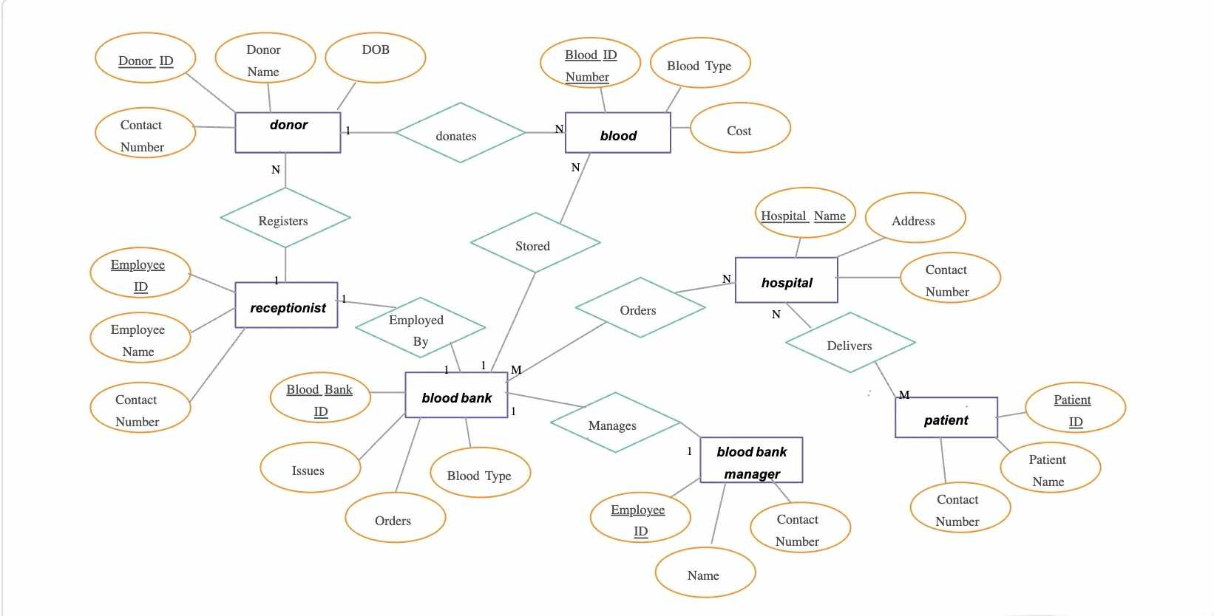
Er diagram for blood donation management database:
donation

Slide 4
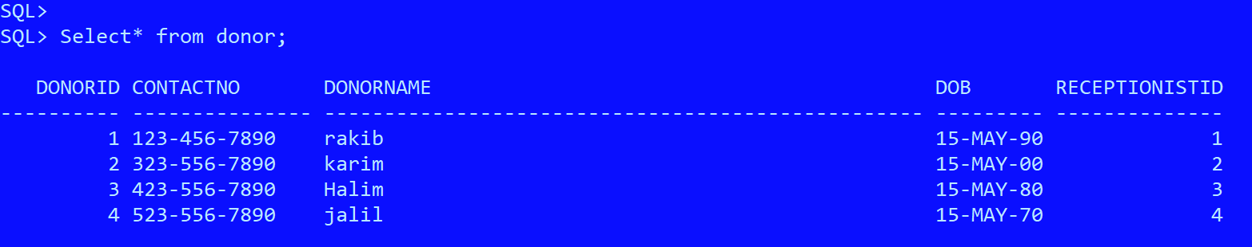

DATA TABLES
Donor:
Donation:

Slide 5
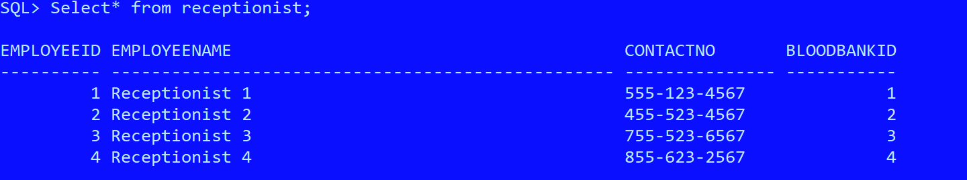
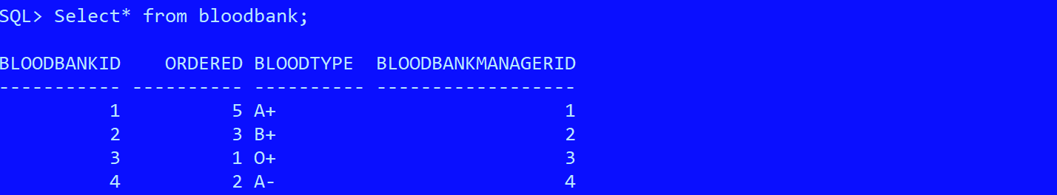

DATA TABLES
Receptionist:
BloodBank:
BloodbankManager:

Slide 6
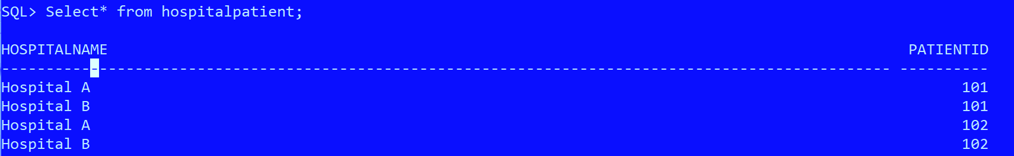
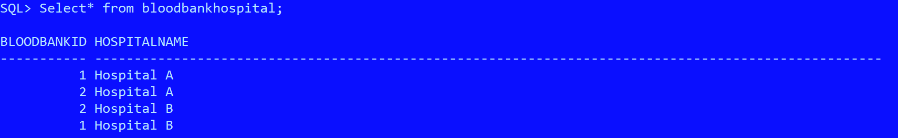
DATA TABLES
Intermediate Tables created by many to many relationship
Hospital-Patient:
Blood-Bank-Hospital:

Slide 7
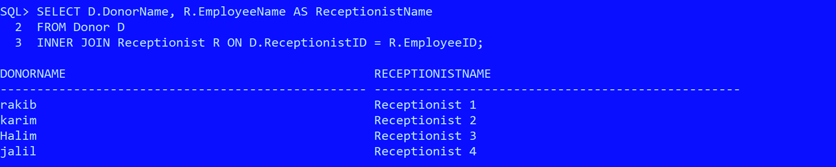

Query operations to check relation among tables:
Retrieve the names of donors and their respective receptionists:
List the donations, including the blood type and cost, along with the names of the donors who made them:

Slide 8
Thank You

