Slide 1

Lecture 1

Slide 2

Compilers – Principles, Techniques and Tools (Second Edition)
  Authors:
    Alfred V. Aho
    Monica S. Lam
    Ravi Sethi
    Jeffrey D. Ullman

Slide 3

Introduce and Describe the Fundamentals of Compilation Techniques
Assist you in Writing your Own Compiler (or a part of it)
  Overview & Basic Concepts
  Lexical Analysis
  Syntax Analysis / Syntax-Directed Translation
  Semantic Analysis
  Intermediate Code Generation.

Slide 4

Assignments: 5%
Quizzes: 5%
Mid-Term : 20%
Project: 10%
Final: 50%

Slide 5

Programming languages: Notations for describing computations to people and to machines
  E.g. Java, C#, C++, Perl, Prolog etc.
A program written in any language must be translated into a form that is understood by the computer
  This form is typically known as the Machine Language (ML), Machine Code, or Object Code
  Consists of streams of 0’s and 1’s
The program that carries out the translation activity is called the compiler.

Slide 6

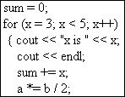


The language to be translated: Source language
  Input code is called the Source code
The language produced: Target language
  Output code is called Target code
A compiler is a program that translates source code written in one language into the target code of another language.
Java
Machine Language

Slide 7

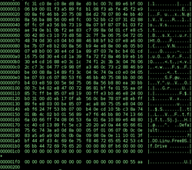

  Executables: Files that actually do something by carrying out a set of instructions (as compared to files that only contain data)
  E.g., .exe files in Windows
  If you look at their data, it won’t make sense
Hex Dump of a
boot loader executable
The primary reason for compiling source code is to create an executable ML program

Slide 8
Once the executable is there, it can be called by the user to process the given inputs to a program and produce the desired outputs
Initially, there is a compile phase which is followed by the run/execute phase
  This approach is used in many languages, e.g., Java, C++, C# etc.
Interpretation is concept parallel to compilation
  There is only one run/execute phase.
Program Inputs
Target Executable
Desired Outputs

Slide 9

Interpreter: A program that doesn’t produce the target executable. It can do three things:
  In a line-by-line fashion, it directly executes the source code by using the given inputs, and producing the desired outputs
  May translate source code into some intermediate language and then execute that immediately, e.g., Perl, Python, and Matlab
  May also execute previously stored pre-compiled code, made by a compiler that is part of the interpreter system, e.g., Java and Pascal
Some systems, e.g., SmallTalk, may combine 2 and 3.

Slide 10

Source Code
Interpreter
Desired Outputs
Program Inputs
Java combines compilation and interpretation
Source Code
Compiler
Bytecodes: Intermediate Program
Virtual Machine (Interpreter)
Desired Outputs
Program Inputs
Portability: Bytecodes compiled on one machine can be interpreted on another one
Faster Execution through Just-in-Time (JIC) compilers: translate parts of bytecode into ML immediately before execution
Notes:
a

Slide 11

Source Code
Combines source code stored in different files
Preprocessor
Converts source code into Assembly Language (which is easier to generate as an intermediate representation and also, easier to debug)
Preprocessed Source Code
Compiler
Target Assembly Program
Assembler produces ML
Assembler
Combines different ML parts (of the same program) that have been compiled separately
Re-locatable ML
Linker/Loader
Library Files
Re-locatable ML Files
Target ML
Linker: resolves external references
Loader: Puts all object files into memory for execution

Slide 12

Character Stream
Machine-Independent Code Optimizer
Lexical Analyzer
Token Stream
Intermediate Representation
Syntax Analyzer
Machine Code Generator
Syntax Tree
Target Machine Code
Semantic Analyzer
Machine-Dependent Code Optimizer
Semantically-correct Syntax Tree
Intermediate Code Generator
Optimized Target Machine Code
Intermediate Representation
SYMBOL TABLE

Slide 13

Phases involved:
  Lexical Analysis
  Syntax Analysis
  Semantic Analysis
  Determines the operations implied by the source program which are recorded in a tree structure called the Syntax Tree
  Breaks up the source code into constituent pieces, while storing information in the symbol table
  Imposes a grammatical structure on these pieces.

Slide 14

Phases involved:
  Intermediate Code Generation
  Intermediate Code Optimization
  Machine Code Generator
  Machine Dependent Code Optimization
Constructs the target code from the syntax tree, and from the information in the symbol table
Optimization is another important activity
  Both the intermediate and machine codes are optimized in order to achieve an efficient translation, with the least possible use of computing resources.

Slide 15

Front End phases:
  Lexical Analysis
  Syntax Analysis
  Semantic Analysis
  Intermediate Code Generation
  Intermediate Code Optimization
  Front end is machine independent
Back End phases:
  Machine Code generation
  Machine Code optimization
  Back end is machine dependent.

Slide 16

Read the character stream of the source code and break it up into meaningful sequences called lexemes (a.k.a Scanning)
Each lexeme is represented as a token
  <token_name, attribute value>
  Single, atomic unit of the language
E.g., force = mass * 60
  Lexeme force: token <id,1>
  Lexeme =: token <=>
  Lexeme mass: token <id,2>
  Lexeme *: token <*>
  Lexeme 60:token <60>.
Output: <id,1>=<id,2>*60
1 | force | ..
2 | mass | ..
SYMBOL TABLE

Slide 17

Syntax analysis: Parsing the token stream to identify the grammatical structure of the stream (a.k.a parsing)
Typically builds a parse tree, which replaces the linear sequence of tokens with a tree structure
  The tree is built according to the rules of a formal grammar which define the language's syntax
  It is analyzed, augmented, and transformed by later phases of compilation.
=
Syntax tree for <id,1>=<id,2>*60
<id,1>
*
<id,2>
60

Slide 18

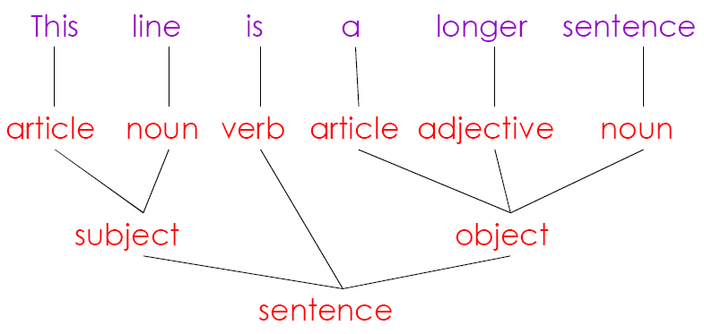

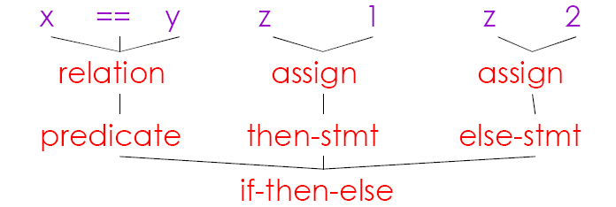

Slide 19

Semantic analysis: Adding semantic information to the parse tree
Performs semantic checks, e.g., type checking (checking for type errors), object binding (associating variable and function references with their definitions), rejecting incorrect programs or issuing warnings
Suppose force and mass are floats and acceleration is integer: type casting required
=
<id,1>
*
Semantically correct syntax tree for <id,1>=<id,2>*60
<id,2>
inttofloat
60

Slide 20

Ahmad told us that Faisal was going to his place
  Who does his refer to?
In programming language, such ambiguities are avoided
{
int Ahmad = 10;
  {
  int Ahmad = 15;
  System.out.println(Ahmad);
  }
  }
15 is printed

Slide 21

Intermediate Code Generation: After verifying the semantics of the source code, we convert it into a machine-like intermediate representation i.e., like a program for a machine
Typically, an assembly language-like form is used, because it is easy to generate and debug
Three address code: 3 operands/instruction
  Suppose t1 and t2 are registers
  t1=inttofloat(60)
  t2=id2*t1
  id1=t2.
=
<id,1>
*
<id,2>
inttofloat
60

Slide 22

Machine-Independent Optimizer: Optimize the intermediate code, so that a better target program can be generated
  Faster, smaller code that consumes less computation power
  E.g., X = Y * 0 is the same as X = 0
Example:
  t1=inttofloat(60)
  t2=id2*t1 t1=id2*60.0
  id1=t2 id1=t1
Eliminating the one time use of register t2, and converting 60 to a float

Slide 23

Machine Code Generator: Converts the optimized intermediate code into the target code (typically the Machine Code)
This is done through the Assembly Language
In case of Machine Code, registers (memory locations) are selected for each variable
Then, intermediate instructions are translated into sequences of machine code instructions that perform the same task
Example:
  id1=id2*60.0 LDF R2,id2
  MULF R1, R2, #60
Transfer id2 into R2, multiply and assign to R1

Slide 24

Machine-Dependent Optimizer: In this phase, after the Machine Code has been generated, it is optimized further (if needed)
This completes the compilation process
Important: Optimization is an optional activity in compilation
  One or both of the optimization phases might be missing.

Slide 25



