Slide 1
What you asked
THREADLINE
Lindström × Since AI 2026
Threadline turns a multi-site customer's data into a clear, honest review for the annual meeting.
You asked | Where it is in Threadline
Customer-level managerial view with site drill-down | Overview · Sites
Customer-ready review export | Export: PowerPoint, PDF, Excel
Show customers they can save more by working with Lindström more | Opportunities
Know where customer companies are going and how Lindström can help | Company insights
Easy to understand and explain for account managers | Review meeting · Simple and Expert views · glossary
A credible path to approved sources, more industries, countries and service lines | Data readiness · extension pack (Baltic Harbour Hotels, Mats, Estonia)
Prototype · synthetic data · not audited · synthetic Lindström × Since AI data pack
1
Notes:
Lindström asked for a customer value and sustainability review a key account manager can open, tailor and hand to a customer. Your feedback added three things: help your team show customers they save more by working with Lindström more; AI that knows where customer companies are going and how Lindström can help; and dashboards that are easy for account managers to explain. Each row is a page you can click in the live demo.

Slide 2
Built on Lindström's work
THREADLINE
Lindström × Since AI 2026
Each part maps to something Lindström already has. Public facts are context only, never inputs.
Lindström asset | How Threadline uses or extends it | Source
Managerial dashboard mockups | The same module and pack model (config/modules.json) and the same KPI-row layout. | Data pack
eLindström customer portal | Proposed as an eLindström module, adding per-kg, monthly, per-site allocation with baselines and ranges. | Public
RFID garment tracking | Utilisation = scanned ÷ allocated; service cycles and the on-time rate. | Public
Tableau reports | One adapter per report type; these are the Tier 1 source path in Data readiness. | Data pack
WWS laundry environmental-impact calculator | Laundry intensities and waste routes, allocated to the customer by washed-kg share (A003). | Data pack
Sustainability Report 2025 | Context only; status labels keep prototype estimates separate from reported figures. | Public
Workwear Alarm / repairs service | Observations R1 and R5 point to these levers as next steps. | Data pack
Data pack assumptions A001–A008, Baselines, Industry_Priorities | Used verbatim; team assumptions (T1 onwards) are added and labelled in the register. | Data pack
Prototype · synthetic data · not audited · synthetic Lindström × Since AI data pack
2
Notes:
We started from your material, not a blank dashboard: the managerial dashboard mockups (same modules and packs), eLindström (we propose this as a portal module), RFID tracking (utilisation and on-time), the Tableau reports (one adapter per report), the WWS laundry calculator (per-kg allocation), the Sustainability Report (context only), repairs, and your data-pack assumptions A001–A008 used verbatim. Every public fact is listed below with its source link.
- Managerial dashboard mockups (inspiration deck): data pack: Lindstrom_Managerial_dashboard_mockups_INSPIRATION.pptx
- eLindström customer portal: https://lindstromgroup.com/uk/article/bringing-greater-transparency-to-emissions-data-in-our-online-portal/
- RFID garment tracking: https://lindstromgroup.com/sustainability-goes-digital/
- Tableau reports (Allocated pieces, Washing %, End-to-end delivery, Repairs table, WWS washed kg): data pack: Data_Dictionary / Data_Quality
- WWS laundry environmental-impact calculator; Textile waste kg report: data pack: Laundry_Resources / Waste_Circularity
- Sustainability Report 2025 (CSRD-referenced, EY-assured): https://d2ris6qfzcz0wn.cloudfront.net/wp-content/uploads/sites/8/2026/04/Lindstrom-Sustainability-Report-2025.pdf
- Workwear Alarm / repairs service: data pack: Repairs / Products
- Data pack assumptions A001–A008, Baselines, Industry_Priorities: data pack: Assumptions / Baselines / Industry_Priorities

Slide 3
Easy to explain: a guided customer meeting
THREADLINE
Lindström × Since AI 2026
Five steps, one message each. NorthStar Foods Group (synthetic), 2025, demo scenario on.
1 · What you got
1,407 m³ of water saved
255 t CO₂e avoided
1,152 h of staff time freed
range 206 t CO₂e – 304 t CO₂e
2 · Vs doing it yourself
About €788k less with Lindström
€1.96M do it yourself vs €1.17M example contract
net range €193k – €1.57M
3 · Where to improve
NorthStar Kraków: 67 kg per wearer
Typical across sites: 49 kg
One site, one action
4 · Grow together
4 more sites + Mats
€410k do-it-yourself cost avoided a year
60 t CO₂e saved
range €257k – €692k
5 · Agree next steps
Discussion points
Actions with an owner and a target
Export: PowerPoint, PDF, Excel
Same order in the exports
• Each step: one message, two or three big numbers, and the sentence to say (What to say, with Copy).
• Steps 2 and 4 never open empty: a KAM-only Load demo scenario button fills example numbers.
• Customer view: no edit controls, no Company insights, no internal metrics.
• Expert shows how each figure is calculated; the exports follow the same five steps.
Prototype · synthetic data · not audited · synthetic Lindström × Since AI data pack
3
Notes:
The landing page is a five-step meeting a KAM can run: What you got, Versus doing it yourself, Where to improve, Grow together, Agree next steps. Each step has one message, two or three big numbers in one compact style (with the range on a second line) and a What to say line. The demo scenario button fills an example contract price (60% of the do-it-yourself total, rounded to 10,000 euros), four more sites and the Mats service, so steps 2 and 4 are never empty; the KAM can edit or reset it. In the customer view the edit controls, the Company insights page and internal metrics are hidden. PowerPoint, PDF and Excel follow the same five steps; the coaching lines are in the PowerPoint speaker notes only.
What the service delivered: Compared with outsourced local laundry, the Lindström service saved about 1,407 m³ (between 691 m³ and 2,122 m³) of water and about 255 t CO₂e (between 206 t CO₂e and 304 t CO₂e) in 2025.
Service versus doing it yourself: Doing the same yourself would cost about €1.96M (between €1.36M and €2.74M) in 2025. It also frees about 1,152 h (between 576 h and 2,304 h) of your staff's time.
Your biggest opportunity to improve: NorthStar Kraków washes 67 kg per wearer, more than your other sites (typically about 49 kg). Reviewing how often garments are changed there could cut cost and water.
What happens next: Suggested next steps: Check change frequency against hygiene needs; Break the requests down by type and agree a target; Review route, pickup window and delivery day.

Slide 4
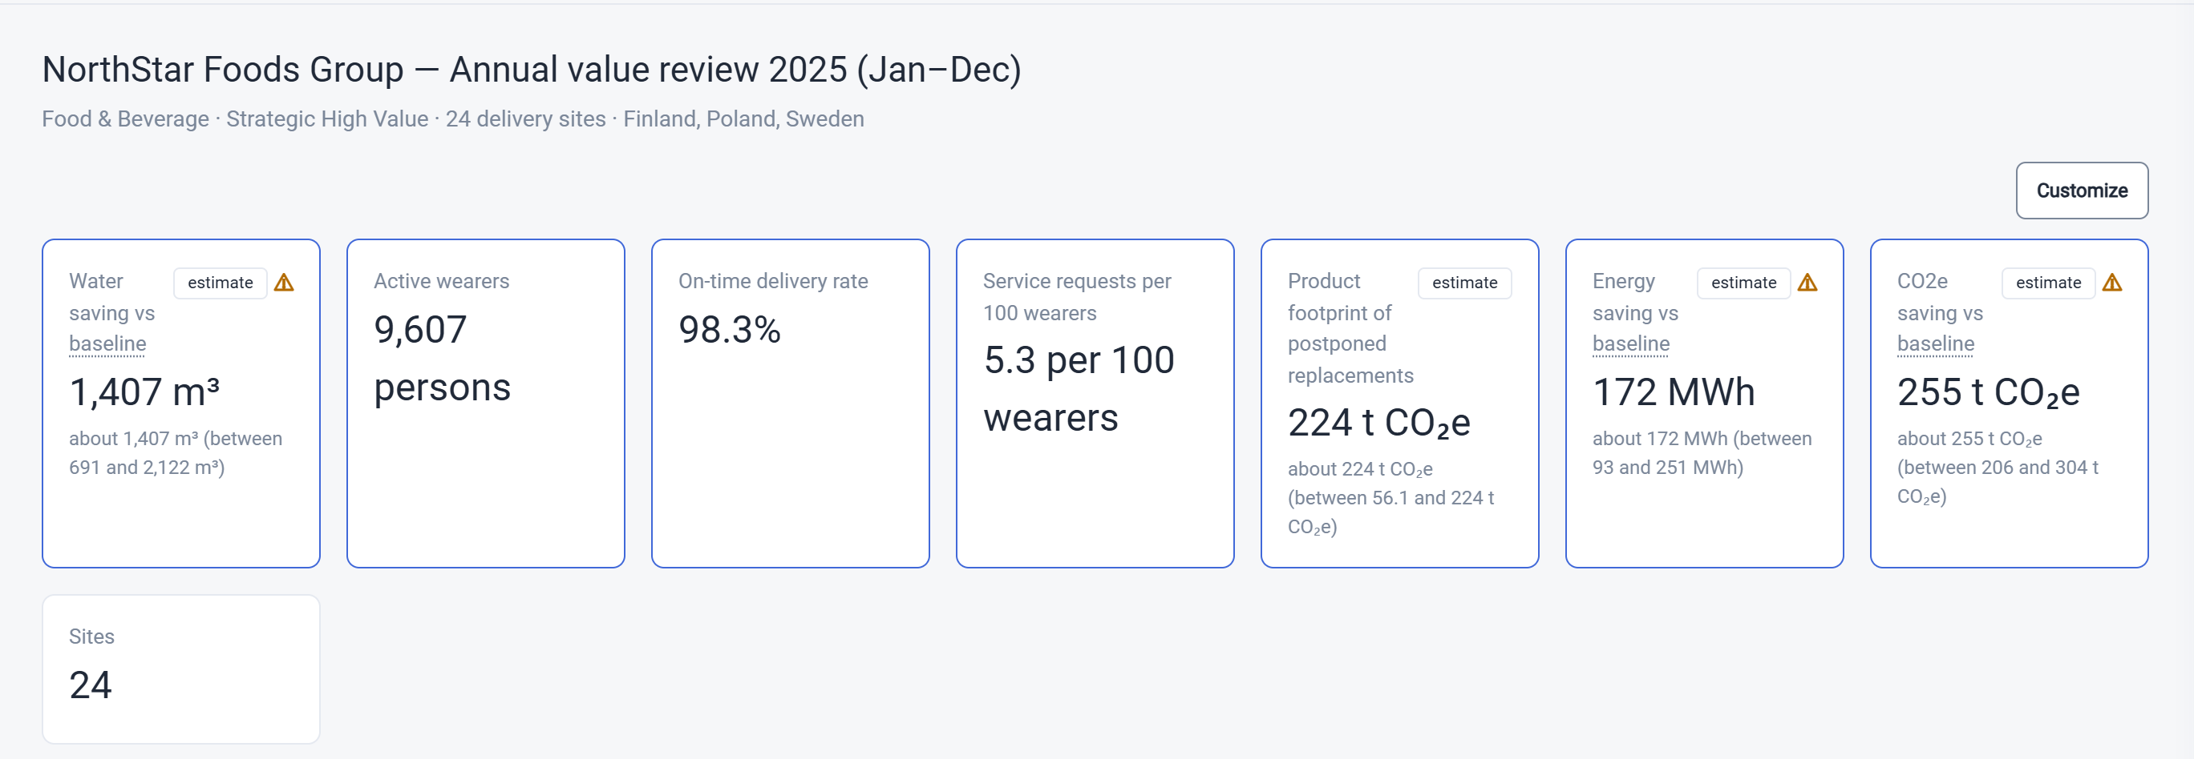
The dashboard at a glance
THREADLINE
Lindström × Since AI 2026
A real screen from the prototype: the Overview page for the synthetic NorthStar Foods Group.
Each figure has a status and, for estimates, a low to high range. Sites, observations and the priority view sit below.
Prototype · synthetic data · not audited · synthetic Lindström × Since AI data pack
4
Notes:
A real screen of the Overview page. The headline figures each carry a status label (for example estimate) and a low to high range. Below the fold: observations that are rules-generated and ranked by the chosen priority, and the sites ranked on a metric. A click on a site opens its own detail with monthly trends. The data is synthetic.

Slide 5
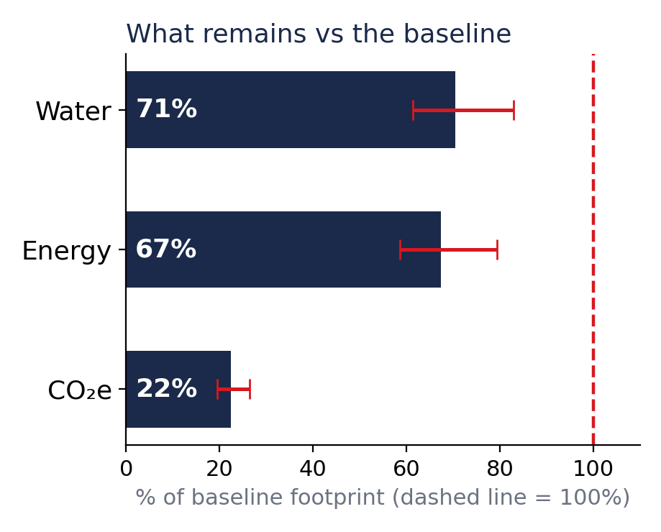
The customer's numbers, with ranges
THREADLINE
Lindström × Since AI 2026
NorthStar Foods Group, 2025, against outsourced local laundry.
Measure | Value | Low to high | Status
Water saving | 1,407 m³ | 691 – 2,122 m³ | Estimated
CO₂e saving | 255.1 t CO₂e | 205.7 – 304.4 t CO₂e | Estimated
Energy saving | 172 MWh | 93 – 251 MWh | Estimated
Active wearers | 9,607 persons | n/a | Calculated
Repairs completed | 15,233 | n/a | Calculated
On-time delivery rate | 98.3% | n/a | Calculated
Recycling rate | 73.1% | n/a | Allocated
• Lower is better: 71% means 29% less than the baseline.
• Whiskers show the low to high range. Estimates, not audited.
Status tells the reader how each figure was made: measured, calculated, allocated or estimated.
Prototype · synthetic data · not audited · synthetic Lindström × Since AI data pack
5
Notes:
The table is the headline set from the engine, formatted by the shared formatter used everywhere. Each estimate has a low and high case instead of one false-precision number. The chart shows the allocated footprint as a share of the selected baseline; 100 percent is the baseline and the whiskers are the low to high range. These are prototype estimates on synthetic data.

Slide 6
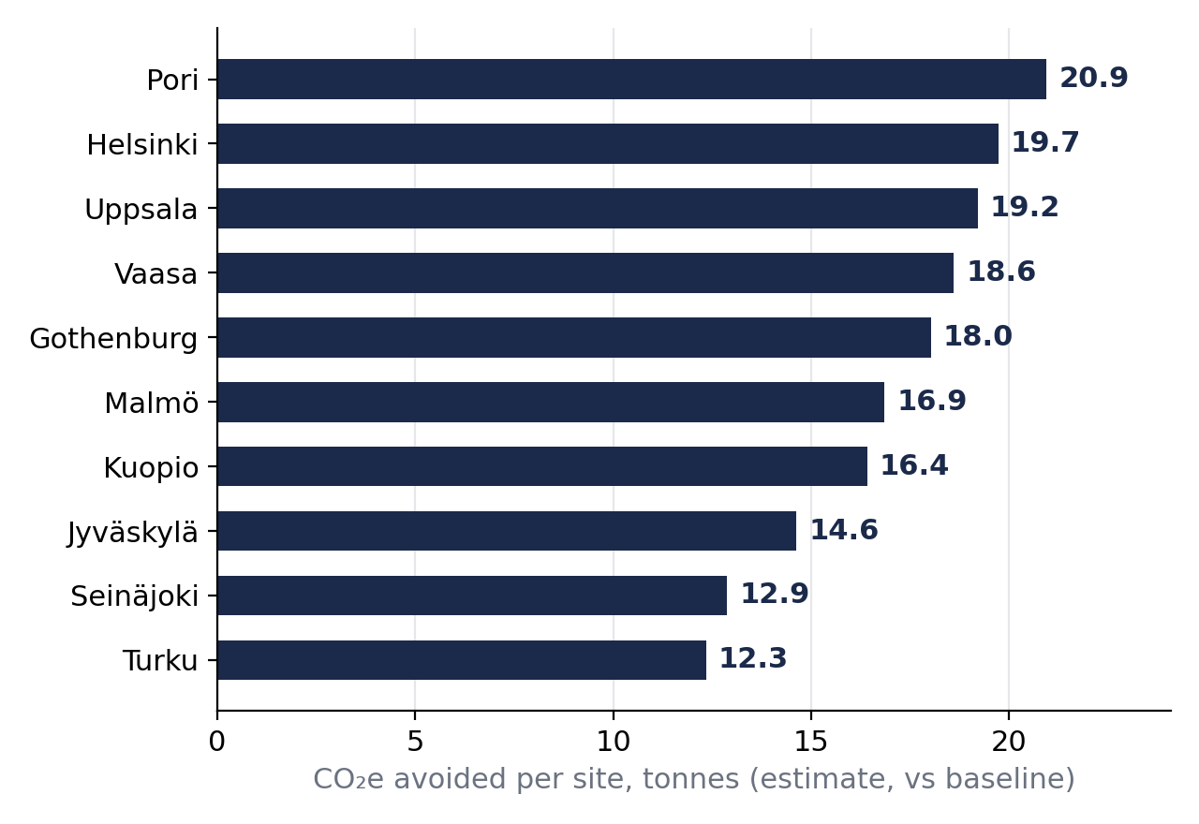
Savings by site, and where to look
THREADLINE
Lindström × Since AI 2026
Customer level first, then the sites: the biggest savings and the ones that stand out.
Top 10 of 24 sites: CO₂e avoided
Highest and lowest washing per wearer
Site | kg / wearer | Utilisation | On time
Kraków | 67.0 | 85.6% | 98.2%
Malmö | 62.9 | 84.9% | 98.1%
Pori | 60.5 | 84.2% | 97.2%
Lahti | 38.1 | 84.4% | 97.8%
Tampere | 38.1 | 83.4% | 98.3%
Warsaw | 37.3 | 82.7% | 97.9%
• Three highest and three lowest of 24 sites, per year.
• Site figures are indicative estimates. A site far from its peers gets an observation, not a verdict.
Prototype · synthetic data · not audited · synthetic Lindström × Since AI data pack
6
Notes:
Left: the ten sites with the largest estimated CO2e avoided against the baseline. Right: the three highest and three lowest sites on washed kilograms per wearer, with utilisation and on-time delivery. Outliers become observations with a suggested next step in the dashboard. All values are synthetic and estimated.

Slide 7
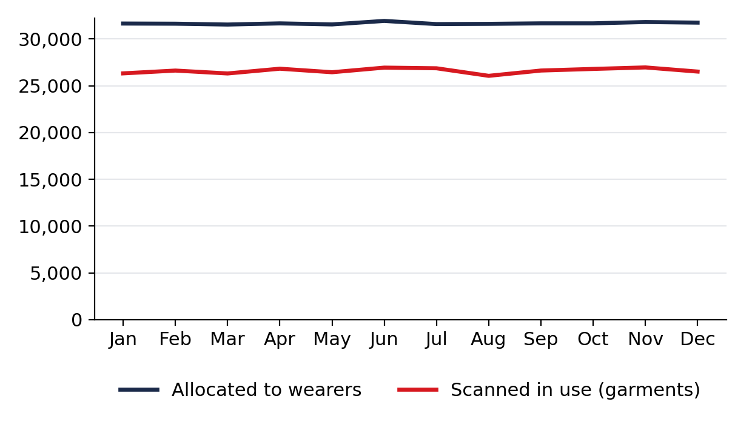
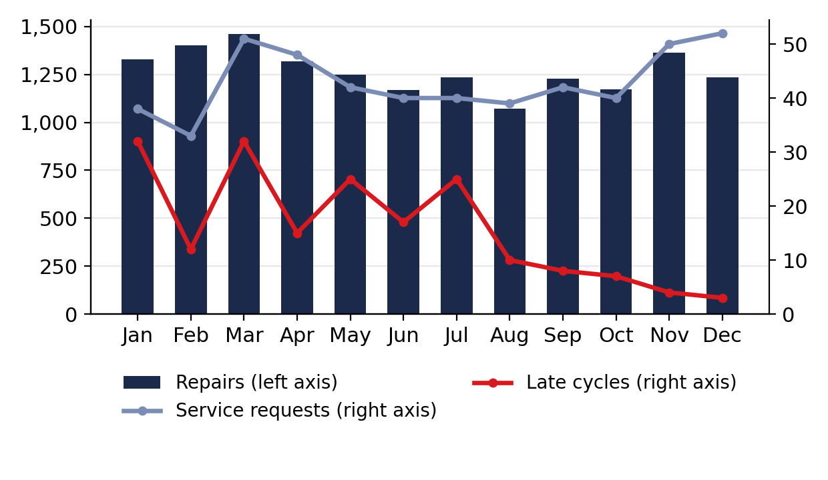
Month by month
THREADLINE
Lindström × Since AI 2026
Account totals for each month of 2025, all sites together.
Garments in the service
Repairs, service requests, late cycles
• About 84% of allocated pieces were scanned in use across the year.
• Left: pieces allocated against pieces scanned. Right: repairs on the left axis, service requests and late cycles on the right.
• Click a site in the dashboard to see the same two charts for that site.
Prototype · synthetic data · not audited · synthetic Lindström × Since AI data pack
7
Notes:
The two charts show the 12 monthly totals for the whole account: pieces allocated against pieces scanned in use, and repairs, service requests and late cycles. The same charts exist for every site. Monthly values come straight from the data pack; they are synthetic.

Slide 8
Save more by working with us more
THREADLINE
Lindström × Since AI 2026
NorthStar Foods Group, per year, vs outsourced local laundry. Typed by the KAM, defaults otherwise.
Service vs doing it yourself
Grow with us: 4 more sites + Mats
Doing it yourself would cost
1,957,510 EUR
range 1,363,310 – 2,739,773 EUR
Extra do-it-yourself cost avoided
410,252 EUR
range 257,458 – 691,829 EUR
Example contract price typed by the KAM
1,170,000 EUR
entered on the page
Extra CO₂e saved
59.6 t CO2e
range 41.2 – 91.5 t CO2e
Net: doing it yourself minus the contract
787,510 EUR
range 193,310 – 1,569,773 EUR
Extra water saved
329 m³
range 138 – 638 m³
• Extra replacements without repairs: shown, not in the total.
• Net appears only once a contract price is entered.
• €, hours and CO₂e are never added into one score.
Prototype · synthetic data · not audited · synthetic Lindström × Since AI data pack
8
Notes:
Left: the service versus doing it yourself, from the customer's own volumes and defaults the KAM can overwrite (local laundry price, energy, water, staff cost, handling time, admin time, garment life). The net appears only when the KAM types the contract price; here an example price. Extra replacements without repairs are shown but kept out of the total. Right: growth. The KAM enters sites not yet served and ticks service lines not yet used; lines the customer already uses are skipped. Each lever is scaled from the customer's own averages, with a range.
Story line: Bringing 4 more sites and the Mats service on board would avoid about €410k (between €257k and €692k) a year in laundry and garment costs and save about 60 t CO₂e (between 41 t CO₂e and 91 t CO₂e).

Slide 9
Knows where your customers are going
THREADLINE
Lindström × Since AI 2026
Internal view for the account manager · Fazer Group, a real public company · snapshot from 2026-11-07
Where they're going
In July 2025 Fazer decided to invest approximately EUR 400 million in a new chocolate factory of about 33,300 m² in Lahti, Finland, due to start operating in 2028; chocolate production will partially continue in Vantaa.
Source: news.cision.com, 2025-07-14
At the end of 2025 Fazer had 4,693 employees (FTEs); 68% worked in Finland, 21% in Sweden and 10% in the Baltics.
Source: mb.cision.com, 2026-02-23
Fazer's Scope 3 emissions were 6% above the 2020 baseline in 2025; the company names limited supply-chain data as an obstacle and piloted product-level emission calculations for 100 SKUs.
Source: mb.cision.com, 2026-02-23
How Lindström can help
• Workwear
• Mats
• Washroom
Ask in the next meeting
Your Lahti chocolate factory is due to start in 2028 — how are you planning workwear, hygiene and changing-room services for the new site?
AI-generated from public sources — verify before use. Example public company; no relationship with Lindström is implied.
Prototype · synthetic data · not audited · synthetic Lindström × Since AI data pack
9
Notes:
The KAM types a company name. Claude researches it with web search; code keeps only claims whose source the search actually returned, with a date and a safe http(s) address; Lindström offers must come from our service catalogue and cite a source. No engine numbers are mixed in. Without an API key, or if the live call fails, the committed snapshot is shown, and the snapshot chips never call the API. For the fictional customers the page explains that, in production, the legal name would come from CRM.
Sources:
- Fazer Group January–December 2025: record high net sales and comparable operating result (Fazer Group press release) (2026-02-23): https://news.cision.com/fazer-group/r/fazer-group-january---december-2025--record-high-net-sales-and-comparable-operating-result,c4311468
- Fazer Group financial statement release January–December 2025 (PDF) (2026-02-23): https://mb.cision.com/Main/964/4311222/3946464.pdf
- Fazer initiates the renewal of its chocolate production and invests approx. EUR 400 million in a new factory in Lahti, Finland (Fazer Group press release) (2025-07-14): https://news.cision.com/fazer-group/r/fazer-initiates-the-renewal-of-its-chocolate-production-and-invests-approx--eur-400-million-in-a-new,c4206693
- Fazer looks to M&A after “record” 2025 sales (Just Food) (2026-02-23): https://www.just-food.com/news/fazer-looks-to-ma-after-record-2025-sales/
- Fazer Group's Annual Report 2025 published (Fazer Group press release) (2026-03-09): https://news.cision.com/fazer-group/r/fazer-group-s-annual-report-2025-published,c4318622
- EU Sustainability Omnibus Published in the Official Journal (Latham & Watkins) (2026-02-27): https://www.lw.com/en/insights/eu-sustainability-omnibus-published-in-the-official-journal
- Cocoa prices collapse following record highs (ConfectioneryNews) (2026-02-13): https://www.confectionerynews.com/Article/2026/02/13/cocoa-prices-collapse-following-record-highs/
- Fazer shrinks chocolate bars amid rising cocoa costs (Helsinki Times) (2025-07-28): https://www.helsinkitimes.fi/finland/finland-news/domestic/27530-fazer-shrinks-chocolate-bars-amid-rising-cocoa-costs.html

Slide 10
Credible by design
THREADLINE
Lindström × Since AI 2026
Every figure has a status, every estimate a range
• CO₂e avoided: 255.1 t CO2e (range 205.7 – 304.4 t CO2e), estimated.
• Measured · calculated · allocated · estimated; baselines and assumptions are visible.
We flag what doesn't add up
• One laundry (Nordic Malmö WWS, L003) reports about 11 times more customer volume than it processed in 2025.
• We flag it, lower the confidence and ask Lindström which figure is right.
Honest comparisons
• The baseline is a visible choice (local laundry, home, in-house).
• Extra replacements shown, not in the do-it-yourself total; net only with a contract price.
AI never writes numbers
• The narrative uses placeholders the engine fills; a guard rejects invented digits.
• Company insights keeps only searched, dated sources with safe links.
Prototype · synthetic data · not audited · synthetic Lindström × Since AI data pack
10
Notes:
Credibility is built in, not added later. Two labels on every value (method status and provenance), a low/base/high range on every estimate, and the weakest-input rule. The consistency check found that customer kg routed to laundry Nordic Malmö WWS is about 10.8 times the laundry's own total over the year. We did not hide or fix it: affected figures get lower confidence and a warning, and we ask Lindström (Q35). Washing and repair savings, euros, hours and CO₂e are never summed into one number.

Slide 11
Grows with your business
THREADLINE
Lindström × Since AI 2026
A new service line, industry, customer and country: data and config only.
The whole change
config/sources.yaml
+1 line: the extension pack
data/extension_pack/
6 CSV files (synthetic)
config/industry_rules.yaml
Hospitality priorities and note
Proof test
tests/test_extensibility.py adds Washroom, Restaurants and Latvia from a temporary CSV pack: no code edits.
What appears in the app
• Customers: 3 → 4: Baltic Harbour Hotels (Hospitality)
• 5 sites in Estonia, Finland
• Service lines: Mats, Workwear
• Priorities from the Hospitality rule: Service quality, Cost & utilisation, Water
• NorthStar Foods Group unchanged: CO₂e avoided 255.1 t CO2e
• Check C1 still flags only L003
Prototype · synthetic data · not audited · synthetic Lindström × Since AI data pack
11
Notes:
Lindström adds a service line and a hotel chain in Estonia; this is the whole change. A second adapter (a generic CSV adapter) reads the pack; the engine, insights, UI and exports did not change for it. Switch it off with VR_EXTENSIONS=off for a before and after. Existing customers' figures do not move, and the laundry volume check still flags only L003. A test builds a third pack (Washroom, Restaurants, Latvia) in a temp folder and proves it needs no code edits.

Slide 12
Exports & path to production
THREADLINE
Lindström × Since AI 2026
One review, three formats
Path to production
• Tier 0: synthetic pack (built)
• Tier 1: Tableau / eLindström exports for one pilot customer
• Tier 2: governed data platform
• Tier 3: a module inside eLindström
What we need from Lindström
• Q35: which L003 volume figure is right
• Approved emission factors and baselines
• Contract prices, and CRM legal names for Company insights
PowerPoint
11 slides
PDF
12 pages
Excel
12 sheets
• Counts are for the NorthStar customer review export, not this deck.
• Same numbers as the dashboard; the disclaimer on every page.
• Customer audience hides internal metrics.
Prototype · synthetic data · not audited · synthetic Lindström × Since AI data pack
12
Notes:
Exports work: the same ReviewModel feeds the dashboard, PowerPoint, PDF (server-side, no Office needed) and Excel (numbers as numbers, with status labels). The counts on the left come from exports generated while building this deck. Next: one pilot customer's Tier 1 exports through a new adapter; the engine, UI and exports stay as they are. We need answers to Q35, approved emission factors, and contract prices plus CRM legal names so Company insights can run on real accounts. Prototype, synthetic data, not audited.

