Slide 1
Airlines Management System

Slide 2
Problem Statement
The purpose of the project “AIRLINE MANAGEMENT SYSTEM”, the manual work makes the process slow and other problems such as inconsistency and ambiguity on operations.
Passenger service and revenue management systems, which were not available in the previous system, are now basic requirements for airline management systems. Customers and companies must be up to date on all areas in today's competitive business environment.
The existing airline management system control panel was not advanced enough to make frequent modifications based on specified rules, necessitating human interaction every time information needed to be updated. There was no comprehensive management tool that could assist a three-tier management architecture in collaborating and maximising profits.

Slide 3
Flow of Control throughout the Program:
START
If username and password Doesn’t match, access denied
LOGIN PAGE
HOME PAGE
Booking Ticket page
Ticket reservation page
Payment Page
Ticket Generation page
Logout Page

Slide 4
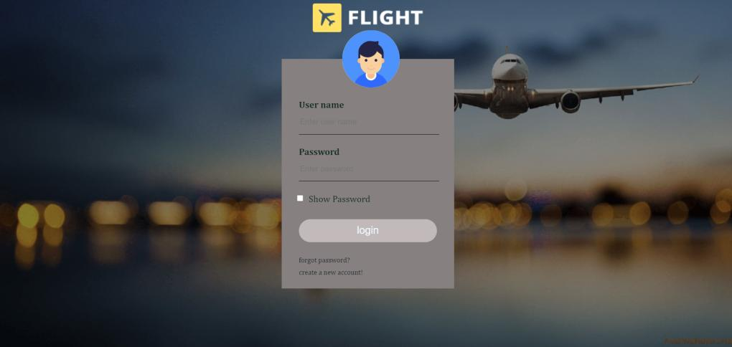
1. LOGIN page:
Users or clients are required to login to our application for ticket booking and making use
our services .
First of all users need to register on our application , only registered users are allowed to
login , If unregistered users try to login an alert pops up saying UserName and Password are
Incorrect.

Slide 5
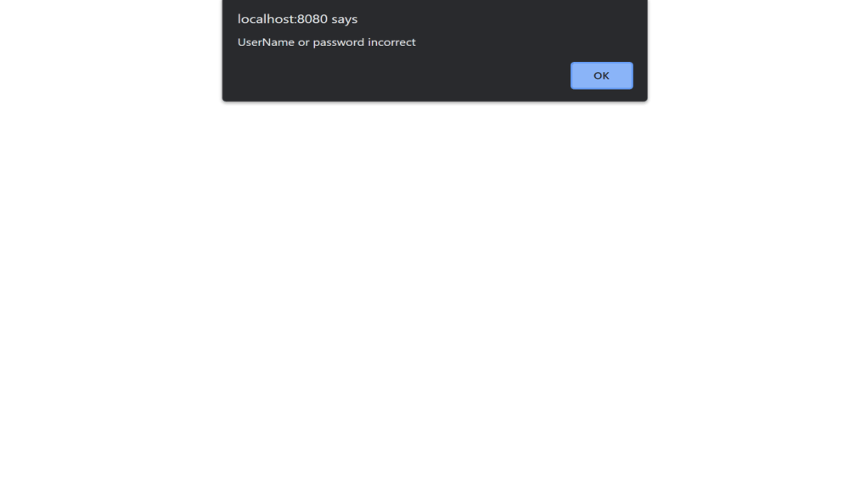
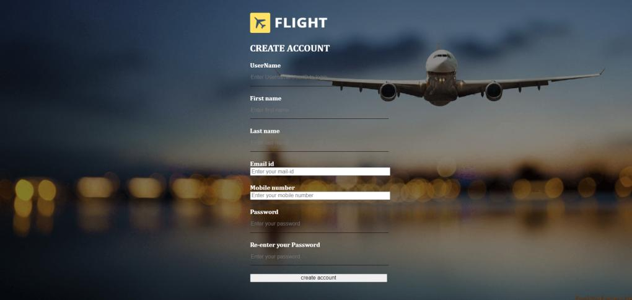
2. REGISTER page
page for New users to register on our page

Slide 6
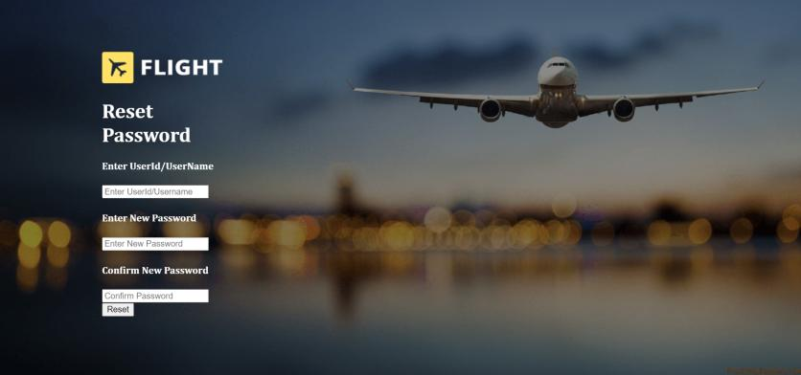
3. FORGOT password page
page for users to change , update passwords .

Slide 7
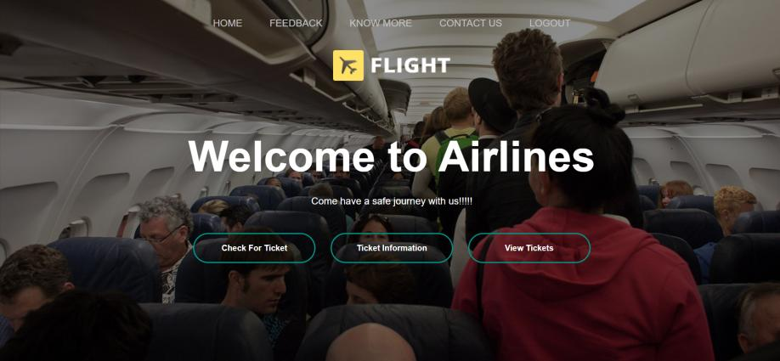
4. HOME page
Home page is where the control passes after logging in where the users can start exploring our project.
The Home page has two main sections
TaskBar
Main Body

Slide 8
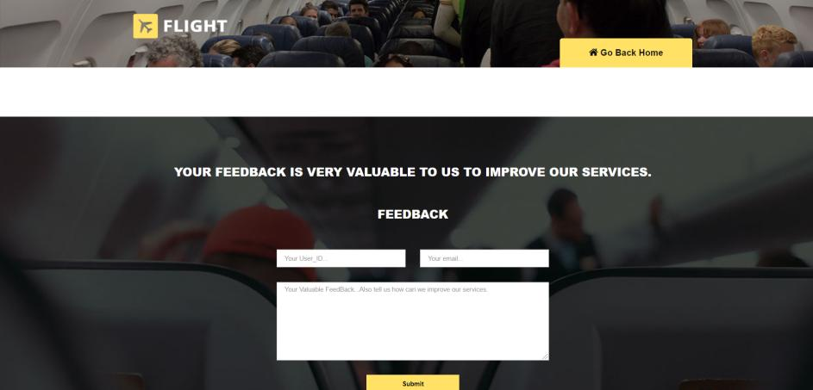
The Taskbar contains the following icons
1. Home Icon : on clicking this icon , the request is redirected to the home page from
any corner of the program.
2. FeedBack Icon : this icon helps users to give feedbacks on how the developers can
improve their project , add some features if required etc…. .

Slide 9
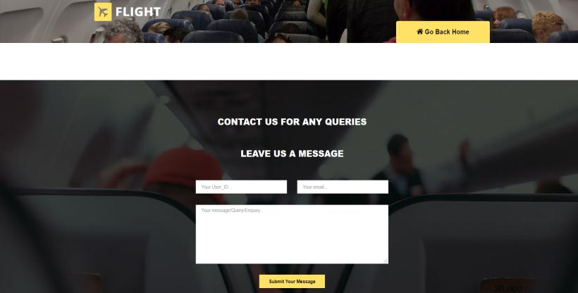
3. Contact Us icon:
this icon is basically a help desk which on clicking provides space for users to enter their problems , any kind queries and so on…

Slide 10
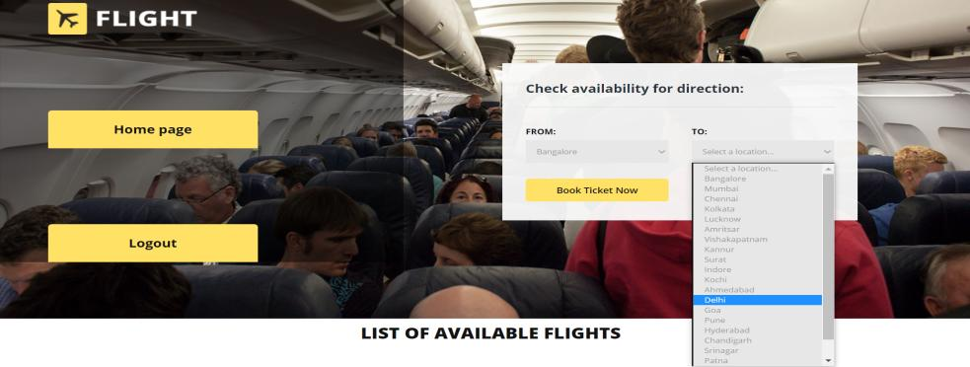
4. Logout Icon :
This icon completely logs out the current user and also the cookies and attributes which were set by the users during the program.
The Body of the Home Page contains a Welcome Message and some important icons of the program .
1. Check for Ticket : On clicking check for tickets , the request is redirected to the below page where the user can check for the availability of the flights he is willing to travel and results are shown upon the request as shown.

Slide 11
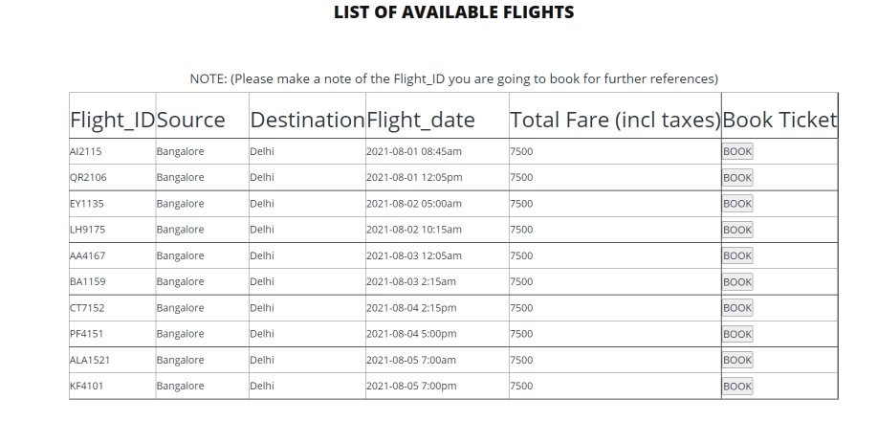
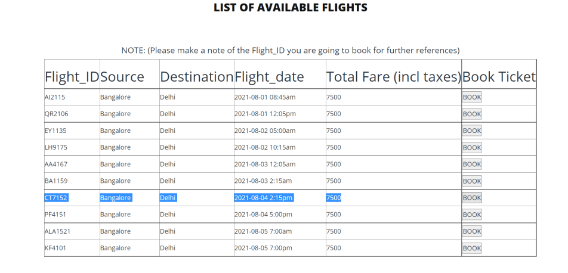
The list of all the available flights are displayed as per the user’s request ,
The user can book the desired flight by clicking on the Book button .
For example , if booking a ticket of 4th aug 2021, note down the flight_id and click on
Corresponding book button.
NOTE: Please note the flight_id as per the above request for further references .

Slide 12
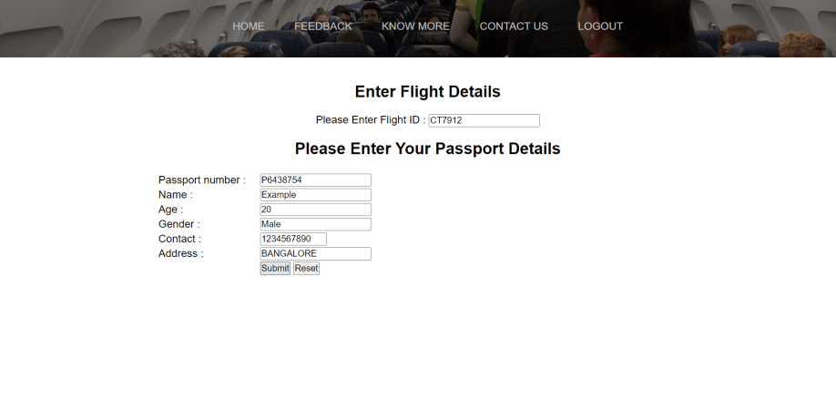
Upon clicking Book , the above page is displayed where the user needs to submit his Passport details . For example Passport Number , Name of the user / passenger as per passport , Age , Gender, Contact and address for booking a ticket.
Upon submitting the details , reservation of the passenger is confirmed and the following details are displayed as shown in the below figure.

Slide 13
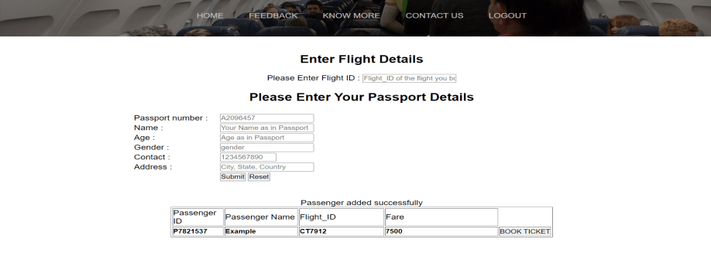
Upon submitting the passenger details , the above page is displayed where we can observe the message ‘Passenger added successfully ‘ .
Upon clicking BOOK TICKET , the request is redirected to the Payment page as shown

Slide 14
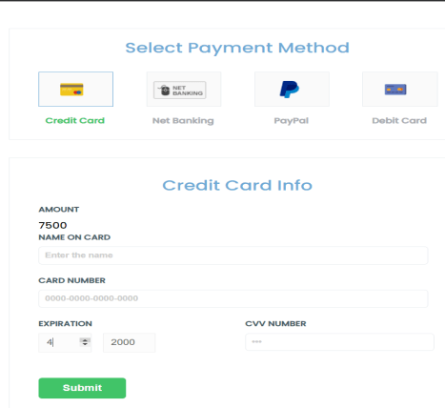
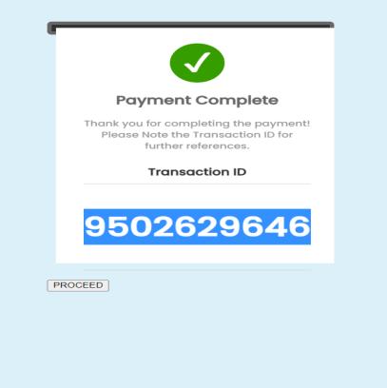
After doing the payement , the user needs to enter the transaction_ID for generating his ticket .
So after the successful payment , click on proceed .

Slide 15
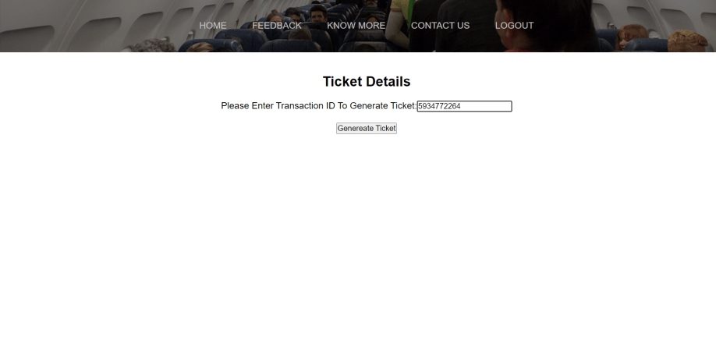
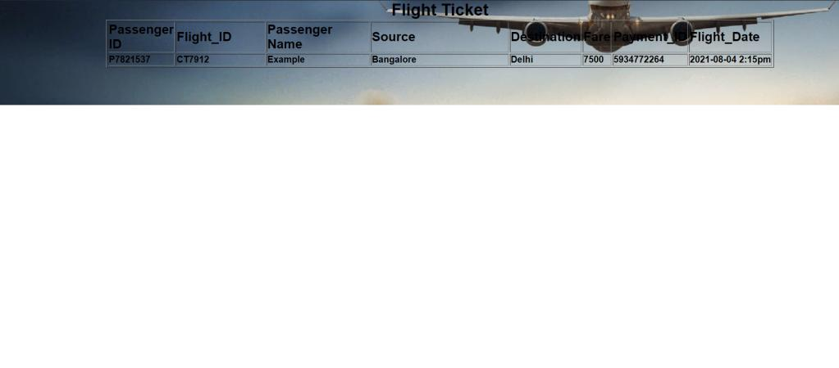
After entering the transaction_ID in the given space , the ticket is generated with the
Passenger _ID as Passport number , flight_ID which the user chose to travel , Passenger
Name , Source –Destination with Payment_ID and Flight_date.
The user can print the ticket or can save as PDF on his/her device and can travel on the
departure date.

Slide 16
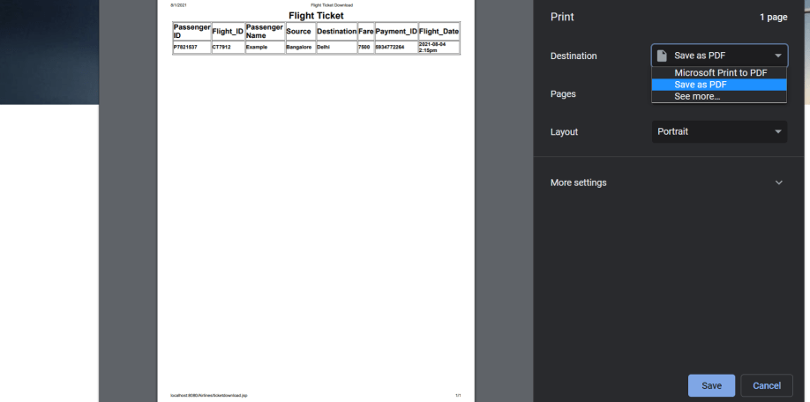

Slide 17
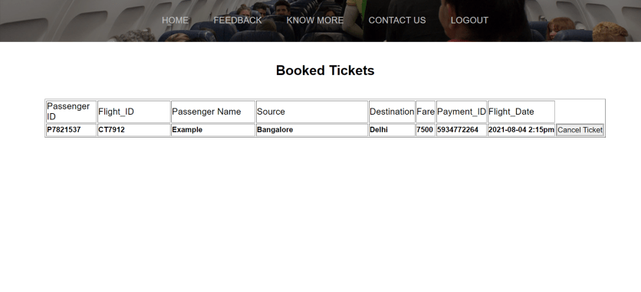
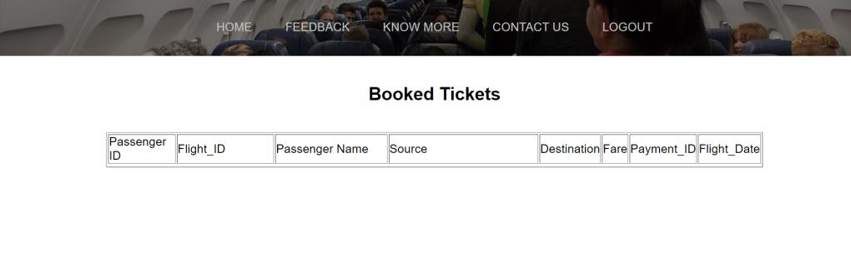
The user can view the tickets he booked by clicking on the icon ‘View Ticket’ on the home page.
If ‘View Ticket’ icon is clicked ,the below page is displayed .
If the user decides to cancel the ticket he can click on ‘Cancel Ticket’ button and his/her ticket will be cancelled .
If cancel ticket is clicked .
After this the user logout or can book multiple tickets.

