Slide 1
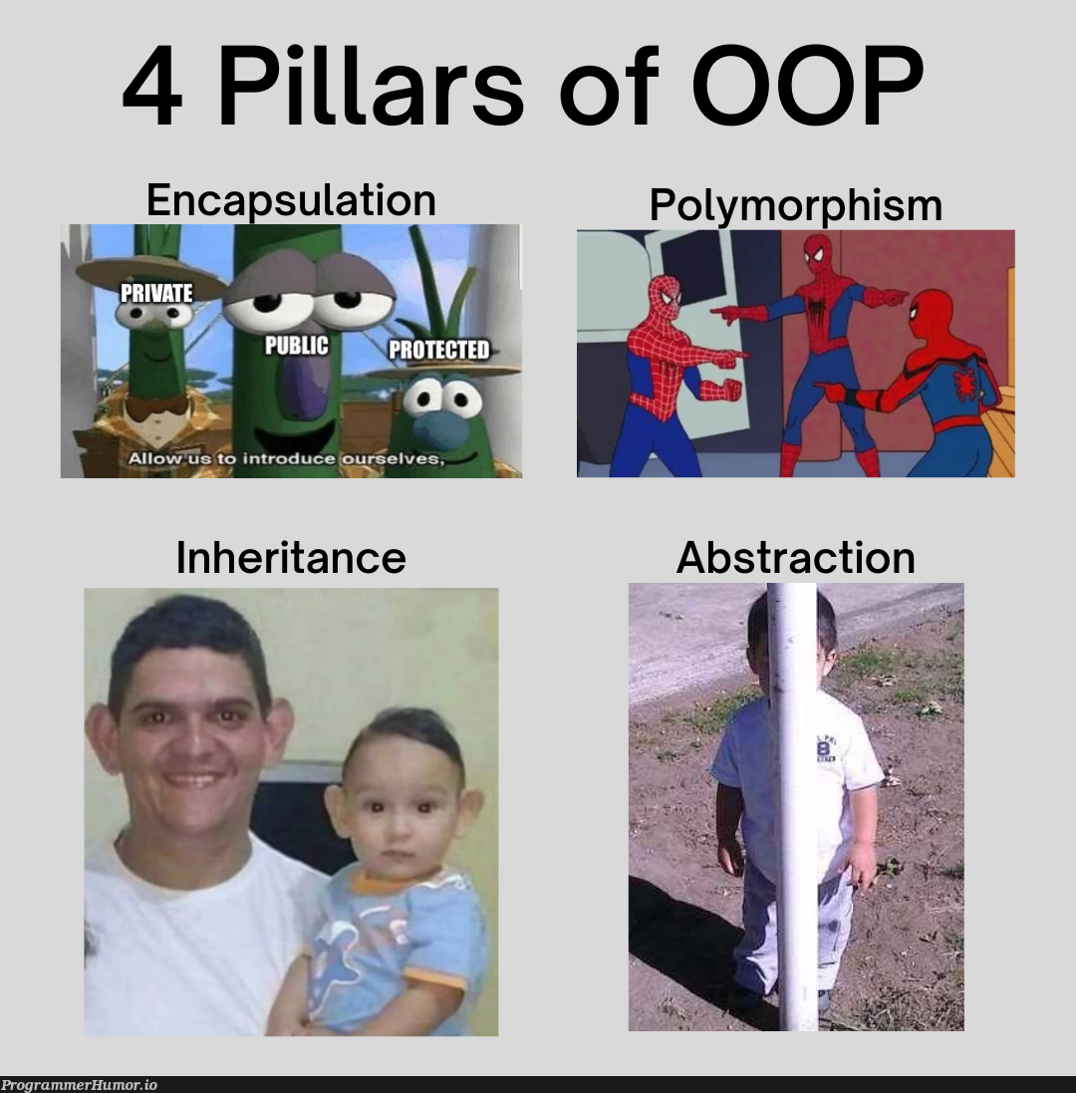
https://programmerhumor.io/
Notes:
The term “polymorphism” comes from the Greek words “poly” (many) and “morph” (forms), meaning that the same operation can behave differently on different classes or objects.

Slide 2
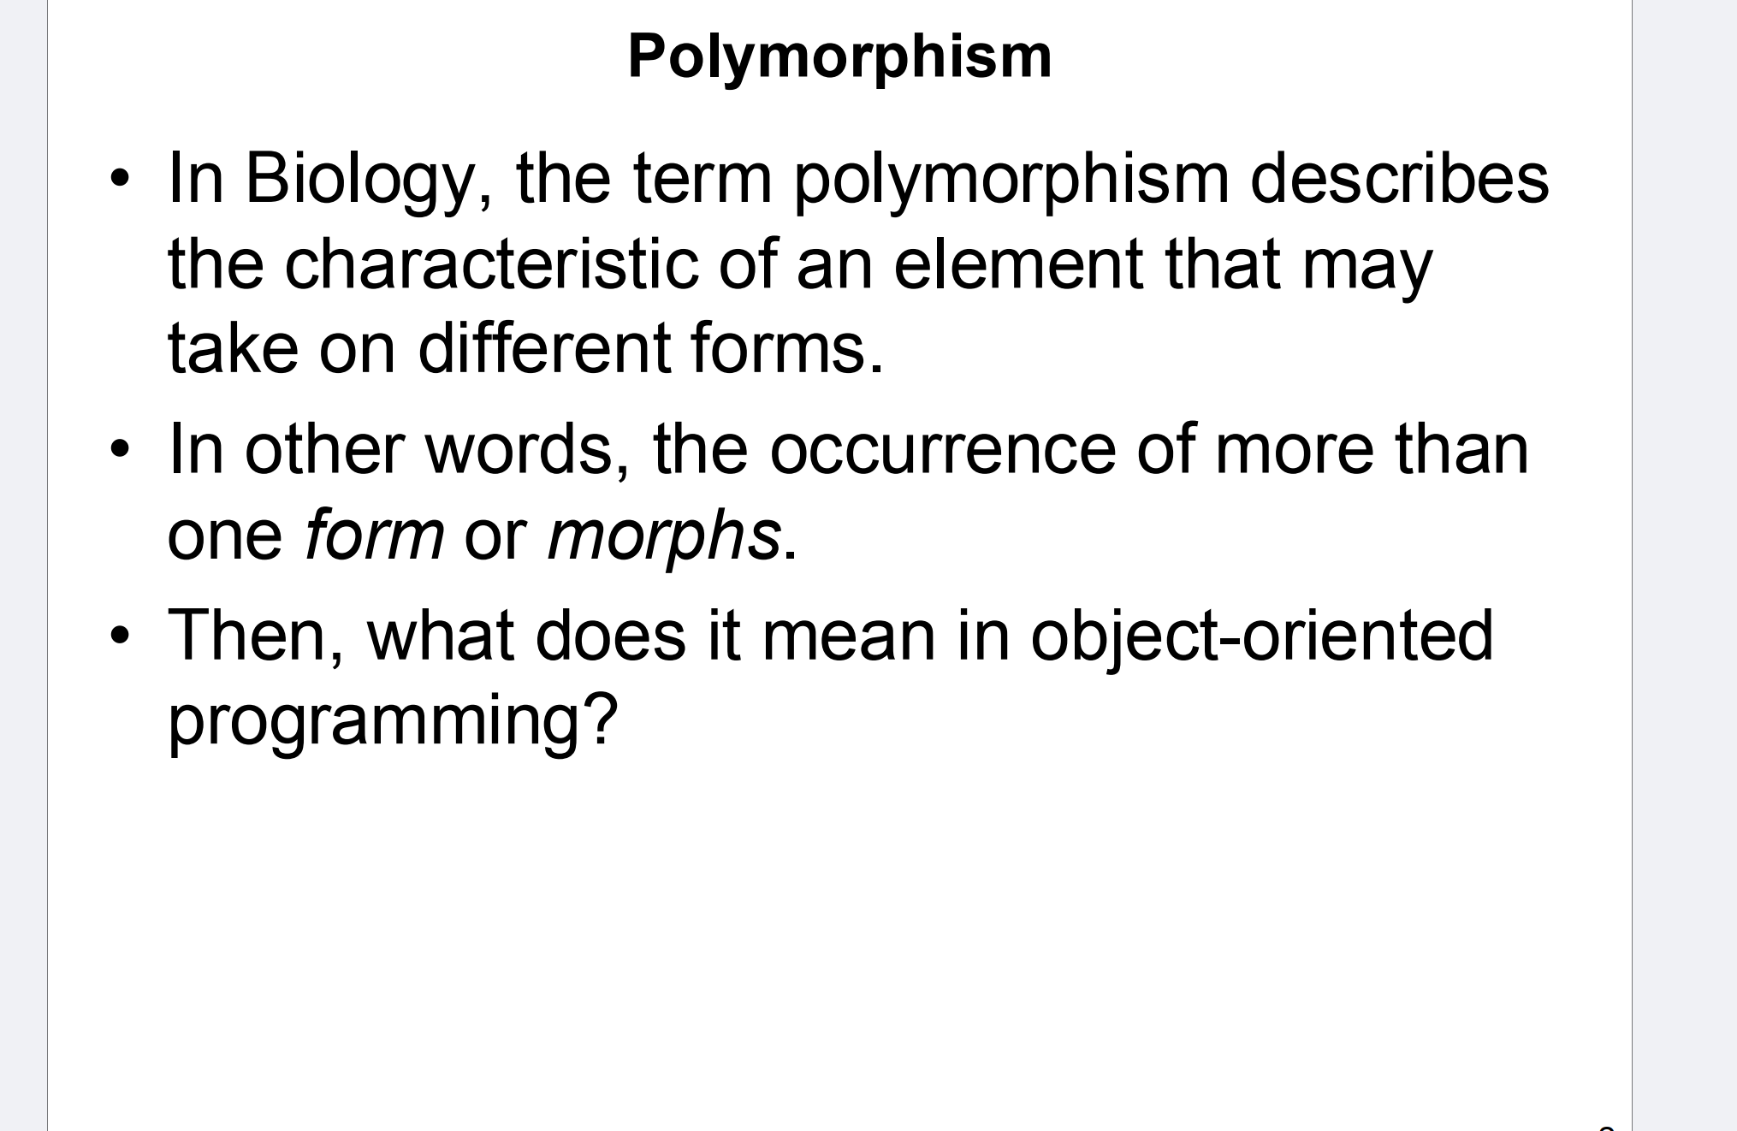
Notes:
It allows objects to be treated as instances of their base class, even if they are instances of derived classes.

Slide 3
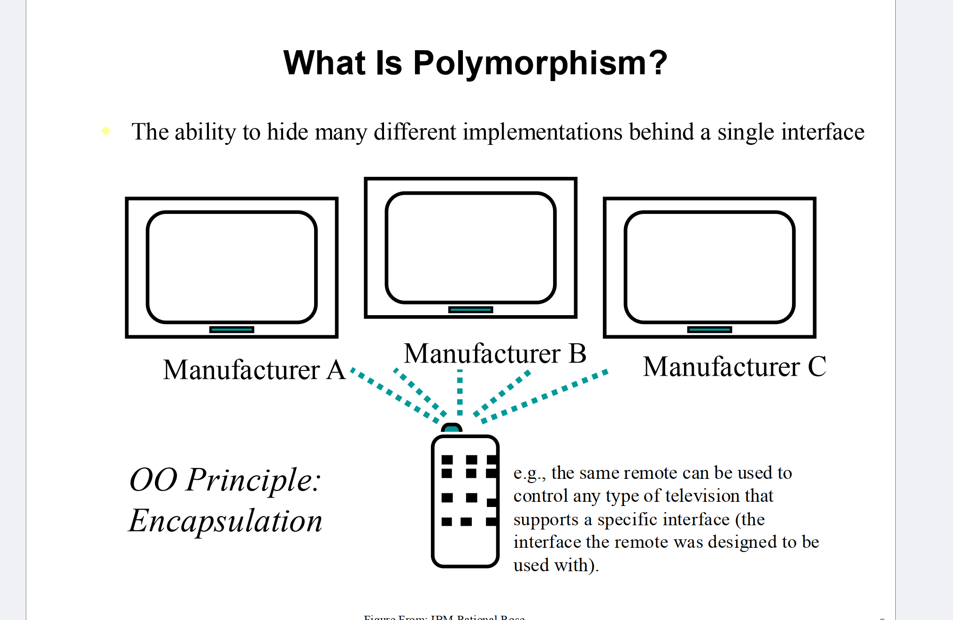
Notes:
This slide illustrates polymorphism using the analogy of a remote control that works with different televisions from different manufacturers (A, B, C). The key idea is that polymorphism allows different implementations (different TVs) to be controlled through a single, consistent interface (the remote control). Here’s a more detailed breakdown:
Single Interface, Multiple Implementations: In object-oriented programming, polymorphism allows objects of different types to be accessed through a common interface, even though their internal workings might differ. In this example, the interface is the remote control, and the implementations are the TVs from different manufacturers. The remote sends commands, and each TV responds in its own way, but the user interacts with them in a unified manner.
Encapsulation is related to polymorphism because it hides the internal details of the TV (or object) from the user. The user (or client) only needs to know how to use the interface (remote control), and they don't need to worry about how each TV internally processes the commands.

Slide 4
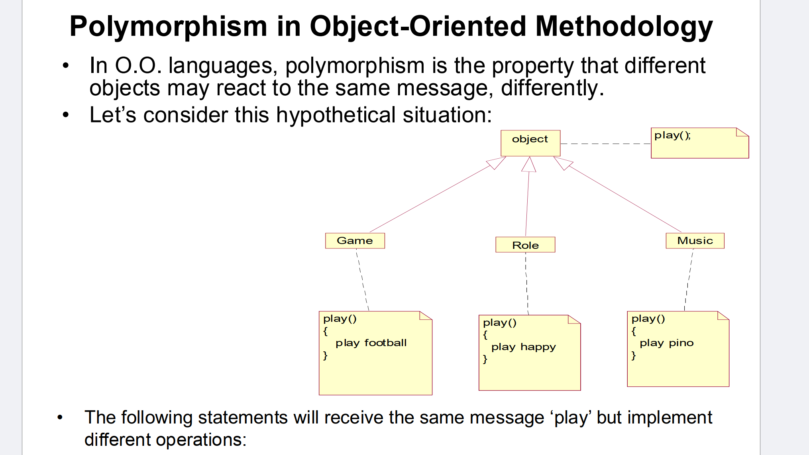
class Object {
public:
virtual void play() = 0; // Abstract method, must be overridden
};
class Game : public Object {
public:
void play() override {
cout << "Playing football" << endl; }
};
class Role : public Object {
public:
void play() override {
cout << "Playing happy" << endl; }
};
class Music : public Object {
public:
void play() override {
cout << "Playing piano" << endl; }
};
Notes:
Polymorphism allows different classes to respond to the same method (play()) in their own specific way. In this example, three different classes—Game, Role, and Music—all have a method called play(), but each class implements the method differently.
Single Interface, Different Implementations:
The common method here is play(), which is called on different objects like game, role, and music.
Each object handles the play() method differently
Overriding in C++ refers to the process where a derived class provides a specific implementation for a function that is already defined in its base class
When a method in a base class is declared as virtual, the derived class can override it by providing its own version of the method. The override keyword explicitly tells the compiler that this method is intended to override a virtual method in the base class.

Slide 5
class Employee {
public:
virtual void doWork() {
cout << "Employee does some general work." << endl;
}
};
class Developer : public Employee {
public:
void doWork() override {
cout << "Developer writes code." << endl; }
};
class Designer : public Employee {
public:
void doWork() override {
cout << "Designer creates graphics." << endl; }
};
class Manager : public Employee {
public:
void doWork() override {
cout << "Manager schedules meetings." << endl;
}
};
int main() {
Employee* employee1 = new Developer();
Employee* employee2 = new Designer();
Employee* employee3 = new Manager();
employee1->doWork(); // Developer writes code
employee2->doWork(); // Designer creates graphics
employee3->doWork(); // Manager schedules meetings
delete employee1;
delete employee2;
delete employee3;
return 0;
}
Notes:
Imagine you are managing a tech company where you have different types of employees. There are developers, designers, and managers. All of these employees perform some common tasks (like attending meetings), but they also have their specific tasks. For example, developers write code, designers create graphics, and managers manage projects.
Now, in your company system, you have a function called doWork(). Every employee should have this function, but how they work depends on their role. This is where polymorphism comes in. You don’t need to know exactly what kind of employee you’re working with to call doWork(), because the system will figure out whether it’s a developer, a designer, or a manager and make them perform their specific task.
Developers: Write code.
Designers: Design logos.
Managers: Schedule meetings.
You could think of it like this:
Base Class: Employee.
Derived Classes: Developer, Designer, Manager.
Virtual Function: doWork() behaves differently depending on which type of employee is working, but you only need to call it using a general Employee reference.
Base Class: Employee represents a general type of worker. This is like saying all employees have some shared properties (like a name or ID).
Derived Classes: Developer, Designer, and Manager all inherit from Employee but have their own implementation of doWork(). This represents the specialized tasks that each type of employee does in the company.
Polymorphism: Even though you are using a pointer to Employee, when you call doWork(), the correct version (Developer, Designer, or Manager) is called depending on the actual object type. This is dynamic polymorphism in action.

Slide 6
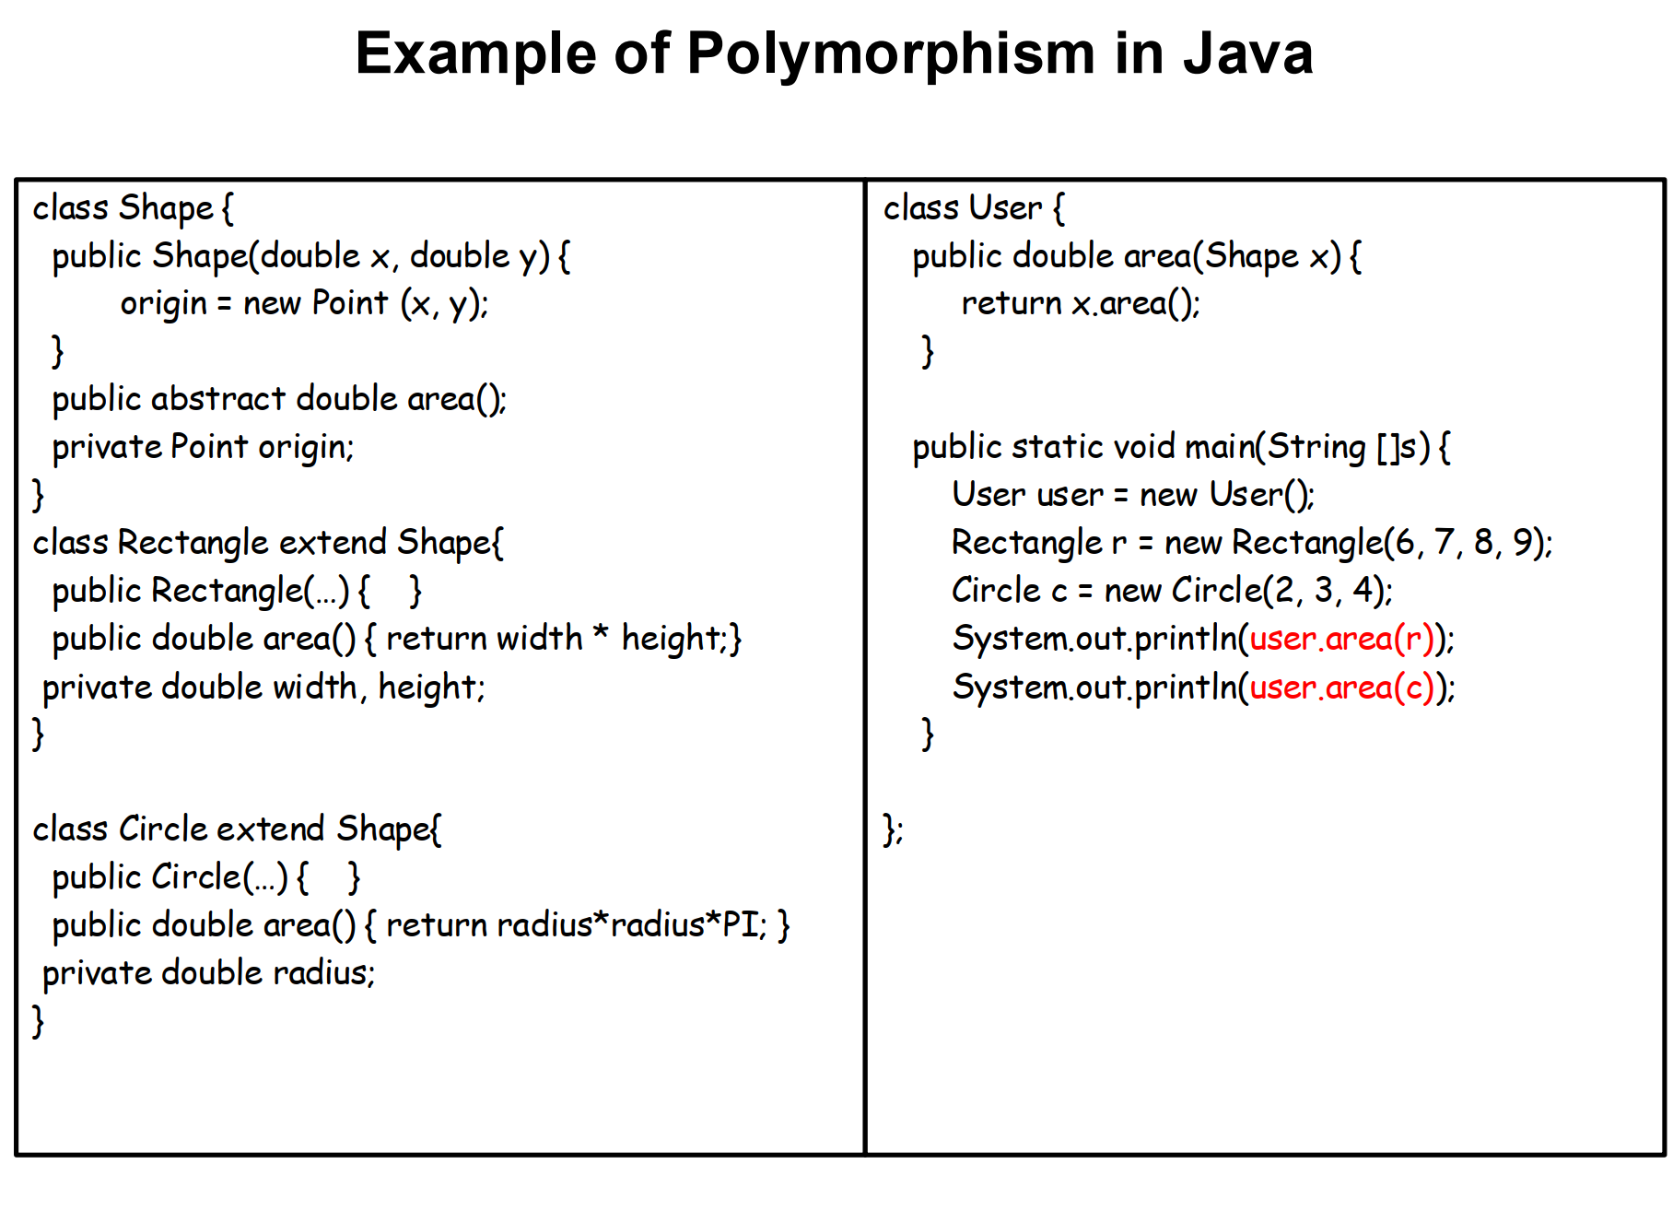
Notes:
How Polymorphism Works Here:
The User.area(Shape x) method accepts any object that is a subclass of Shape. This is the essence of polymorphism: the ability to treat different types of objects (e.g., Rectangle, Circle) as instances of the base class (Shape).
At runtime, Java determines which area() method to call based on the actual object type (Rectangle or Circle), even though the variable is of type Shape. This is called dynamic method dispatch.
The User class in this example serves as a demonstration of how polymorphism works by providing a common interface (area(Shape x)) to interact with different types of Shape objects, such as Rectangle and Circle. Here's why it’s used:

Slide 7
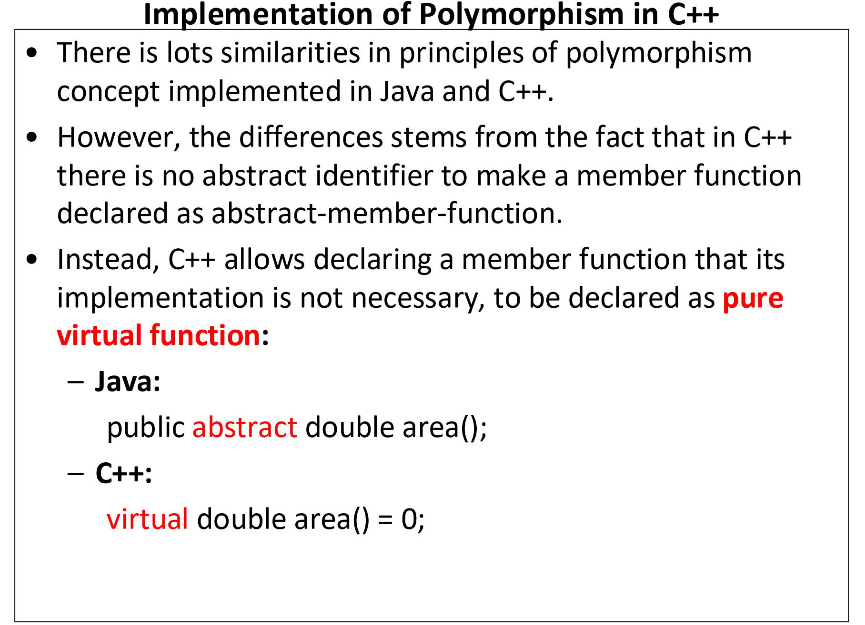

Slide 8
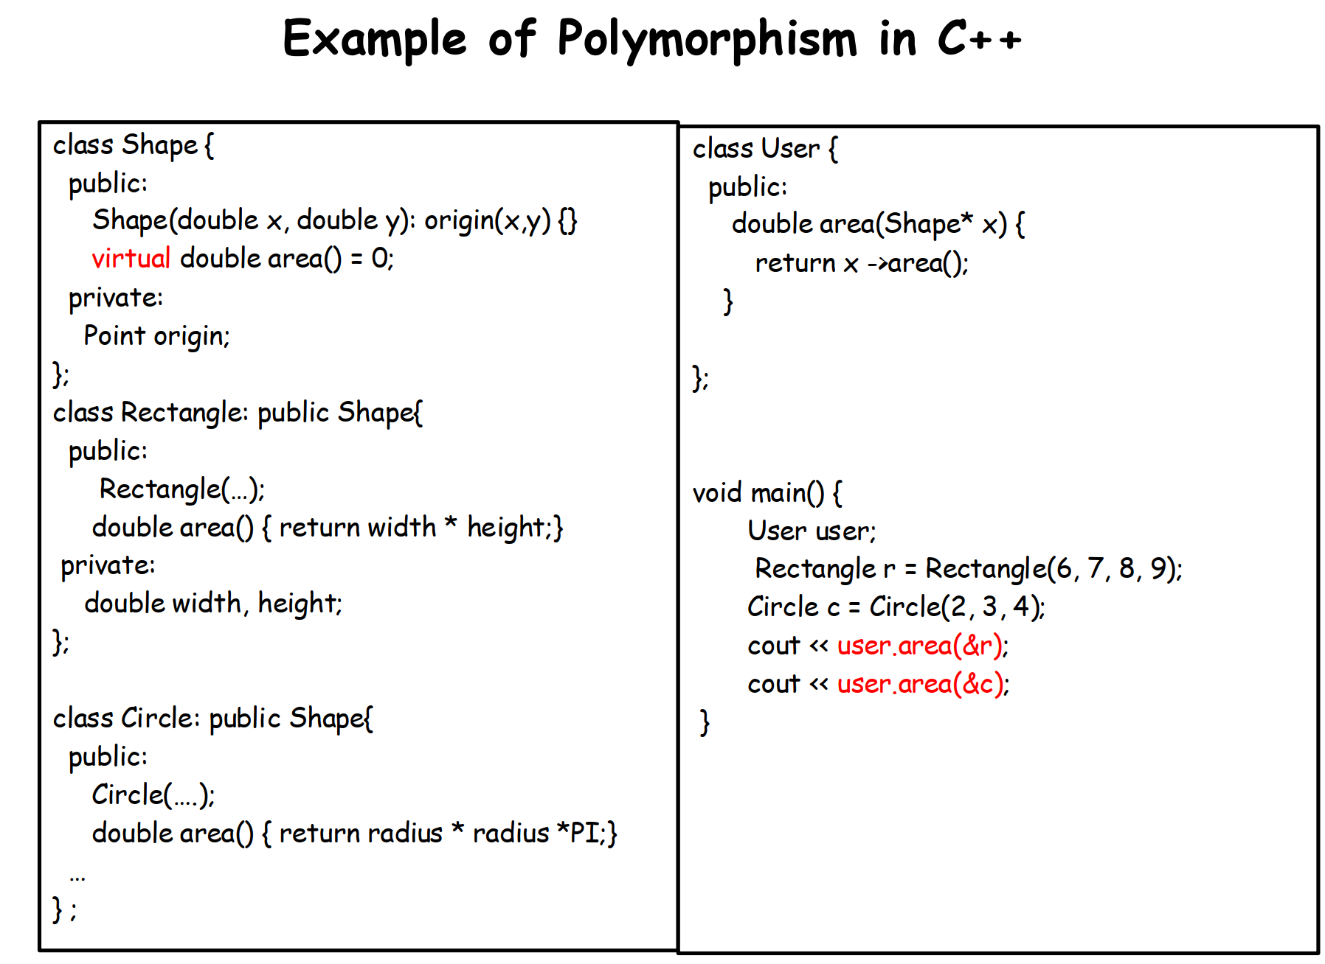

Slide 9
Polymorphism
Compile-time Polymorphism (Static Polymorphism)
Function Overloading
Operator Overloading
Run-time Polymorphism (Dynamic Polymorphism)
Inheritance and virtual functions
Notes:
Compile-time polymorphism is achieved using function overloading and operator overloading. The binding of the function call to the function definition happens at compile time, and the compiler determines which function or operator to use based on the arguments passed.
Run-time polymorphism is achieved through inheritance and virtual functions. In this type, the function call is resolved at run time, and the appropriate function is called based on the actual type of the object being referred to, even if it is accessed through a pointer or reference to the base class.
Dynamic binding, also known as late binding, is when the function call is determined at runtime. This occurs when a virtual function is called through a base class pointer or reference. The decision on which function to call is deferred until the actual object type is known at runtime.

Slide 10
Function Overloading
#include <iostream>
class Print {
public:
void show(int i) {
std::cout << "Integer: " << i << std::endl;
}
void show(double d) {
std::cout << "Double: " << d << std::endl;
}
};
int main() {
Print p;
p.show(5); // Calls the int version
p.show(5.5); // Calls the double version
return 0;
}

Slide 11
Operator Overloading
// Overloading prefix ++
Vector& operator++() {
++x; ++y;
return *this;
}
// Overloading postfix ++
Vector operator++(int) {
Vector temp = *this;
++(*this);
return temp;
}

