Slide 1
SOLAR ENERGY FORECASTING USING MACHINE LEARNING
DATA ANALYTICS
Syed Zain Abbas

Slide 2
AGENDA
Introduction
Problem Statement
Data Analysis
Machine Learning
Results & Improvements

Slide 3
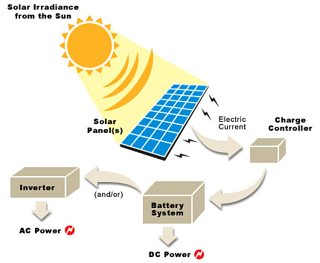
Introduction

Slide 4
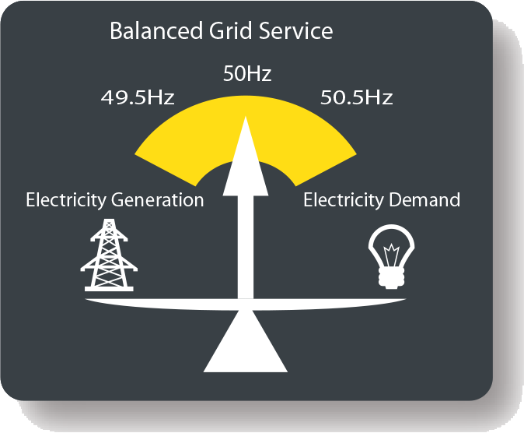
Problem Statement
Increase of Renewable Energies
Nature Dependent Phenomenon
Heavy Fines

Slide 5

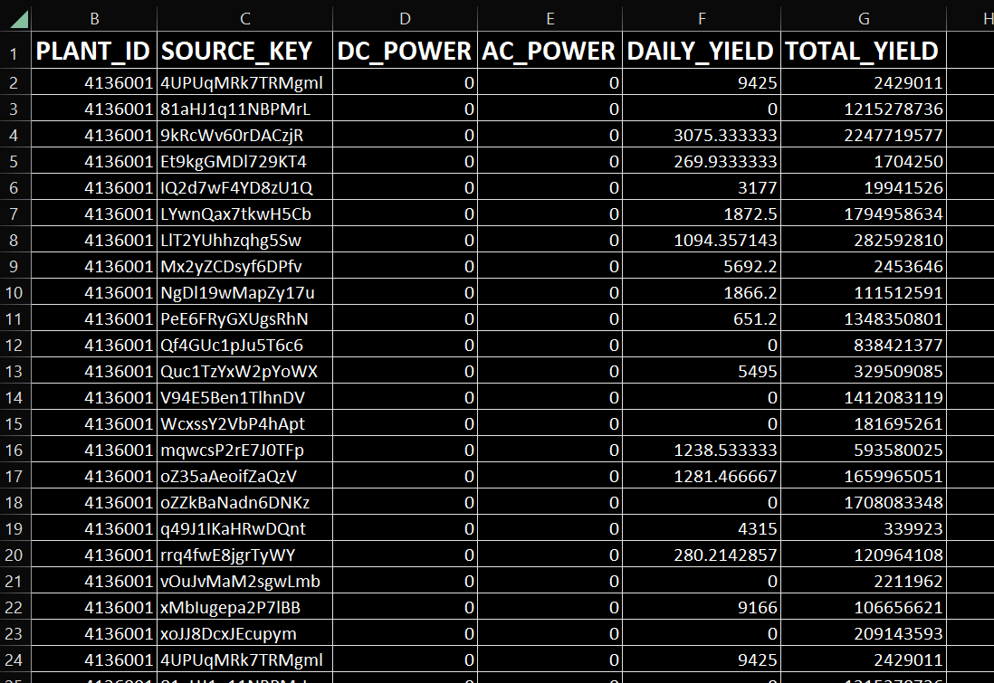
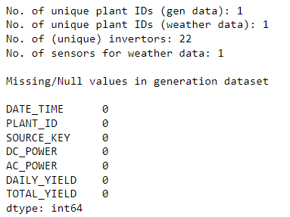
Data Analysis – Dataset Description

Slide 6
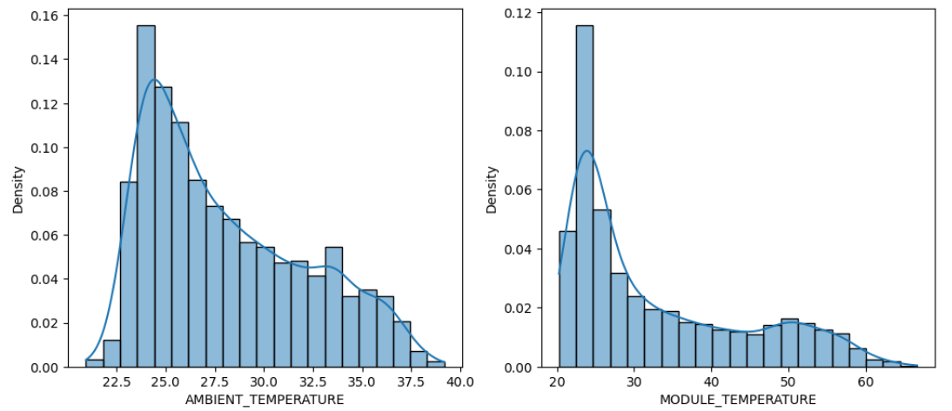
Data Analysis – Distribution Curves

Slide 7
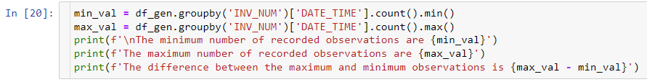

Data Analysis – Missing Values

Slide 8
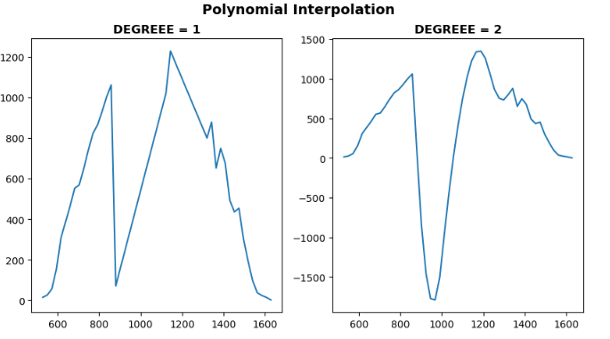
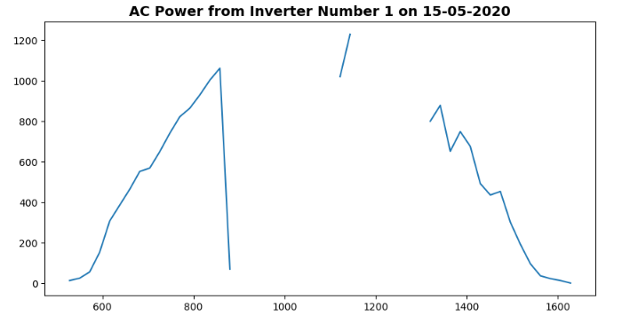
Data Analysis – Missing Values Imputation

Slide 9
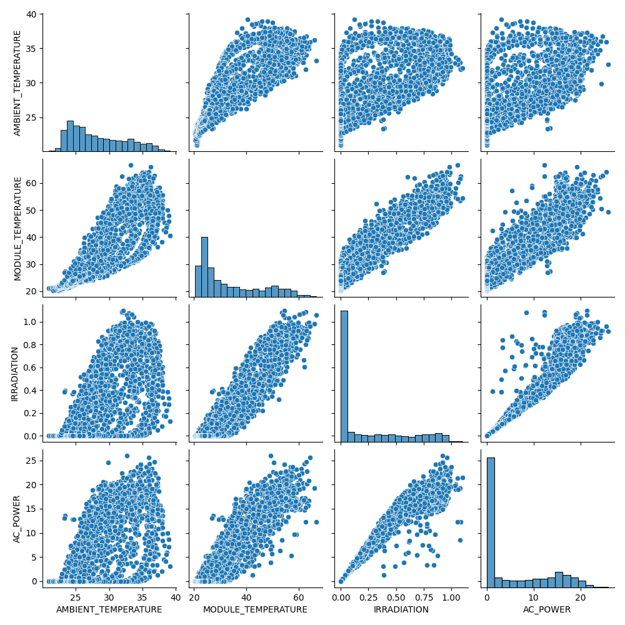
Data Analysis – Correlation

Slide 10
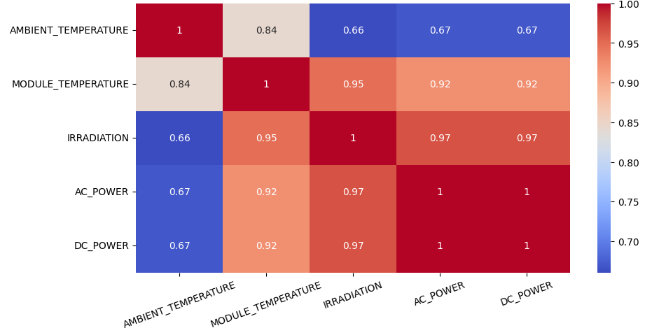
Data Analysis – Correlation

Slide 11
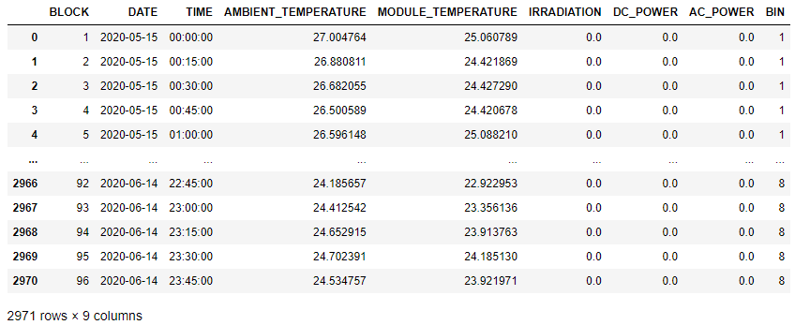
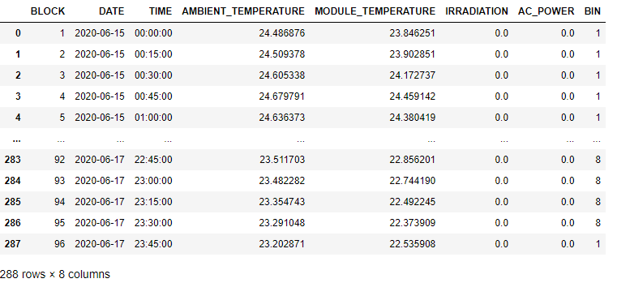
Machine Learning – Train Test Split
Training Data
Testing Data

Slide 12
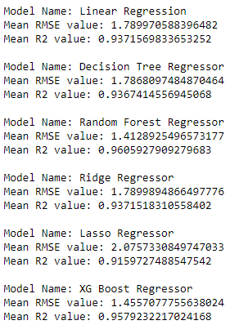
Machine Learning – Algorithms
Linear Regression
Decision Tree Regressor
Random Forest Regressor
Ridge
Lasso
XGB Regressor

Slide 13
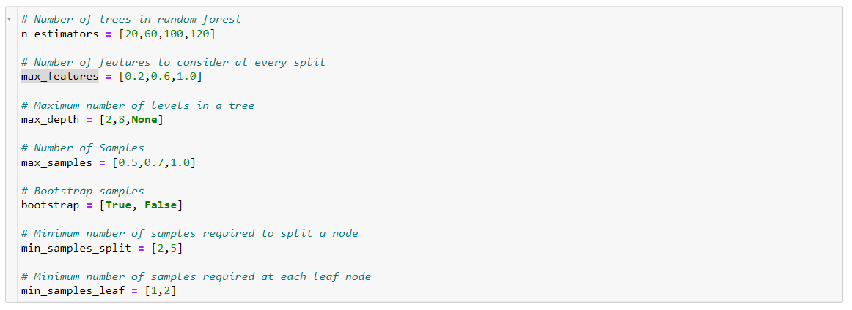
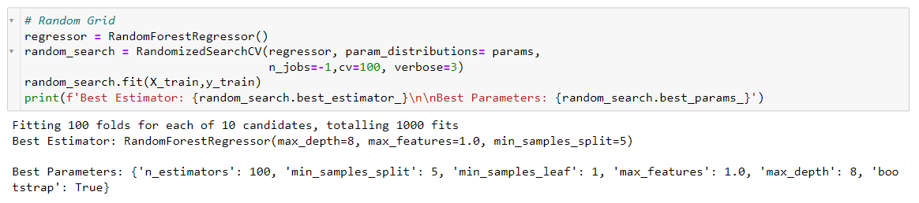
Machine Learning – Parameter Tuning

Slide 14
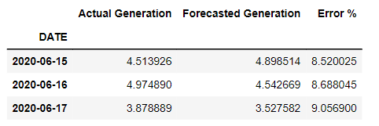

Results & Imporovements
Inclusion of more features (DHI, GHI, Humidity) will allow better results.
Increased number of weather sensors.

Slide 15

Any Questions

