Slide 1

ZOSHKA
Business Pitch Deck
An Innovative E-Commerce Solution for EVERYONE

Slide 2
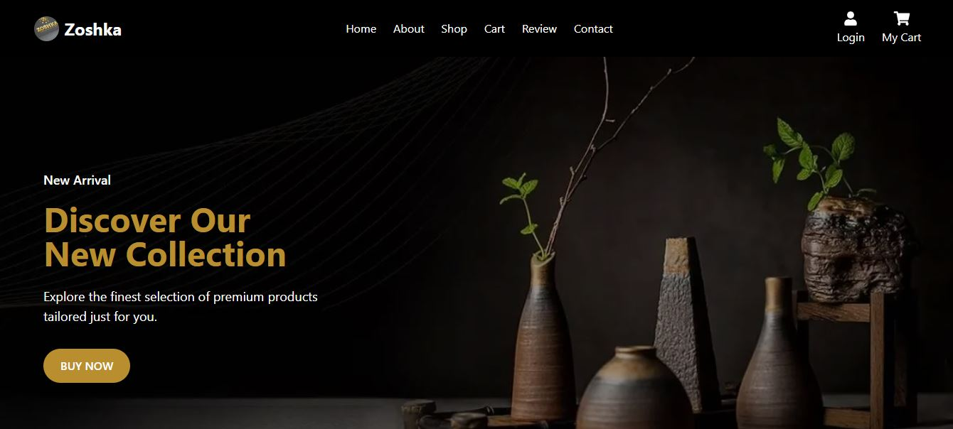
OUR WEBSITE LOOK

Slide 3
INTRODUCTION
Zoshka is an innovative e-commerce platform designed for everyone.
It offers a seamless shopping experience with AI-driven recommendations and personalized services.

Slide 4
PROBLEM & SOLUTION
Problem: Housewives struggle to find high-quality household products efficiently.
Solution: Zoshka provides a curated selection of essential goods with an easy-to-use interface.

Slide 5
MARKET OPPORTUNITY
The e-commerce industry is rapidly growing.
Millions of housewives shop online.
Zoshka targets this market with a dedicated, user-friendly shopping experience.

Slide 6
BUSINESS MODEL
How Zoshka Generates Revenue?
Direct Product Sales
Affiliate Partnerships
Premium Memberships (Exclusive Discounts & Faster Deliveries)

Slide 7
PRODUCT & FEATURES
Key Features of Zoshka
Intuitive user-friendly interface
AI-powered recommendations
Exclusive discounts for members
Secure & flexible payment options
Fast & reliable delivery

Slide 8
MARKETING STRATEGY
How We Reach Customers?
Social Media Marketing
Influencer Collaborations
Targeted Advertisements

Slide 9
FINANCIAL PROJECTIONS
Expected Growth:
25% revenue increase per year
Increased user engagement & sales
Focus on scaling the platform

Slide 10
CALL TO ACTION
Join Us!
Invest in Zoshka & revolutionize e-commerce for everyone.
Seeking investors & strategic partners to scale the platform.

Slide 11
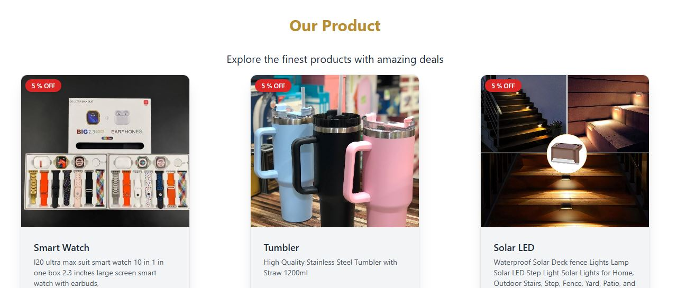
OUR PRODUCTS

Slide 12
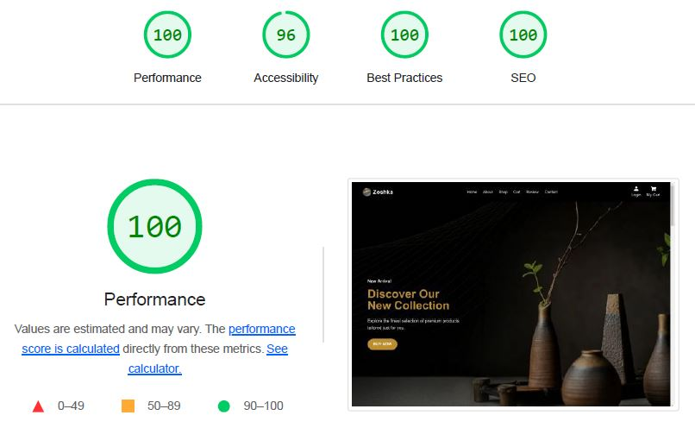
PERFORMANCE REPORT

Slide 13
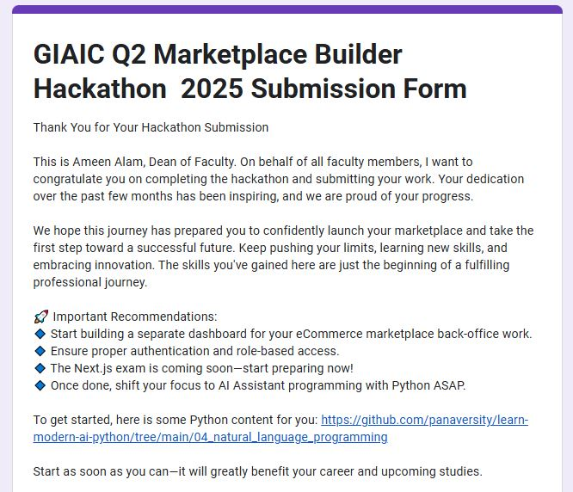
MARKETPLACE SUBMISSION

Slide 14
Thank You
Thank you for your time! 📞 Contact Us: salizamasood@gmail.com 🌐 Visit Us: https://zoshka-website.vercel.app/

