Slide 1
Earnings and Age in Urban Balochistan
PSLM 2019–20 | ECO346 Data Visualization | Assignment 1
Syeda Quratulain Fatima | FA24-BED-095 | Section A
Variant 7
95 = 11 × 8 + 7, so Balochistan urban
486 earners
Aged 15 to 64, earnings above zero
Weighted
Every number uses household weight (hhweight)

Slide 2
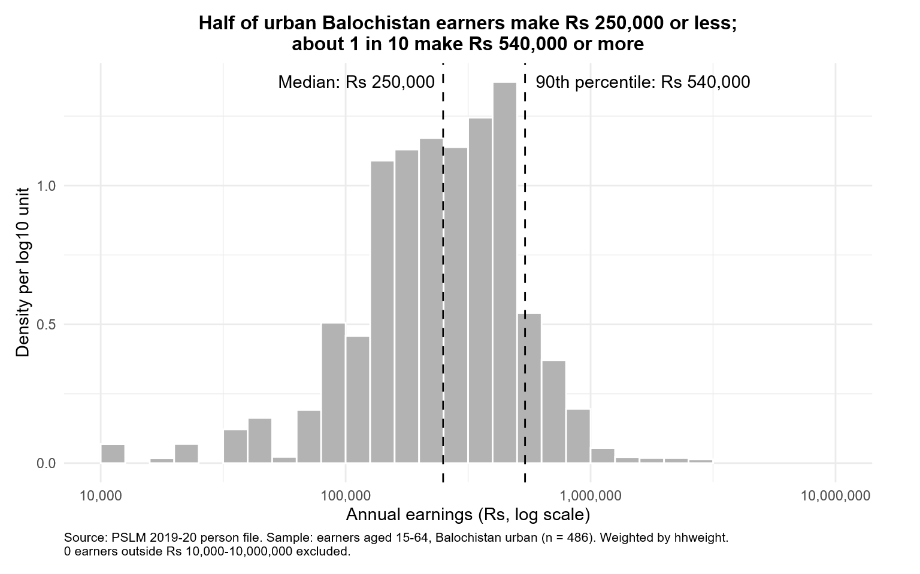
Half earn Rs 250,000 or less
Rs 250,000
Weighted median
Rs 264,000
Unweighted median
Rs 96,000
10th percentile (P10)
Rs 540,000
90th percentile (P90)
5.625
Ratio P90 ÷ P10
0
Earners excluded
The weighted median is a little lower, because the weights give more voice to lower-earning households. The gap is only about 5%.

Slide 3
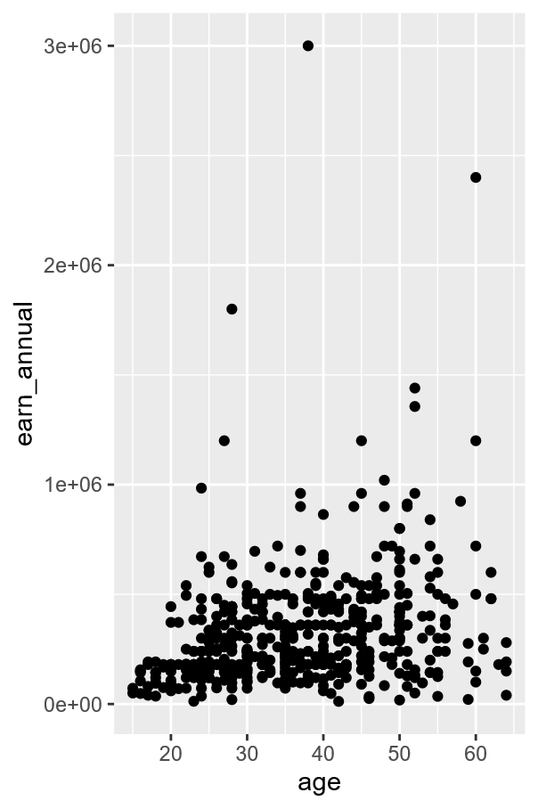
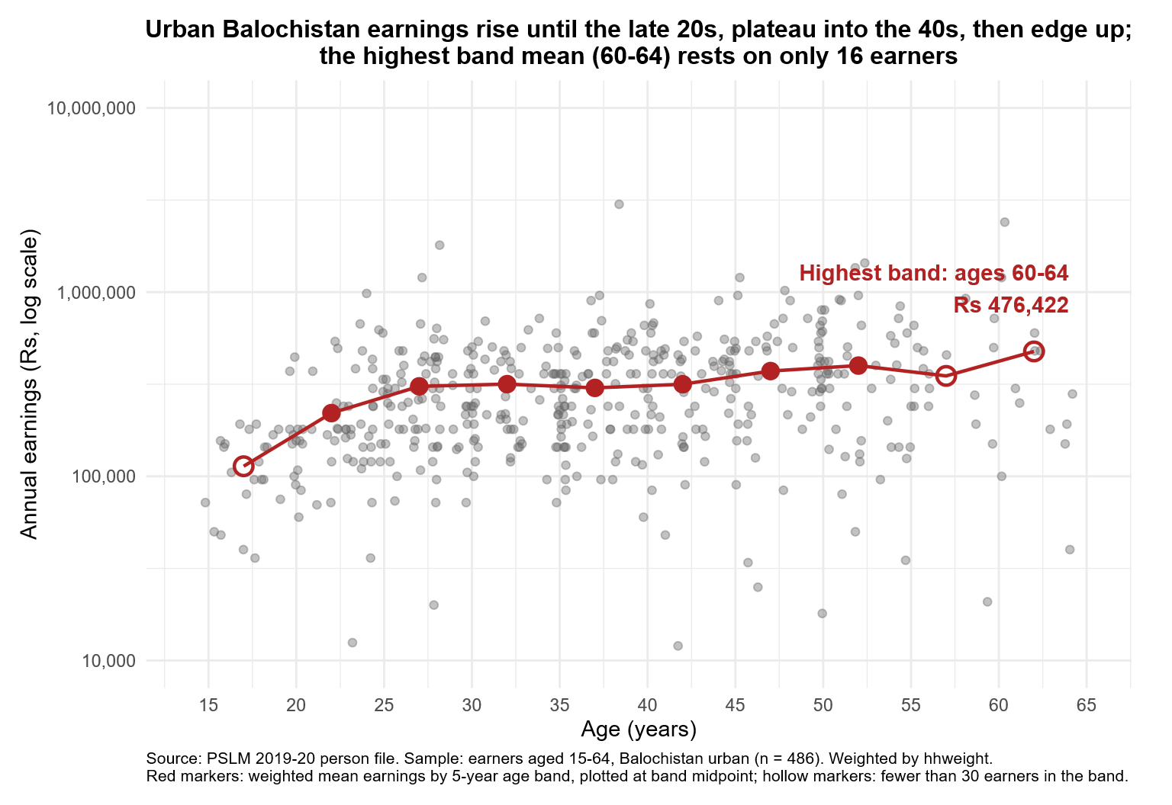
Default plot vs redesign
1
Log scale in rupees
Spreads out the crowded points
2
Transparency 0.4 and jitter
Shows where earners cluster
3
Weighted band means
Hollow = under 30 earners
What the default shows better: how far the top earners (up to about Rs 3,000,000) sit above everyone else. The log scale squeezes that gap.

Slide 4
Pay rises, then levels off
Rises fast until 25–29
Rs 113,382 at ages 15–19 to Rs 307,994 at ages 25–29.
Then about level
Around Rs 300,000–317,000 until the early 40s.
Be careful with 60–64
Highest mean (Rs 476,422), but only 16 earners.
Limit: this compares different people in one year, so it cannot show one person's career path.
Check: R and Python band tables match to the rupee (25–29: Rs 307,994 in both).

