Slide 1



“Water Quality Prediction Using Machine Learning” Innovative technology for a cleaner tomorrow—accurate pollution forecasts to protect India’s precious water resources.
Syeda Tarannum Naaz
STU67eacd95ae8581743441301

Slide 2

Learning Objectives
By the end of this presentation, you will be able to:
Understand the importance of water quality monitoring and its impact on public health and the environment.
Explain how machine learning algorithms can be applied to predict water pollution levels accurately.
Identify key water quality parameters used as input features for prediction models.
Describe the workflow of a machine learning project for water quality prediction, including data collection, preprocessing, model training, and evaluation.
Analyze prediction results to support decision-making and clean water initiatives in India.
Appreciate the role of technology in addressing environmental challenges and promoting sustainable development.
GOAL

Slide 3
Tools and Technology used
Programming Language
Python
For data preprocessing, analysis, and building prediction models
Data Analysis & Machine Learning Libraries
Pandas
Data cleaning and manipulation
NumPy
Numerical computations
scikit-learn
Machine learning algorithms (Regression, Classification)
joblib
Model serialization and loading
Web Application Framework
Streamlit
Creating an interactive web interface to input data and display predictions

Slide 4
Tools and Technology used
Development Environment
Jupyter Notebook
Interactive coding and visualization
(or) Google Colab
Cloud-based notebooks for easy collaboration
Dataset
Publicly available water quality datasets
e.g., Central Pollution Control Board of India
Kaggle repositories
Version Control
Git
Tracking changes in code and collaboration

Slide 5
Methodology
We adopted a structured process to develop the water quality prediction system:
Data Acquisition Historical water quality records were collected, containing measurements of key pollutants monitored at various stations over several years.
Data Preparation The dataset was cleaned to address inconsistencies and fill or remove missing values. The main input features were Year and Station ID. Categorical variables were converted into numerical format using one-hot encoding to ensure compatibility with the model.
Model Development A regression model was trained to predict the concentrations of six primary pollutants: O₂, NO₃, NO₂, SO₄, PO₄, and Cl.
Validation and Optimization The model’s performance was evaluated using appropriate accuracy metrics, and adjustments were made to improve prediction reliability.
Deployment with Streamlit An interactive web application was built using Streamlit, enabling users to enter a Year and Station ID and instantly receive predicted pollutant levels in an easy-to-read format.

Slide 6
Problem Statement:
Water pollution is a significant environmental challenge in some areas in India, affecting human health, agriculture, and ecosystems. Traditional monitoring methods rely on manual sampling and laboratory analysis, which are time-consuming, costly, and limited in coverage. This makes it difficult to track pollution trends or respond quickly to contamination. There is a need for an efficient, scalable solution that can predict pollutant levels accurately and support timely decision-making to protect water resources.

Slide 7
Solution:
To tackle the challenge of monitoring water pollution on a large scale, we designed a machine learning–powered system that predicts the concentrations of six major water pollutants using only two straightforward inputs: the year and the station ID. Beneath this simple interface is a robust predictive model trained on historical environmental data, capable of delivering accurate, location-specific forecasts.
To maximize accessibility, we developed an intuitive web application using Streamlit. This platform allows users to interact with the model easily, without any programming knowledge or specialized training. With just a few clicks, environmental officers and policymakers can quickly estimate pollutant levels for any monitoring site.
This solution not only saves time—it redefines how water quality assessment is carried out. It enables faster identification of high-risk areas, supports proactive pollution control efforts, and reduces dependence on expensive and labor-intensive manual sampling. By putting reliable predictive insights directly into the hands of decision-makers, our project offers a smarter, data-driven way to protect water resources across

Slide 8
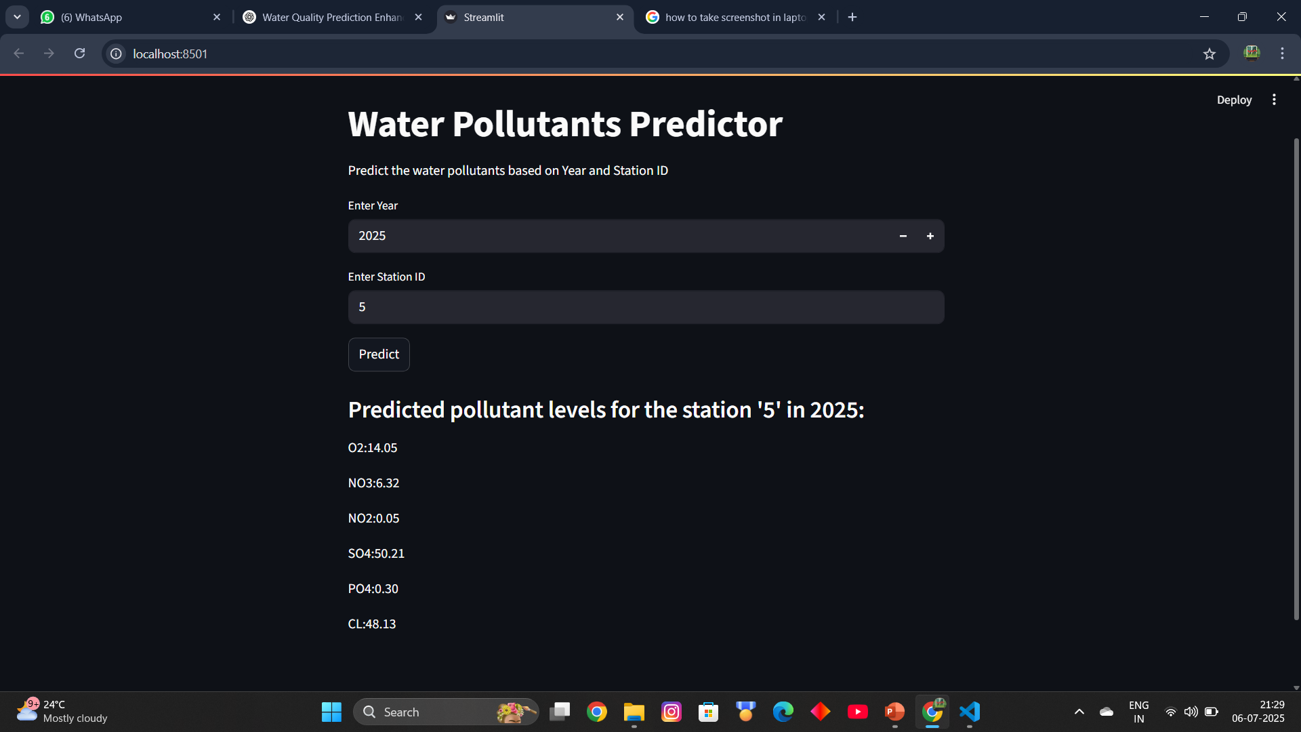
Screenshot of Output:

Slide 9
Conclusion:
This project demonstrates that machine learning can be an effective tool for predicting water pollutant concentrations using minimal input data. By training regression models on historical records, the system provides accurate, location-specific forecasts that help address the limitations of traditional manual monitoring methods. The integration of a Streamlit web application further improves accessibility, enabling users to obtain real-time predictions without requiring technical expertise.
Overall, the solution offers a faster and more cost-effective approach to monitoring water quality. It has the potential to support early detection of pollution, inform decision-making, and contribute to better protection of water resources. The project also lays a strong foundation for future enhancements and wider adoption in environmental management.

Slide 10
Future Scope
The model can be enhanced by including additional input features such as temperature, rainfall, or industrial activity data to improve prediction accuracy.
Advanced machine learning algorithms, like ensemble methods or deep learning models, could be explored for better performance.
The solution can be scaled to cover more stations across India and integrated into existing water management systems for real-time monitoring and alerts.
A mobile app version could be developed to make predictions even more accessible.

Slide 11
Project Resources:
app.py : Click here to view the file from google drive
model_columns.pkl : Click here to download model_columns.pkl file from google drive
Parameters_WQM_RMS : Click here to download parameters from google drive
PB_All_2000_2021 : Click here to download PB All_2000_2021.csv from google drive
pollution_model.pkl : Click here to download pollution_model.pkl from google drive
README : View README from google drive
Water_Quality_Prediction : Click here to download water_quality_prediction.ipynbfile from google drive
GitHub Repository: click here to view repository
THANK YOU!

