Slide 1

Cartify
(The Smart Shopping Trolley)
Presented by: Mahnoor
Malikha Naveed
Syeda Anabia Liaquat
Presented to : Dr. Aamir Arsalan
Department: Information Technology

Slide 2
Introduction
Project Definition:
  Cartify is a smart shopping system designed to make shopping easier, faster, and safer. It combines smart trolley technology with a web-based system that allows customers to scan products, view their bill in real time, and move safely inside the store.
Purpose:
  The purpose of Cartify is to improve the traditional shopping process by reducing long billing lines, avoiding billing errors, and providing a modern shopping experience using technology.
Nature of the Project:
  Cartify is a planned project with a clear start and end. It is developed to create a unique smart shopping solution that can be used in real stores and later connected with cloud systems for future expansion.
01

Slide 3
Problem Description
Issue:
  Traditional shopping involves long queues, billing errors, and inefficiencies in locating and scanning products manually. Customers often waste time and face frustration during busy hours.
Impact:
  These issues lead to customer dissatisfaction, longer shopping times, and potential revenue loss for stores due to inefficient operations. Manual billing also increases the chances of errors
01

Slide 4
Project Defination:
Project Definition: Cartify is a smart shopping system combining smart trolleys with a web-based platform to simplify shopping.
FYP Attributes
  Unique Purpose: Reduce queues, minimize billing errors, and provide faster.
  Temporary: Completed within two Semester .
  Resources: Trolleys, Application barcode scanners, Supabase Data Base, virsual studio , ESP32
  Customers and Sponsors: faculty and Enduser
  Uncertainty: Challenges in trolley-system integration, hardware delays, and user adaptation to new technology.
01

Slide 5
Project Constraints:
Triple Constraints:
  Scope: Includes web application development and secure payment integration.
  Time: Planned to complete the project within 6 months.
  Cost: Initial budget allocated to cover tools, hardware, software, and resources
Quality: Ensure a reliable, secure, and user-friendly system with accurate billing and smooth trolley-web integration.
Usability: Easy-to-use interface for both customers and store staff.
01

Slide 6
Project Stakeholder:
Internal: Mahnoor , Malaikha , Anabia , Sir Adnan
External: Customer , Hardware, Software Vendor
Project Sponsor: University
Opponents: Traditional retail like local supermarkets
Stakeholder Management:
  Identify stakeholders early.
  Communicate progress regularly.
  Collect feedback during testing and demos.
01

Slide 7
Systems Thinking & Organizational Factors :
Systems Thinking: Cartify is part of a bigger smart shopping system.
Three-Sphere Model:
  Business Sphere: Helps make more sales and faster billing.
  Technology Sphere: Uses web app (React/Node.js), database, and smart trolleys.
  Organization Sphere:Team roles, stakeholder coordination, and training.
Organizational Structure: Mix of functional and project-based teams.
Organizational Culture: Team works together, shares ideas, and communicates openly.
01

Slide 8
Project Life Cycle:
Phases Applied to FYP:
  Initiating: Define project, approve idea, identify stakeholders.
  Planning: Scope, schedule, cost, risk, resource planning.
  Executing: Backend & frontend development, database setup, hardware setup.
  Monitoring & Controlling: Track progress, testing, bug fixing.
  Closing: Final demo, documentation, lessons learned.
Approach: Agile hybrid (short iterations, iterative testing, continuous feedback)
01

Slide 9
Knowledge Areas :
Scope Management: Define features like web application, smart trolley integration, and secure payment system.
Schedule Management: Plan timeline, set milestones, and track deadlines for development, testing, and deployment.
Cost Management: Allocate budget for hardware, software, and human resources; include a contingency plan.
Quality Management: Ensure accurate billing, smooth trolley-app integration, and user-friendly interface.
Resource Management: Assign tasks to developers and designers, manage software tools, and hardware resources
01

Slide 10
cont......
Risk Management: Address risks like hardware malfunctions, software bugs, and project delays, prepare mitigation plans.
Procurement Management: Purchase smart trolleys, scanners, servers, and other necessary hardware.
Stakeholder Management: Provide regular demos to supervisior and collect feedback for improvements.
Integration Management: Ensure smooth integration between web application, smart trolleys, database, and payment system.
01

Slide 11
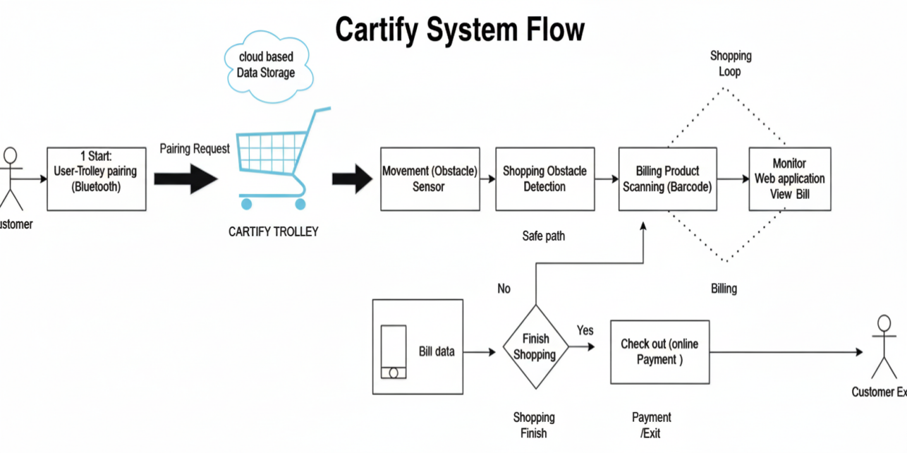
System Diagram:
01

Slide 12
Agile Approach:
  Agile Approach: A project management method where work is done in small phases.
  Planning in Phases: Cartify is divided into planning, development, testing, and deployment phases.
  Regular Monitoring: Progress is checked after each phase to find and fix issues early.
  Stakeholder Feedback: University and users give feedback after each phase.
  Flexibility: Changes in scope, time, or cost can be handled easily.
  Benefits: Better control , Less risk ,On-time project completion
01

Slide 13
Risk Management:
Technical Risk: Problems in smart trolley or web system integration.
Solution: Early testing and regular system checks.
Schedule Risk: Project may be delayed due to development or hardware issues.
Solution:Clear timeline and weekly progress reviews.
Cost Risk: Budget may increase due to extra hardware or changes.
Solution: Fixed budget planning and cost monitoring.
Security Risk: Risk of data or payment security issues.
Solution:Use secure payment methods and data protection.
01

Slide 14
Project Success Criteria:
Meet Scope: Deliver a functional web-based Cartify system with smart trolley support (optional device).
Meet Time: Complete the project within the given semester timeline.
Meet Cost: Finish the project within the approved budget.
Achieve Objectives: Reduce manual billing effort and ensure accurate, real-time billing.
Ensure Stakeholder Satisfaction: Receive positive feedback from the university supervisor and users.
01

Slide 15
Work Breakdown Structure (WBS):
Content: Break the Cartify project into small and manageable tasks.
Tasks for Cartify Project:
  Backend Development: Product management, billing logic, and payment handling.
  Frontend Development: Web interface for product scanning and real-time bill display.
  Database Setup: Store product, user, and transaction data.
  Hardware Integration: Smart trolley , wires and weeles ,
  Testing & Bug Fixing: Test system functions and fix errors.
  Documentation: Prepare project report and user guides.
01

Slide 16
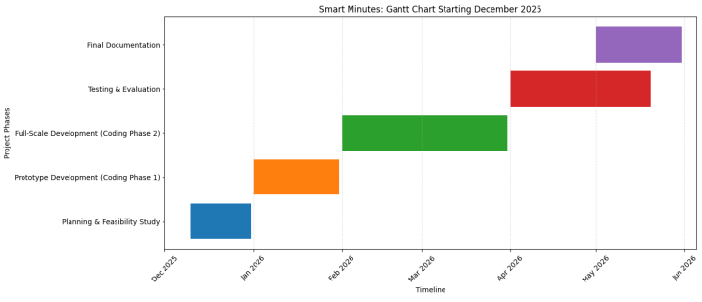
Gantt Chart:
01

Slide 17
RACI Matrix (Cartify Project)
Content: Defines who is Responsible, Accountable, Consulted, and Informed for each task.
Cartify Project Example:
Anabia: (Backend Developer) Responsible for billing logic, product management, and system integration.
Malikha : (Frontend Developer )Responsible for web interface and user experience.
Anabia : (Database Manager ) Responsible for managing product, user, and transaction data.
Mahnoor : (Tester / Documentation Member) Responsible for testing and project documentation.
Sir Adnan: (Supervisor) Consulted for guidance and informed about project progress.
Users: Informed about system usage and updates.
01

Slide 18
Stakeholder Analysis Tools
Content: Identify stakeholders and analyze their interest and influence on the project.
Cartify Project Example:
  High Influence / High Interest: Project Sponsor (University / Store Management) – directly involved in decisions.
  High Influence / Low Interest: IT Administrator – kept informed about technical setup.
  Low Influence / High Interest: Customers (Users) – receive regular updates and provide feedback.
This helps decide who needs more communication and who should be kept informed for project success.
01

Slide 19
Communication Plan
Content: Defines how project information is shared among team and stakeholders.
FYP Example:
  Weekly team meetings for progress tracking
  Supervisor updates via email/WhatsApp
  Feedback sessions with users after testing each module
Explanation: Ensures timely, consistent communication to avoid misunderstandings.
01

Slide 20
Compression:
System | Auto- Follow | Real-Time Billing | Obstacle Detection | Online Checkout | Barcode Scanning | Bluetooth User Pairing | Cloud Storage
Traditional Trollay | No | No | No | No | No | No | No
CalCart | No | Yes | No | No | Yes | No | Limited
Cartify (proposed System) | Yes | Yes | Yes | Yes | Yes | Yes | No
01

Slide 21
Thank You

