Slide 1

STATISTIC AND PREDICTIVE MODELING(DATA-2204) Assignment #2-Logistic Regression
Professor- Sam Plati
Syeda Jaffer
100944094

Slide 2
Rational Statement
Summary
Mr. John Hughes has requested a Logistic Regression model and ROC/AUC curve to predict risk level using his MHR_dataset.csv.
The healthcare sector faces a significant challenge in predicting the risk levels for pregnant women to ensure the mother's and fetus's safety and well-being. Accurate and timely prediction can play a vital role in providing personalized care, timely interventions, and optimizing health outcomes.
With a dataset of 1,014 observations and seven independent variables including age, systolic and diastolic blood pressure, blood glucose levels, body temperature, and heart rate, there is an opportunity to develop a predictive model that can forecast the risk levels associated with pregnancy.

Slide 3
The need for forecasting the risk level helps us for several reasons
Identifying high-risk cases early is crucial as it enables healthcare providers to administer timely interventions, which helps reduce potential complications.
Efficient resource allocation is crucial in directing attention and resources towards cases that require urgent and intensive care.
Developing personalized Care Plans will enable the creation of customized care plans tailored to an individual's unique risk factors.
.

Slide 4
Role of Logistic Regression in Forecasting Risk Levels
Logistic Regression is considered a feasible solution to this problem for a number of reasons:
It is skilled at handling binary outcomes, making it appropriate for classifying patients as high or low risk.
Logistic Regression provides a clear interpretation of each variable's impact on risk level, allowing the for identification of key risk factors and their significance.
Probability estimation is much more than just classifying data. It gives you the probability of each classification, which offers a more detailed view of the risks involved.
This algorithm is efficient and can be deployed quickly. It's also straightforward, which helps through tasks with ease.
.

Slide 5
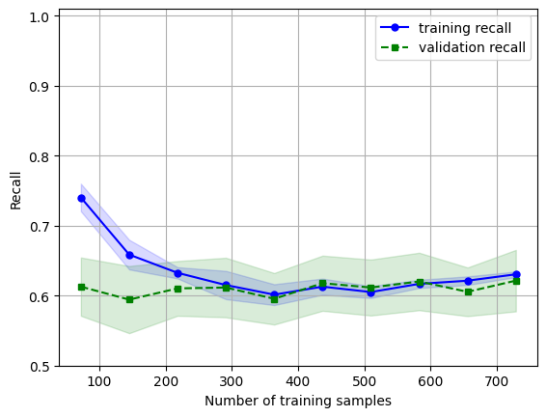
Key Insights - Learning Curve
The current model is not performing well in identifying the risk levels in the dataset, as indicated by the low training and validation recall. Although the training and validation curves are close to each other, this suggests a low variance in the model's predictions. In other words, the model is consistent but not accurate.
In healthcare, a low recall is a cause for concern as it indicates that the model is missing many high-risk cases. This could be particularly worrisome in pregnancy as it may lead to inadequate care and interventions, putting the mother’s and fetus’s health at risk.
Although having low variance is generally considered a positive attribute, it is outweighed by the model's high bias in this case. The model may be stable but consistently makes incorrect or suboptimal predictions.

Slide 6
Cont..
Model Performance:
The Training Score indicates how well the model learns from the training data, while the Validation Score measures the model's performance on unseen data.
High Bias and Variance:
Both the training and validation scores are low; the model is said to be underfitting. This means that the model is too simplistic and cannot capture the underlying patterns in the data.
Limited or Generalized Accuracy:
The low recall scores for both training and validation data suggest limited generalization ability of the model.
Recommendation:
An iterative model enhancement, evaluation, and refinement process should be followed to ensure the best results. Each change, whether related to the dataset, features, or model, should be thoroughly evaluated with a focus on achieving the desired 90% recall.
It's recommended to use cross-validation to ensure that the improvements made are consistent and not specific to a particular subset of data. By doing so, the model can be continually improved until the desired outcome is achieved.
Balancing metrics is crucial to maintain model reliability. Maximizing recall is essential, but balancing precision is equally important. High recall and low precision can cause many false positives in healthcare settings, leading to unnecessary interventions and anxiety. Therefore, it’s essential to optimize the model for all relevant metrics.

Slide 7
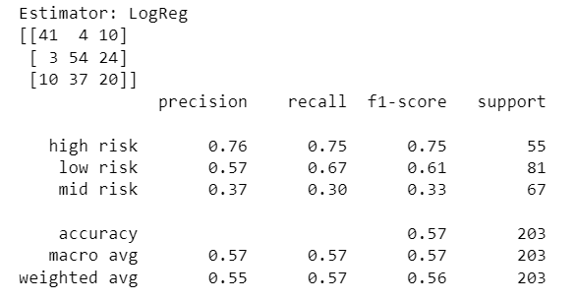
Confusion Matrix (Classification Report)
High Risk:
Precision (0.76): Of all cases predicted as high risk, 76% were actually high risk.
Recall (0.75): Of all actual high-risk cases, 75% were correctly identified.
Low Risk:
Precision (0.57): 57% of the cases predicted as low risk were actually low risk.
Recall (0.67): Of all actual low-risk cases, the model identified 67%.
Mid Risk:
Precision (0.37): Only 37% of the cases predicted as mid-risk were correct.
Recall (0.30): It could identify just 30% of the actual mid-risk cases.

Slide 8
Key Insights from Confusion Matrix
Precision: For "high risk" instances, the model boasts a high precision of 0.76, indicating a strong ability to correctly identify them while minimizing false positives. However, for “low risk" cases, the precision drops to a moderate 0.57, indicating a notable number of false positives. The precision for "mid risk" instances is even lower at 0.37, suggesting a significant number of false positives.
Recall: The model has a recall of 0.75 for high-risk instances, indicating that it identifies most of them but still misses a few. For low-risk cases, the recall is higher at 0.67, meaning that the model catches a majority of them but is not perfect. However, for mid-risk instances, the model has a low recall of 0.30, which means that it misses a significant number of actual mid-risk cases.
F1: When evaluating the model's performance, we use a metric called F1-Score. For high-risk situations, we aim for a strong F1-Score of 0.75, which indicates a balance between precision and recall. However, for low-risk situations, an F1-Score of 0.61 is considered lower and suggests that there is room for improvement. For mid-risk situations, an F1-Score of 0.33 indicates poor performance and highlights the need for significant improvement.
Support: The model was tested on 55 instances of high risk, 67 instances of mid risk, and 81 instances of low risk.

Slide 9
ROC-AUC Curve (Optimizing the Model)
General Guidelines for AUC Interpretation:
0.90 - 1.00: Excellent
0.80 - 0.90: Good
0.70 - 0.80: Fair
0.60 - 0.70: Poor
0.50 - 0.60: Fail/No Discrimination
The ROC-AUC curve is a visual representation of how well a classification model performs. It's an abbreviation of Receiver Operating Characteristic (Area Under the Curve). Although it's mainly used for binary classification, it can also be used for multi-class classification.
The ROC curve of different class are:
class 0 shows an AUC score of 0.91 – (Excellent)
class 1 shows an AUC of 0.75 – (fair)
class 2 shows an AUC of 0.5 9- (fail/error/no discrimination)

Slide 10
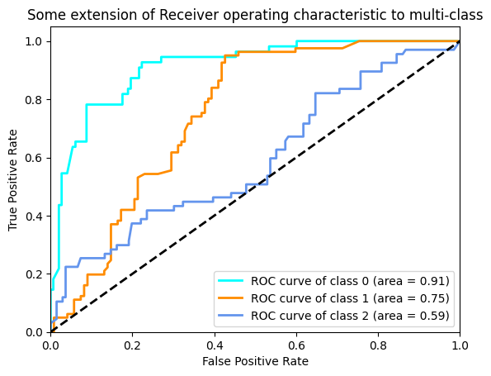
Key Insights-ROC/AUC Curve (Optimized Model)
1. The first classifier is highly effective, as it has an exceptional discriminative ability to distinguish Class 0 from the other classes, with a 91% probability of ranking a positive instance higher than a negative one.
3. The second classifier performs decently with a 75% likelihood of ranking a positive instance from Class 1 higher than a negative one, but falls short of exceptional performance.
4. The third classifier has limited capability to differentiate Class 2 from others, as indicated by an AUC of 0.59, which is only slightly better than random guessing (AUC = 0.5).

Slide 11
Recommendation for Mr.Hughes for next steps
Feature Engineering: To improve the model's performance, feature engineering techniques can be implemented, especially for the "mid-risk" category. This involves creating or enhancing new features by raising existing ones to a power (polynomials), building new features that are combinations of two or more existing ones (interaction terms), and transforming features using techniques like log transformation and categorical encoding. Choosing the right features is also important and can be done using algorithms like recursive feature elimination or feature importance from tree-based models.
Model Complexity: To improve prediction accuracy and evaluation, try more complex models or ensemble methods. Advanced algorithms like SVM and ensemble models such as Random Forest and Gradient Boosting can be used. Neural networks like MLP can capture complex patterns and interactions in the dataset.
Hyperparameter tuning is essential for improving model performance. It can be done using Grid Search or Random Search techniques. Bayesian Optimization is another powerful approach that utilizes statistical models to identify the best hyperparameters for optimal performance.

