Slide 1
Object Oriented Programming
Syeda Jannatul Naim
Lecturer, Dept. of CSE
Daffodil Institute of IT

Slide 2
Content
Introduction
Paradigm Evolution
Motivation
Categories of languages that support OOP
Concepts used extensively in OOP
Class and Objects
Encapsulation and Data abstraction
Inheritance
Polymorphism
Dynamic Binding
Message Passing
Conclusion
References

Slide 3
Introduction
Object-oriented programming is a method of programming based on a hierarchy of classes, and well-defined as well as cooperating objects.OOP breaks up problems based on object.
A class is a structure that defines the data and the methods to work on that data.
An object is an instance of a class or variable of a class.

Slide 4
Paradigm Evolution
1. Procedural - 1950s-1970s (procedural abstraction)
2. Data-Oriented - early 1980s (data abstraction)
3. OOP - late 1980s (inheritance and dynamic binding)

Slide 5
Motivation
Though Procedure Oriented Programming (POP) is simple enough and ease to implement, it has some drawbacks.Two major drawbacks are :
Data is exposed to whole program at once, so there is no security of data available.
Since the focus is on the instructions, it is rather difficult to relate to real world objects and in transition some real world problems.
To overcome the drawbacks of the POP , the Object Oriented Programming (OOP) was invented.It treat the data as a critical element in the program development and does not allow it to flow freely around the system.OOP breaks up problems and design the program based on object which can easily solve the real world problem.

Slide 6
Categories of languages that support OOP
C++ (also supports procedural and data-oriented programming)
Ada 95 (also supports procedural and data-oriented programming)
CLOS (also supports functional programming)
Scheme (also supports functional programming)
Java (based on C++)
Smalltalk (pure OOP)
Python (also supports procedural programming) ...............etc.

Slide 7
Concepts used extensively in OOP
Class
Object
Data abstraction and Encapsulation
Inheritance
Polymorphism
Dynamic Binding
Message Passing

Slide 8
Class and Object
Class : Classes are user-defined data types that act as the prototype or template or blueprint for individual objects.
Object : Objects are instances or variables of a class created with specifically defined data. Objects can correspond to real-world objects or an abstract entity.
Class and object are building block of OOP.

Slide 9
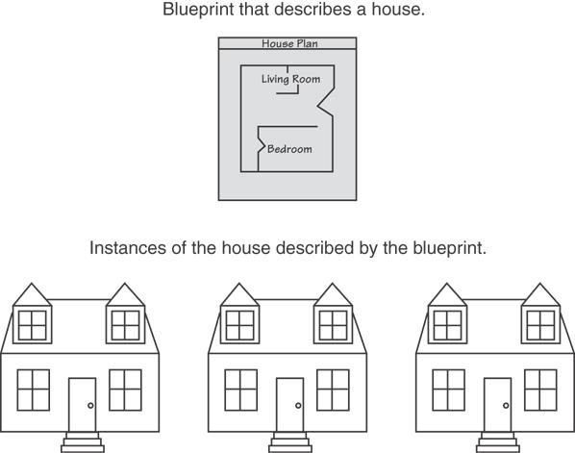
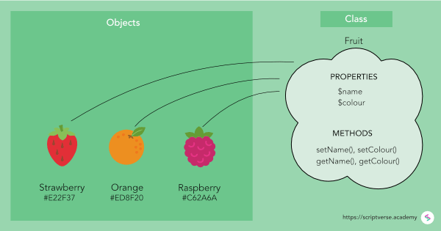
Class and Object
Figure 1 : example of class & object
Figure 2 : example of class & object

Slide 10
Encapsulation and Data-abstraction
Classes use the concept of data abstraction and encapsulation.Classes also known as ADT.
Encapsulation : The wrapping up the data(variables/attributes) and associated functions(methods) into a single unit is known as encapsulation.
Data-abstraction : Abstraction refers to the act of representing essential features without including details or background. Class helps us to group data members and member functions using available access specifiers. A Class can decide which data member will be visible to outside world and which is not.

Slide 11
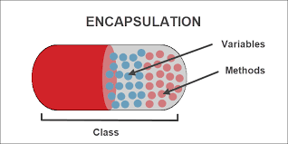
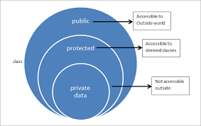
Encapsulation and Data-abstraction
Figure 3 : encapsulation & data-abstraction

Slide 12
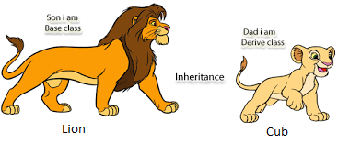
Inheritance
Figure 4 :example of inheritance
Inheritance is the process by which object of one class acquire the properties of objects of another class.It supports the concept of hierarchical classification.
It provides the idea of reusability, this means that we can add extra features to an existing class without modifying it by deriving a new class from the class. The new class will have the combined features of both classes.

Slide 13
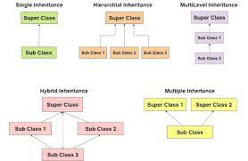
Inheritance
Figure 5 : types of inheritance

Slide 14
Polymorphism
Polymorphism a greek term means, the ability to take more than one form.An operation may represent different behaviors in different instances.
It allow objects having different internal structure to share the same external interface. This means that a general class of operations may be accessed in the same manner even though specific actions associated with each operation may differ.

Slide 15
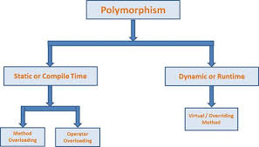
Polymorphism
Figure 6 : types of polymorphism
Method/Function overloading : In function overloading two or more functions can have the same name but different parameters so different functions perform different jobs though they have same name.
Operator overloading : In operator overloading we can change the way operators work for user-defined types like objects and structures.
Virtual method/function : A virtual function is a member function in the base class that we expect to redefine in derived classes. Basically, a virtual function is used in the base class in order to ensure that the function is overridden. This especially applies to cases where a pointer of base class points to an object of a derived class.

Slide 16
Dynamic Binding & Message Passing
Dynamic Binding : Dynamic Binding also known as late binding means that the code associated with a given procedure call is not known until the time of the call at run time. It is associated with the inheritance and polymorphism.
Message Passing : A message for an object is a request for execution of a procedure(function) and therefore will invoke a function in the receiving order that generates the desired result.A message passing involves -specifying the name of the object,name of the function(message) and the information to be sent.

Slide 17
Conclusion
Programs are divided into what are known as objects
Data structures are designed such that they characterize the objects
Functions are operate on the data of an object are tied together in the data structure
Data is hidden and can not be accessed by external functions
Object may communicate with each other through functions
New data and functions can be easily added whenever necessary
Follows bottom-up approach in program design

Slide 18
References
E Balagurusamy, “Object Oriented Programming With C++”,6th edition.
Robert W. Sebesta, “Concept of Programming Languages” sixth edition, chapter-12(support of object oriented programming).
Bjarne Stroustrup,”Programming: Principles and Practice Using C++”,2nd edition.
https://en.wikipedia.org/wiki/Object-oriented_programming.

Slide 19
Any question???
Thank You

