Slide 1
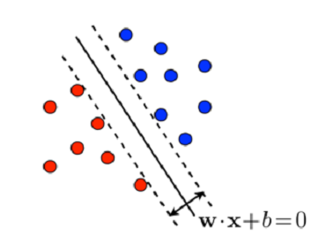
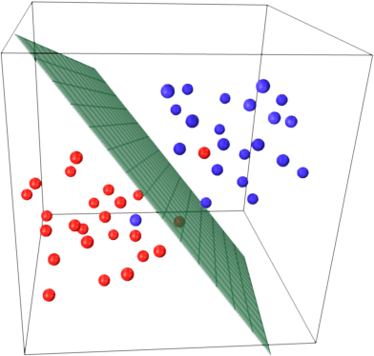

Support Vector Machines
Dr. M. Aksam Iftikhar,
Assistant Professor, CS

Slide 2
SVM: History & Motivation
Support Vector Machine (SVM) is a supervised learning algorithm developed by Vladimir Vapnik and it was first heard in 1992, introduced by Vapnik, Boser and Guyon in COLT-92.
It is said that Vladimir Vapnik has mentioned its idea in 1979 in one of his paper but its major development was in the 90’s.
SVM got into mainstream because of their exceptional performance in Handwritten Digit Recognition.
Notes:
Vikramaditya Jakkula : “Tutorial on Support vector machines” school of EECS Washington State University .

Slide 3
SVM: Applications
Text and image classification
Hand-writing recognition,
Data mining
Bioinformatics
Medicine and biosequence analysis
and even stock market

Slide 4
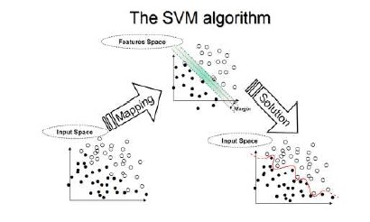
SVM: Algorithm
Notes:
Vikramaditya Jakkula : “Tutorial on Support vector machines” school of EECS Washington State University .

Slide 5
SVM: Problem Definition - Linear separable case
We are given a set of n points (vectors): x₁, x₂,…,x_{n}, such that x_{i} is a vector of length m, and each belong to one of two classes we label them by “+1” and “-1”.
So our training set is:
We want to find a separating hyperplane w.x + b = 0
that separates these points into the two classes.
“The positives” (class “+1”) and
“The negatives” (class “-1”).
(Assuming that they are linearly
separable)
So the decision function will be
f(x) = sign(w.x + b)
Notes:
Rasterization: Slide # 37

Slide 6
Linear Separators
Binary classification can be viewed as the task of separating classes in feature space:
w^{T}x + b = 0
w^{T}x + b > 0
w^{T}x + b < 0
f(x) = sign(w^{T}x + b)
But There are many possibilities
for such hyperplanes !!

Slide 7
SVM: Separating Hyperplane
Which one should we choose!
Yes, There are many possible separating hyperplanes
It could be
this one
or this
or this
or may be….!

Slide 8
SVM: Choosing a Separating Hyperplane
Suppose we choose the hypreplane (seen below) that is close to some sample x_{i}.
Now suppose we have a new point x’ that should be in class “-1” and is close to x_{i}. Using our classification function f(x) this point is misclassified!
Poor generalization!
(Poor performance on unseen data)

Slide 9
SVM: Choosing a Separating Hyperplane
Hyperplane should be as far as possible from any sample point.
This way a new data that is close to the old samples will be classified correctly.
Good generalization!

Slide 10
SVM: Choosing a Separating Hyperplane
The SVM idea is to maximize the distance between The hyperplane and the closest sample points.
In the optimal hyper- plane:
The distance to the closest negative point =
The distance to the closest positive point.

Slide 11
SVM: Choosing a Separating Hyperplane
SVM’s goal is to maximize the Margin which is twice the perpendicular distance “d” between the separating hyperplane and the closest sample.
Why it is the best?
Robust to outliners as we saw and thus strong generalization ability.
It proved itself to have better performance on test data in both practice and in theory.
Margin
d
d
d

Slide 12
SVM: Support Vectors
Support vectors are the samples closest to the separating hyperplane.
Oh! So this is where the name came from!
Margin
These are Support Vectors
d
d
d

Slide 13
Maximum Margin Classification
Maximizing the margin is also good according to intuition.
Implies that only support vectors matter; other training examples are ignorable.

Slide 14
Finding the SVM hyperplane
Determining the hyperplane is equivalent to finding the optimal parameters w and b.
The SVM hyperplane is determined by solving a dual optimization problem based on Lagrange multipliers, and not discussed here in detail.
However, one thing is important to note that this optimization problem requires computing the inner products x_{i}^{T}x_{j} between all the training examples pairs.
Remember, inner product/dot product between 2 products is simply sum of products of all its components.
We will return to this point later in the topic of Kernel trick.

Slide 15
SVM: Limitations
Limitations of Linear SVM:
Doesn’t work well on non-linearly separable data.
Noise (outlier) problem.
But, it can deal with non-linear classes with a nice tweak.
Margin
d
d
d

Slide 16
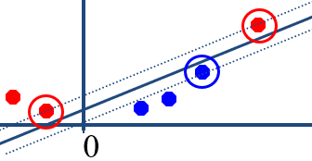
SVM: Non Linear case
Key idea: map our points with a mapping function φ(x) to a space of sufficiently high dimension so that they become separable by a hyperplane in the new higher-dimensional feature space.
Input space: the space where the points x_{i} are located.
Feature space: the space of f(x_{i}) after the transformation, where f(.) is the transformation function, For example: a non-linearly separable case in one dimension:
0
x
Mapping data to two-dimensional space with φ(x) = (x, x²)
x²
0
x

Slide 17
Interlude: Illustration of a hyperplane
A hyperplane refers to a D-dimensional plane in a D+1 dimensional space.
E.g. a SVM boundary line is a hyperplane in a 2D input space (see figure below). Similarly, in a 3D input space, the SVM boundary will be a 2-dimensional hyperplane and so on.
This terminology is especially used for 4D and higher-dimensional input spaces, for which, visualizing the input space is not possible.
x²
0
x

Slide 18
Input space vs Feature space
Earlier, we referred a space induced by features (feature vectors) as a feature space.
In this lecture on SVM, the space before mapping to higher dimension is referred as input space, and after the mapping, it’s called the feature space.

Slide 19
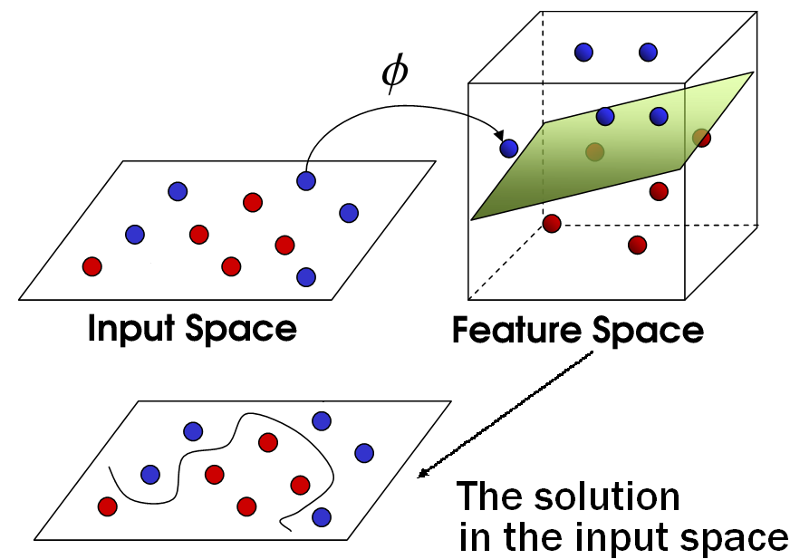
SVM: Non Linear
An illustration of the algorithm in 2D input space:

Slide 20
Non-linear SVMs: Feature spaces
General idea: the original feature space can always be mapped to some higher-dimensional feature space where the training set is separable:
Φ: x → φ(x)

Slide 21
Limitations of non-linear mapping
The new feature space (after mapping) may be very high dimensional, and working in the high dimensional space is computationally expensive.
Remember, in order to compute w (and b), we need to compute the inner products of feature vectors of training examples together.
i.e. x_{i}^{T}x_{j} for all i, j
Computing the inner products in the higher dimensional space increases the computational complexity to great extent.

Slide 22
Limitations of non-linear mapping
How do we know the mapping function, i.e. what will be the new set of features in the higher dimensional space? E.g. for a single feature x, the additional features can be x², sqrt(x), sin(x) etc.
Finding the correct mapping function is not easy.
Both of the above limitations are addressed in SVM classification by applying a simple tweak – the Kernel Trick.

Slide 23
The Kernel Trick

Slide 24
The Kernel Trick – intuitition
To compute the inner products of vectors in higher dimensional space, we can apply the kernel trick.
Using this trick, we can compute the inner products (in higher dimension) without actually going into the higher dimension.
Remember, it’s the inner products of vectors, which we need in the higher dimension, and not the vectors themselves.
This trick is known as the Kernel trick, as it is applied with the help of a kernel function.

Slide 25
SVM: Kernel Function
A kernel function is defined as a function of input space that can be written as a dot product of two feature vectors in the expanded feature space:
We noted earlier that determining the hyperplane in linear SVM involves dot product of input vectors, i.e. x_{i}^{T}x_{j .}
Now, we only need to compute K(x_{i}, x_{j}) (which uses the input space) and don’t need to perform the computations in the higher dimensional feature space explicitly. This is what is called the Kernel Trick.

Slide 26
The “Kernel Trick” – example
Let us understand the kernel trick with the help of an example.
Assume, a non-linear separability case, where the original input vectors are 2-dimensional, i.e. x₁ and x₂.
In order to apply SVM, the input space is transformed into a (higher) 6-dimensional feature space according to the following mapping function.
φ(x) = [1 x₁² √2 x₁x₂ x₂² √2x₁ √2x₂], i.e. every datapoint x = [x₁, x₂] is mapped into high-dimensional space via the transformation Φ: x → φ(x)

Slide 27
The “Kernel Trick” – example (contd.)
Now, determining the hyperplane in this higher dimension requires computing the dot product of the feature vectors, i.e. φ(x_{i}) ^{T}φ(x_{j}) for all i, j. Therefore,
K(x_{i},x_{j})= φ(x_{i}) ^{T}φ(x_{j}). where φ(x) = [1 x₁² √2 x₁x₂ x₂² √2x₁ √2x₂]
Expanding the product:
K(x_{i},x_{j}) = [1 x_{i1}² √2 x_{i1}x_{i2} x_{i2}² √2x_{i1} √2x_{i2}]^{T} [1 x_{j1}² √2 x_{j1}x_{j2} x_{j2}² √2x_{j1} √2x_{j2}]
= 1+ x_{i1}²x_{j1}² + 2 x_{i1}x_{j1} x_{i2}x_{j2}+ x_{i2}²x_{j2}² + 2x_{i1}x_{j1} + 2x_{i2}x_{j2}
=(1 + x_{i}^{T}x_{j})²
Where the final expression is a function of the original input space, i.e. x_{i} = [x_{i1}, x_{i2}] and not the transformed higher dimension feature space.

Slide 28
The “Kernel Trick” – example (contd.)
In other words, if we compute (1 + x_{i}^{T}x_{j})² in the input space, this is equivalent to finding the inner products of vectors in the higher dimensional feature space, i.e.
K(x_{i},x_{j}) =(1 + x_{i}^{T}x_{j})² = φ(x_{i}) ^{T}φ(x_{j})
Thus, a kernel function implicitly maps data to a high-dimensional feature space (without the need to compute each φ(x) explicitly).
In this case, the kernel function K(x_{i},x_{j})=(1 + x_{i}^{T}x_{j})²
Note that choosing the kernel function also relieves us from the problem of choosing the feature set in higher dimension, i.e. we don’t need to engineer features in higher dimension.

Slide 29
The “Kernel Trick”
The kernel function K(x_{i},x_{j}) =(1 + x_{i}^{T}x_{j})² is a special case of a more generalized class of kernel functions, called polynomial functions (more about this on the next slide).
This is not the only choice for kernel function.
In fact, we can choose from different kernel functions including the polynomial function, sigmoid kernel, gaussian kernel etc.

Slide 30
Examples of Kernel Functions
Linear kernel:
Polynomial kernel of power p:
Gaussian kernel
(Also called RBF Kernel)
Can lift to infinite dim. space
Two-layer perceptron:

Slide 31
SVM: Kernel Issues
How to know which Kernel to use?
This is a good question and actually still an open question, many researches have been working to deal with this issue but still we don’t have a firm answer. It is one of the weakness of SVM. Generally, we have to test each kernel for a particular problem.
How to verify that rising to higher dimension using a specific kernel will map the data to a space in which they are linearly separable?
Even though rising to higher dimension increases the likelihood that they will be separable we can’t guarantee that.

Slide 32
SVM: Kernel Issues
We saw that the Gaussian Radial Basis Kernel lifts the data to infinite dimension so our data is always separable in this space so why don’t we always use this kernel?
First of all we should decide which σ to use in this kernel:
Secondly, A strong kernel, which lifts the data to infinite dimension, sometimes may lead us the severe problem of Overfitting.

Slide 33
SVM: Kernel Issues
In addition to the above problems, another problem is that sometimes the points are linearly separable but the margin is Low:
All these problems leads us to the compromising solution:
Soft Margin:
A solution which can work even if our data is not perfectly linearly separable.

Slide 34
SVM: Kernel Issues
In addition to the above problems, another problem is that sometimes the points are linearly separable but the margin is Low:
All these problems leads us to the compromising solution:
Soft Margin:
A solution which can work even if our data is not perfectly linearly separable.

Slide 35
SVM: Kernel Issues
In addition to the above problems, another problem is that sometimes the points are linearly separable but the margin is Low:
All these problems leads us to the compromising solution:
Soft Margin:
A soft margin in a Support Vector Machine (SVM) is a technique that allows SVMs to classify data that is not linearly separable by making some mistakes.
The goal is to keep the margin wide enough so that other points can still be classified correctly..

