Slide 1
BOOKVISION

Slide 2
Team Name
Team Leader
Institute Name
Theme
Digital Dazzlers
Syeda Muneeza Kauser
Stanley College of Engineering and Technology
NLP
Generative AI

Slide 3
IDEA
To create an app that allows people to read books without reading lengthy and continuous paragraphs. It creates images or animation for the given book according to user’s preference and allows them to enjoy the story.

Slide 4
Description of Idea
The app gives users the option to upload their favorite e-book and the application performs a text extraction using natural language.
In this way, the app creates the scenarios and renders them by generating pictures of the story which are then animated.
The users can interact with this animated story through a flip book like interface, they can do so by speeding up the playback and by choosing their own pace.
Adding to that, the app has exportability feature that enables the saved animated book in either video or to the online platforms.
Even big books and complex animations run smoothly without any drop in quality, and this makes the user experience pleasant and smooth.

Slide 5
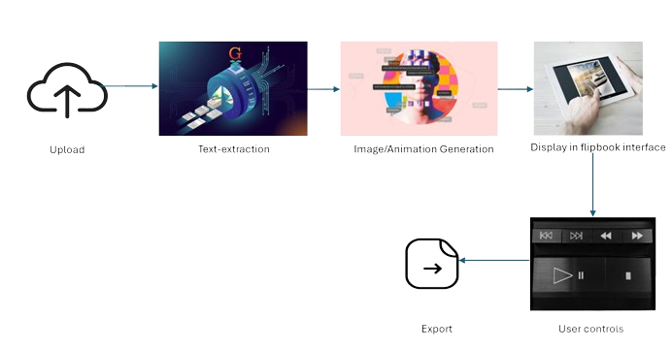
Flow Chart

Slide 6
Approach
Requirement Gathering
Design Phase
Setup Development Environment
Frontend Development
Backend Development
Text Processing and NLP
Image Generation and Animation
User Interface Implementation
Integration and Testing
Optimization
Deployment
Maintenance

Slide 7
Recommended readings
 | NAME | STREAM | YEAR
1 | TEAM LEAD: Syeda Muneeza Kauser | CSE | |||
2 | Member 1: Salma Tahreem | CSE | |||
3 | Member 2: Shaik Tehseen Mehek | CSE | |||

Slide 8
Thank You

