Slide 1
Presentation on- “Estimating the Best Possible Trajectory for the Robot by using Interpolating polynomial (Newton’s Divided Difference Interpolation)”.

Slide 2
Topic: Estimating the Best Possible Trajectory for the Robot by using Interpolating Polynomial (Newton’s Divided Difference Interpolation)
Course Title: Numerical Methods
Course Code: CSE 225
Section:01
Course Instructor:
Md Al-Imran
Lecturer Department of Computer Science & Engineering

Slide 3
Presented By:
ID | NAME
2018-2-60-010 | Syeda Tamanna Sheme

Slide 4
Content Page:
Project Description Methodology Process Description Code Description Code Run Output Description

Slide 5

Project Description
A robot arm with a rapid laser scanner is doing a quick quality check on holes.
It doing by drilling in a rectangular plate.
The centers of the holes in the plate describe the path the arm needs to take.
The hole centers are located on a Cartesian coordinate system.
Task is to plot a smooth path for the robot to follow so that it may inspect the holes.
Figure: Robot

Slide 6
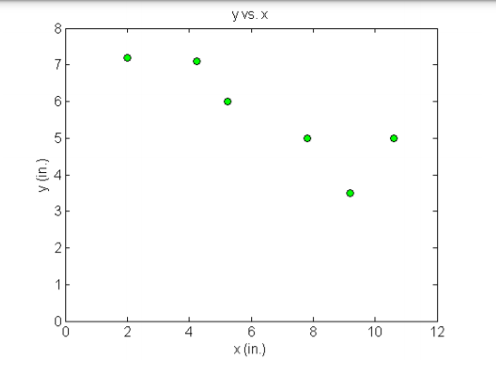
Project Description
For project purpose we assume some values,
A robot arm with a fast laser scanner inspects holes drilled in a 15"x10" rectangular plate for quality.
The hole centers are located on a Cartesian coordinate system which is at the origin of the bottom left corner of the plate. Here on the right side , we give the specifications in Table 1 and also the Location of holes on the rectangular plate in Figure-1.
X(inches) | Y(inches)
2.00 | 7.2
4.25 | 7.1
5.25 | 6.0
7.81 | 5.0
9.20 | 3.5
10.60 | 5.0
Table 1: Coordinates of the holes in the plate
Figure-1:Location of holes on the rectangular plate

Slide 7
Methodology
Main goal is to estimate the best possible trajectory for the robot to navigate by using interpolating polynomial.
Mainly used Newton’s Divided Difference Interpolation.
Newton’s Divided Difference Interpolation: is an interpolation technique used when the interval difference is not same for all sequence of values.
The values in the table are not maintaining same sequence. So, the interval difference is not same for all sequence of values.

Slide 8


Methodology
The first divided difference is given by,
The second divided difference is given by,
By using first divided difference, second divided difference as so on. A table is formed which is called the divided difference table,
For, drawing graph we use, python polynomial generation formula.
, and so on……..

Slide 9
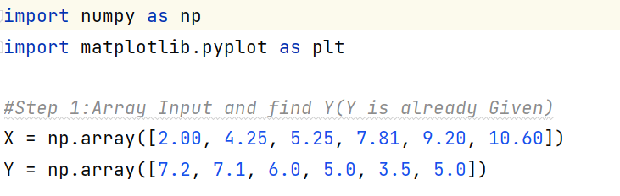
PROCESS DESCRIPTION
Divided our whole work in several steps. There are in total six steps.
Step 1: Array Input and Declare Y (Where, Y is already Given and Y=F(X)
Input: Input Value X and Y=F(X)-
X | 2.00 | 4.25 | 5.25 | 7.81 | 9.20 | 10.60
Y=F(X) | 7.2 | 7.1 | 6.0 | 5.0 | 3.5 | 5.0
Code Screen Shot:-

Slide 10
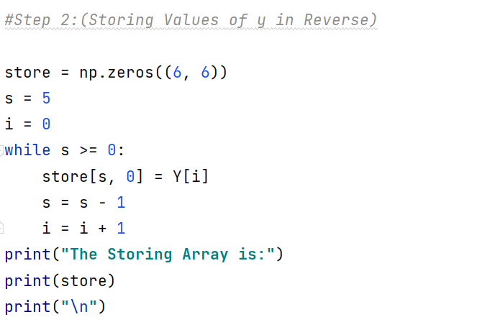
PROCESS DESCRIPTION
Step 2: Storing Values in an Array and Implementing Newton’s Divided Difference Interpolation
Sorted Array List:
[[5. 0. 0. 0. 0. 0. ]
[3.5 0. 0. 0. 0. 0. ]
[5. 0. 0. 0. 0. 0. ]
[6. 0. 0. 0. 0. 0. ]
[7.1 0. 0. 0. 0. 0. ]
[7.2 0. 0. 0. 0. 0. ]]
Code Screen Shot:-

Slide 11
PROCESS DESCRIPTION
Step 2: Storing Values in an Array and Implementing Newton’s Divided Difference Interpolation
Implementing Newton’s Divided Difference Interpolation :
x | y=f(x) | f [xi, xj] | f [xi, xj, xk] | f [xi, xj, xk, xl] | f [xi, xj, xk, xl, xm]
5.0 | 0 | 0 | 0 | 0 | 0
3.5 | 1.07142857 | 0 | 0 | 0 | 0
5.0 | -1.07913669 | 0.77081192 | 0 | 0 | 0
6.0 | -0.390625 | -0.17430676 | 0.1766577 | 0 | 0
7.10 | -1.1 | 0.19926264 | 0.1766577 | 0 | 0
7.20 | -0.04444444 | -0.32478632 | 0.09019776 | -0.02300921 | 0.00729234
Figure 2:- Table 2

Slide 12
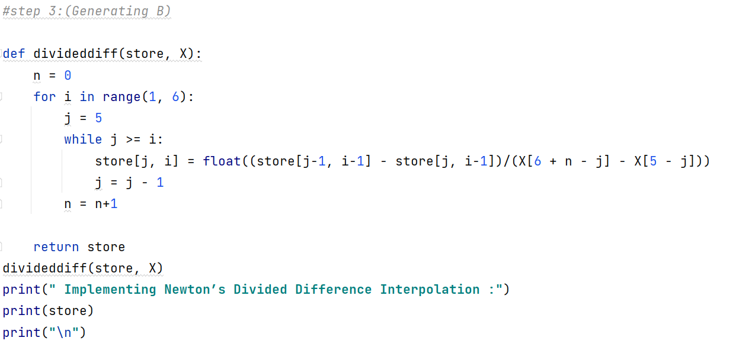
PROCESS DESCRIPTION
Step 3: Generating B
Here, B is the last Row Value
[ 7.2 -0.04444444 -0.32478632 0.09019776 -0.02300921 0.00729234]
Code Screen Shot:-

Slide 13
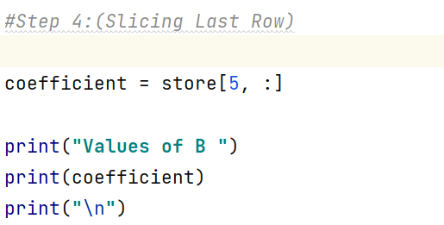
PROCESS DESCRIPTION
Step 4: Slicing Last Row
In step-4 we Slice the last row and by slicing the row we get six value.
The six values are the Final Co-efficient as we apply Newton’s Divided Difference Interpolation in the array and get six final value so these values will be our graph identifications points.
Coefficient Size: 6
Final Co-efficient:
[ 7.29234122e-03 -2.30913860e-01 2.78623110e+00 -1.58547836e+01 4.13443757e+01 -3.08981989e+01]
Code Screen Shot:-

Slide 14
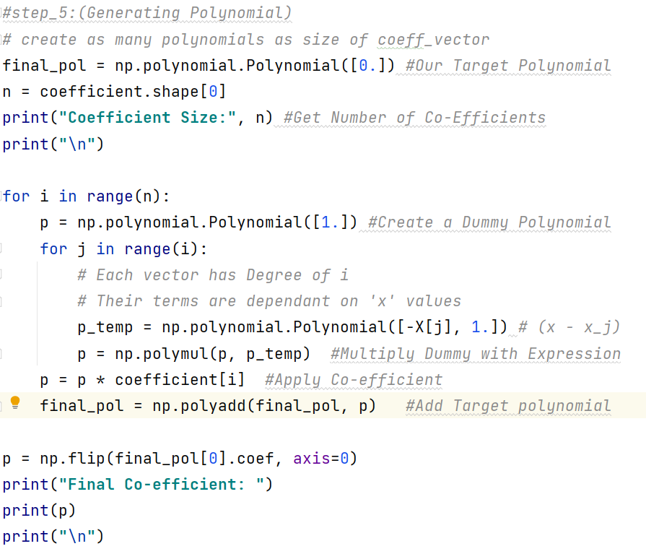
PROCESS DESCRIPTION
Step 5: Generating Polynomial
For plotting the graph we use Matplotlib, which is a plotting library for Python.
Matplotlib module was first written by John D. Hunter. Since 2012, Michael Droettboom is the principal developer.
Conventionally, the package is imported into the Python script by adding the following statement −
from matplotlib import pyplot as plt
Here pyplot() is the most important function in matplotlib library, which is used to plot 2D data.
Code Screen Shot:-

Slide 15
PROCESS DESCRIPTION
Step 5: Generating Polynomial
The np.flip() method is used to reverse the order of array elements by keeping the shape of the array along a specified axis. The numpy flip() method accepts the array and axis as arguments and returns the array while preserving the shape of the array.
Syntax
numpy.flip(array, axis( axis on which array is to be reversed))
Code Screen Shot:-

Slide 16
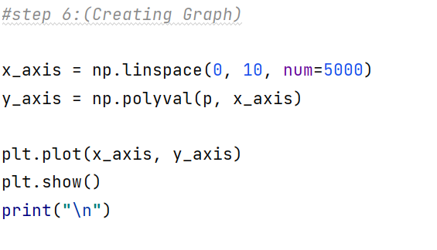
PROCESS DESCRIPTION
Step 6: Creating Graph
Code Screen Shot:-
For creating the graph we use some functions. Now I will describe the function working Principal:
An 2D array object x is created from np.arange() function as the values on the x axis. The corresponding values on the y axis are stored in another 2D array object y. These values are plotted using plot() function of pyplot submodule of matplotlib package.
The NumPy linspace function creates sequences of evenly spaced values within a defined interval.

Slide 17
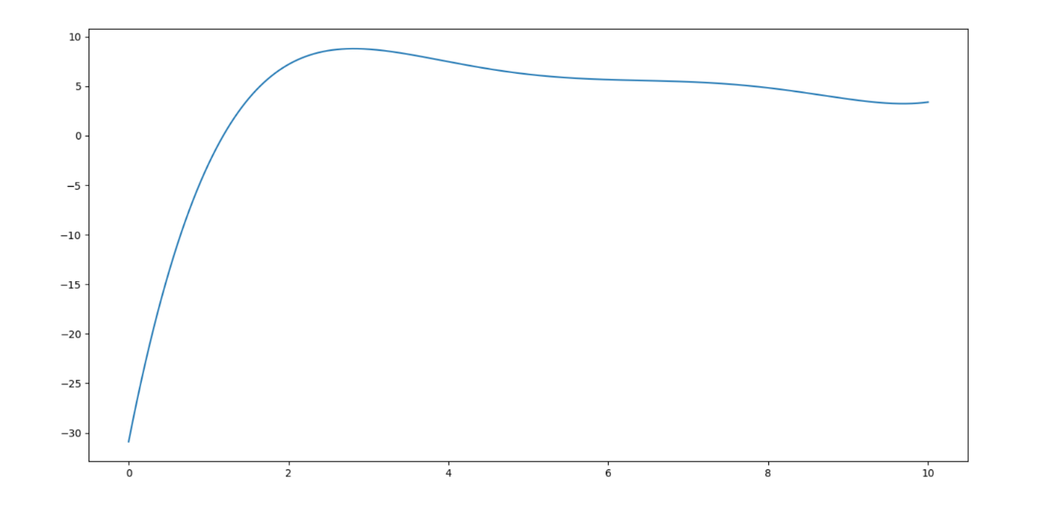
PROCESS DESCRIPTION
Step 6: Creating Graph
The Numpy polyval() function helps us to evaluate the polynomial at the given specific values. It has two parameters in it, P and X. If we have polynomial P of length L.
Syntax:
numpy.polyval (p, x)
Figure-3: Ploting Graph
The Numpy polyval() function helps us to evaluate the polynomial at the given specific values. It has two parameters in it, P and X. If we have polynomial P of length L. Then, it returns the value as:
p[0]*x**(L-1) + p[1]*x**(L-2) + ..... + p[L-2]*x + p[L-1]

Slide 18
Let’s run the code and see the output

Slide 19
“Computers are composed of nothing more than logic gates stretched out to the horizon in a vast numerical methods system.” ~Stan Augarten

Slide 20



