Slide 1
Presentation on “Seeking Tutor Problem”

Slide 2
Topic: Seeking Tutor Problem
Course Title: Operating System
Course Code: CSE 325
Section:03
Course Instructor:
Masiath Mubassira
Lecturer Department of Computer Science & Engineering

Slide 3
Presented By:
ID 2018-2-60-010 | Name Syeda Tamanna Sheme

Slide 4
Content Page:
Project Description Methodology Flow Chart Thread Descriptions Student Thread Coordinator Thread Tutor Thread Output Description

Slide 5
Project Description
EWU runs a programming club where undergraduate students get help.
Club has a coordinator and several tutors to assist the students.
Students come to waiting area. If there is no available seat they will go back to programming. Otherwise, they will wait in the waiting area.
Coordinator prioritize students in a queue and assign them to the tutor.
If more than one student has the same priority the tutor will choose whoever came first.
After getting the maximum amount of help student terminate.
When all students will get help, tutor will terminate and then coordinator will be terminated.

Slide 6
Methodology
Pthread_create()
Pthread_join()
Sem_init()
Sem_wait()
Sem_post()
Sem_mutex()

Slide 7
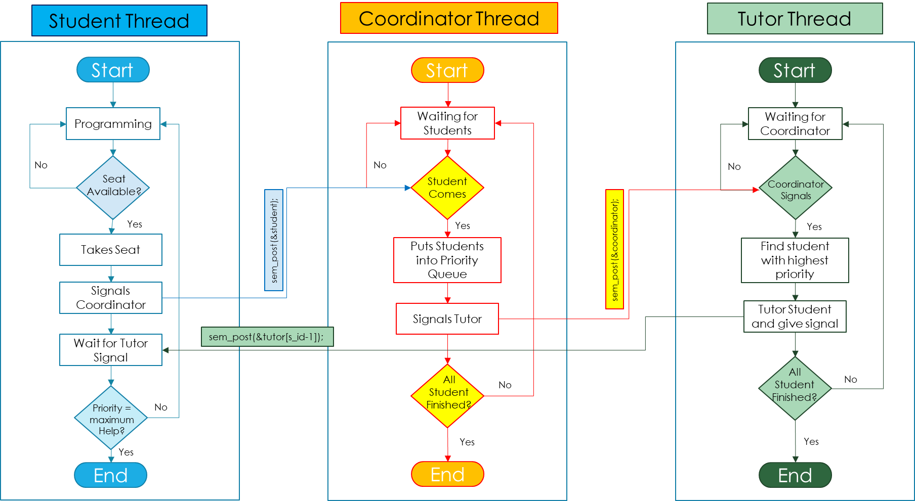
Flowchart

Slide 8
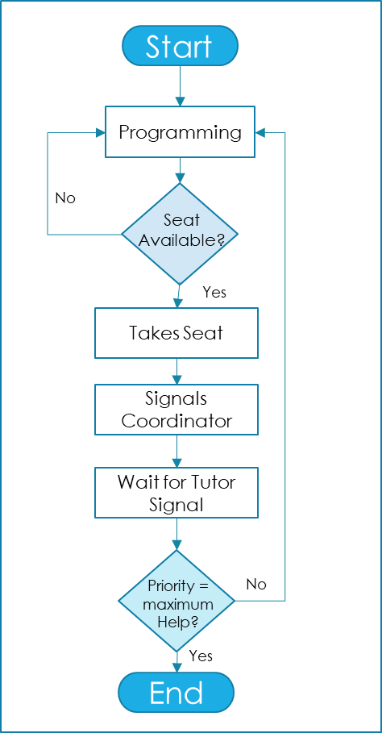
Thread Description (Student)
Student has 3 parts:
Student has to start programming and seek help from a tutor, student needs to get a seat. After coming to get seat, if student does not find any seat, then has to go back to programming and try again later.
If a student gets a seat then coordinator gets a notice and then wait for tutor to be assigned
After getting maximum amount of help, the student will stop seeking help .

Slide 9
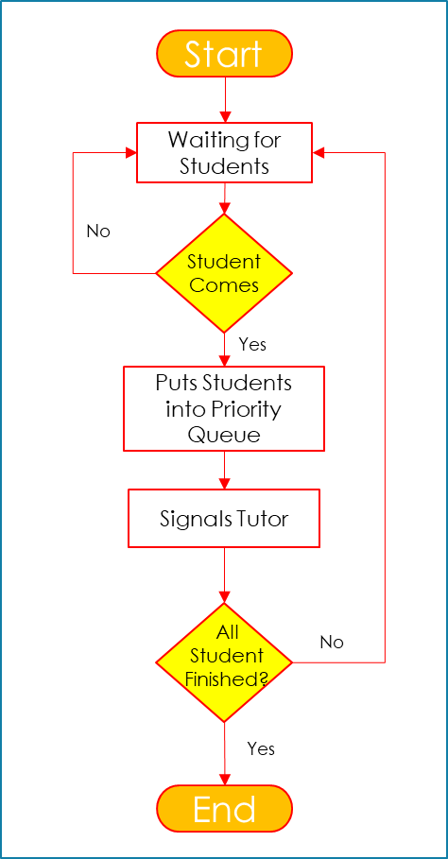
Thread Description (Coordinator)
Coordinator has 3 parts:
The coordinator waits for students to come to seek help.
Prioritize students according to who has come first.
If all students leave then coordinator notify the tutor and leaves .

Slide 10
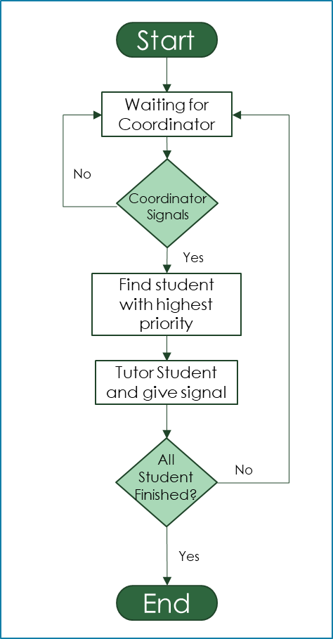
Thread Description (Tutor)
Tutor has 3 parts:
Tutor waits for the coordinator to notify if a student has come to seek help.
Tutor selects to student to help according to the priority of the student
If all students have done seeking help from the tutor ,the tutor waits for coordinators notification to finish work.

Slide 11
“Computer science is the operating system for all innovation.” ~ Steve Ballmer

Slide 12



